Slide 1
BEAUFORT – JASPER COUNTY LINE SOUTH CAROLINA GEODETIC SURVEY (SCGS)

Slide 2
SC Code of Law and Act 262 Of 2014
Role of South Carolina Geodetic Survey
(1994) Dispute between two or more counties- SCGS will act as mediator to resolve the dispute
(1994/2014) SCGS to assist counties in defining and monumenting the locations of county boundaries and positioning the monuments using geodetic surveys where counties are ill-defined, unmarked, or poorly marked
(2014) SCGS will clarify county boundaries as defined in Chapter 3, Title 4
(2014) SCGS will analyze archival and other evidence and perform field surveys to position geographically all county boundaries in accordance with statutory descriptions

Slide 3
Steps for Clarifying Boundaries
Notify County Administrators in advance of planned work
Conduct historical research for documentary evidence of boundaries
Perform field work to locate monuments and corroborating evidence and position on State Plane Coordinates
Share preliminary findings with county officials for impact analysis and to plan public meetings
Receive feedback and input from local officials and public
Review and update findings, as appropriate
Work to build cooperation with affected parties

Slide 4
Public Meeting Notification

Slide 6
Beaufort - Jasper County Line Manigaults Neck to New River

Slide 8
Lines are Established by Legislative Acts
Acts and Joint Resolutions Regular Session 1912: Created Jasper County and placed the County Line on the Beaufort side of the roads.
Acts and Joint Resolutions Regular Session 1939: Corrected that the roads are in Beaufort County. Where no right of way existed in 1939 it is assumed to be the Jasper County edge of the unimproved road.
Acts and Joint Resolutions Regular Session 1992: Clarified the water courses and that the county lines follow the centerlines of the waters.

Slide 9
Acts & Joint Resolution of 1912 Number 459 Established Jasper County
…thence down said creek and through the nearest water ways to a point on Manigault’s Neck, where the land line dividing the land of Chelsea Club from the Fripp land intersects said creek or water ways; thence the said land line to its intersection with the Fripp public road; thence down the Beaufort county side of the said Fripp public road to its intersection with the Hazel road; thence westerly along the Beaufort County side of said Hazel road to its intersection with a public road at or near Hazel Episcopal Church; thence westerly along the Beaufort county side of said public road to its intersection with the Charleston and Savannah Turnpike; thence the Beaufort County side of the said Turnpike to a point opposite its intersection with the southern boundary line of the land of Okeetee Club; thence across said road to the said boundary line the line in a westerly direction to a corner where said land line turns in a northeasterly direction;….

Slide 10
Acts & Joint Resolution of 1939 Number 325
…thence down said creek and through the nearest waterways to a point on Manigaults Neck, where the land line dividing the land of Chelsea Club from the Fripp land intersect said creek or waterway; thence the said land line to its intersection with the Fripp Public Road; thence down Jasper County side of the said Fripp Public Road to its intersection with the Hazel Road; thence westerly along the Jasper County side of said Hazel Road to its intersection with a public road at or near Hazel Episcopal Church; thence westerly along the Jasper County side of said public road to its intersection with the Charleston and Savannah Turnpike; thence the Jasper County side of the said Turnpike to a point opposite its intersection with the southern boundary line of the land of Okeetee Club; thence across said road to said boundary line the line in a westerly direction to a corner where said land line turns in a northeasterly direction;….

Slide 11
Acts & Joint Resolution 1992 Regular Session SECTION 4-3-70
…thence following the center line of Hazzard Creek and through the nearest waterways following their center lines to a point on Manigaults Neck where the land line dividing the land now or formerly owned by the Chelsea Club from the land now or formerly owned by Fripp intersect the center line of said creek or waterway; thence following said land line to its intersection with the Fripp public road; thence following the Jasper County side of the Fripp public road to its intersection with the Hazel road; thence westward following the Jasper County side of said Hazel road to its intersection with a public road at or near Hazel Episcopal Church; thence westward following the Jasper County side of said public road to its intersection with the Charleston and Savannah turnpike; thence following the Jasper County side of the said turnpike to a point opposite its intersection with the southern boundary line of the land now or formerly owned by the Okeetee Club; thence across said road to said boundary line; thence westward following said line to the center line of the New River;…

Slide 22
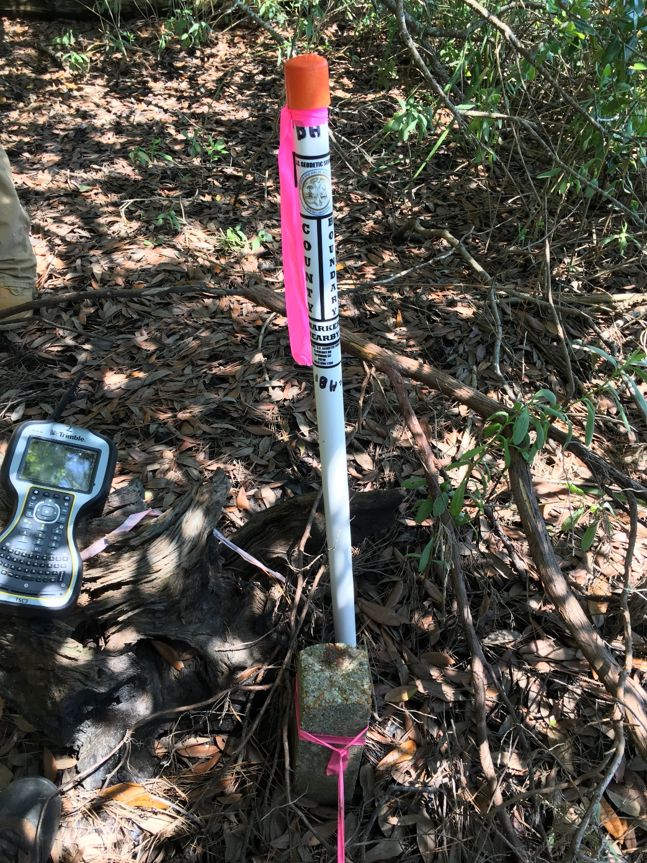

Slide 24
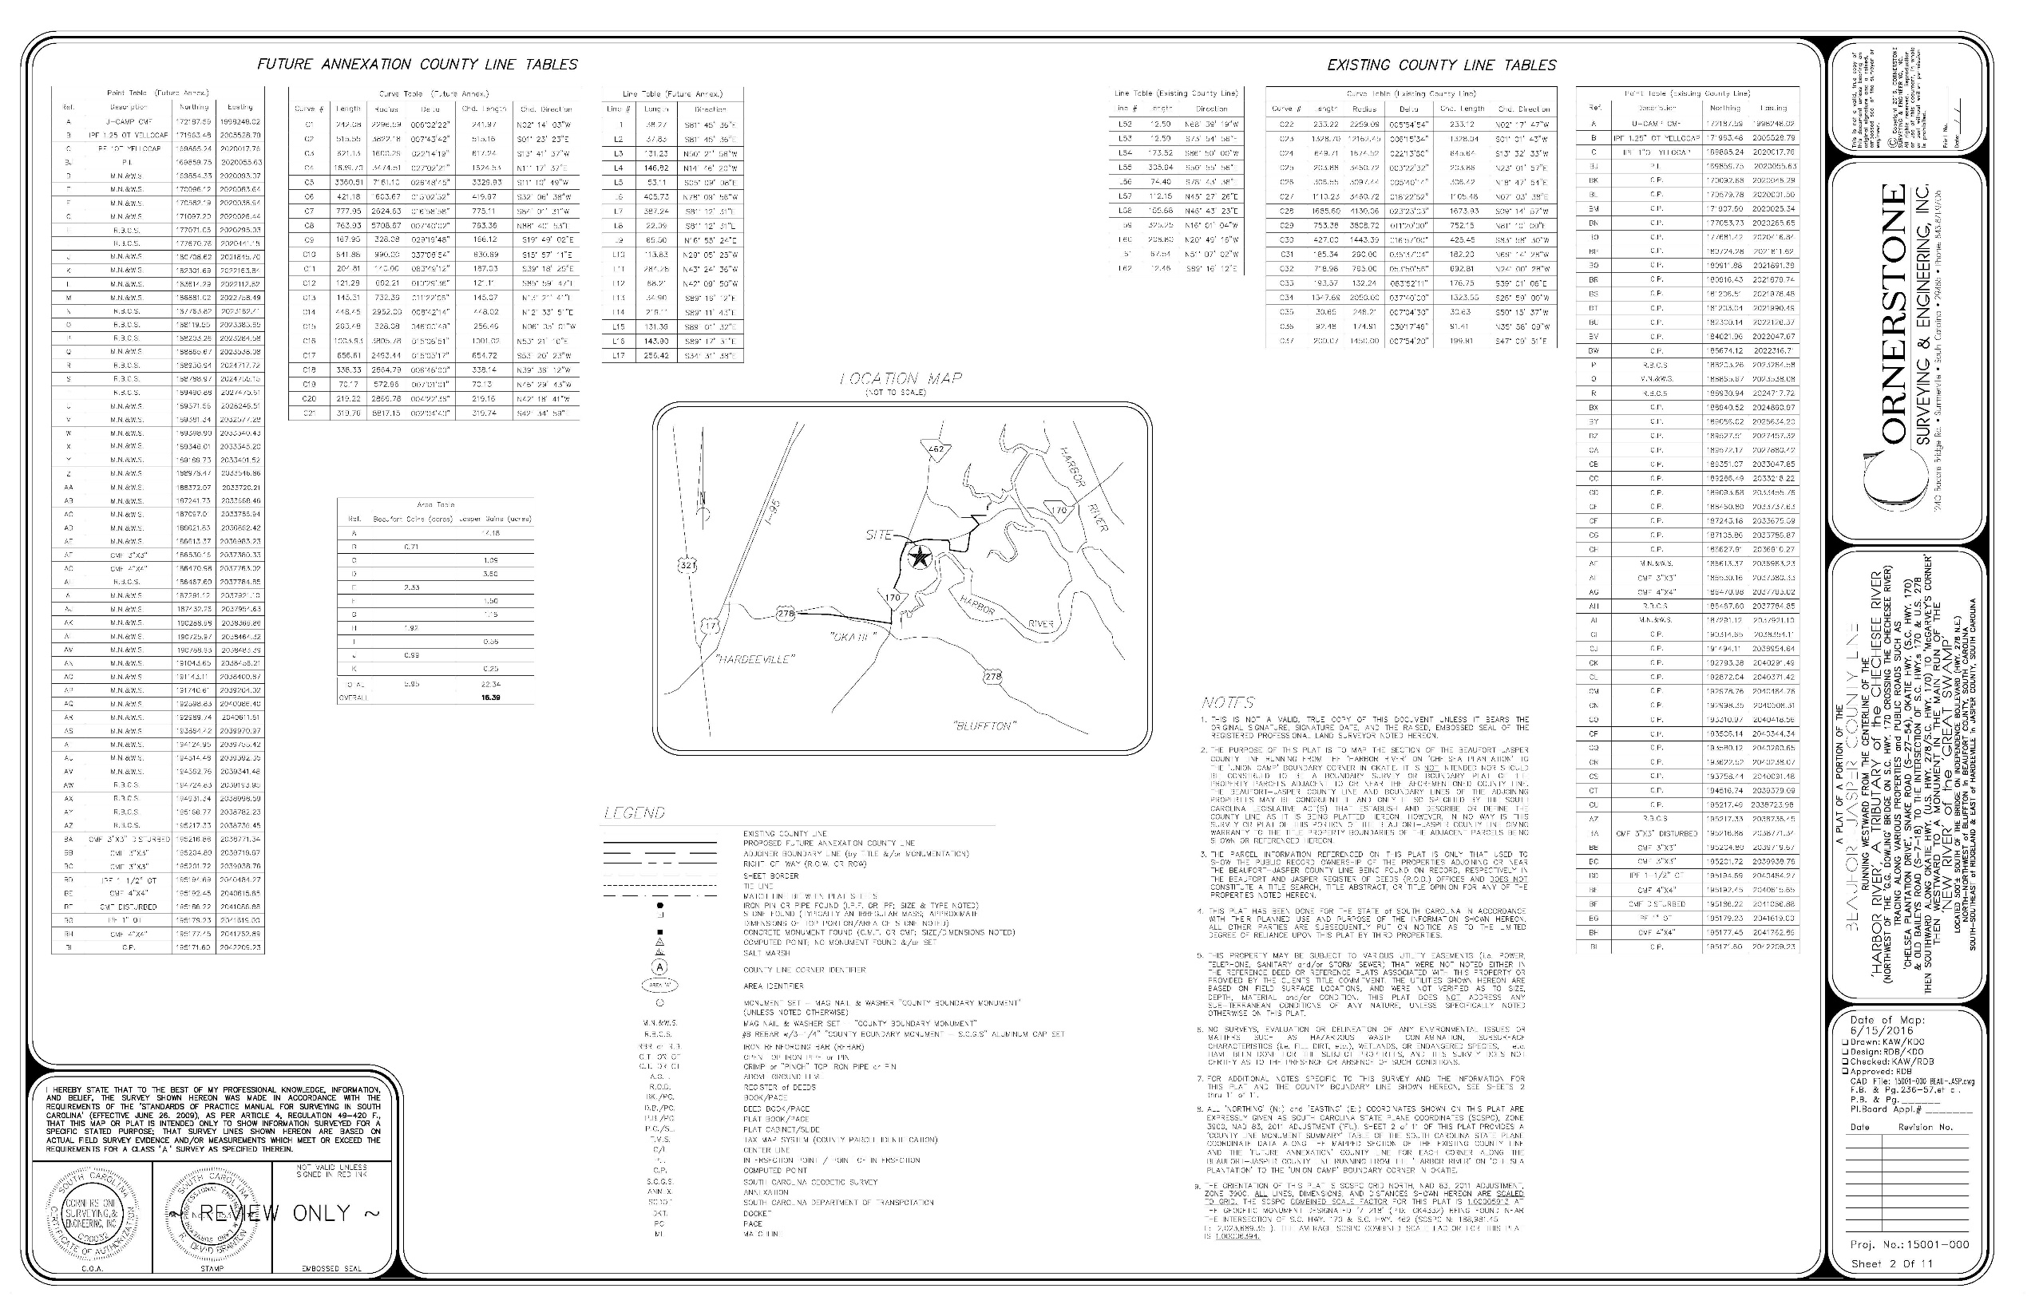

Slide 25
Act 262 Of 2014
Steps for Clarifying Boundaries
SCGS Requirements:
Upon reestablishing county boundary, SCGS shall certify its work and within 30 days of certification:
Provide copies to the administrator of each affected county;
Provide written notification to affected parties
Provide notice and copies to the public through its official website and or other means it considers appropriate; and
Notify as it determines appropriate, other affected state and federal agencies
(Initiates 60 Day Appeal Process)
Certified Surveys submitted to Secretary of State, Register of Deeds Offices, and South Carolina Department of Archives with Cover Letter
Date of the cover letter is the date the surveys become effective
Introduce Legislation to update Code of Law to reflect clarified boundary with State Plane Coordinates

Slide 26
Act 262 of 2014
Affected Parties Disagreeing with SCGS:
May file request for a contested case hearing with the SC Administrative Law Court
This decision may be appealed
“Affected Party”
Governing body of an affected county
Governing body of a political subdivision of this State
An elected official, other than a statewide elected official
A property owner or an individual residing in the certification zone
A business entity located in the certification zone
A nonresident individual who owns or leases real property situated in the certification zone

Slide 27
ANNEXATION RESOLUTION

Slide 28
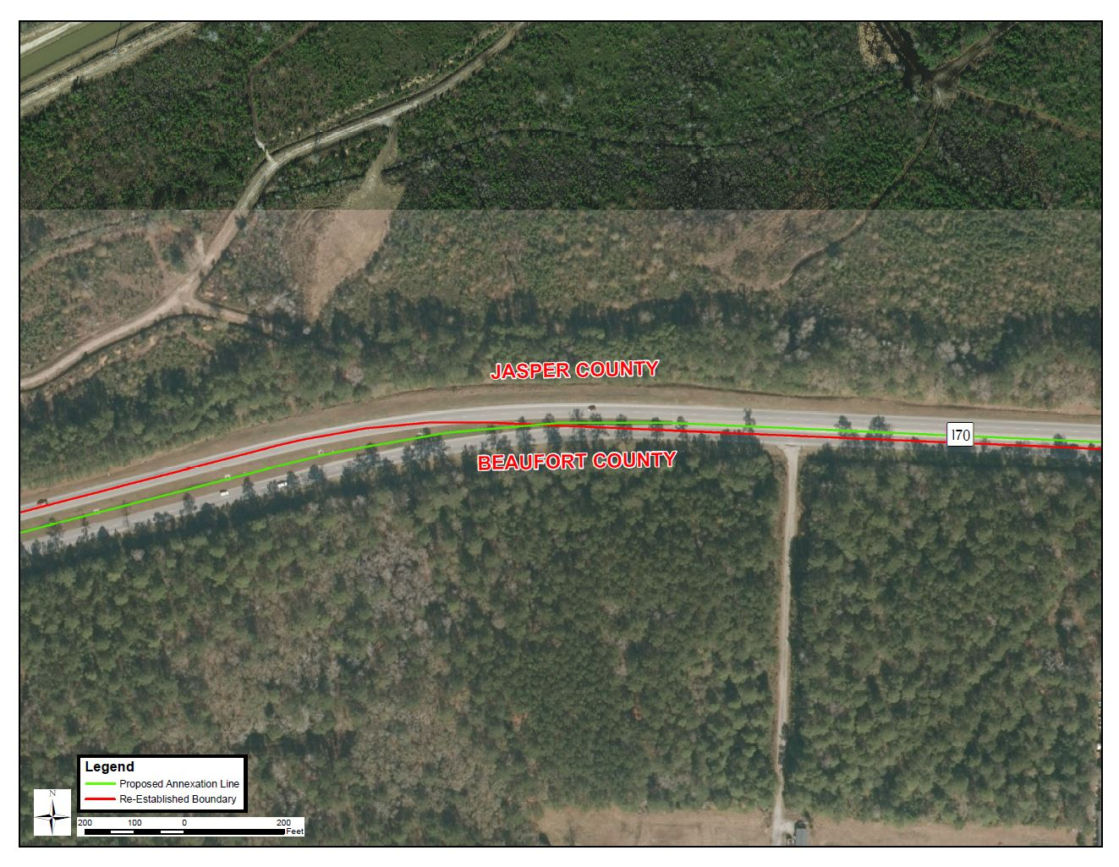

Slide 29
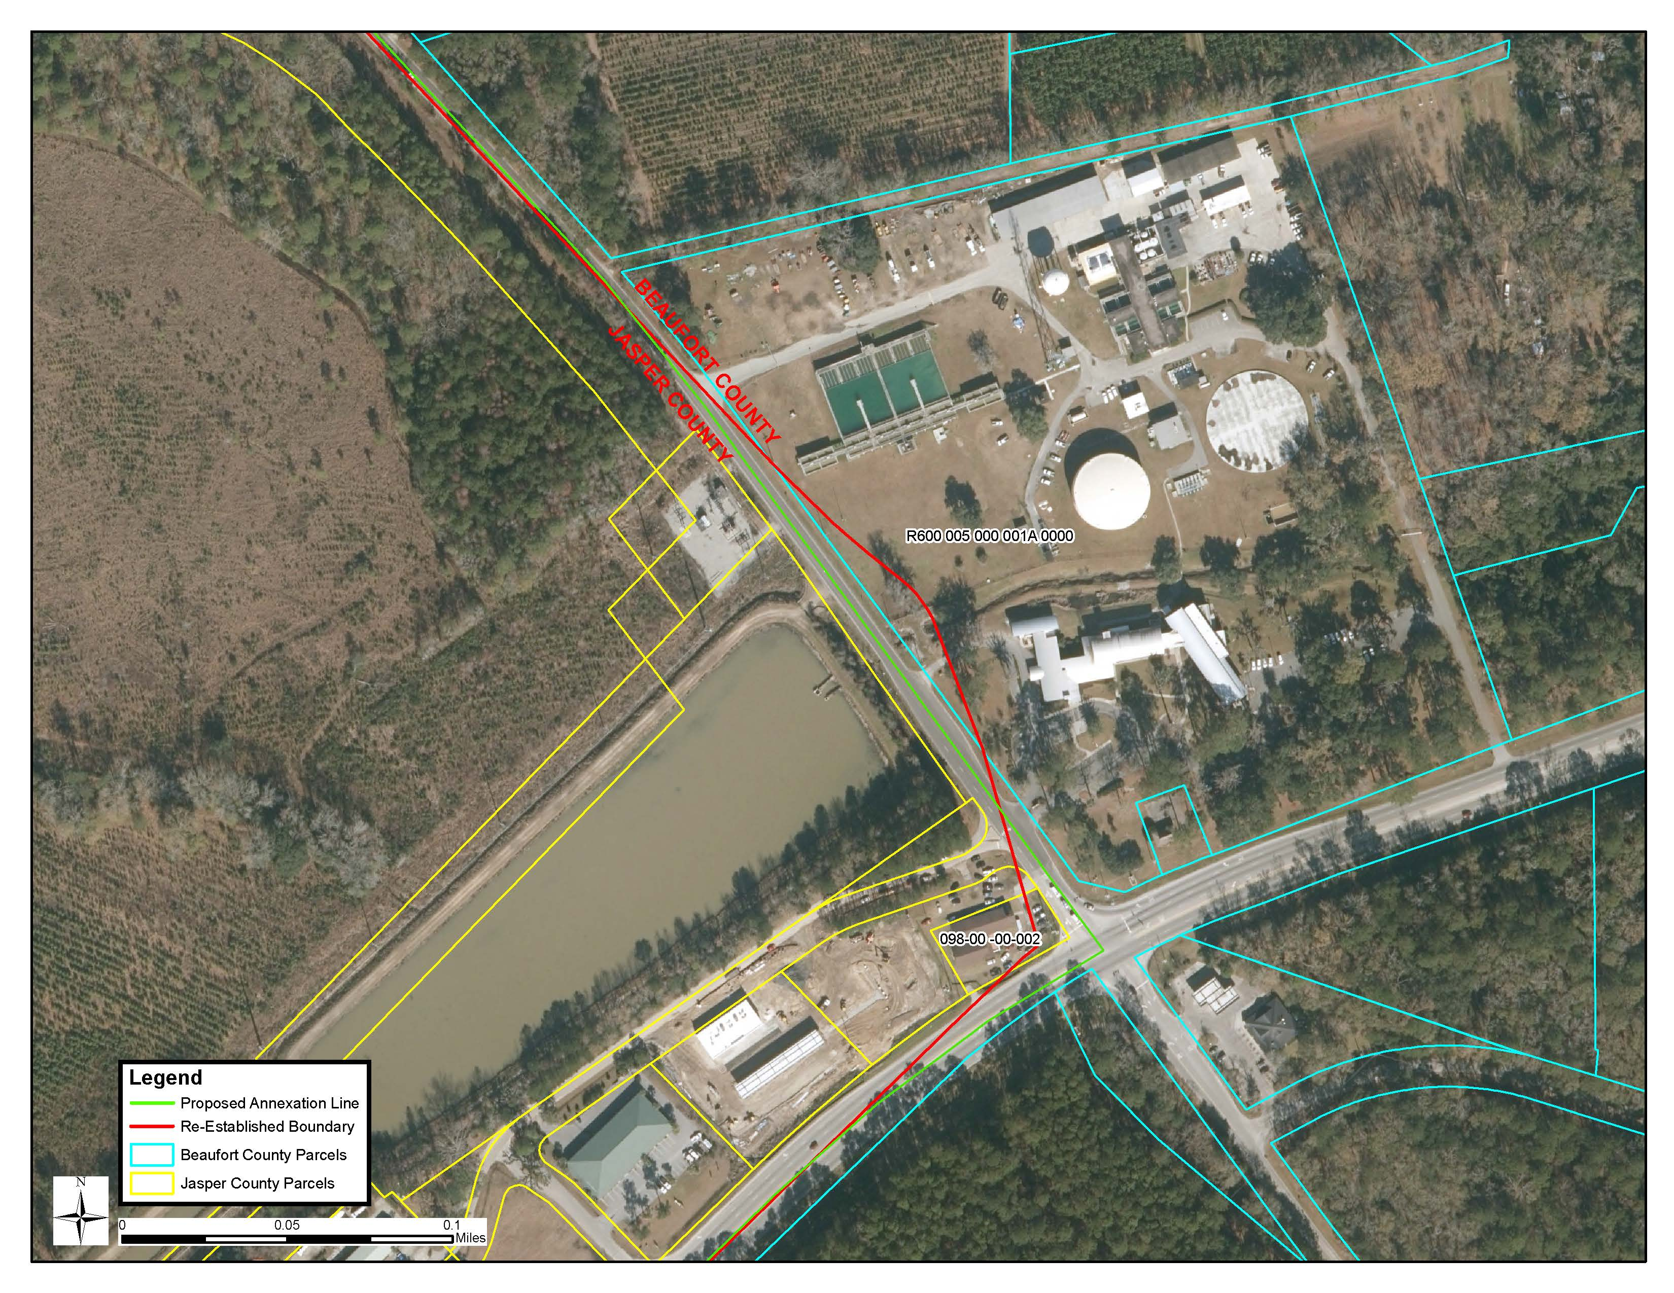

Slide 30
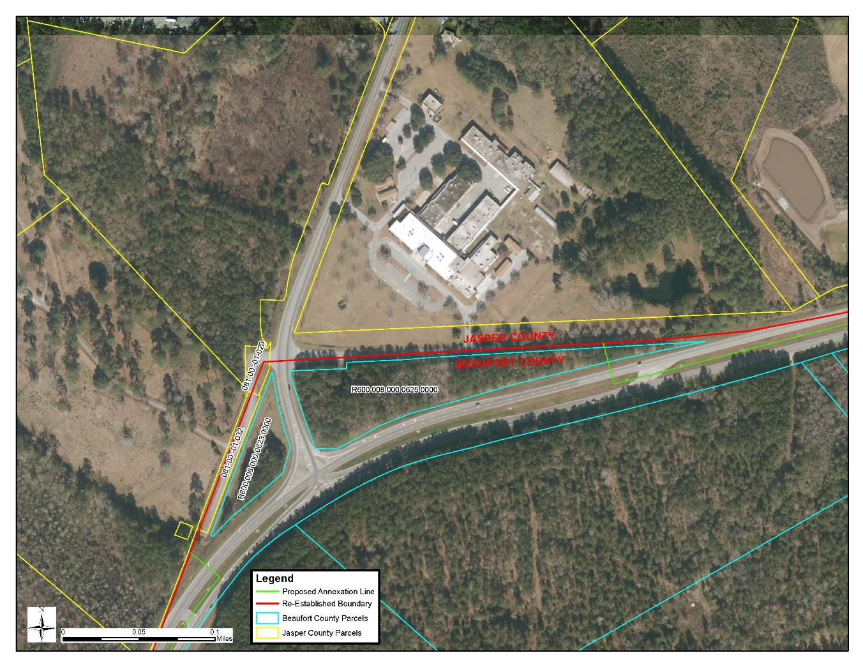
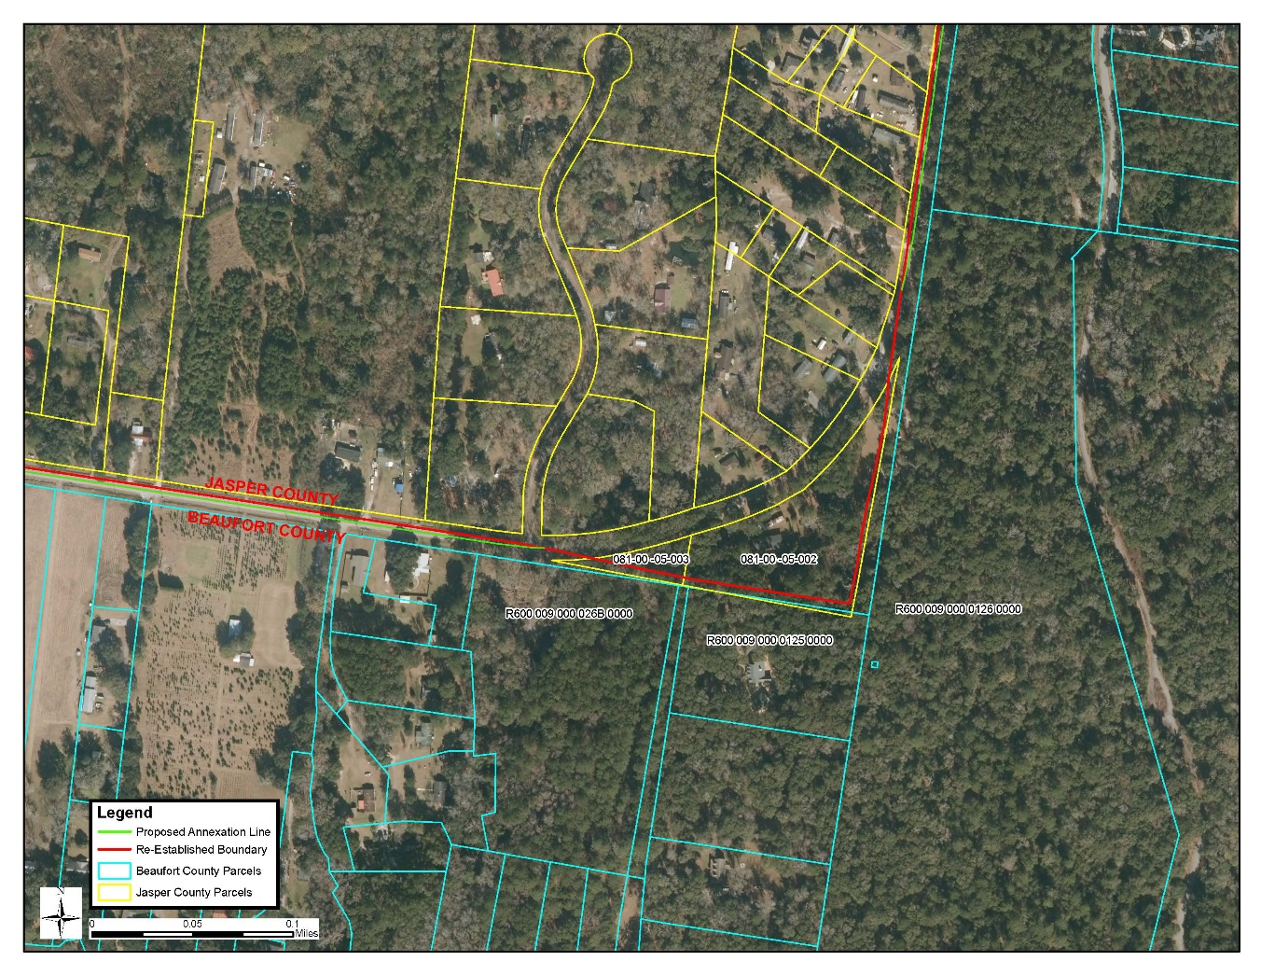

Slide 31
BEAUFORT TO JASPER = 22.34 ACRES
JASPER TO BEAUFORT = 5.95 ACRES
TOTAL INCREASE TO JASPER, DECREASE TO BEAUFORT = 16.39 ACRES

Slide 32
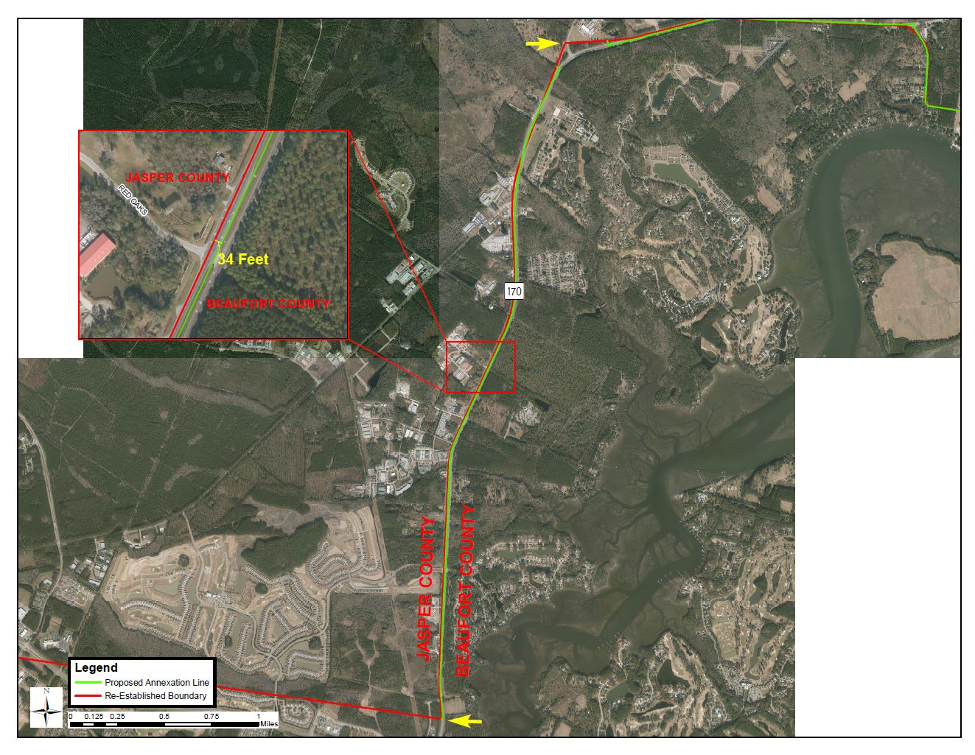

Slide 33
QUESTIONS?

