Slide 1
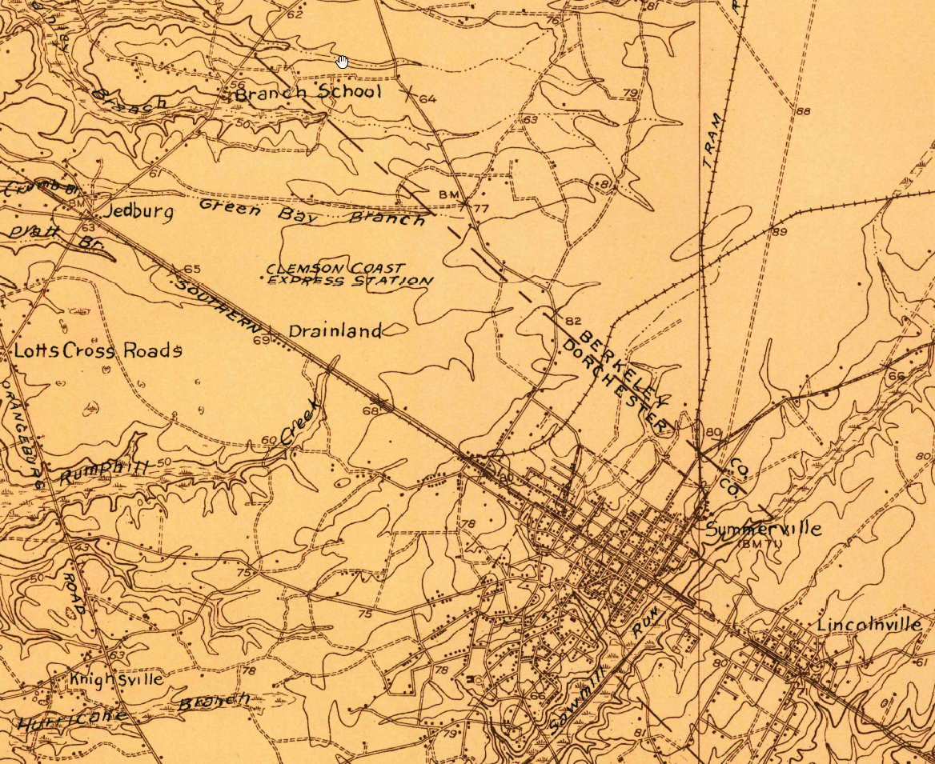

BERKELEY/DORCHESTER
COUNTY LINE RE-ESTABLISHMENT
David Ballard, PLS
Revenue and Fiscal Affairs
Geodetic Survey
1988-2017

Slide 2
SC Code of Law and Act 262 Of 2014
Role of South Carolina Geodetic Survey
      (1994) Dispute between two or more counties- SCGS will act as mediator to resolve the dispute
      (1994/2014) SCGS to assist counties in defining and monumenting the locations of county boundaries and positioning the monuments using geodetic surveys where counties are ill-defined, unmarked, or poorly marked
      (2014) SCGS will clarify county boundaries as defined in Chapter 3, Title 4
      (2014) SCGS will analyze archival and other evidence and perform field surveys to position geographically all county boundaries in accordance with statutory descriptions

Slide 3
Steps for Clarifying Boundaries
Notify County Administrators in advance of planned work
Conduct historical research for documentary evidence of boundaries
Perform field work to locate monuments and corroborating evidence and position on State Plane Coordinates
Share preliminary findings with county officials for impact analysis and to plan public meetings
Receive feedback and input from local officials and public
Review and update findings, as appropriate
Work to build cooperation with affected parties

Slide 4
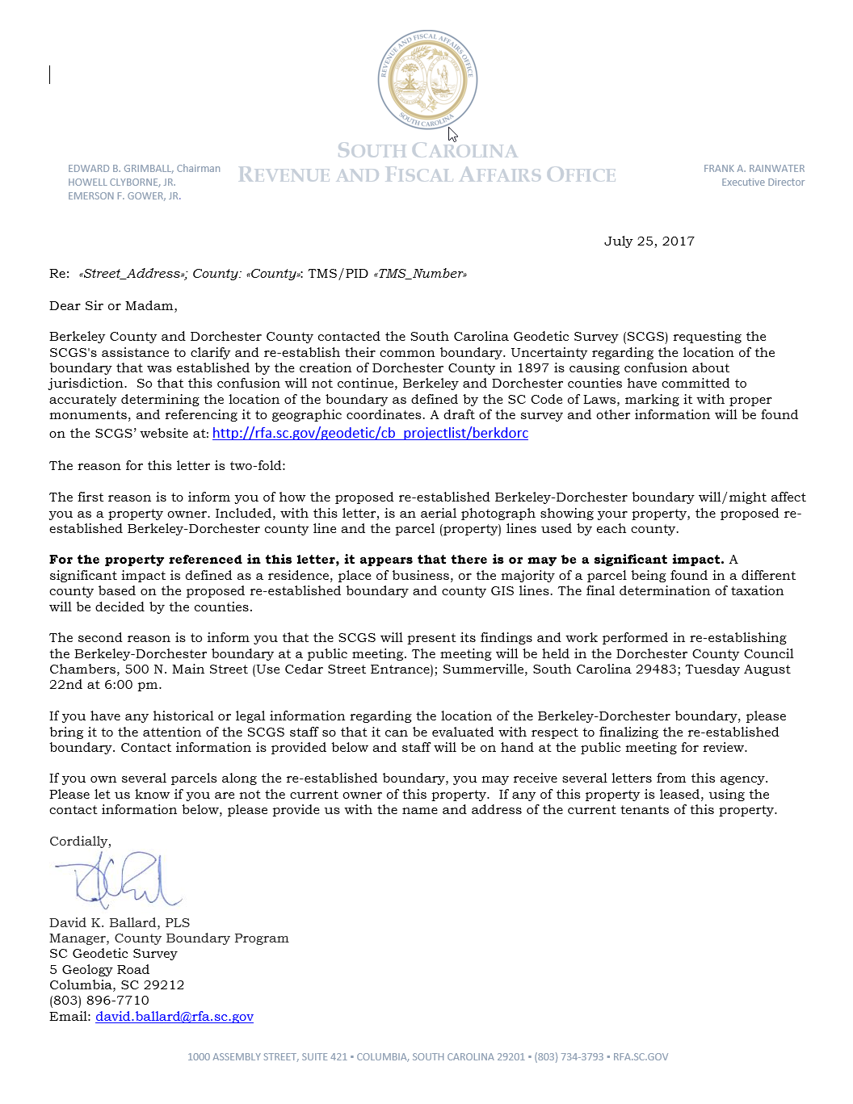
Public Meeting Notification

Slide 5
Scatter Gram of Differences
Between Observations
2 – Five Minute Sessions
RMSE(2-D) = 0.020m @95%
0.015m = ~0.05’
Axis Units in Meters

Slide 6
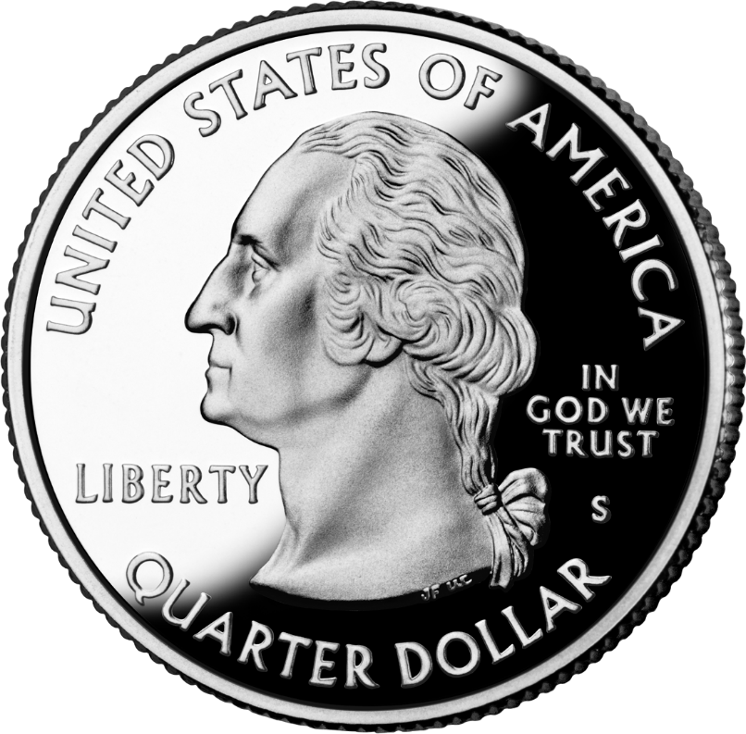
Scatter Gram of Differences
Between Observations
2 – Five Minute Sessions
RMSE(2-D) = 0.020m @95%
0.015m = ~0.05’
Axis Units in Meters

Slide 7
Berkeley – Dorchester County Line
INQUIRIES
1988: Drug bust
1998: Tom Dion – Professor of Engineering at the Citadel – Detmold Baseline Committee (Town of Summerville) – Committee requests SCGS look at the Berkeley-Dorchester line from Sawmill Branch/Canal to Four Holes Swamp after finding major discrepancies on the County Line
2000: Wes Birt – Dorchester County Public Works – Inquiry about the County Line, met with Berkeley and Dorchester County representatives.
2007: Mark Stokes – Berkeley County Attorney – Inquiry, met with Berkeley and Dorchester County representatives.
2015: Mark Stokes – Berkeley County Attorney – Inquiry, met with Berkeley and Dorchester County representatives.

Slide 8
SC CODE of LAW
-Section 4-3-80. Berkeley County. “…Berkeley County is bounded southwesterly by Dorchester County.”
-Section 4-3-200. Dorchester County. “…the intersection of the run of said swamp with the old county line between Colleton and Berkeley Counties; and by a straight line running thence to a point upon Saw Mill Branch one mile northeast of the South Carolina and Georgia Railroad…”

Slide 9
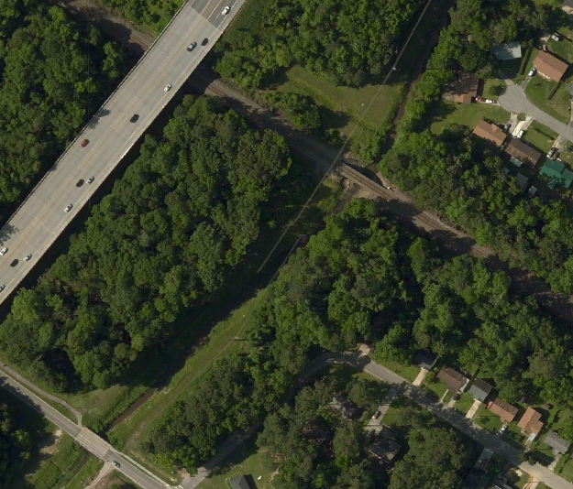
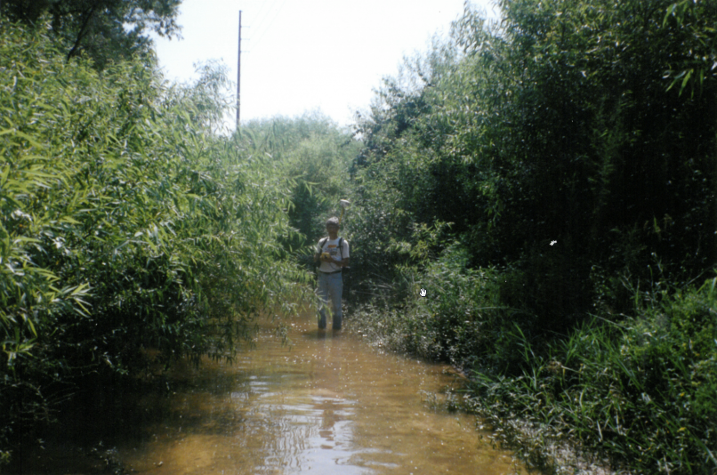
SC CODE of LAW
-Section 4-3-200. Dorchester County. “…a point upon Saw Mill Branch one mile northeast of the South Carolina and Georgia Railroad…”
Railroad Crossing Saw Mill Branch
Saw Mill Branch Near County Line

Slide 10
SC CODE of LAW
-Section 4-3-200. Dorchester County. “…the intersection of the run of said swamp with the old county line between Colleton and Berkeley Counties;…”
The Revised Statutes of the State of South Carolina:
-Title V, Chapter XIII, Section 414, p. 140:
“…then by a straight line drawn from Windsor Hill (north 49° west) to Four Hole Swamp, three-quarters of a mile above Four Hole Bridge, near Harley's…”

Slide 11
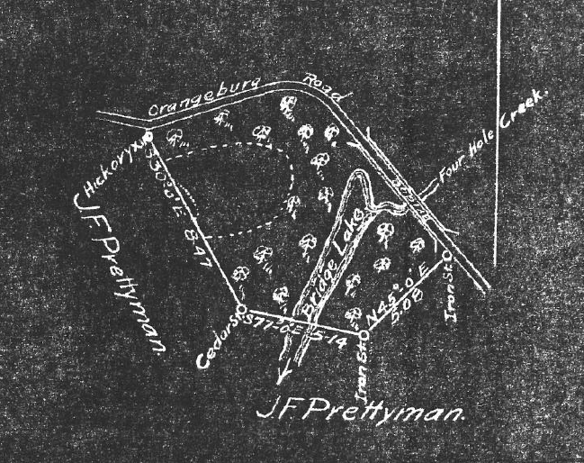
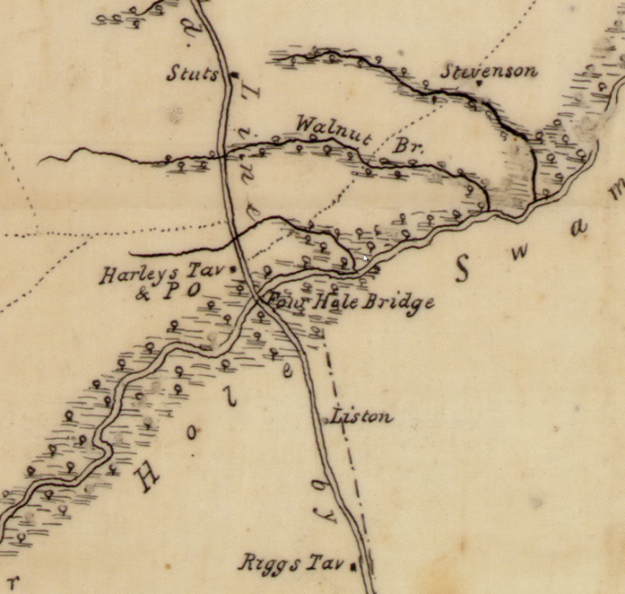
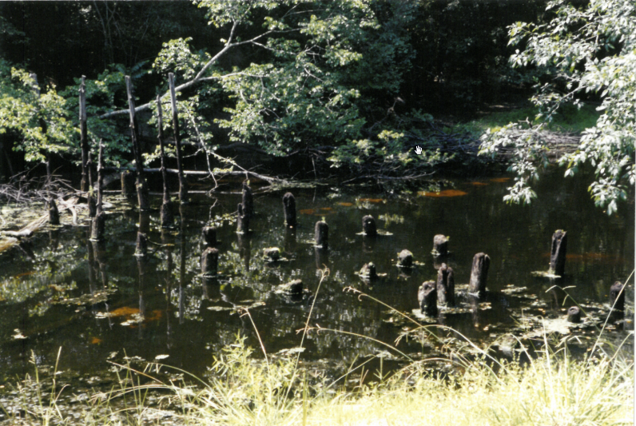
SC CODE of LAW
“…then by a straight line drawn from Windsor Hill (north 49° west) to Four Hole Swamp, three-quarters of a mile above Four Hole Bridge, near Harley's…”
Plat Showing Old Road Location
Mills Atlas (Colleton)
Mills Atlas (Colleton)

Slide 12
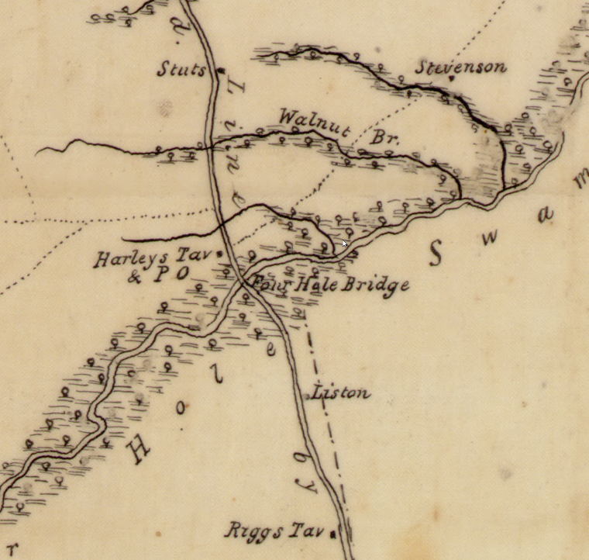
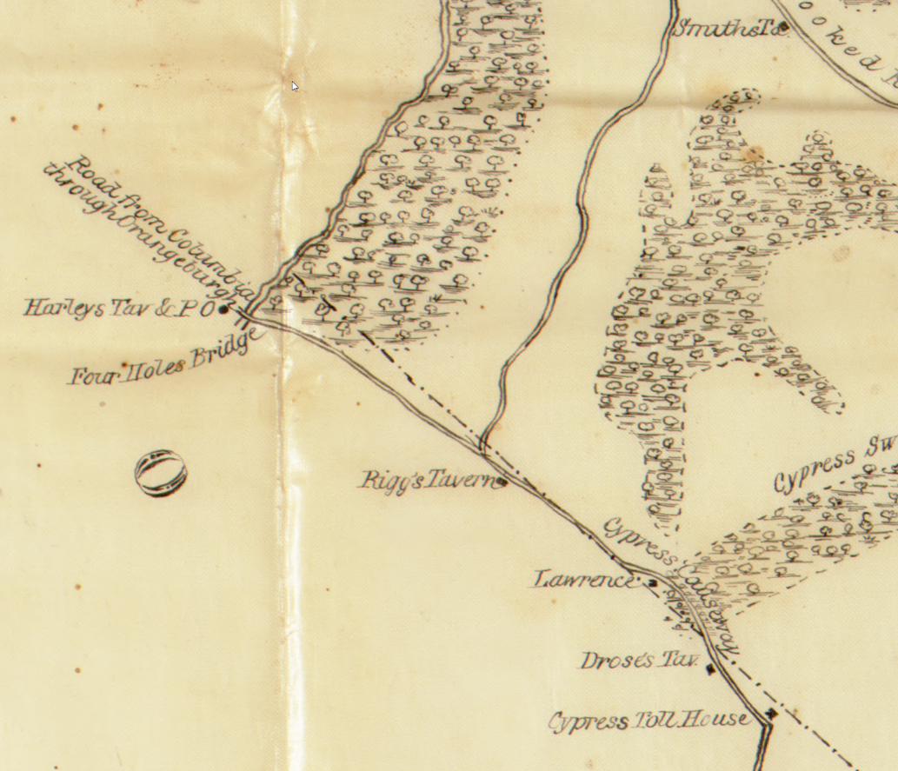
MILL’S ATLAS of 1825
Mills Atlas (Colleton)
Mills Atlas (Charleston)

Slide 13
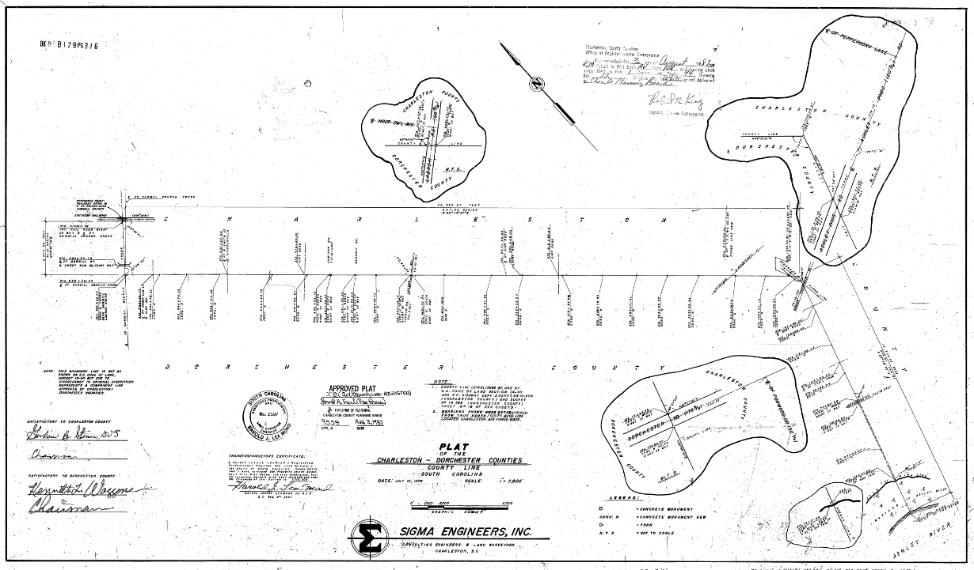
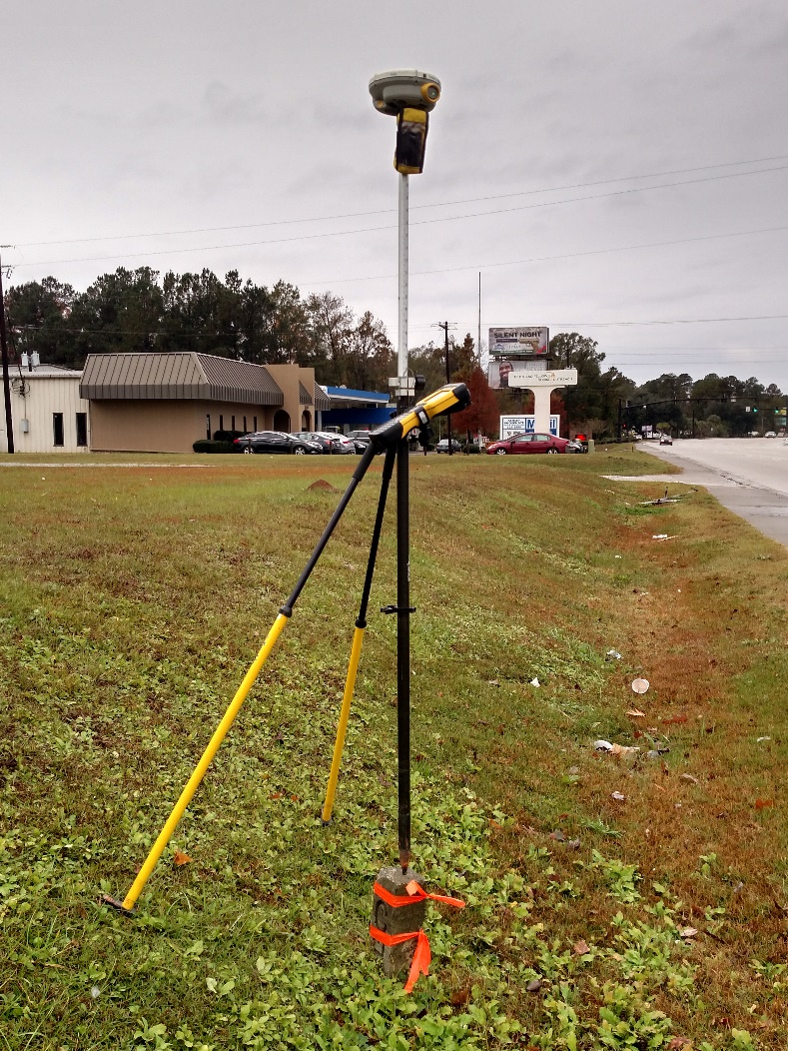
1982 COUNTY LINE SURVEY

Slide 14
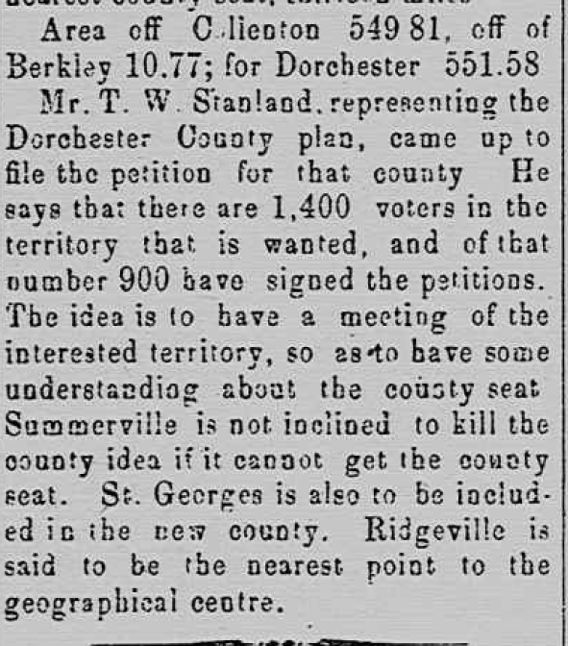
PORTION of BERKELEY

Slide 15
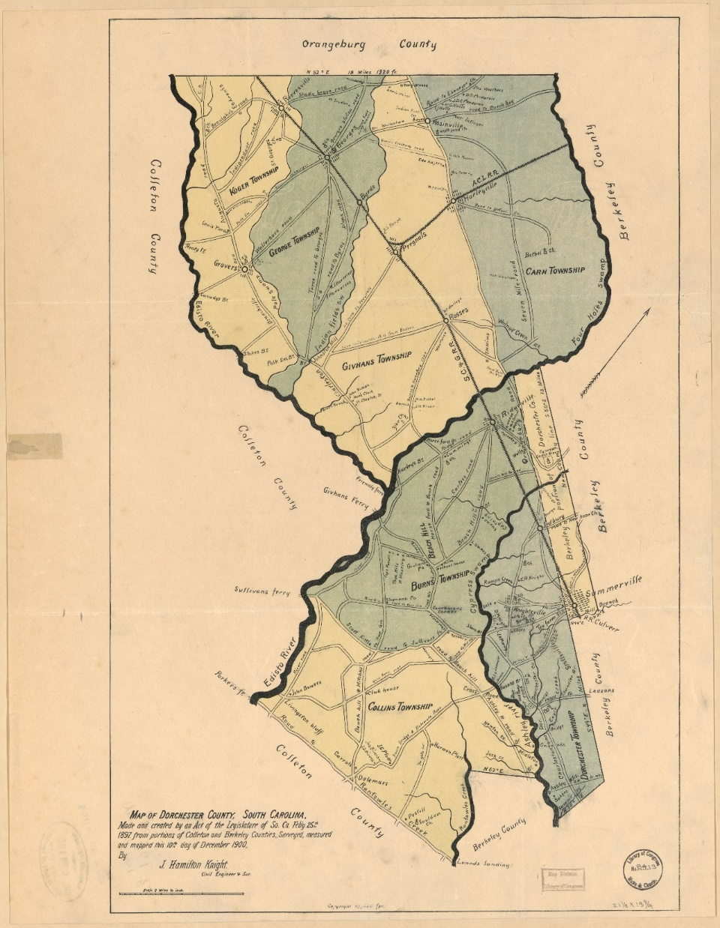
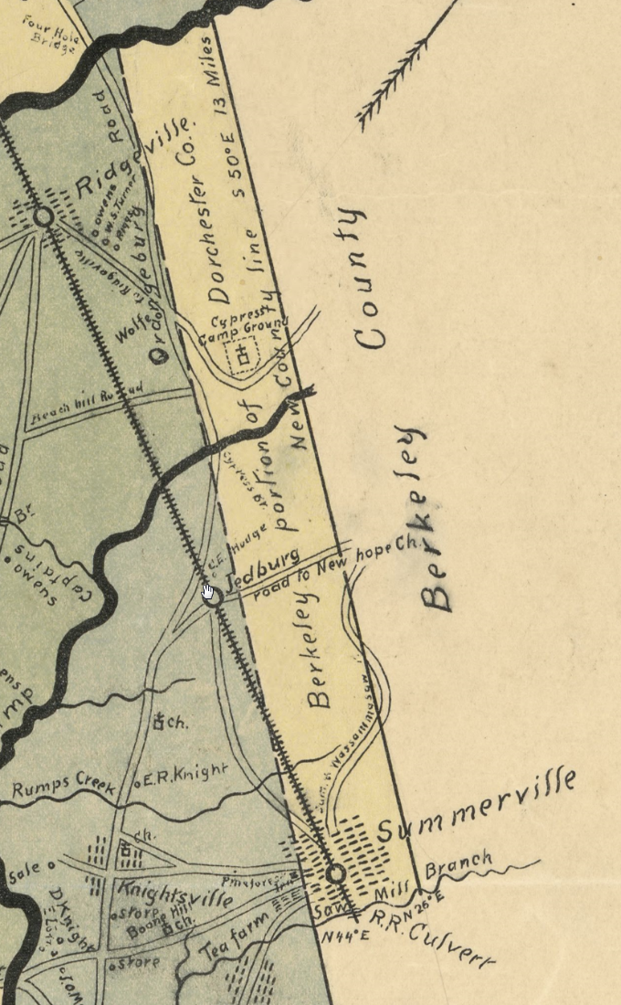
1900 Dorchester County Map

Slide 16
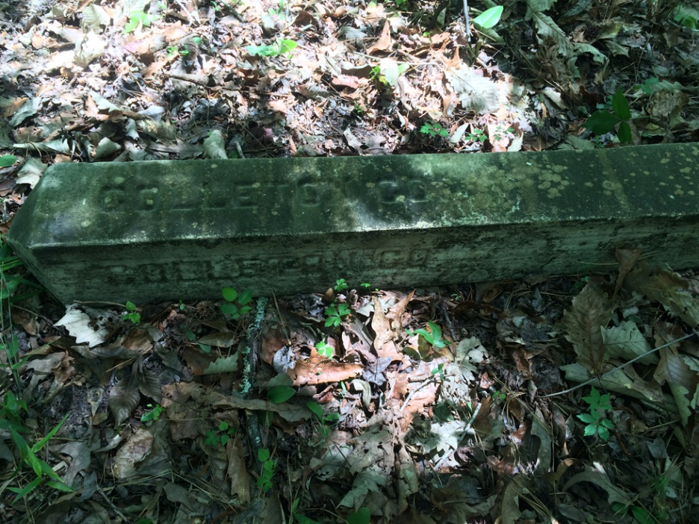
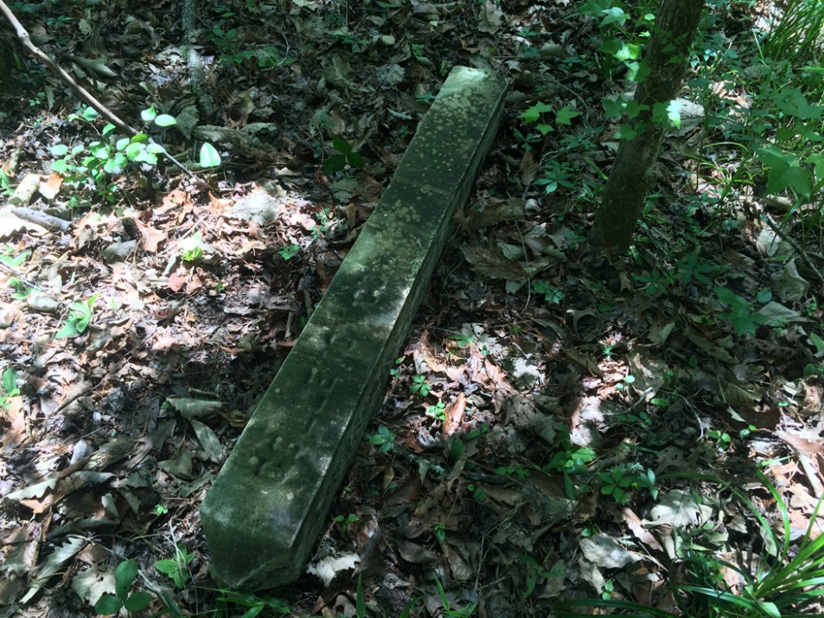
Monument

Slide 17
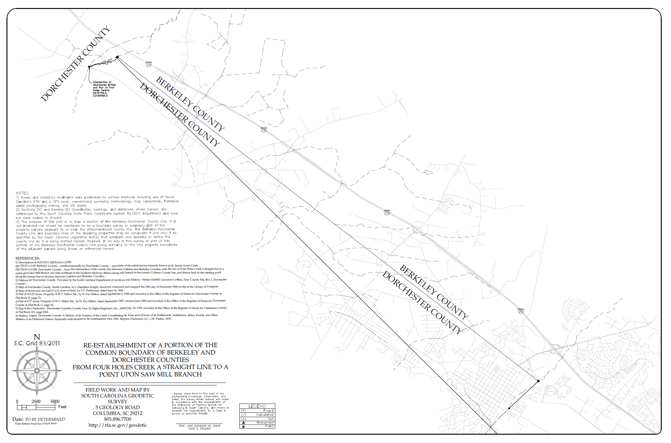
Plat of Survey (Draft)

Slide 18
Act 262 of 2014
Steps for Clarifying Boundaries
SCGS Requirements:
    Upon reestablishing county boundary, SCGS shall certify its work and within 30 days of certification:
        Provide copies to the administrator of each affected county;
        Provide written notification to affected parties
        Provide notice and copies to the public through its official website and or other means it considers appropriate; and
        Notify as it determines appropriate, other affected state and federal agencies
    (Initiates 60 Day Appeal Process)
  Certified Surveys submitted to Secretary of State, Register of Deeds Offices, and South Carolina Department of Archives with Cover Letter
  Date of the cover letter is the date the surveys become effective
  Introduce Legislation to update Code of Law to reflect clarified boundary with State Plane Coordinates

Slide 19
Act 262 of 2014
Affected Parties Disagreeing with SCGS:
    May file request for a contested case hearing with the SC Administrative Law Court
    This decision may be appealed
    “Affected Party”
              Governing body of an affected county
              Governing body of a political subdivision of this State
              An elected official, other than a statewide elected official
              A property owner or an individual residing in the certification zone
              A business entity located in the certification zone
              A nonresident individual who owns or leases real property situated in the certification zone

Slide 20
SIGNIFICANT IMPACTS?
A significant impact for this section of boundary has been defined as a residence, place of business, or a the majority of a parcel being found in a different county based on the re-established boundary.
Reviewed Over 500 Properties Along the nearly 10.5 Mile Section of Re-established Boundary:
Determined around 330 Significant Impacts

Slide 21
QUESTIONS?

