Slide 1
SOUTH CAROLINA ECONOMIC AND BUDGET UPDATE
Presented to
South Carolina City and County
Management Association
January 20, 2023
Frank A. Rainwater, Executive Director
South Carolina Revenue and Fiscal Affairs Office
1000 Assembly Street
Rembert Dennis Building, Suite 402
Columbia, SC 29201
(803) 734-2265
www.rfa.sc.gov

Slide 2
Demographic Trends and Projections

Slide 3
South Carolina had the 6th Largest Population Increase in the US Population increased by 59,976 from 2020 to 2021
Source: Population Estimates Program Vintage 2021 estimates. File Name: Annual Estimates of Resident Population Change for the United States, States, District of Columbia, Puerto Rico, and State Rankings: April 1, 2020 to July 1, 2021

Slide 4
South Carolina Population, 2010 Five Largest: Greenville, Richland, Charleston, Spartanburg, Horry Five Smallest: McCormick, Allendale, Calhoun, Bamberg, Lee
Source: US Census Bureau, Vintage 2020 Postcensal Estimates

Slide 5
South Carolina Population, 2020 Five Largest: Greenville, Richland, Charleston, Horry, Spartanburg Five Smallest: Allendale, McCormick, Bamberg, Calhoun, Lee
Source: US Census Bureau, Vintage 2021 Postcensal Estimates

Slide 6
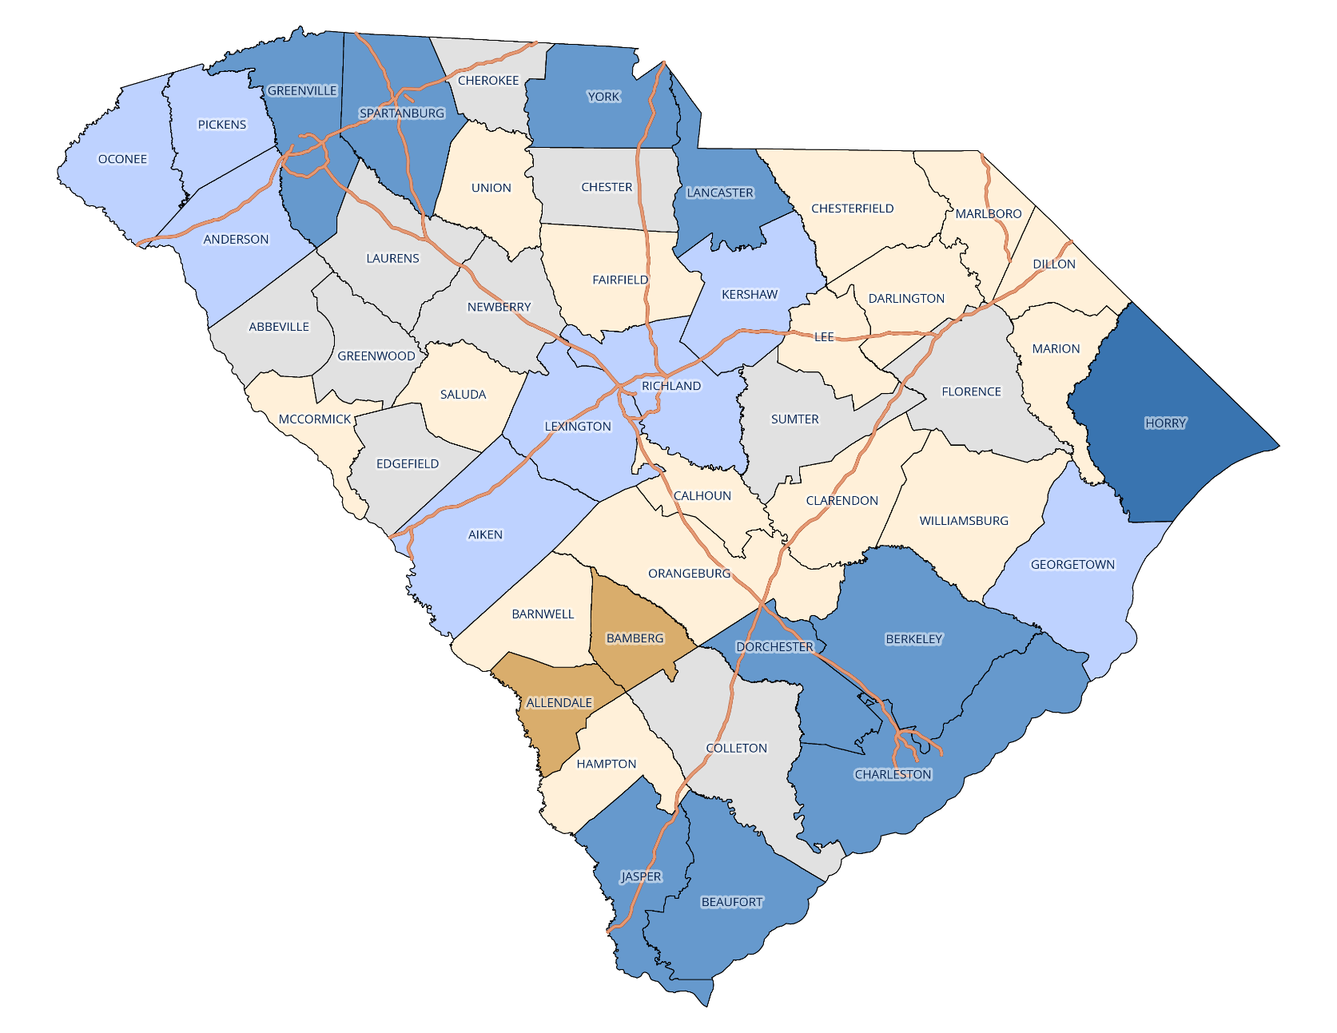
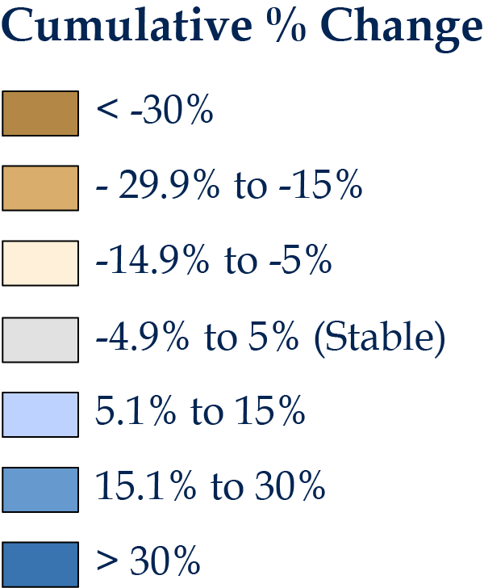
South Carolina’s Population Change, 2010 - 2020 Varied by county from +30.8% (Horry) to -22.8% (Allendale)
Data Sources:
US Census Bureau Population Estimates Program:
Vintage 2020 Estimates for 2010 and
Vintage 2021 Estimates for 2020;
RFA Adjusted Estimates for 2011-2019

Slide 7
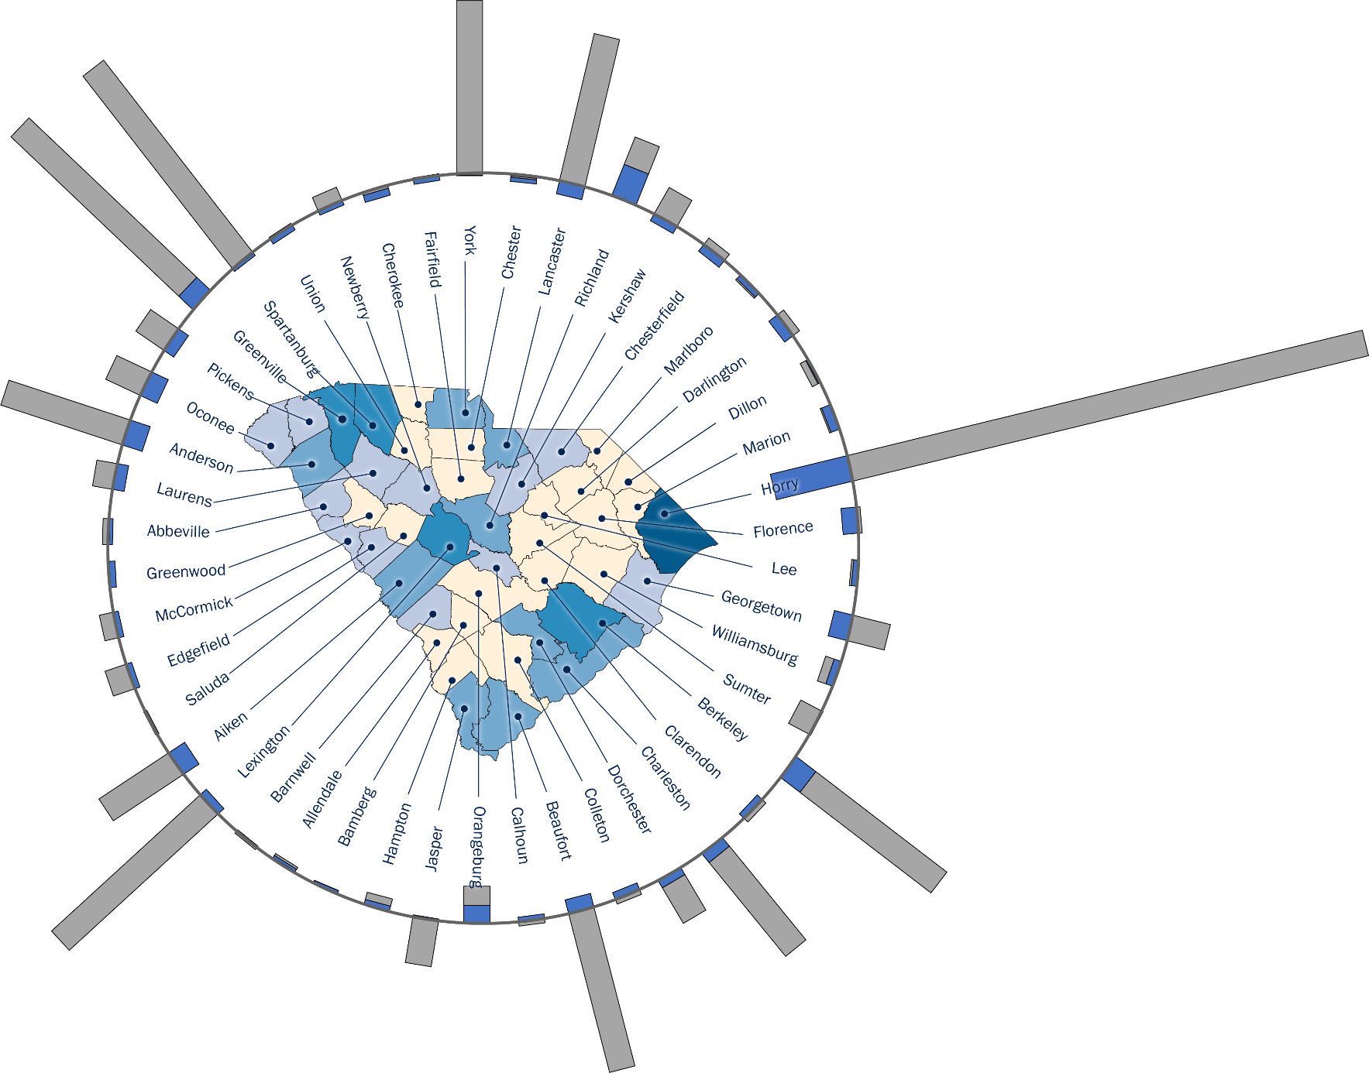
South Carolina’s Components of Population Change by County 2020 - 2021
Data Sources:
US Census Bureau Population Estimates Program: Vintage 2021 Postcensal Estimates. File Name: Annual and Cumulative Estimates of the Components of Resident Population Change for Counties in the United States: April 1, 2020 to July 1, 2021 (CO-EST2021-COMP)

Slide 8
Components of Population Change Natural v. Migration; deaths exceeded births in 2021
Natural Increase – the number of births minus the number of deaths Net Migration – the number of people moving into the state minus the number moving out

Slide 9
South Carolina Births and Deaths, 1999 - 2020 The number of deaths have increased each year since 2010 while the number of births remained fairly constant; deaths exceeded births in 2020.
SC Department of Health and Environmental Control Vital Records Data, SCAN

Slide 10
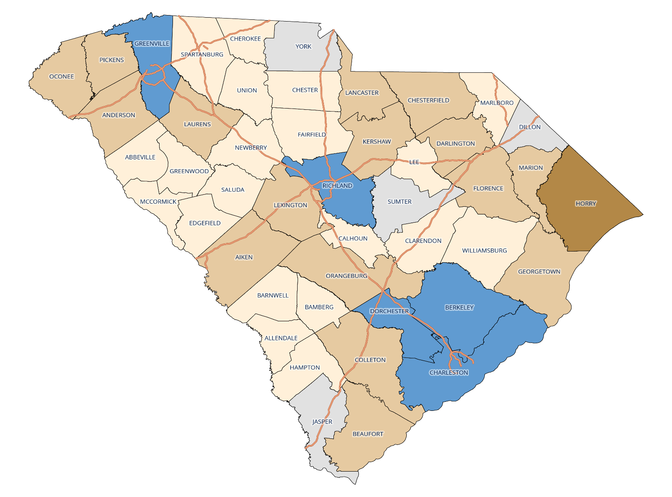
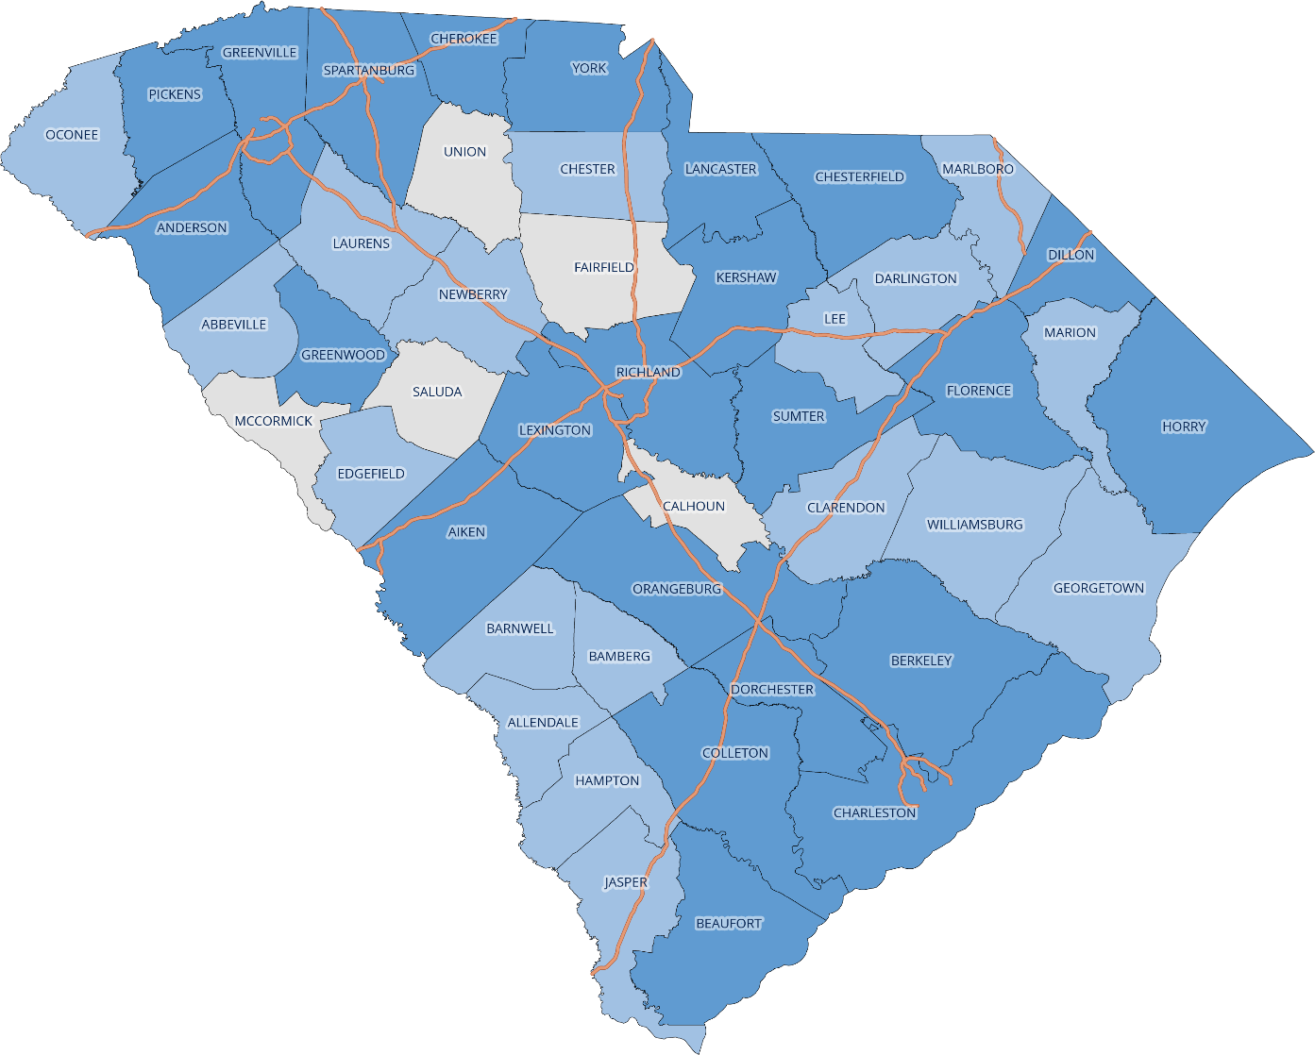
South Carolina Components of Population Change – Natural Increase Dramatic shift in the number of counties experiencing a natural increase from 2001 to 2021
Estimated Natural Increase 2000 - 2001
Estimated Natural Increase 2020 - 2021
Data Sources:
US Census Bureau Population Estimates Program: Vintage 2010 Evaluation Estimates. File Name: Annual Resident Population Estimates, Estimated Components of Resident Population Change, and Rates of the Components of Resident Population Change for States and Counties: April 1, 2000 to July 1, 2010 (CO-EST2010-ALLDATA)
Data Sources:
US Census Bureau Population Estimates Program: Vintage 2021 Postcensal Estimates. File Name: Annual and Cumulative Estimates of the Components of Resident Population Change for Counties in the United States: April 1, 2020 to July 1, 2021 (CO-EST2021-COMP)

Slide 11
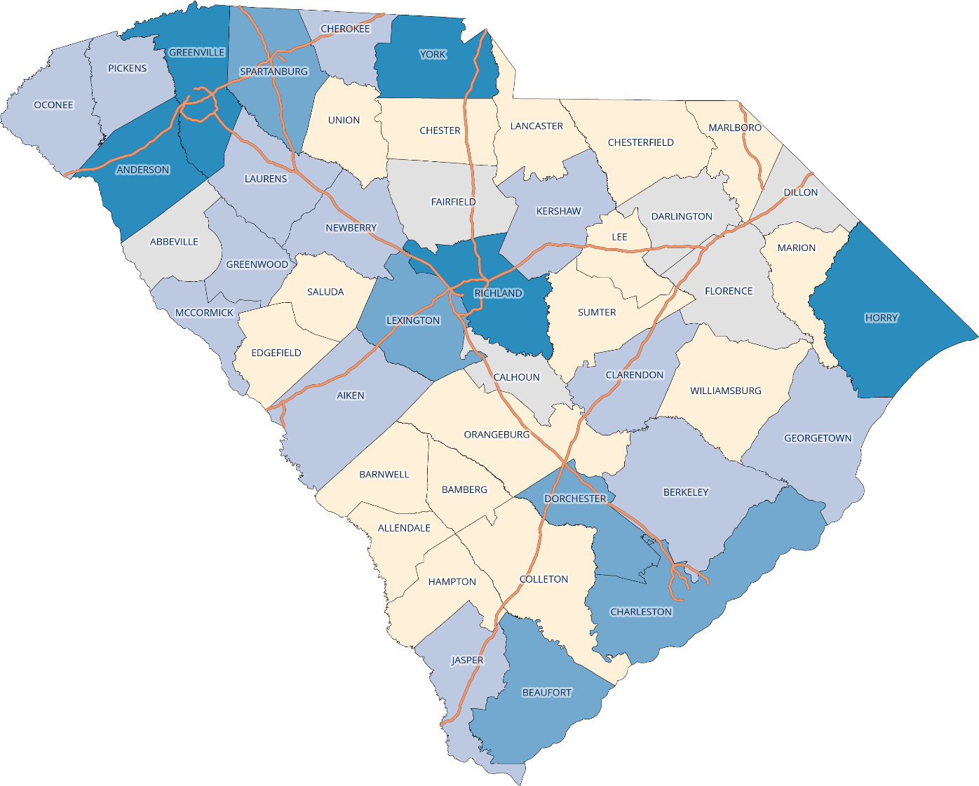
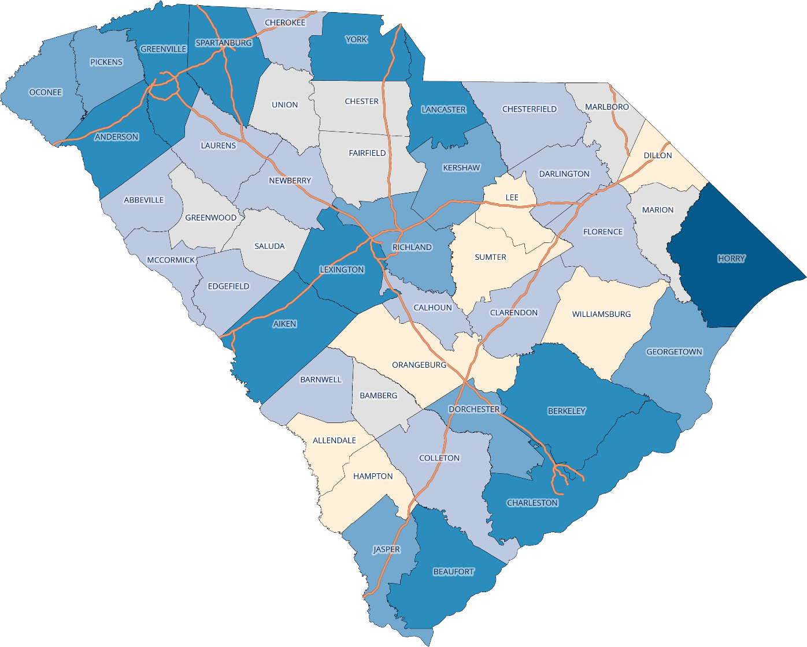
South Carolina Components of Population Change - Net Migration Only seven counties experienced a loss of more than 50 people due to migration from 2020 to 2021 compared to seventeen from 2000 to 2001
Estimated Net Migration 2000 - 2001
Estimated Net Migration 2020 - 2021
Data Sources:
US Census Bureau Population Estimates Program: Vintage 2010 Evaluation Estimates. File Name: Annual Resident Population Estimates, Estimated Components of Resident Population Change, and Rates of the Components of Resident Population Change for States and Counties: April 1, 2000 to July 1, 2010 (CO-EST2010-ALLDATA)
Data Sources:
US Census Bureau Population Estimates Program: Vintage 2021 Postcensal Estimates. File Name: Annual and Cumulative Estimates of the Components of Resident Population Change for Counties in the United States: April 1, 2020 to July 1, 2021 (CO-EST2021-COMP)

Slide 12
South Carolina Projected Population, 2030 Five Largest: Greenville, Horry, Charleston, Richland, Spartanburg Five Smallest: Allendale, McCormick, Bamberg, Calhoun, Lee
Source: US Census Bureau, Vintage 2021 Postcensal Estimates

Slide 13
South Carolina Projected Population Change, 2020 - 2030 Horry, York, Spartanburg, Greenville, and Berkeley are expected to experience the highest growth
Source: Population Estimates Program Vintage 2020 estimates for 2010, Vintage 2021 estimates for 2020

Slide 14
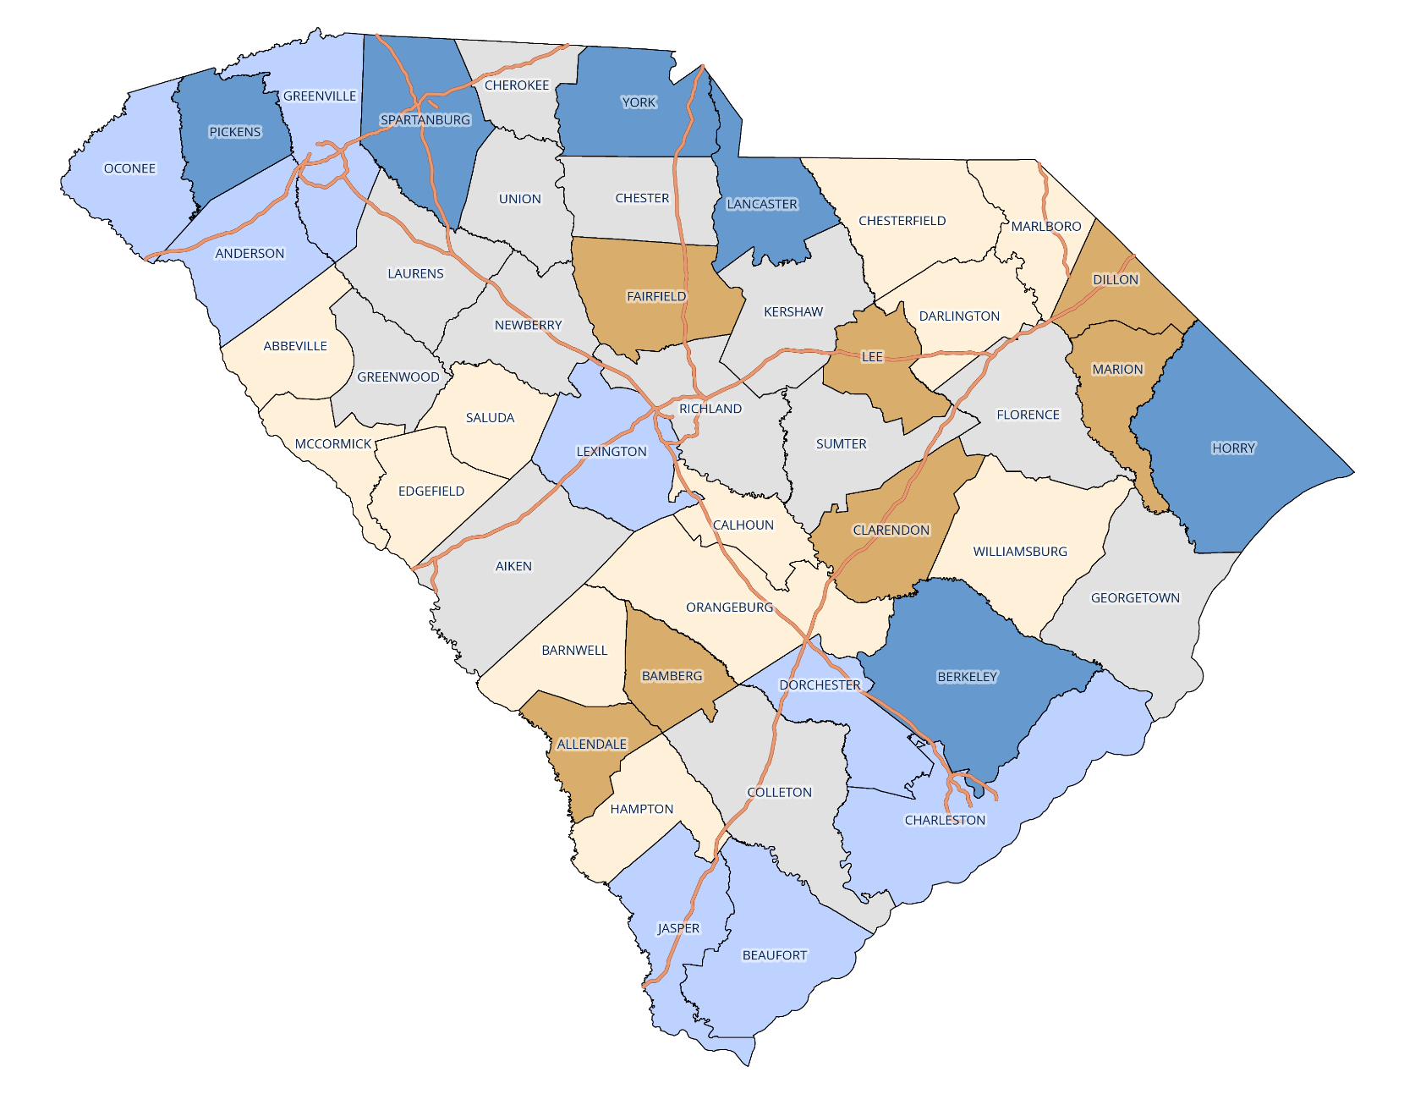
South Carolina Projected Total Population Change, 2020 - 2030 By County
Data Sources:
US Census Bureau Population Estimates Program:
Vintage 2021 Estimates for 2020;
RFA Projections for 2021-2030

Slide 15
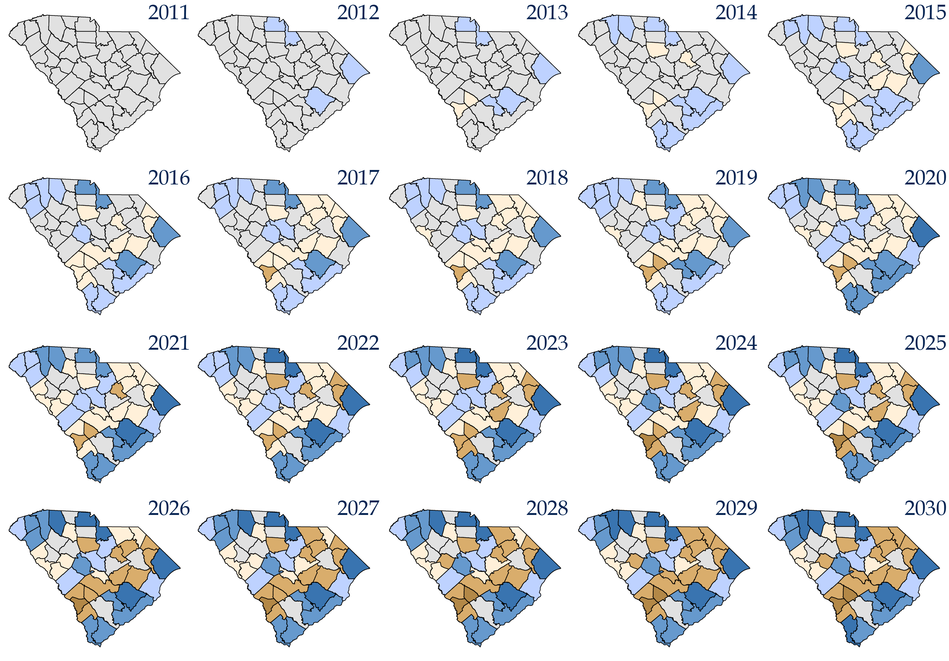
SC Estimated Cumulative Population Change, 2010 – 2030 Total Population by County
Data Sources:
US Census Bureau Population Estimates Program:
Vintage 2020 Estimates for 2010 and
Vintage 2021 Estimates for 2020;
RFA Adjusted Estimates for 2011-2019; RFA Projections for 2021-2030

Slide 16
SC 2030 Population Projections The median age is expected to increase from 40 to 42 over the next decade; all baby boomers will be older than 65

Slide 17
SC Projected Population Change, 2020 – 2030 The growth in the 65+ age group makes up over 60% of the total population growth
AGE GROUP | SC POPULATION CHANGE 2020 - 2030 | PCT
Total | 471,013
0 - 17 | 10,370 | 2%
18 - 64 | 167,328 | 36%
65+ | 293,315 | 62%

Slide 18
SC Age 0 - 17 Population Projected to decline to 20% of total population by 2030

Slide 19
South Carolina 0 – 17 Age Group Based on Births Absent migration, the declining number of births will result in a smaller 0 – 17 population over time.

Slide 20
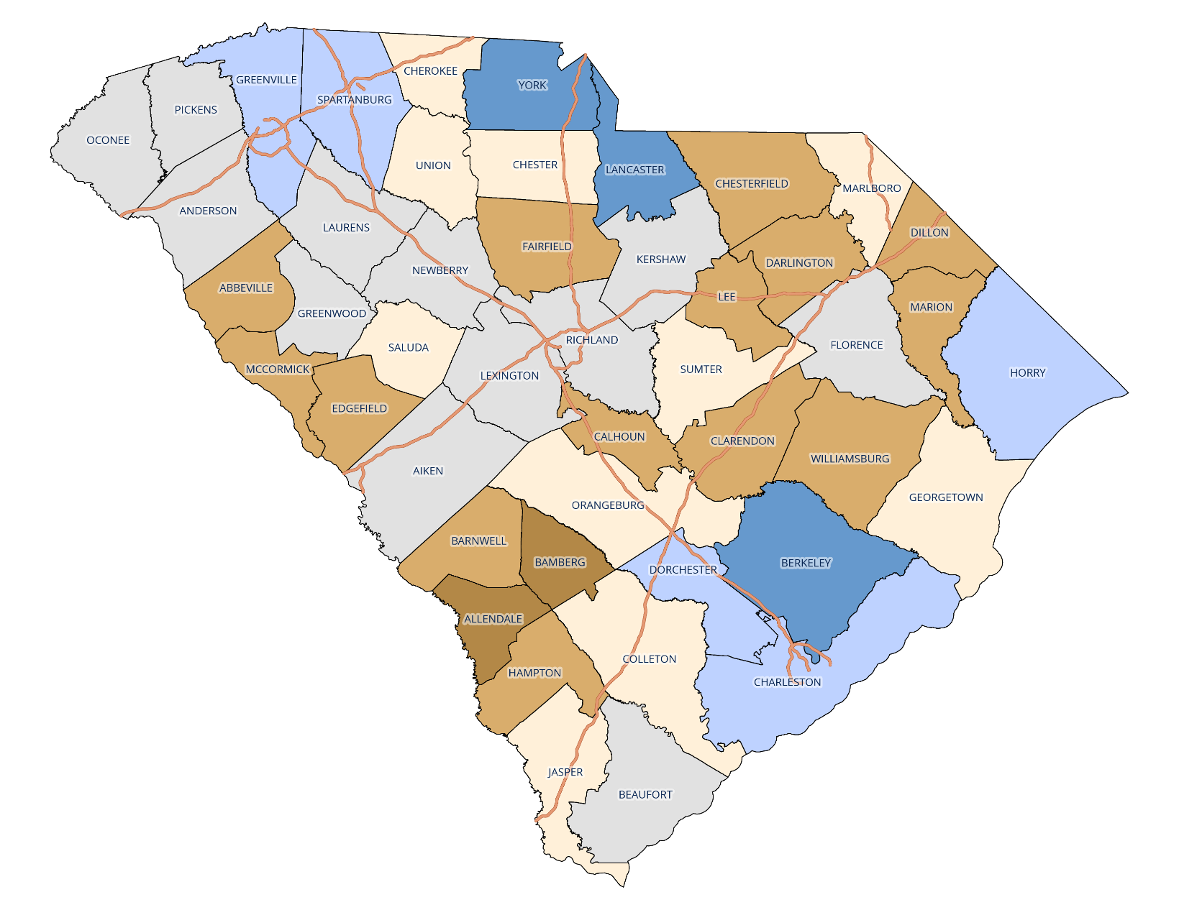
South Carolina Age 0 – 17 Population Change, 2010 - 2020 Only eight counties increased in this age group
Data Sources:
US Census Bureau Population Estimates Program:
Vintage 2020 Estimates for 2010 and
Vintage 2021 Estimates for 2020;
RFA Adjusted Estimates for 2011-2019

Slide 21
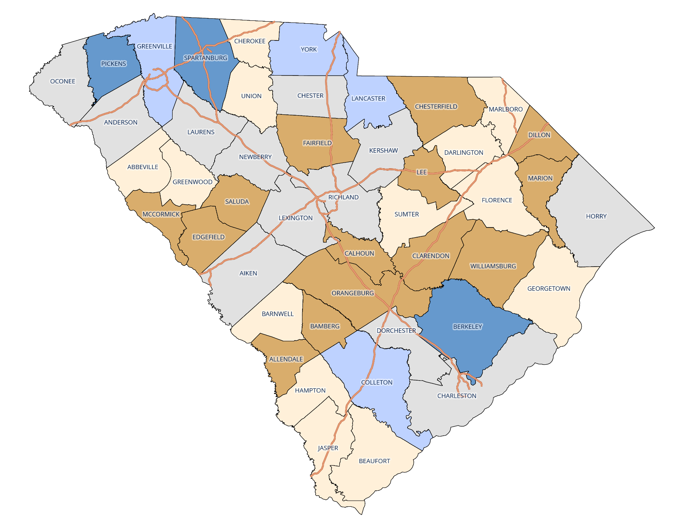
South Carolina Projected Age 0 – 17 Population, 2020 - 2030 Seven counties are projected to increase in this age group
Data Sources:
US Census Bureau Population Estimates Program:
Vintage 2021 Estimates for 2020;
RFA Projections for 2021-2030

Slide 22
SC Projected Age 18 - 64 Population Workforce age population will represent less than 60% of the state’s total population in 2030

Slide 23
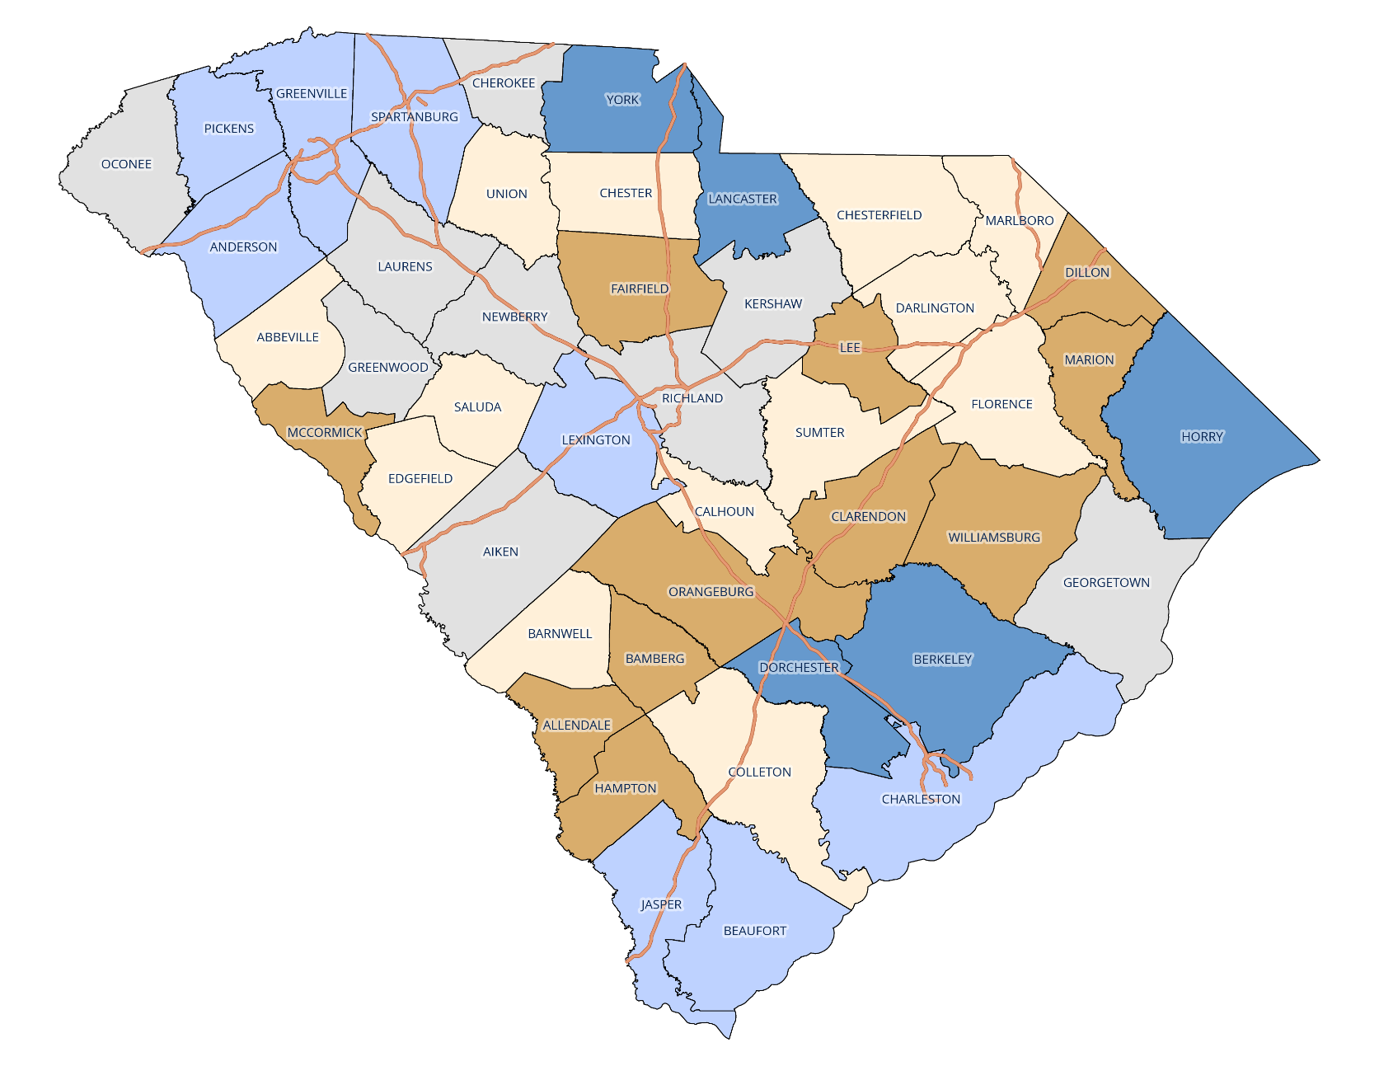
SC Estimated Workforce Age (18 – 64) Population, 2010 – 2020 Thirteen counties increased in this age group
Data Sources:
US Census Bureau Population Estimates Program:
Vintage 2020 Estimates for 2010 and
Vintage 2021 Estimates for 2020;
RFA Adjusted Estimates for 2011-2019

Slide 24
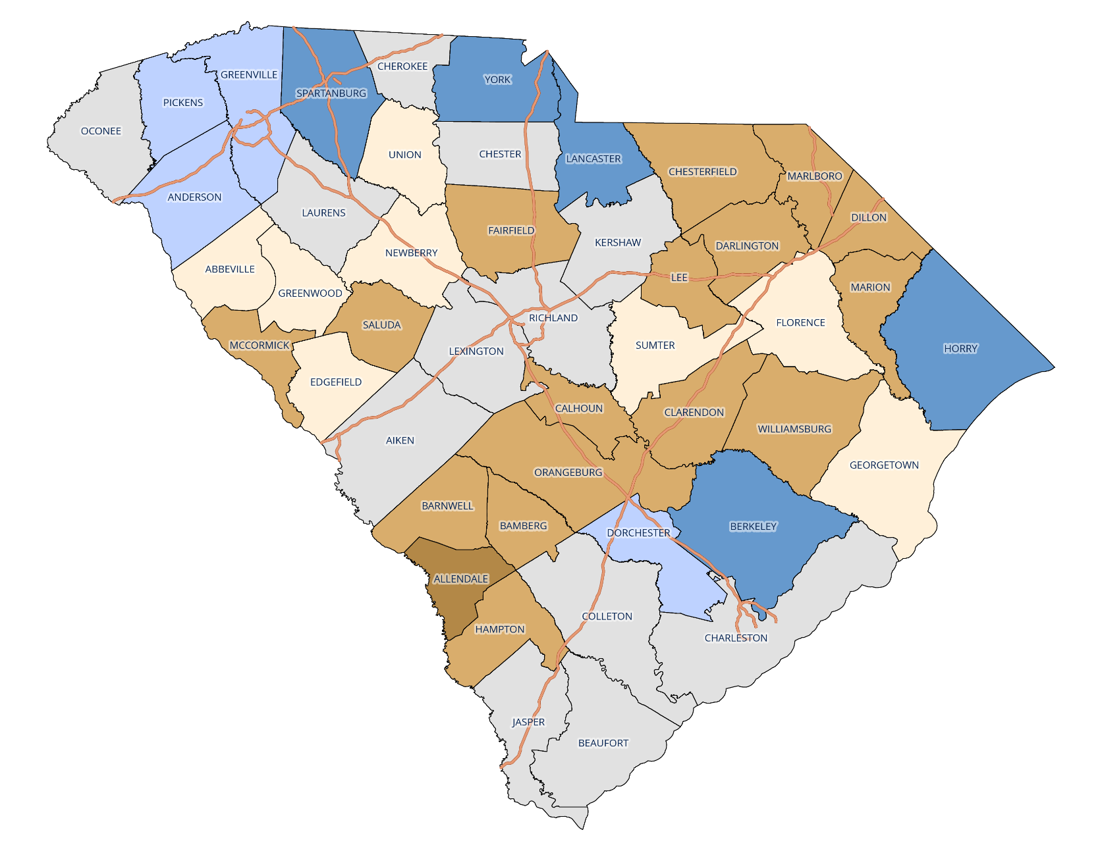
SC Estimated Workforce Age (18 – 64) Population, 2020 – 2030 Nine counties increased in this age group
Data Sources:
US Census Bureau Population Estimates Program:
Vintage 2021 Estimates for 2020;
RFA Projections for 2021-2030

Slide 25
SC Projected Age 65+ Population Projected to increase to approximately 22% of total population by 2030

Slide 26
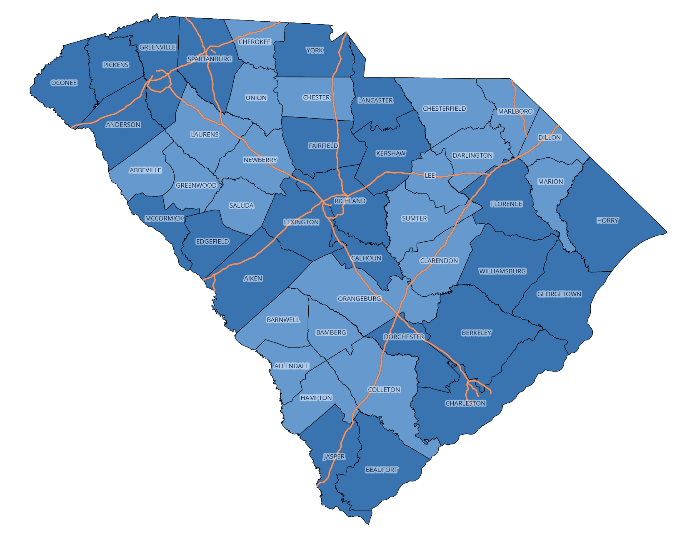
SC Estimated Retirement Age (65+) Population, 2010 - 2020 All counties experienced an increase in this age group
Data Sources:
US Census Bureau Population Estimates Program:
Vintage 2020 Estimates for 2010 and
Vintage 2021 Estimates for 2020;
RFA Adjusted Estimates for 2011-2019

Slide 27
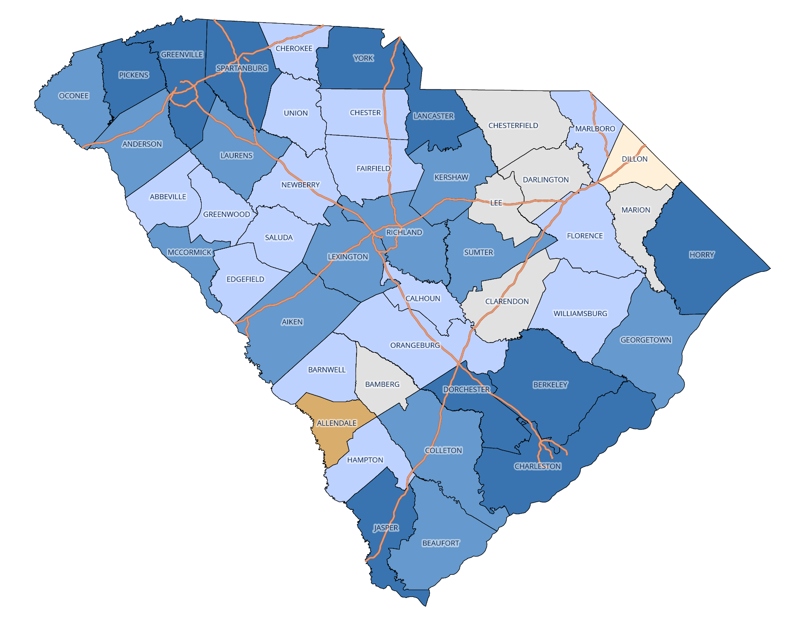
SC Estimated Retirement Age (65+) Population, 2020 - 2030 Thirty-eight counties experienced an increase in this age group
Data Sources:
US Census Bureau Population Estimates Program:
Vintage 2021 Estimates for 2020;
RFA Projections for 2021-2030

Slide 28
Workforce Trends and Challenges

Slide 29
SC Employment Employment has exceeded pre-pandemic levels

Slide 30
SC Employment by Industry Not all sectors have recovered to pre-pandemic employment levels; Government is below pre-pandemic levels

Slide 31
SC Projected Population Change by Age Group, 2021 – 2025 The growth in the retiree age group is approximately twice that of the workforce age group

Slide 32
SC Workforce Population, Age 18 - 64 The workforce age population is expected to comprise a smaller percentage of the total SC population; employers may be faced with more demand for goods and services but a relative smaller pool of workers

Slide 33
US Median Age of the Labor Force The median age remained almost the same for men but fell for women from 2011 to 2021; both are projected to increase by one year to 42.6 and 42.7, respectively, by 2031

Slide 34
US Unemployed Persons Per Job Opening The US labor market remains at historic levels of tightness as employers compete over a smaller pool of potential workers

Slide 35
Wages and the Labor Market Wage growth and labor market tightness remain above historical levels but continue to slow

Slide 36
US Wage and Salary Growth Private sector wage growth has far outpaced the public sector since the pandemic; competition for workers is driving up wages, and government sectors are lagging behind

Slide 37
Economic and Budget Outlook

Slide 38
SC Personal Income Actual 2022 Q3 personal income was slightly above estimated, driven by higher-than-expected wage growth (9.1% forecasted, 10.4% actual)

Slide 39
Consumer Price Index Inflation remains elevated but is trending down and is slightly below expectations

Slide 40
US Wage Growth – Percent Change Wage growth continues to slow, declining to 4.6% in December 2022 but remains above historical levels

Slide 41
U.S. Consumer Spending Consumers are spending more on services while purchases of goods have flattened out

Slide 42
General Fund Revenue – Actual vs. November Estimate Collections are 10.1% above last year and $391.0 million ahead of the estimate

Slide 43
Withholdings - Actual vs. Estimate As expected, growth in Withholdings has started to slow but not as quickly as predicted; collections remain $81.9 million above estimates

Slide 44
Sales Tax - Actual vs. Estimate Collections are $61.5 million above the estimate fiscal year-to-date; growth slowed to 6.3 percent for December

Slide 45
Deed Recording Fees As expected, collections have slowed significantly since the start of the fiscal year; revenue remains $4.9 million ahead of expectations

Slide 46
South Carolina Revenue and Fiscal Affairs Office
www.rfa.sc.gov

