Slide 1
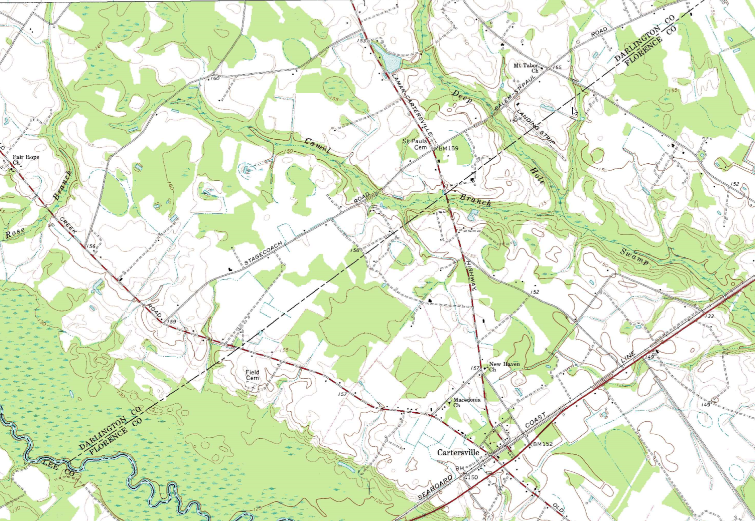

DARLINGTON/FLORENCE
COUNTY LINE RE-ESTABLISHMENT
David Ballard, PLS
Revenue and Fiscal Affairs
Geodetic Survey

Slide 2
SC CODE of LAW
-Section 4-3-170. Darlington County:
“…line to Lynch's River; thence down said river to Sander's Bridge; thence by an air line running to the point where the Cheraw and Darlington Railroad crosses High Hill Creek; thence down High Hill Creek…”
-Section 4-3-260: Florence County:
“…by a line beginning at Sanders' Bridge on Lynch's River running in an air line to a point where the Cheraw and Darlington Railroad crosses High Hill Creek; thence down High Hill Creek…”

Slide 3
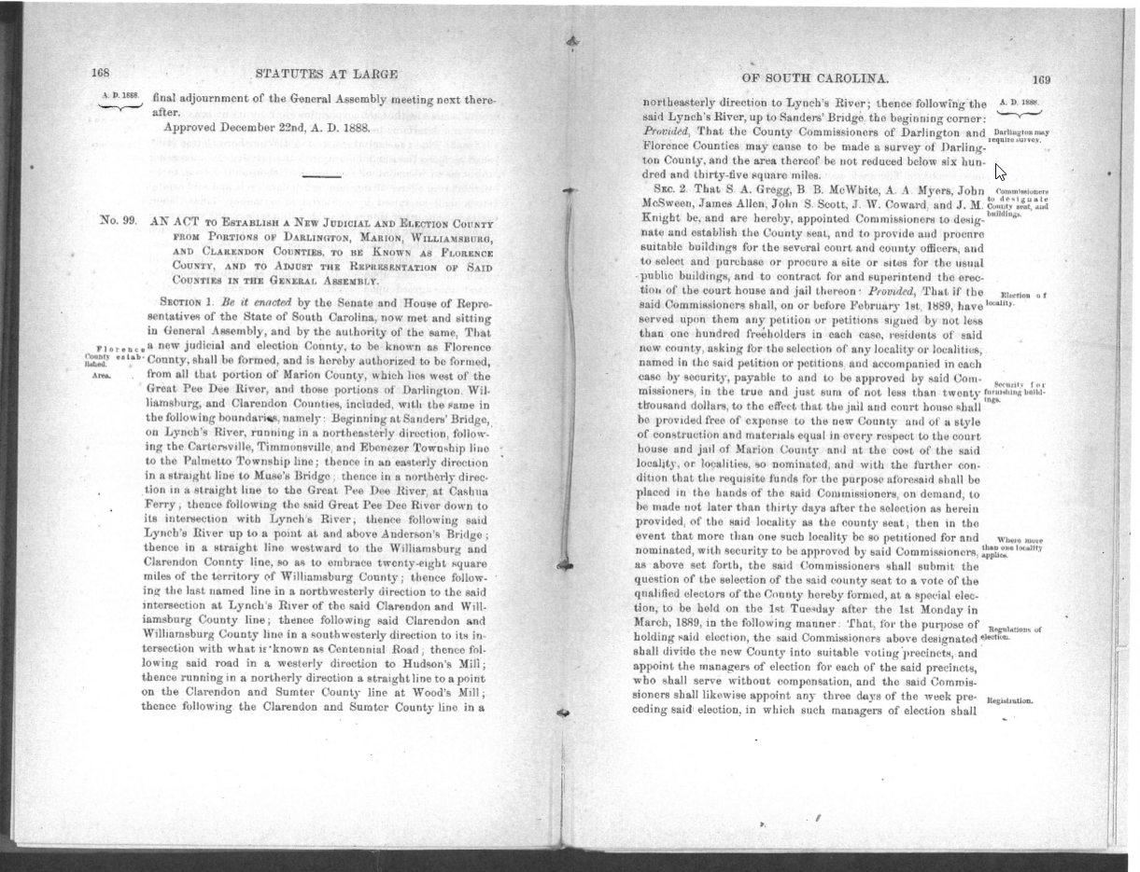
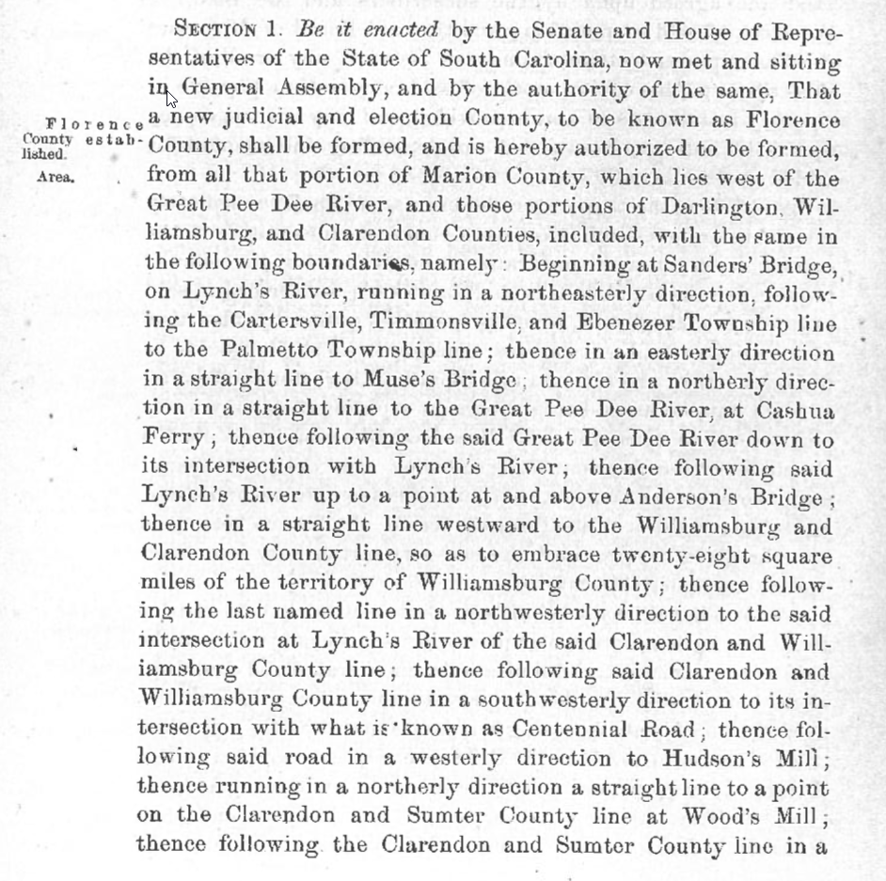
ACT 99 of 1888

Slide 4
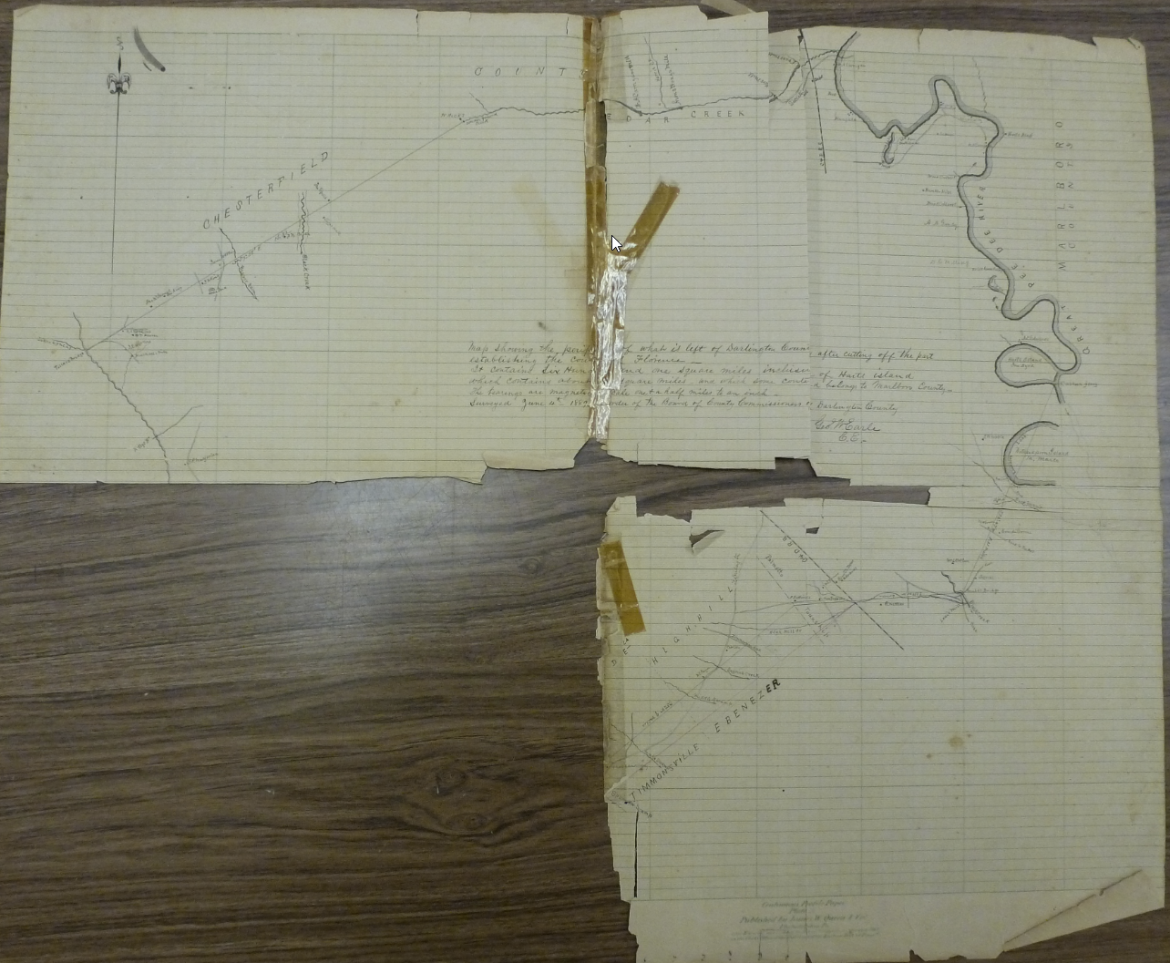
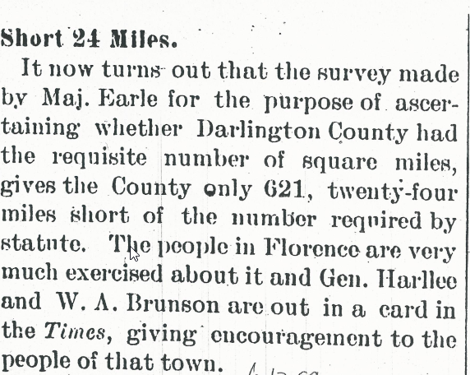
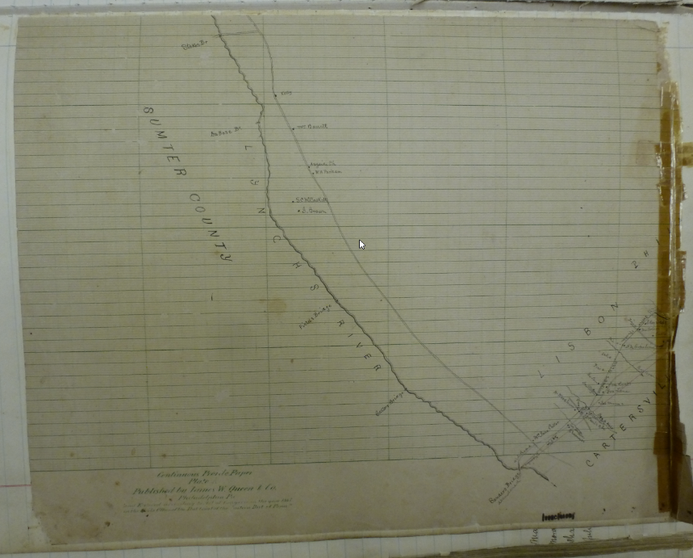
Earle Survey of 1889

Slide 5
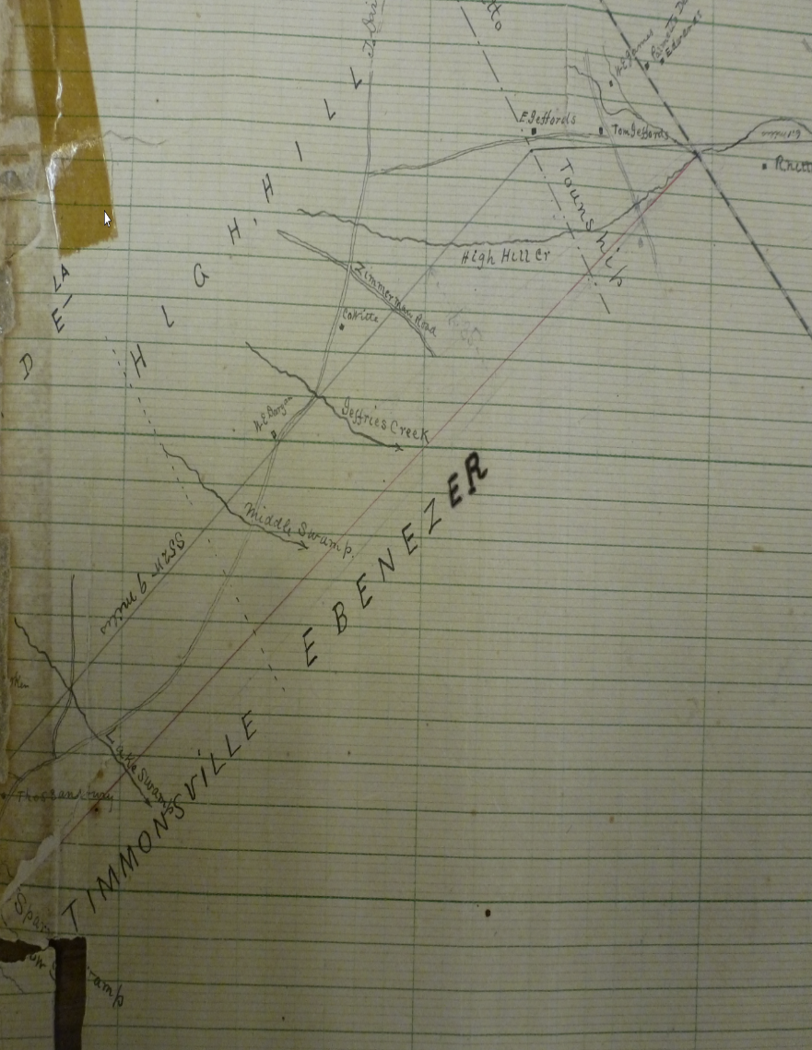
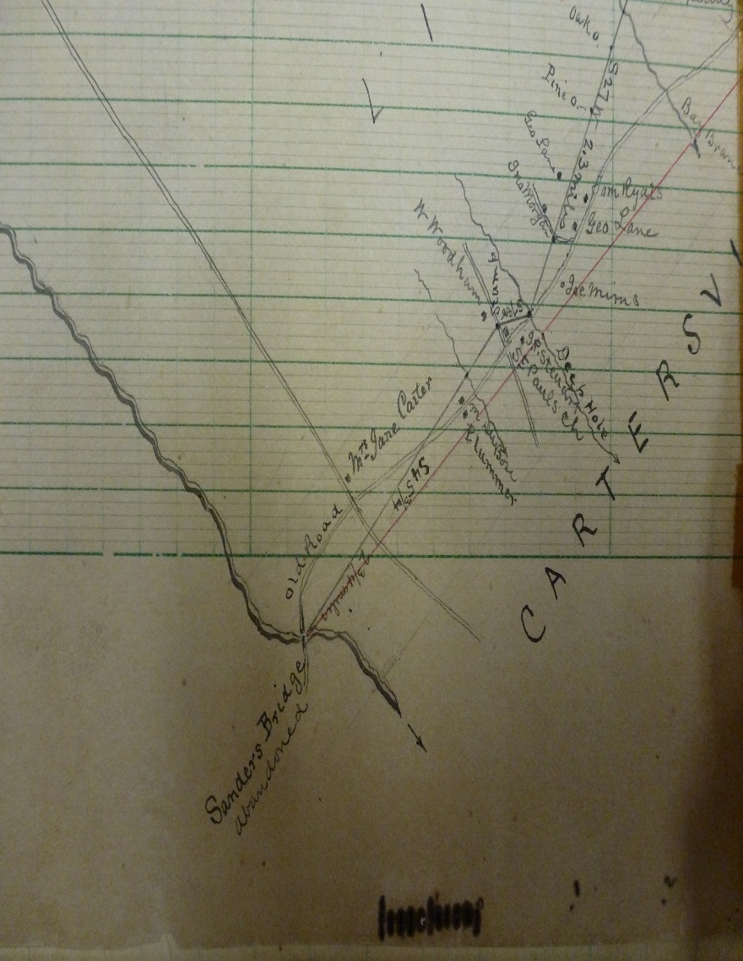
Earle Survey of 1889

Slide 6
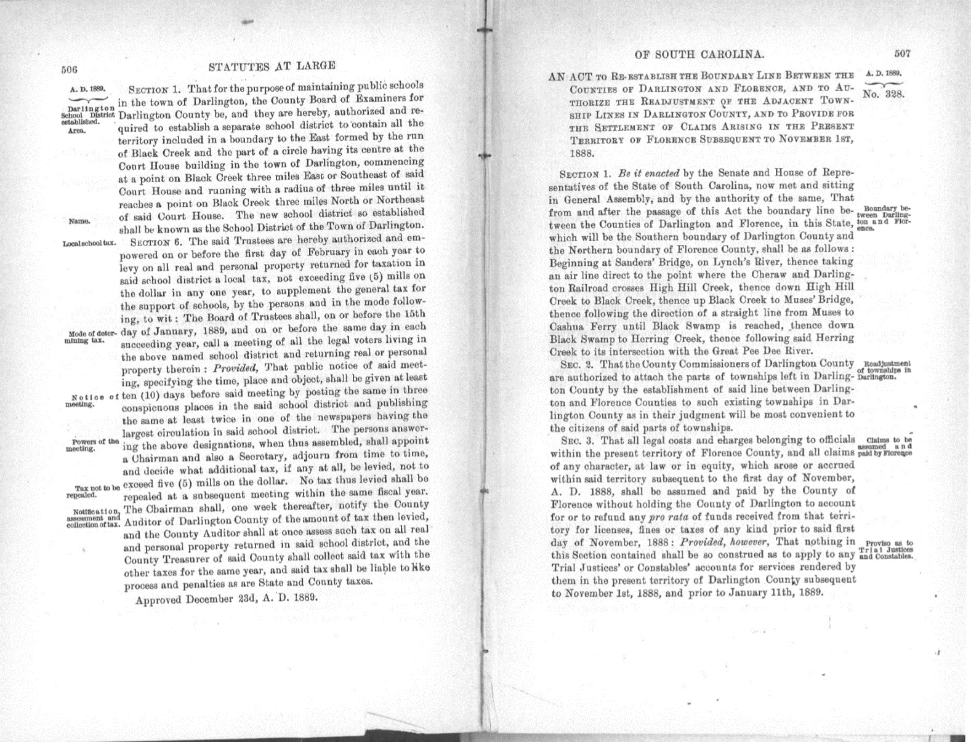
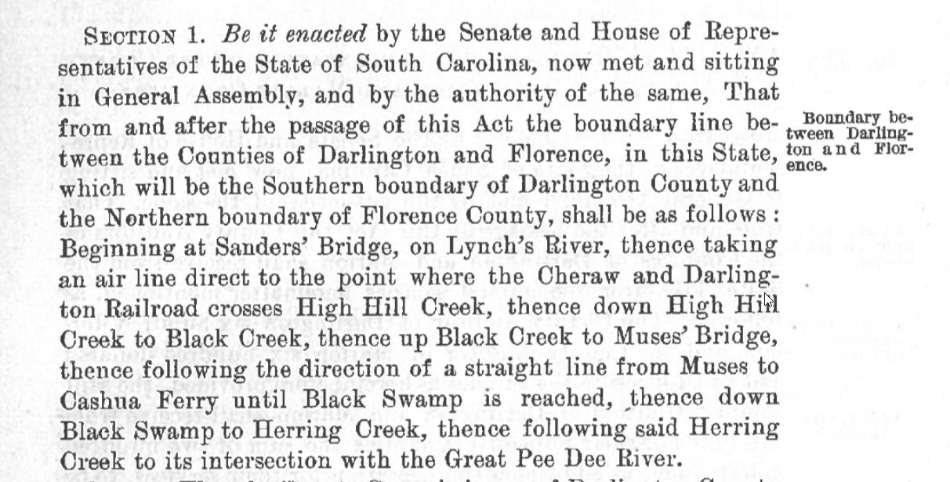
ACT 328 of 1889

Slide 7
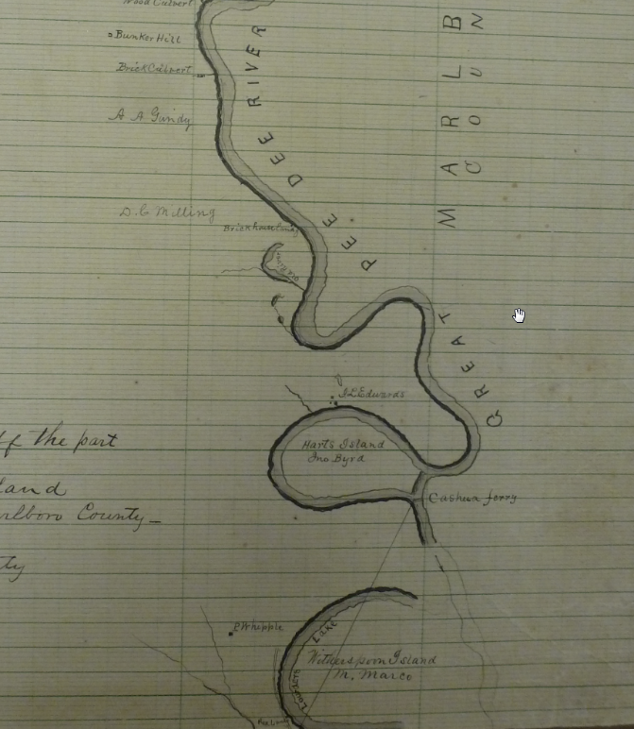
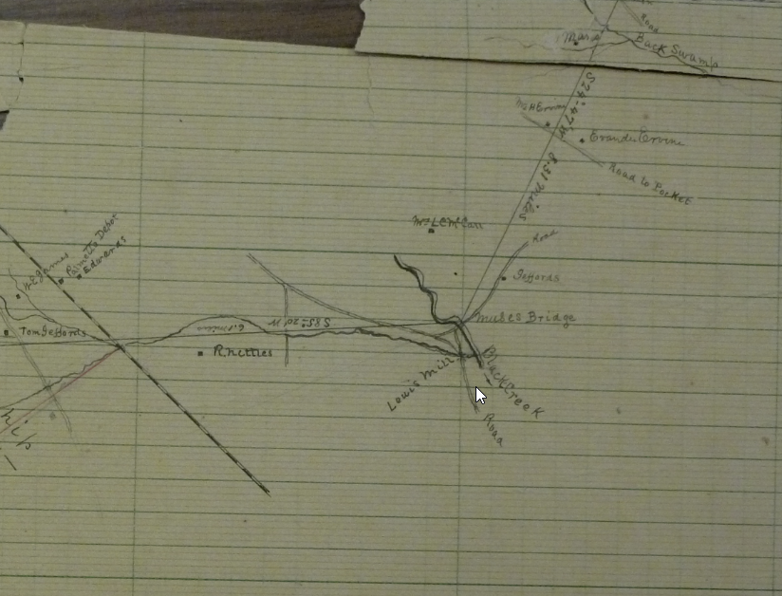
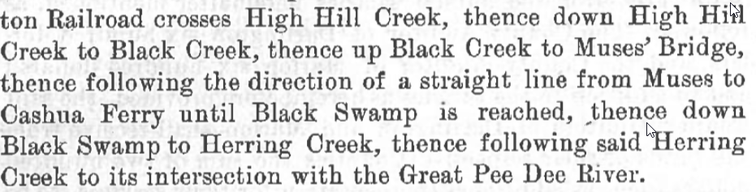
Earle Survey of 1889

Slide 8
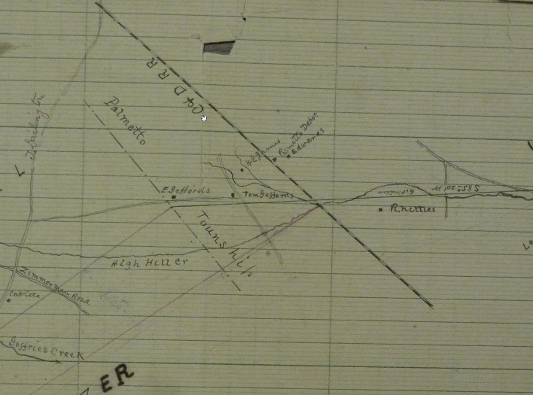
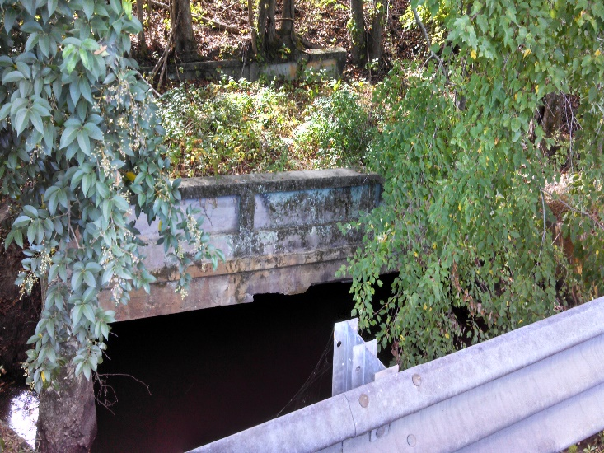
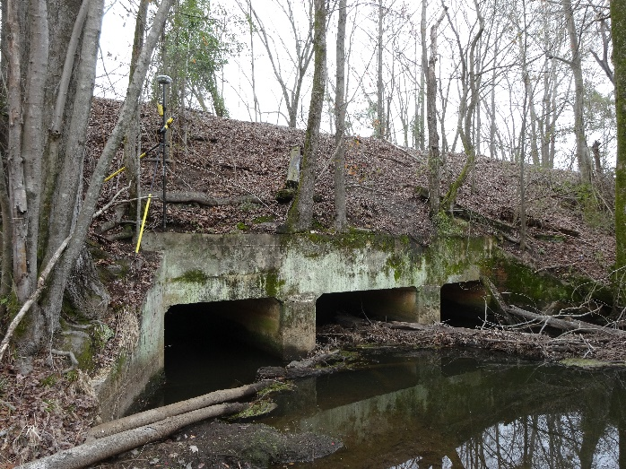
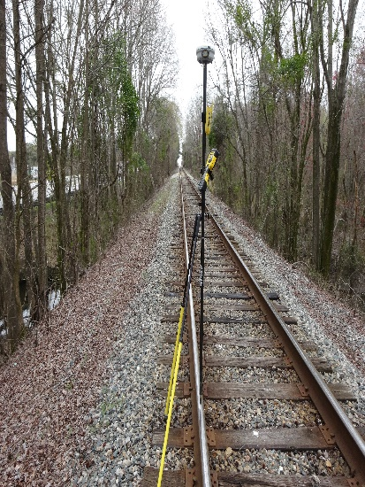
C&D Railroad & High Hill Creek
“bounded as follows: by a line beginning at Sanders' Bridge on Lynch's River; thence by an air line running to the point where the Cheraw and Darlington Railroad crosses High Hill Creek”

Slide 9
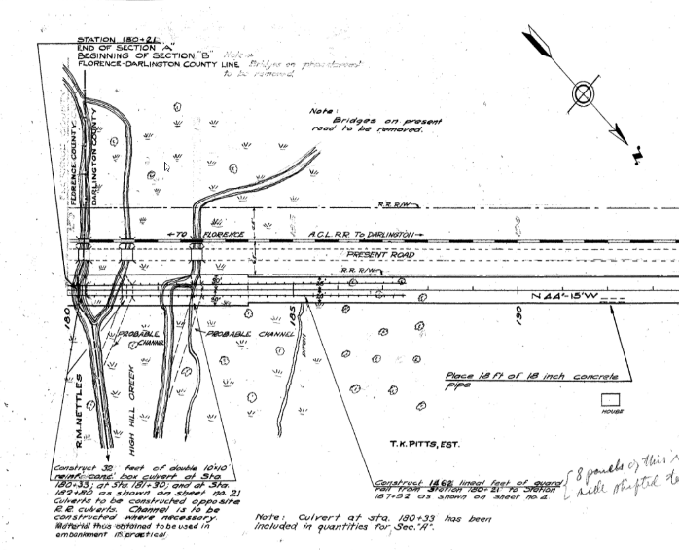
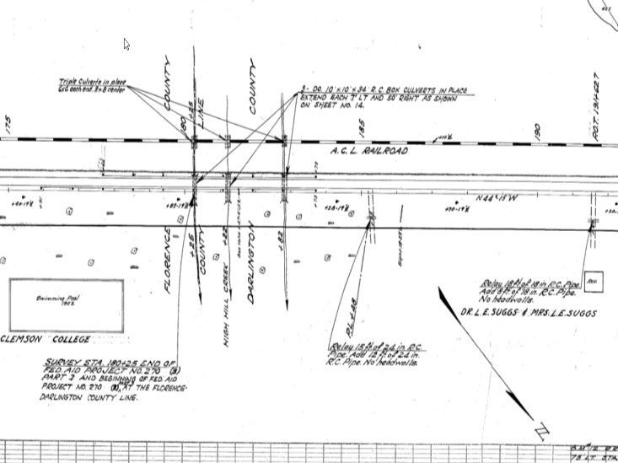
C&D Railroad & High Hill Creek
“bounded as follows: by a line beginning at Sanders' Bridge on Lynch's River; thence by an air line running to the point where the Cheraw and Darlington Railroad crosses High Hill Creek”

Slide 10

Sander’s Bridge on Lynch’s River
“bounded as follows: by a line beginning at Sanders' Bridge on Lynch's River; thence by an air line running to the point where the Cheraw and Darlington Railroad crosses High Hill Creek”

Slide 11
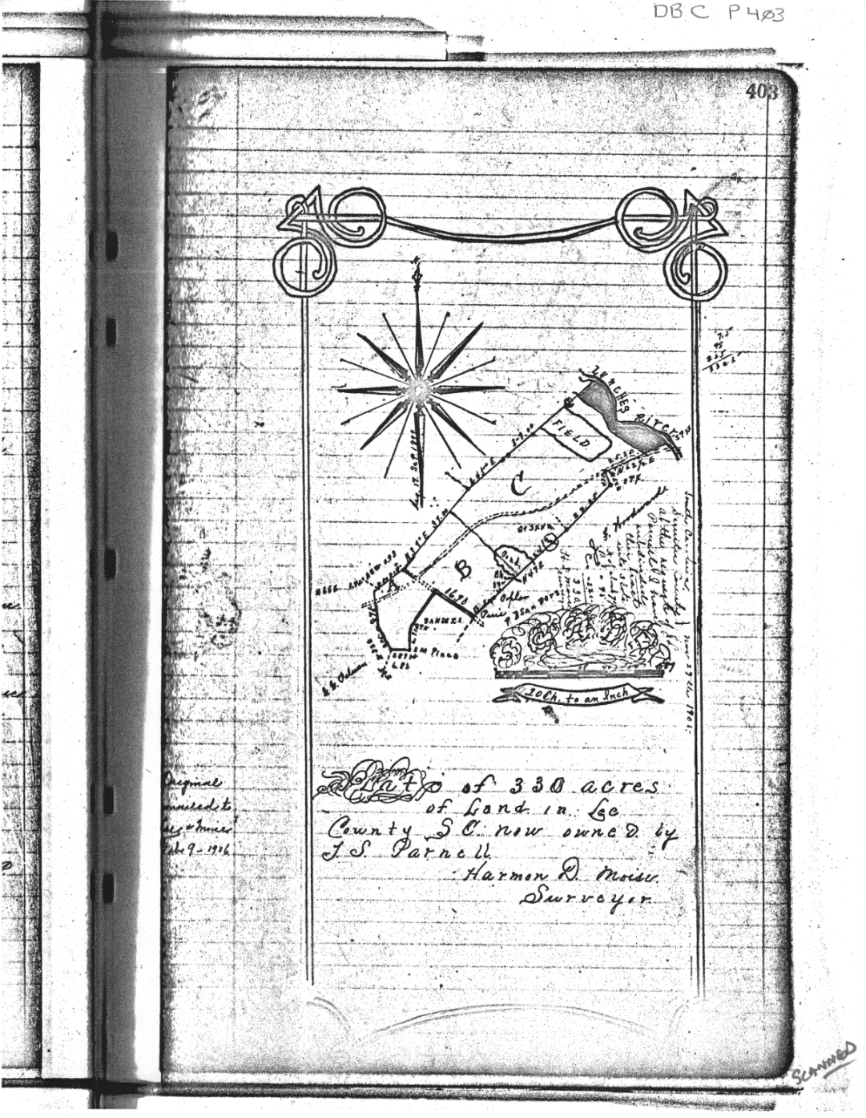
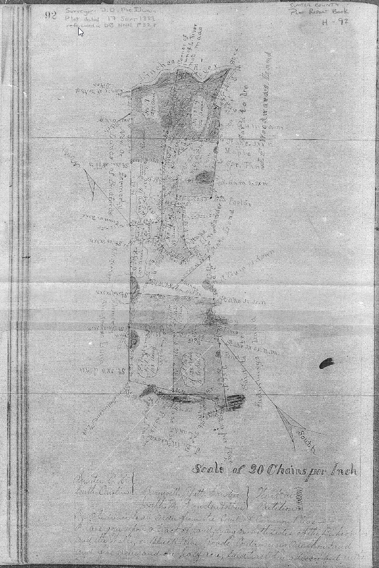
Sander’s Bridge on Lynch’s River
“bounded as follows: by a line beginning at Sanders' Bridge on Lynch's River; thence by an air line running to the point where the Cheraw and Darlington Railroad crosses High Hill Creek”

Slide 12
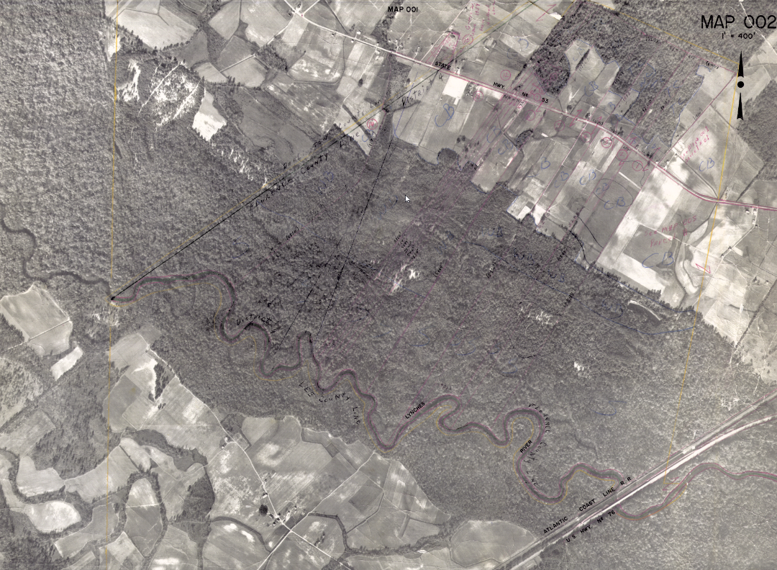
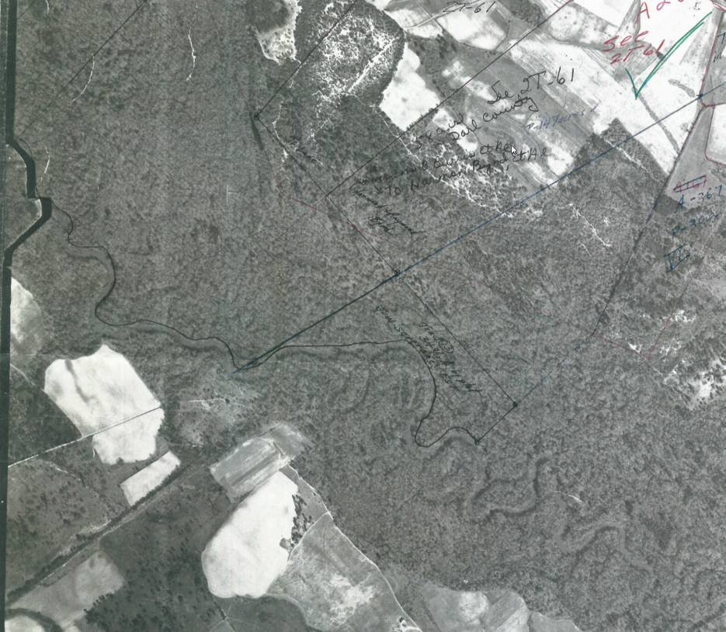
Sander’s Bridge on Lynch’s River
“bounded as follows: by a line beginning at Sanders' Bridge on Lynch's River; thence by an air line running to the point where the Cheraw and Darlington Railroad crosses High Hill Creek”

Slide 13
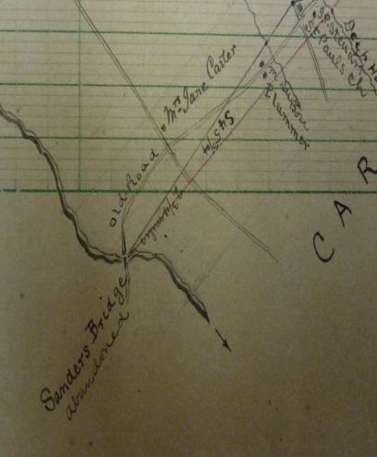
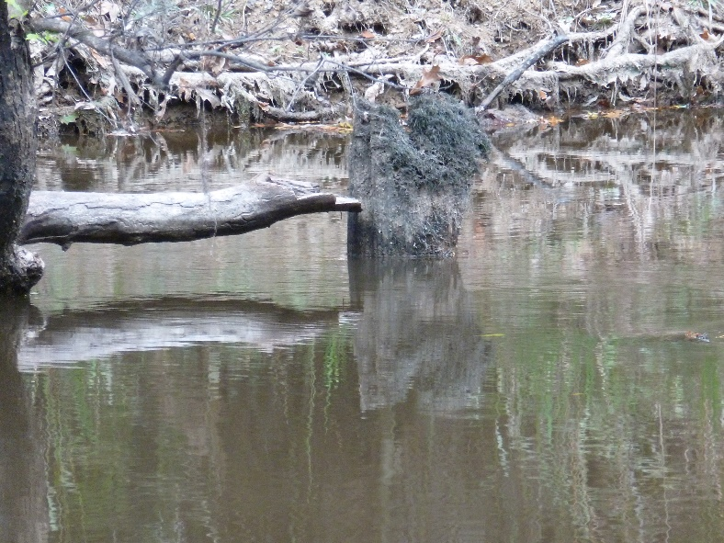
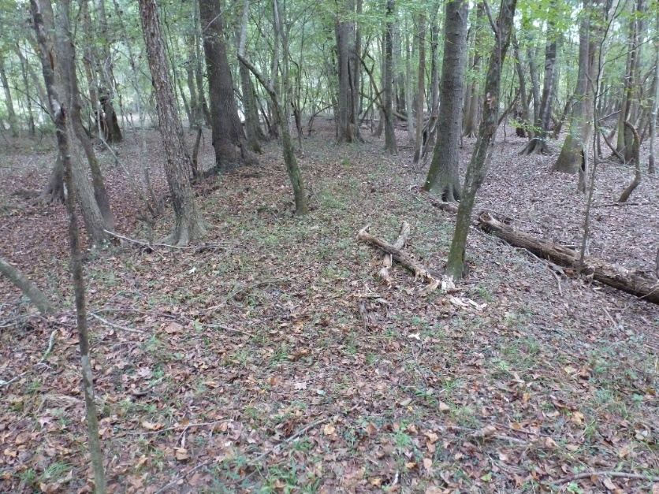
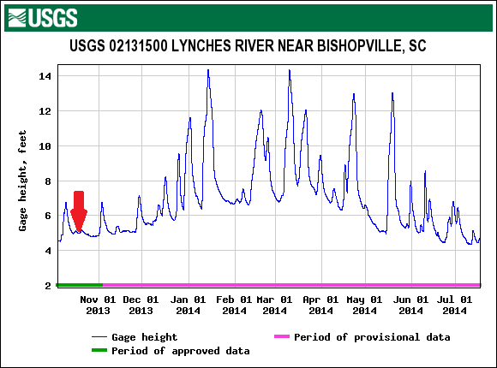
Sander’s Bridge on Lynch’s River
“bounded as follows: by a line beginning at Sanders' Bridge on Lynch's River; thence by an air line running to the point where the Cheraw and Darlington Railroad crosses High Hill Creek”

Slide 14
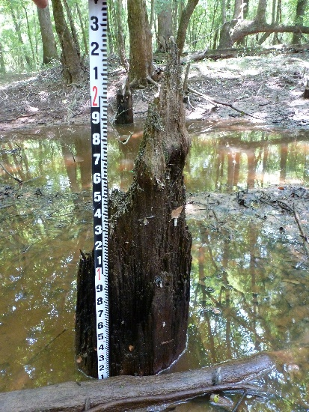
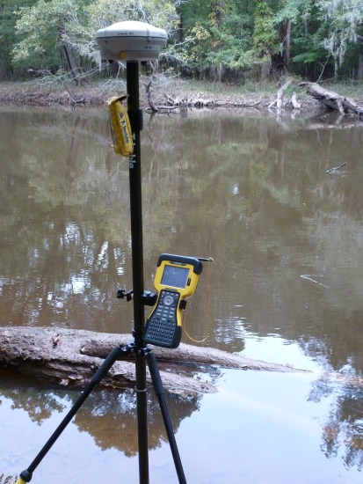
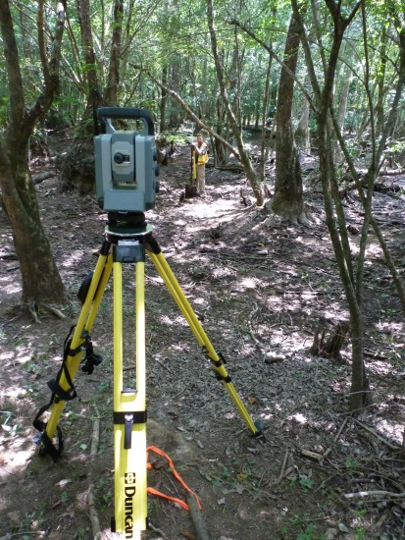
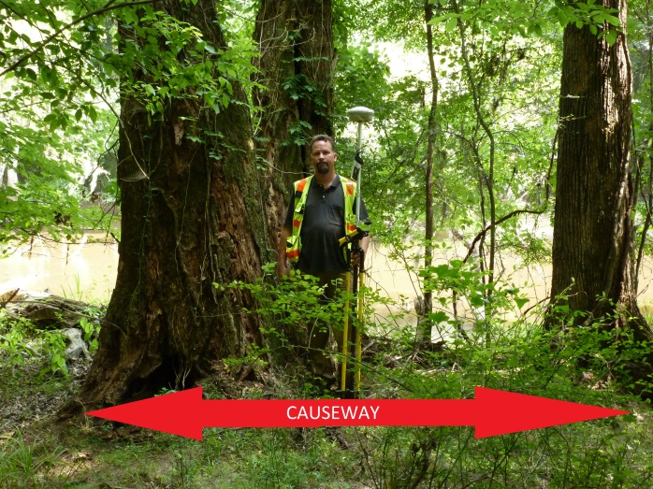
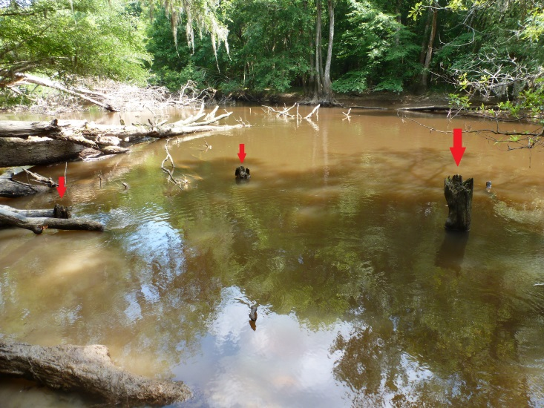
Sander’s Bridge on Lynch’s River
“bounded as follows: by a line beginning at Sanders' Bridge on Lynch's River; thence by an air line running to the point where the Cheraw and Darlington Railroad crosses High Hill Creek”

Slide 15
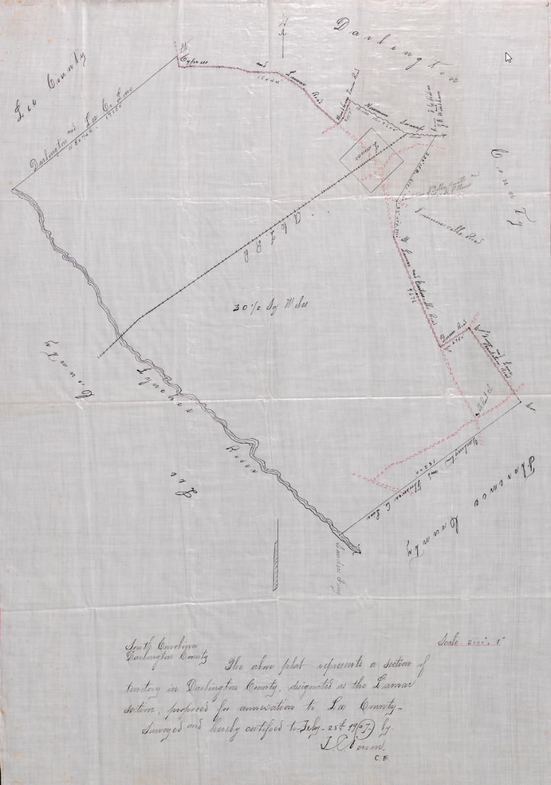
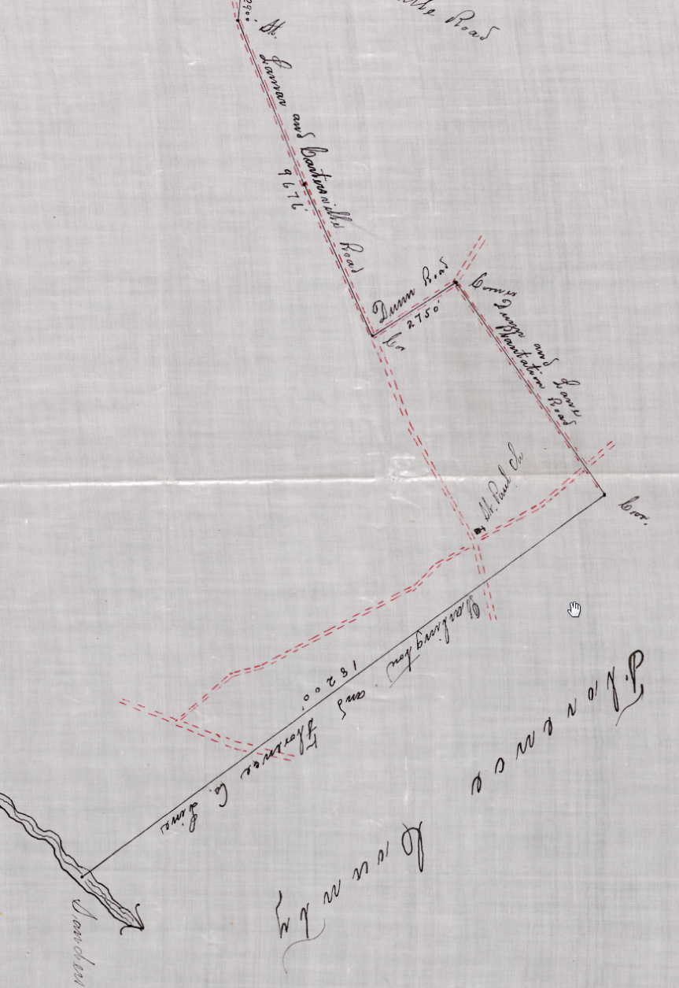
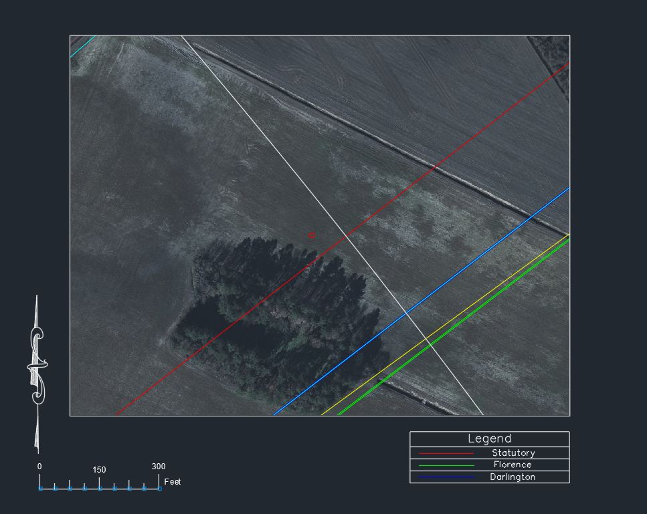
1907 Annexation Attempt

Slide 16
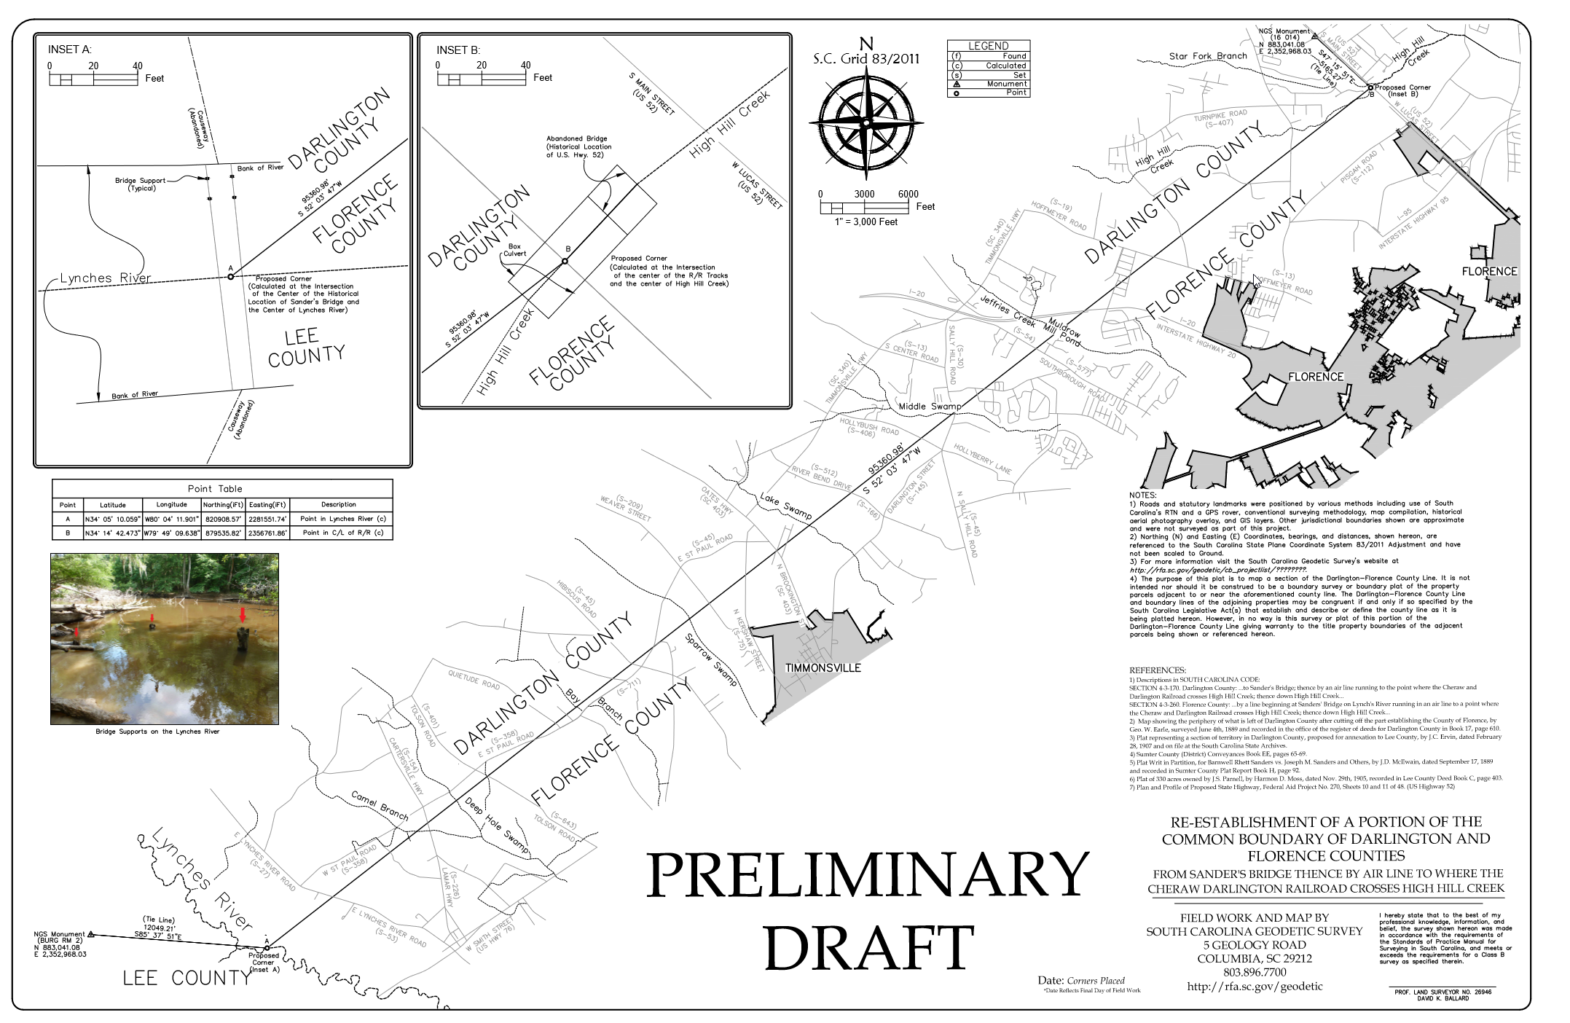
Draft of Current Survey

Slide 17
SC CODE of LAW
-Section 4-3-170. Darlington County:
“…Black Creek to Muse's Bridge; thence following the direction of a straight line running from Muse's Bridge to Cashua's Ferry until Back Swamp is reached…”
-Section 4-3-260: Florence County:
“…up Black Creek to Muse's Bridge; thence following the direction of a straight line running from Muse's Bridge to Cashua's Ferry to Back Swamp…”

Slide 18
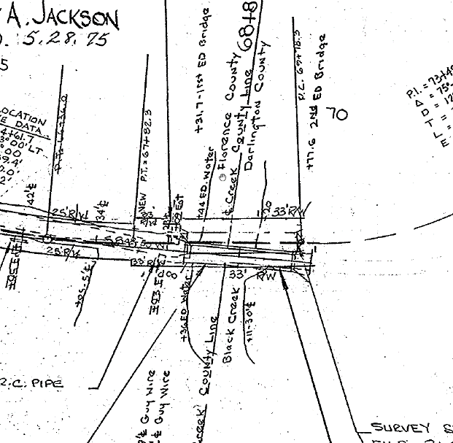
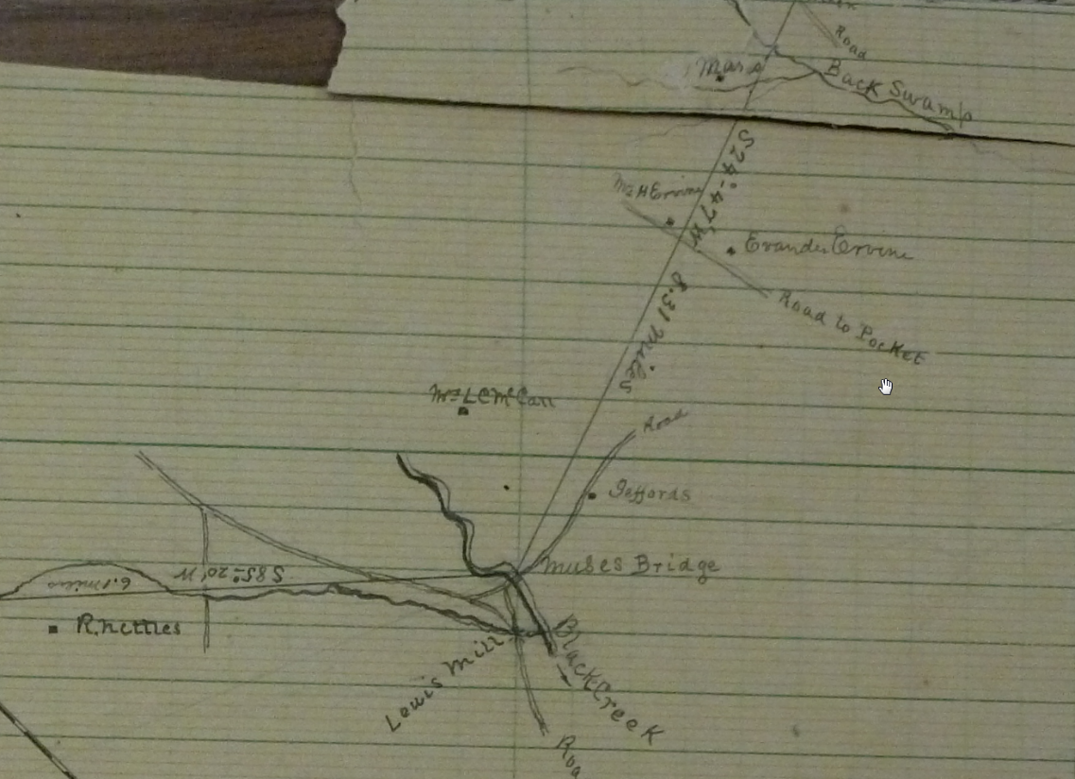
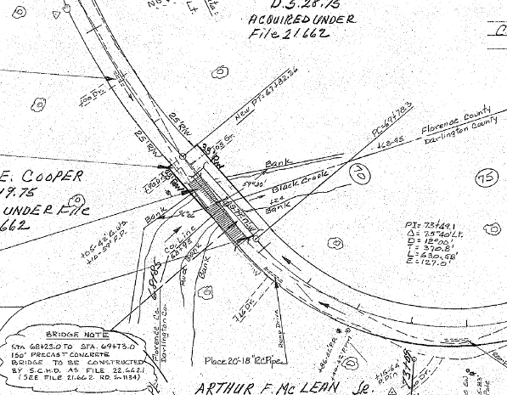
Muse’s Bridge & Black Creek
““…Black Creek to Muse's Bridge; thence following the direction of a straight line running from Muse's Bridge to Cashua's Ferry until Back Swamp is reached…””

Slide 19
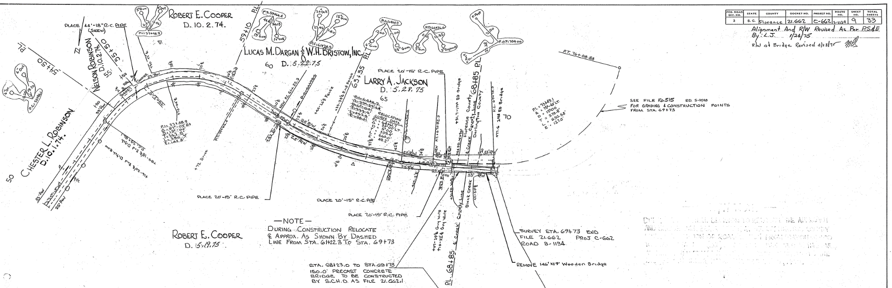
Muse’s Bridge & Black Creek
““…Black Creek to Muse's Bridge; thence following the direction of a straight line running from Muse's Bridge to Cashua's Ferry until Back Swamp is reached…””

Slide 20
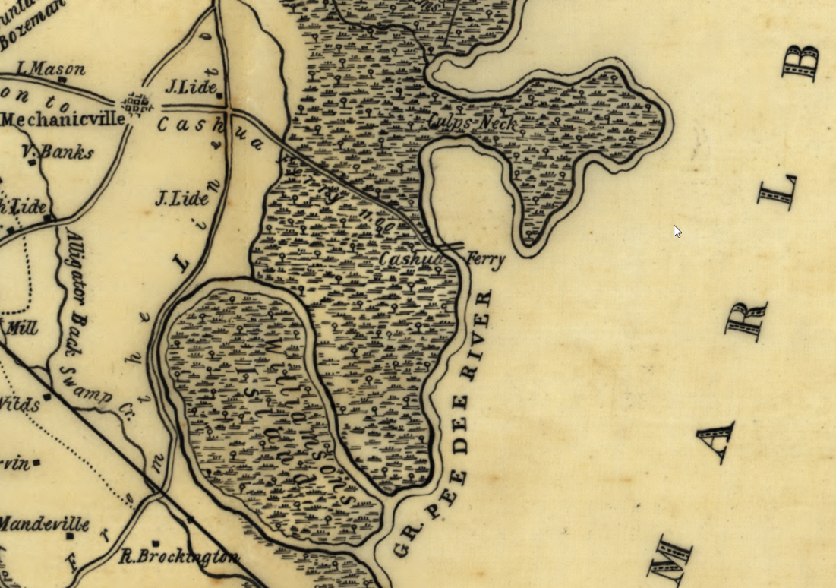
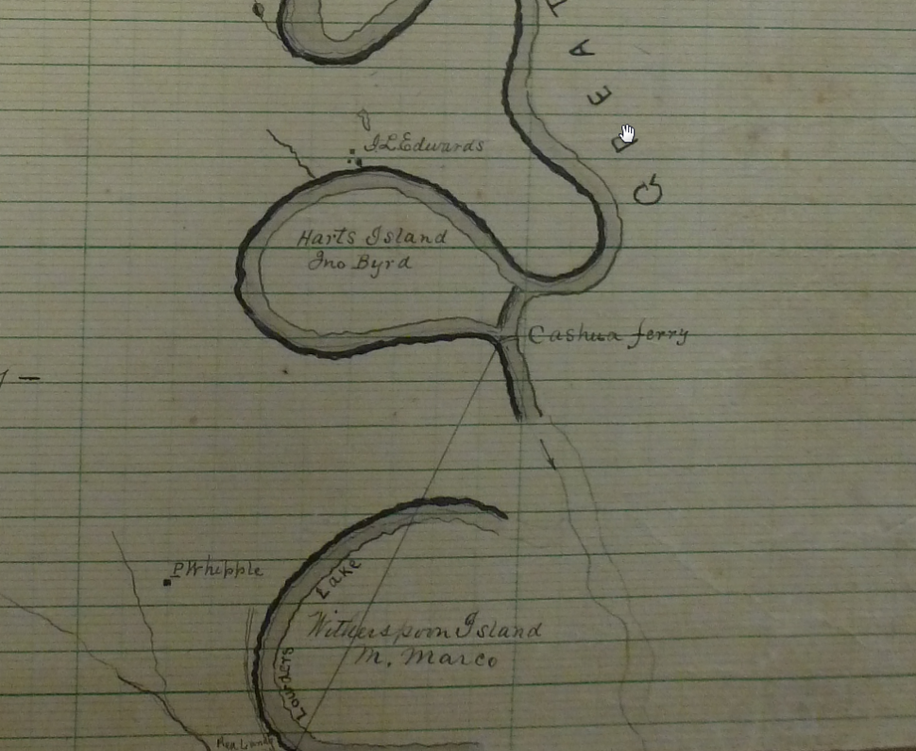
Cashua’s Ferry
““…Black Creek to Muse's Bridge; thence following the direction of a straight line running from Muse's Bridge to Cashua's Ferry until Back Swamp is reached…””

Slide 21
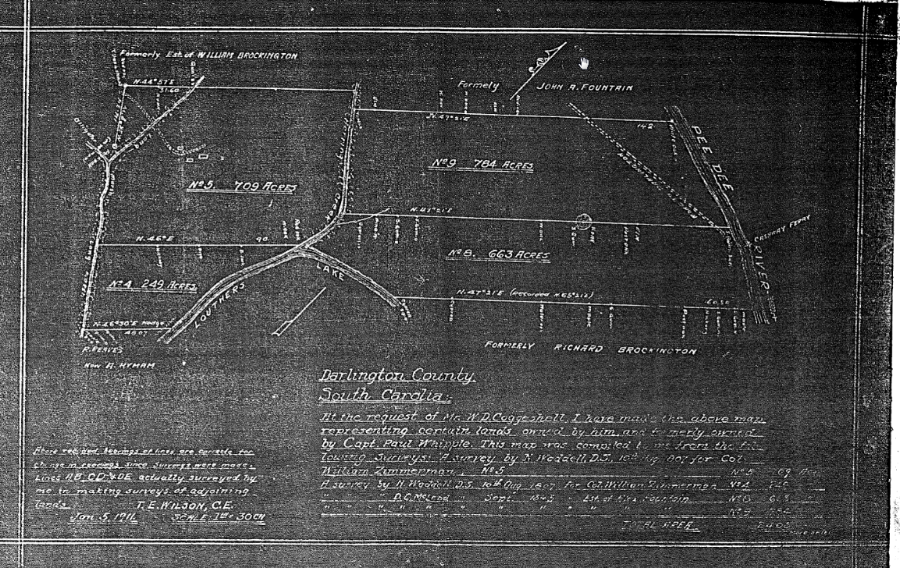
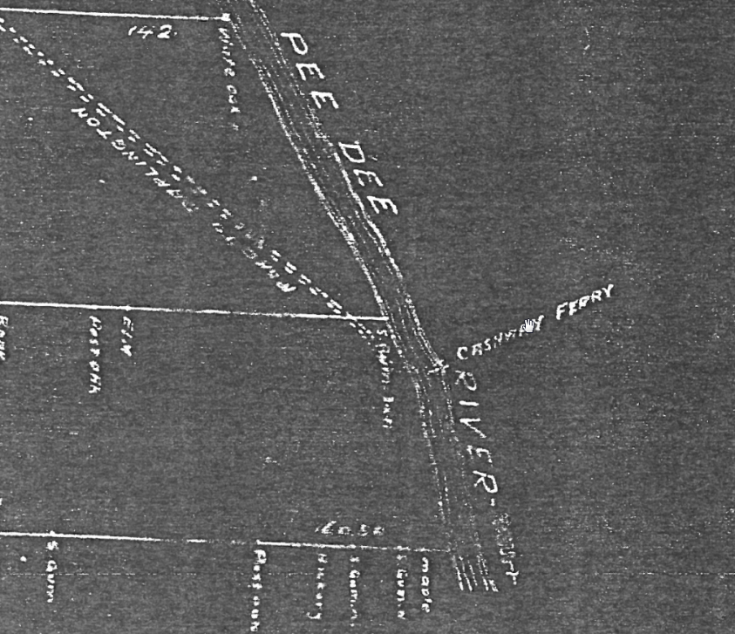
Cashua’s Ferry
““…Black Creek to Muse's Bridge; thence following the direction of a straight line running from Muse's Bridge to Cashua's Ferry until Back Swamp is reached…””

Slide 22
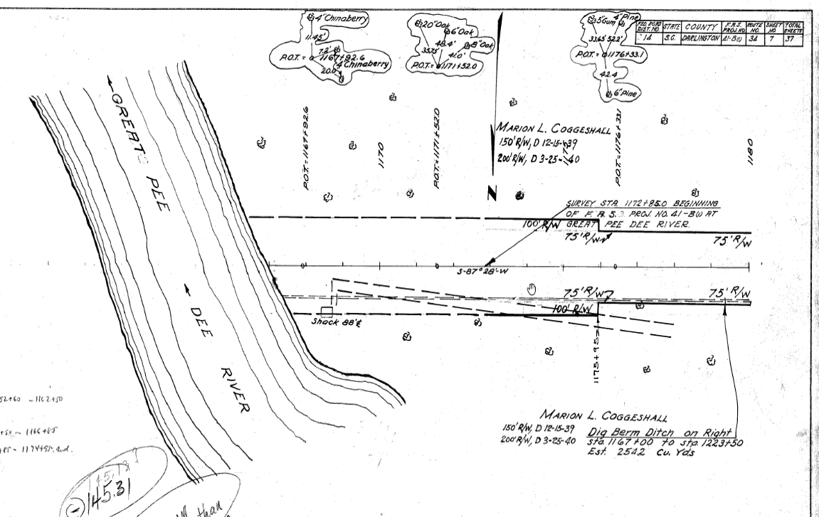
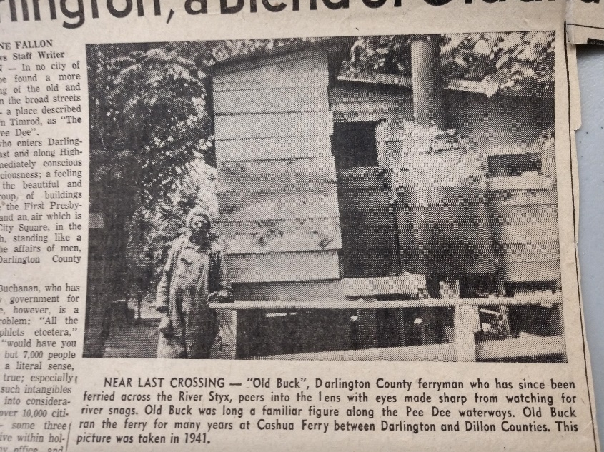
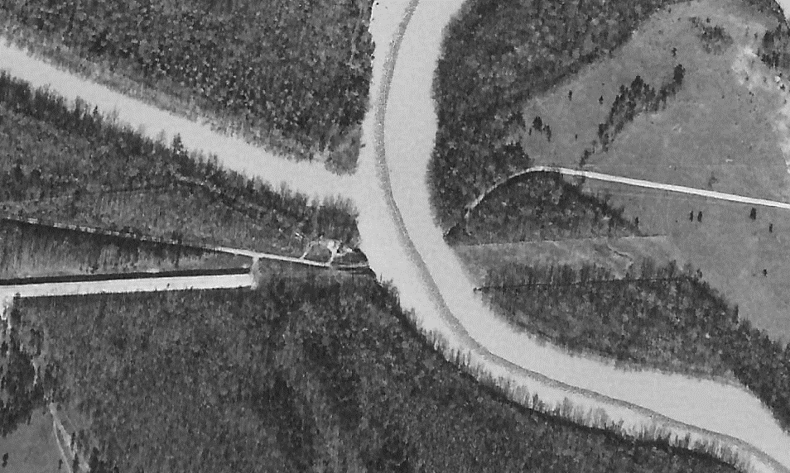
Cashua’s Ferry
““…Black Creek to Muse's Bridge; thence following the direction of a straight line running from Muse's Bridge to Cashua's Ferry until Back Swamp is reached…””

Slide 23
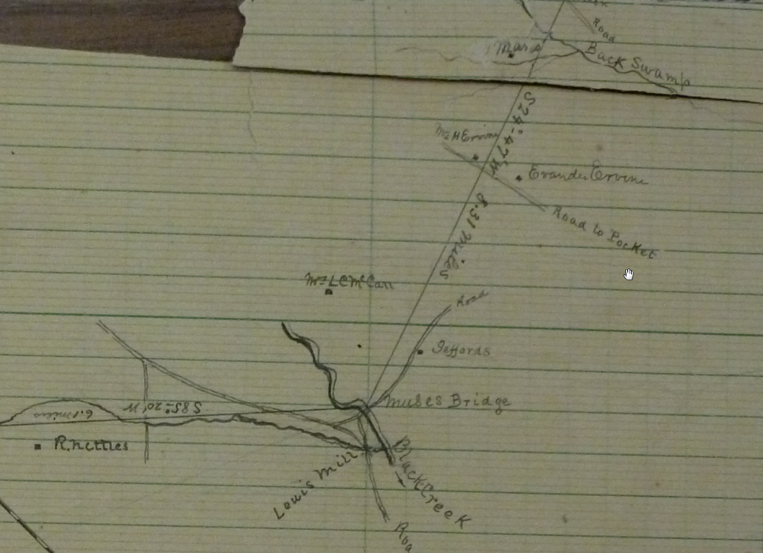
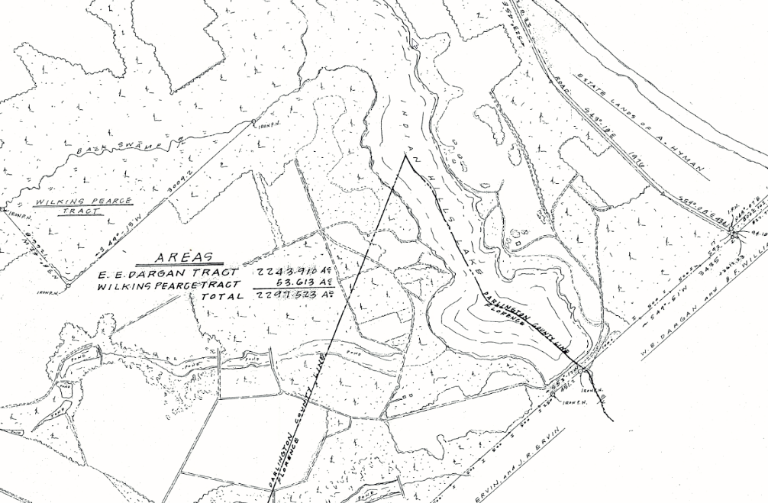
Back Swamp
““…Black Creek to Muse's Bridge; thence following the direction of a straight line running from Muse's Bridge to Cashua's Ferry until Back Swamp is reached…””

Slide 24
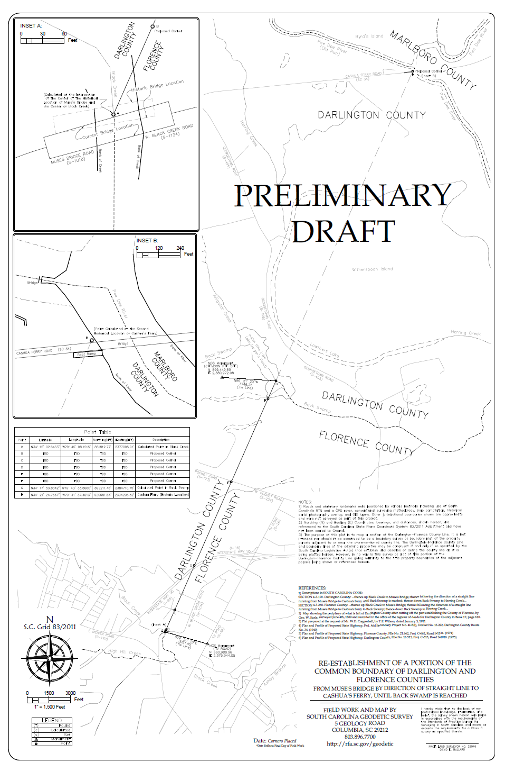
Draft of Current Survey

Slide 25
SC Code of Law and Act 262 Of 2014
Role of South Carolina Geodetic Survey
      (1994) Dispute between two or more counties- SCGS will act as mediator to resolve the dispute
      (1994/2014) SCGS to assist counties in defining and monumenting the locations of county boundaries and positioning the monuments using geodetic surveys where counties are ill-defined, unmarked, or poorly marked
      (2014) SCGS will clarify county boundaries as defined in Chapter 3, Title 4
      (2014) SCGS will analyze archival and other evidence and perform field surveys to position geographically all county boundaries in accordance with statutory descriptions
      (2014) To amend section 27-2-105, Code of Laws of South Carolina, 1976, relating to the duties of the South Carolina Geodetic Survey (SCGS) with respect to determining county boundaries, so as to authorize and direct the SCGS to clarify county boundaries and mediate boundary disputes between counties by providing a procedure allowing the SCGS administratively to adjust county boundaries, to provide the procedures including notice that SCGS must follow in making such adjustments, to provide that affected parties may appeal these adjustments to the Administrative Law Court in a de novo hearing, to provide the method of determining the effective date of these administrative county boundary adjustments and the notice requirements for these adjustments to be effective and to provide that nothing contained in this administrative process restricts the authority of the General Assembly by legislative enactment to adjust or otherwise clarify county boundaries by legislative enactment.
Op. S.C. Atty. Gen. 2016 (S.C.A.G. March 1, 2016)
Op. S.C. Atty. Gen. 2018 (S.C.A.G. May 22, 2018)

Slide 26
Act No. 262 of 2014
An Act to amend Section 27-2-105
Relating to the duties of the SC Geodetic Survey (SCGS) with respect to determining county boundaries
Purpose:
    Exact and precise locations and boundaries of state’s political subdivisions are critical for services, enforcement of property rights and election of public officials.
    Passage of time and growth has led to confusion over statutory county descriptions and the locations of county boundary lines
    Technology exists now to cost-effectively provide definite and permanent markers of boundary lines
    Necessary for state government and political subdivisions
    SCGS is the appropriate instrument to vest with the necessary authority to resolve county boundary issues

Slide 27
Steps for Clarifying Boundaries
Notify County Administrators in advance of planned work
Conduct historical research for documentary evidence of boundaries
Perform field work to locate monuments and corroborating evidence and position on State Plane Coordinates
Share preliminary findings with county officials for impact analysis and to plan public meetings
Receive feedback and input from local officials and public
Review and update findings, as appropriate
Work to build cooperation with affected parties

Slide 28

Public Meeting Notification

Slide 29

Public Meeting Notification

Slide 30
Scatter Gram of Differences
Between Observations
2 – Five Minute Sessions
RMSE(2-D) = 0.020m @95%
0.015m = ~0.05’
Axis Units in Meters

Slide 31

Scatter Gram of Differences
Between Observations
2 – Five Minute Sessions
RMSE(2-D) = 0.020m @95%
0.015m = ~0.05’
Axis Units in Meters

Slide 32
Act 262 of 2014
Steps for Clarifying Boundaries
SC Code of Law SECTION 27-2-105
SCGS Requirements:
    Upon reestablishing county boundary, SCGS shall certify its work and within 30 days of certification:
        Provide copies to the administrator of each affected county;
        Provide written notification to affected parties
        Provide notice and copies to the public through its official website and or other means it considers appropriate; and
        Notify as it determines appropriate, other affected state and federal agencies
    (Initiates 60 Day Appeal Process)
  Certified Surveys submitted to Secretary of State, Register of Deeds Offices, and South Carolina Department of Archives with Cover Letter
  Date of the cover letter is the date the surveys become effective
  Introduce Legislation to update Code of Law to reflect clarified boundary with State Plane Coordinates

Slide 33
SC Code of Law SECTION 27-2-105
Affected Parties Disagreeing with SCGS:
    May file request for a contested case hearing with the SC Administrative Law Court
    This decision may be appealed
    “Affected Party”
              Governing body of an affected county
              Governing body of a political subdivision of this State
              An elected official, other than a statewide elected official
              A property owner or an individual residing in the certification zone
              A business entity located in the certification zone
              A nonresident individual who owns or leases real property situated in the certification zone

Slide 34
Chapter 5, Title 4
Change of Boundaries
  S.C. Code § 4-5-120: Procedure for annexing part of county- governing body or 10 percent of registered voters petition in writing, shall deposit with the clerk of court an amount of money sufficient to cover the expenses of surveys , plats, annexation commission and the election to be held to determine whether the proposed annexation shall be effected and then file such resolution or petition in the office of the clerk of court
  S.C. Code § 4-5-130: Appointment of Commission for annexation- once presented to the governor then within 30 days the governor shall appoint a commission of four persons
  S.C. Code § 4-5-140: Employment of Surveyors- commission may contract for survey and location of the proposed change of line and for such purpose may employ 3 surveyors
  S.C. Code § 4-5-170: Governor shall order election; voting place; eligible electors- to be held in an area sought to be transferred and an election to be held in the county to which the area is proposed to be transferred
  Propose and adopt Legislation

Slide 35
QUESTIONS?
Email: Boundary@rfa.sc.gov
Website: rfa.sc.gov/programs-services/geodetic/county

