Slide 1
LEXINGTON SALUDA COUNTY LINE RE-ESTABLISHMENT
David Ballard, PLS South Carolina Revenue and Fiscal Affairs Office
Geodetic Survey 1000 Assembly Street Rembert Dennis Building, Suite 421 Columbia, SC 29201 (803) 734-2265 www.rfa.sc.

Slide 2
Act No. 262 of 2014
An Act to amend South Carolina Code of Laws §27-2-105
Relating to the duties of the SC Geodetic Survey (SCGS) with respect to determining county boundaries
Purpose:
Exact and precise locations and boundaries of state’s political subdivisions are critical for services, enforcement of property rights and election of public officials.
Passage of time and growth has led to confusion over statutory county descriptions and the locations of county boundary lines
Technology exists now to cost-effectively provide definite and permanent markers of boundary lines
Necessary for state government and political subdivisions
SCGS is the appropriate instrument to vest with the necessary authority to resolve county boundary issues

Slide 3
SC Code of Laws and Act 262 of 2014
Role of South Carolina Geodetic Survey
(1994) Dispute between two or more counties- SCGS will act as mediator to resolve the dispute
(1994/2014) SCGS to assist counties in defining and monumenting the locations of county boundaries and positioning the monuments using geodetic surveys where counties are ill-defined, unmarked, or poorly marked
(2014) SCGS will clarify county boundaries as defined in Chapter 3, Title 4
(2014) SCGS will analyze archival and other evidence and perform field surveys to position geographically all county boundaries in accordance with statutory descriptions
(2014) To amend section 27-2-105, Code of Laws of South Carolina, 1976, relating to the duties of the South Carolina Geodetic Survey (SCGS) with respect to determining county boundaries, so as to authorize and direct the SCGS to clarify county boundaries and mediate boundary disputes between counties by providing a procedure allowing the SCGS administratively to adjust county boundaries, to provide the procedures including notice that SCGS must follow in making such adjustments, to provide that affected parties may appeal these adjustments to the Administrative Law Court in a de novo hearing, to provide the method of determining the effective date of these administrative county boundary adjustments and the notice requirements for these adjustments to be effective and to provide that nothing contained in this administrative process restricts the authority of the General Assembly by legislative enactment to adjust or otherwise clarify county boundaries by legislative enactment.
Op. S.C. Atty. Gen. 2016 (S.C.A.G. March 1, 2016)
Op. S.C. Atty. Gen. 2018 (S.C.A.G. May 22, 2018)

Slide 4
Steps for Clarifying Boundaries
Conduct historical research for documentary evidence of boundaries
Perform field work to locate monuments and corroborating evidence and position on State Plane Coordinates
Share preliminary findings with county officials for impact analysis and to plan public meetings
Receive feedback and input from local officials and public
Review and update findings, as appropriate
Work to build cooperation with affected parties

Slide 5
Public Meeting Notification (Example)

Slide 6
Public Meeting Notification (Example)

Slide 7
Scatter Gram of Differences Between Observations 2 – Five Minute Sessions
RMSE(2-D) = 0.020m @95%
0.015m = ~0.05’
Axis Units in Meters

Slide 8
Scatter Gram of Differences Between Observations 2 – Five Minute Sessions
RMSE(2-D) = 0.020m @95%
0.015m = ~0.05’
Axis Units in Meters

Slide 9
Steps for Clarifying Boundaries SC Code of Laws §27-2-105
SCGS Requirements:
Upon re-establishing a county boundary, SCGS shall certify its work and within 30 days of certification:
Provide copies to the administrator of each affected county;
Provide written notification to affected parties
Provide notice and copies to the public through its official website and or other means it considers appropriate; and
Notify as it determines appropriate, other affected state and federal agencies (Initiates 60 Day Appeal Process)
Certified Surveys submitted to Secretary of State, Register of Deeds Offices, and South Carolina Department of Archives with Cover Letter
Date of the cover letter is the date the surveys become effective
Introduce Legislation to update Code of Law to reflect clarified boundary with State Plane Coordinates

Slide 10
SC Code of Laws §27-2-105
Affected Parties Disagreeing with SCGS:
May file request for a contested case hearing with the SC Administrative Law Court
This decision may be appealed
“Affected Party”
Governing body of an affected county
Governing body of a political subdivision of this State
An elected official, other than a statewide elected official
A property owner or an individual residing in the certification zone
A business entity located in the certification zone
A nonresident individual who owns or leases real property situated in the certification zone

Slide 11
Chapter 5, Title 4
Change of Boundaries
S.C. Code of Laws § 4-5-120: Procedure for annexing part of county- governing body or 10 percent of registered voters petition in writing, shall deposit with the clerk of court an amount of money sufficient to cover the expenses of surveys , plats, annexation commission and the election to be held to determine whether the proposed annexation shall be effected and then file such resolution or petition in the office of the clerk of court
S.C. Code of Laws § 4-5-130: Appointment of Commission for annexation- once presented to the governor then within 30 days the governor shall appoint a commission of four persons
S.C. Code of Laws § 4-5-140: Employment of Surveyors- commission may contract for survey and location of the proposed change of line and for such purpose may employ 3 surveyors
S.C. Code of Laws § 4-5-170: Governor shall order election; voting place; eligible electors- to be held in an area sought to be transferred and an election to be held in the county to which the area is proposed to be transferred
Propose and adopt Legislation

Slide 12
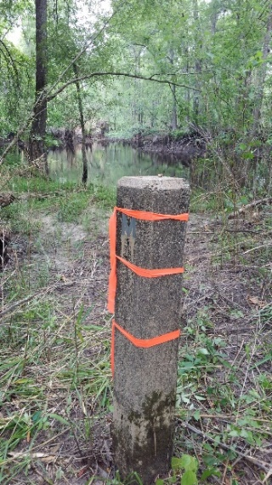
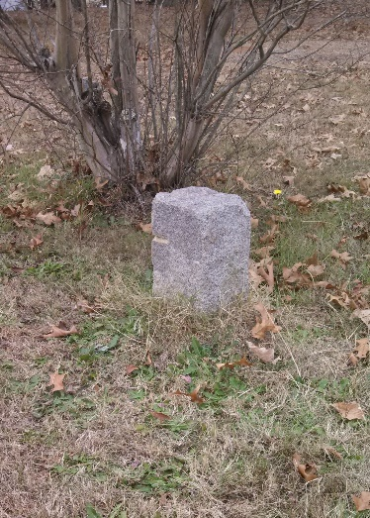
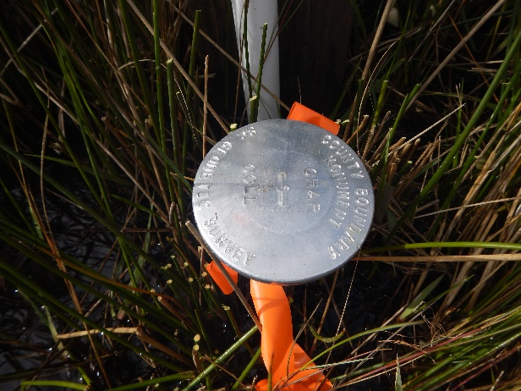
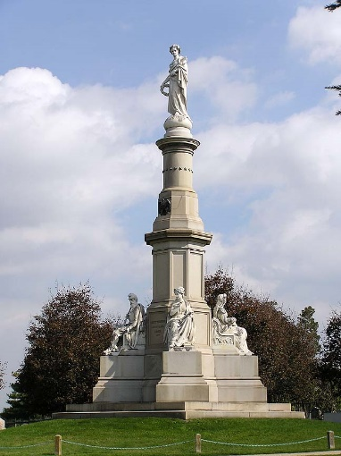
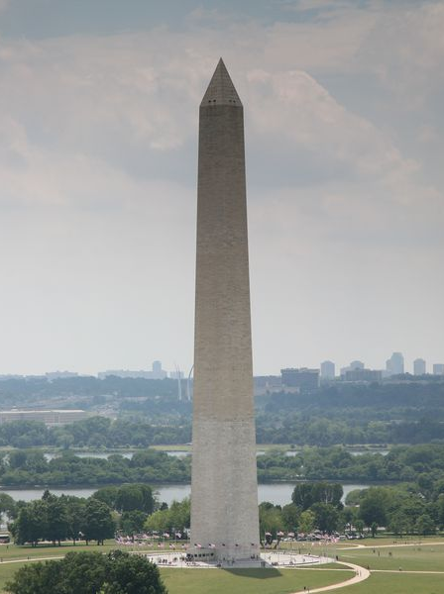
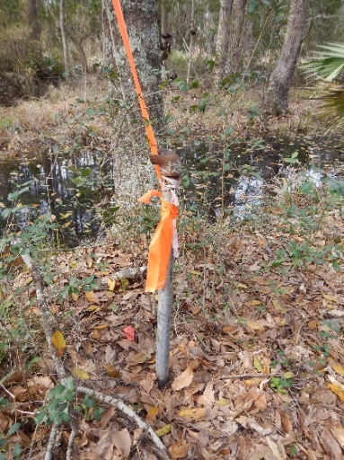
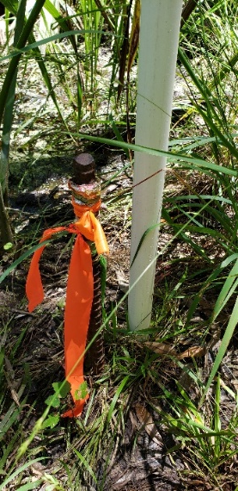
MONUMENTS
VS
MONUMENTS

Slide 13
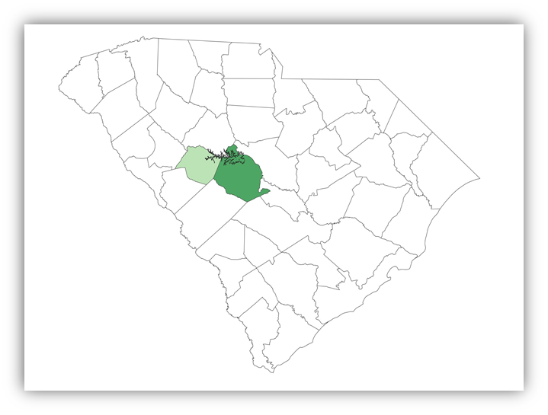
South Carolina Geodetic Survey County Boundary Project
Portion of Lexington and Saluda Common Boundary
Re-establishment Presentation

Slide 14
The Following Section Prepared by Glenn Associates Surveying, Inc. 11547 State Highway 215 S P.O. Box 12 Jenkinsville, South Carolina 29065 (803) 345.5297 www.glennassociates.com
South Carolina Licensed Professional Land Surveyor
Brian B. Bonds, SCPLS #28582

Slide 15
Introduction
Glenn Associates Surveying has been in business in South Carolina for almost 50 years. The company was founded in 1972 as Glenn Brothers Land Surveying Company and became Glenn Associates Land Surveying Company in 1980, forming a partnership between Michael R. Mills, Mark E. Mills, and William T. Glenn, III. When Mr. Glenn retired in 2000, Michael R. Mills, Sr. and Mark E. Mills elected to form the current corporation, Glenn Associates Surveying, Inc., located in Jenkinsville, South Carolina.

Slide 16
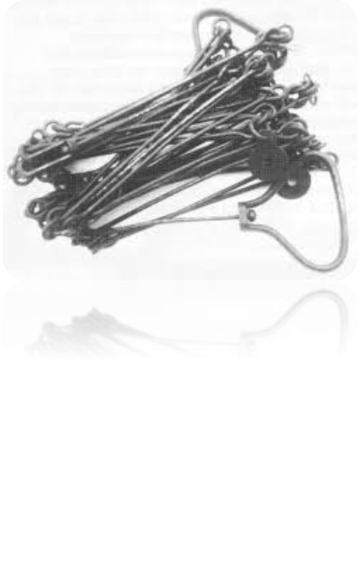
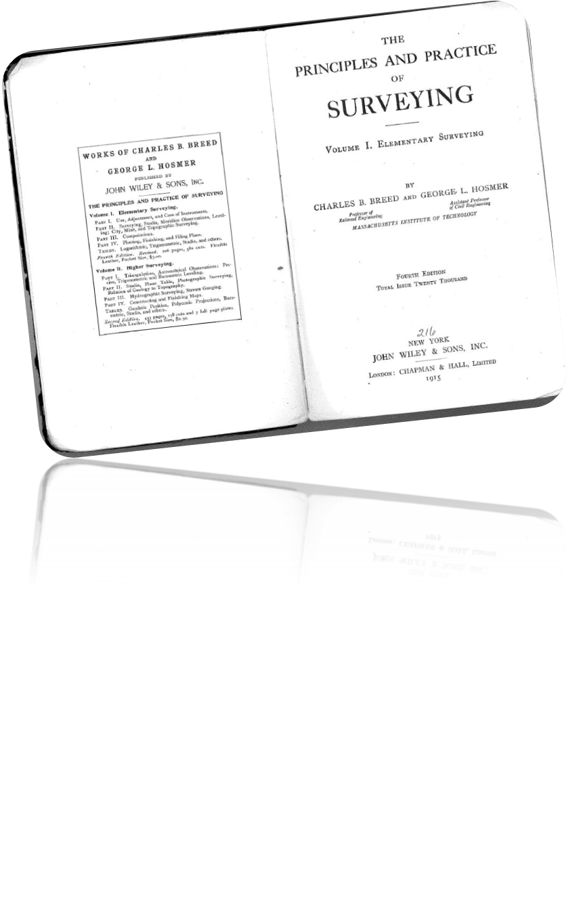
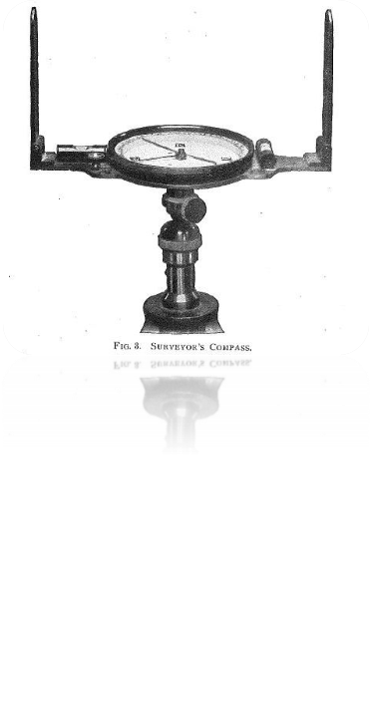
Historic Principles

Slide 17
Methodology
Glenn Associates has based their surveys on the SC State Plane Coordinate System for over forty years and currently uses the latest technology available in GNSS equipment. Our practice is to tie our work to existing NGS Monumentation and the SC State Plane Coordinate System using the SC Real Time Network.

Slide 18
County Boundary Re-establishment
This is a list of items used to prepare the plats:
Field survey data; using modern surveying practices
Physical evidence on or near the County Boundary
South Carolina Code of Laws
S. C. Archive Documents
Plats of Record
SCDOT Highway Plans
USGS Quadrangle Maps
Soil Surveys
Reference material

Slide 19
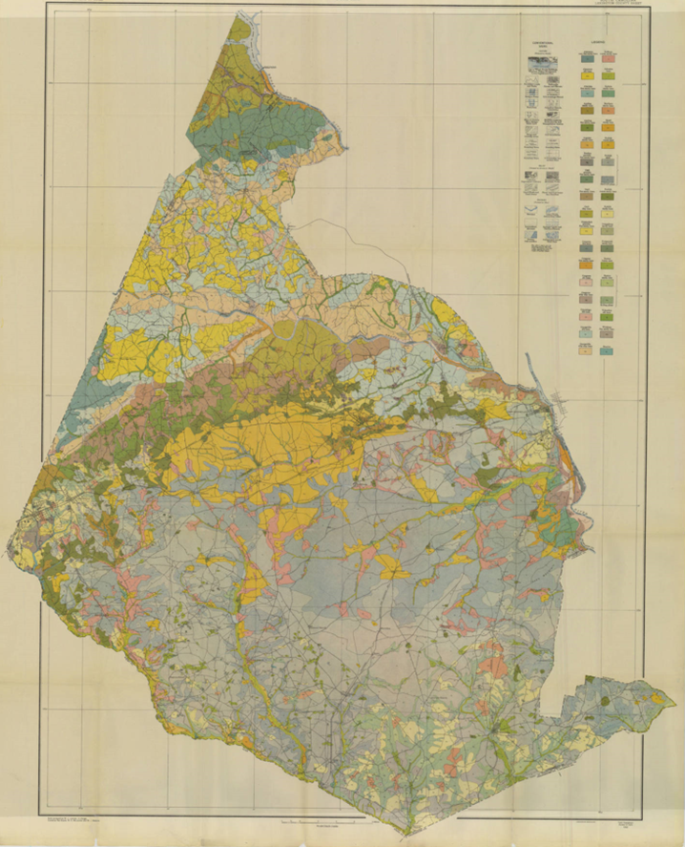
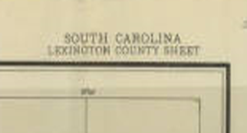
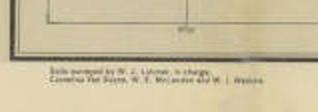
Lexington County Soil Map

Slide 20
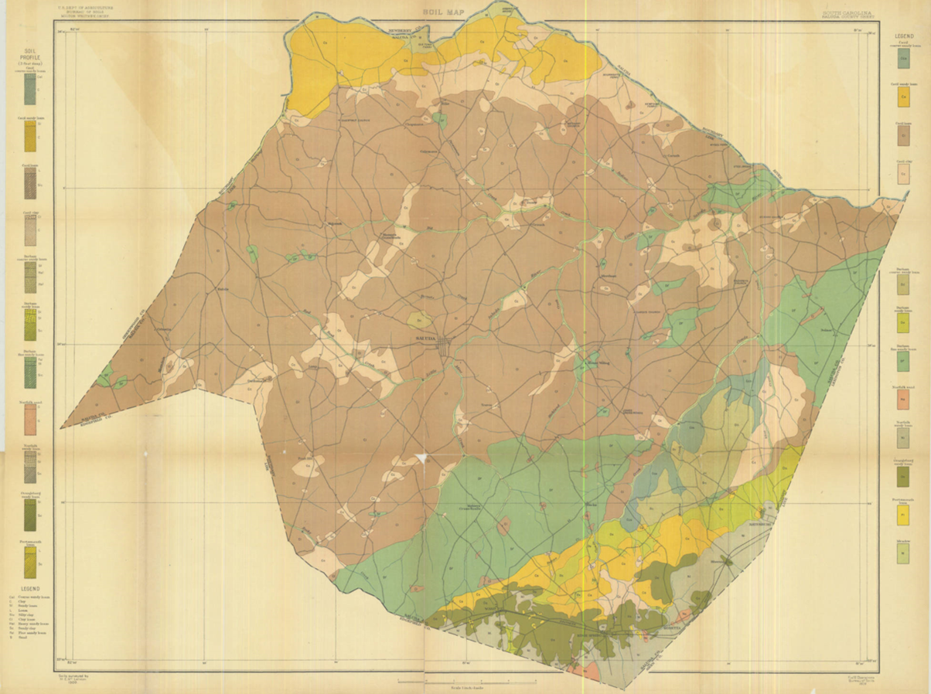
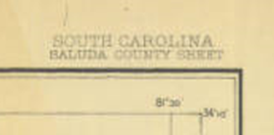
Saluda County Soil Map

Slide 21
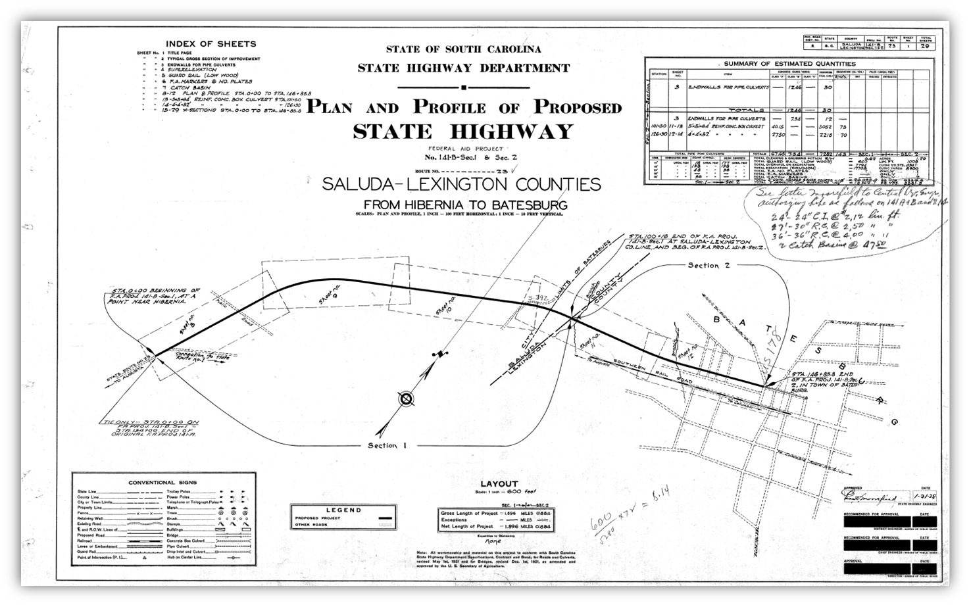
Lexington and Saluda Boundary

Slide 22
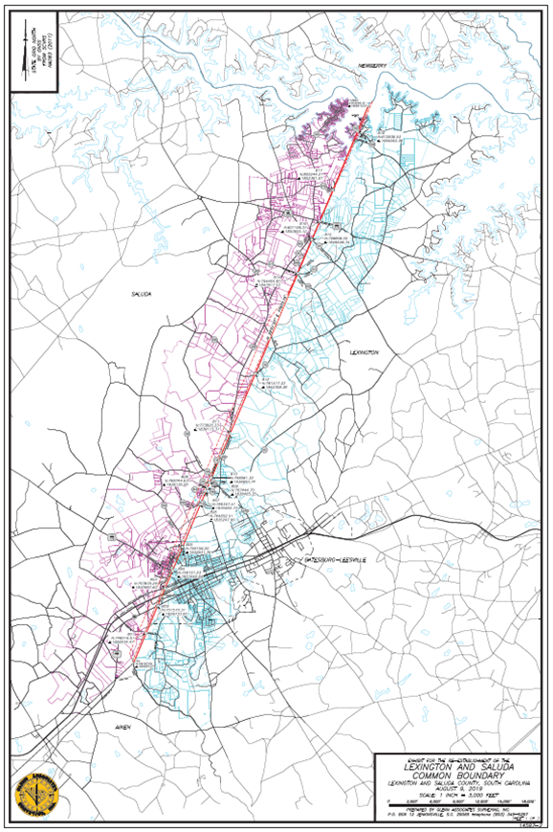
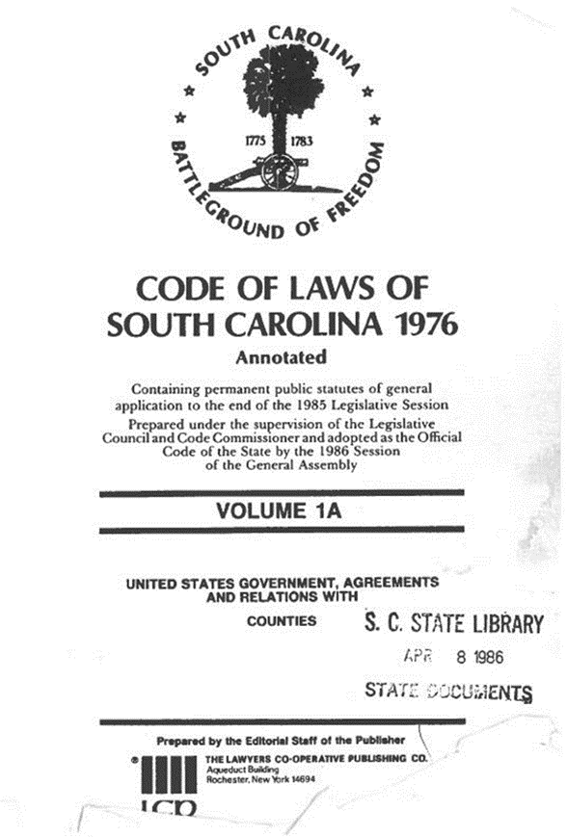
Lexington and Saluda Boundary

Slide 23
Lexington and Saluda Boundary
SECTION 4‑3‑370. Lexington County.
Lexington County is bounded on the northeast and east by Richland County; on the southeast by Orangeburg and Calhoun Counties, from which it is divided by Beaver Creek; on the Southwest by Aiken County, from which it is separated by the north fork of the Edisto River to the mouth of the southern branch of Chinquepin Falls Creek and then by said creek to a point where it intersects the line drawn from Silver Bluff, on the Savannah River, to the mouth of Rocky Creek, on Saluda River; on the northwest by Saluda County, from which it is separated by a line drawn from Silver Bluff, on Savannah River, to the mouth of Rocky Creek, on the Saluda River;…
HISTORY: 1962 Code Section 14‑82; 1952 Code Section 14‑82; 1942 Code Section 3007; 1932 Code Section 3007; Civ. C. ‘22 Section 699; Civ. C. ‘12 Section 617; Civ. C. ‘02 Section 556; G. S. 125; R. S. 484; (5) 478, 506; (6) 463, 664; (7) 248; 1870 (14) 695; 1896 (22) 249; 1901 (23) 662; 1912 (27) 821; 1913 (28) 107; 1920 (31) 976; 1922 (32) 977; 1953 (48) 416.

Slide 24
Lexington and Saluda Boundary
SECTION 4‑3‑470. Saluda County.
Saluda County is bounded by a line beginning at the center of Big Saluda River at a point opposite the corner of Edgefield and Lexington Counties; thence the old Edgefield and Lexington line to the corner of Lexington and Aiken Counties; thence the old Edgefield and Aiken line to a point three miles north of where the public road crosses said line near Lybrand’s old mill; thence a straight line to ten‑mile post on public highway leading from Edgefield to Columbia, near the present or former residence of J. W. L. Bartley; thence a straight line to the junction of the public road leading from Pleasant Cross with the Long Cane road near the present or former residence of William Lott; thence by the Long Cane road to Matt Mathis’ crossroads; thence a straight line to Owdom’s Postoffice; thence a straight line to Little Red Hill schoolhouse near Dr. Landrum’s old place; thence a straight line to a point on the northwestern line of Pine Grove township, one mile north of Double Bridges; thence along the northwestern boundary of Pine Grove township to the point on the old Charleston and Cambridge road, where it crosses Halfway Swamp Creek; thence down the middle of Halfway Swamp Creek to a point in the middle of Saluda River opposite the mouth of said creek; thence down the middle of Big Saluda River to the initial point.
HISTORY: 1962 Code Section 14‑91; 1952 Code Section 14‑91; 1942 Code Section 3016; 1932 Code Section 3016; Civ. C. ‘22 Section 708; Civ. C. ‘12 Section 625; Civ. C. ‘02 Section 564; 1896 (22) 249.

Slide 25
Lexington and Saluda Boundary
History
Lexington County created in Orangeburgh District
An Act for laying off the several counties therein mentioned, and appointing commissioners to erect the public buildings (Statutes at Large of South Carolina, vol. 4, pt. 2, pp. 661-666, March 12, 1785).
"one other county, beginning at the mouth of Beaver creek, thence along the line of Orange county, thence southwest 54° to the road leading from Orangeburgh to Ninety-Six, thence along the road to the district line, thence along the said line to Saluda river, …" The northwestern boundary of Orangeburgh district which is defined as …"and a direct line, to be run from Silver Bluff on Savannah River, to the mouth of Rocky Creek, on Saludy river, and thence in the same
course, to Broad river."
Portion of a 1911 South Carolina map by Rand McNalty shown by Mygenealogyhound.com

Slide 26
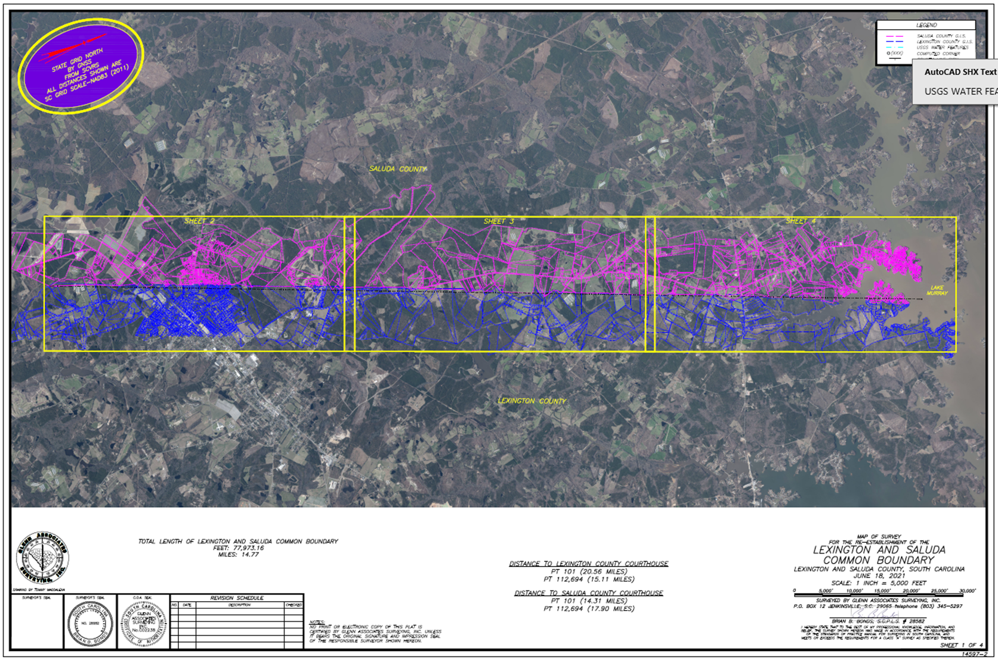

Slide 27
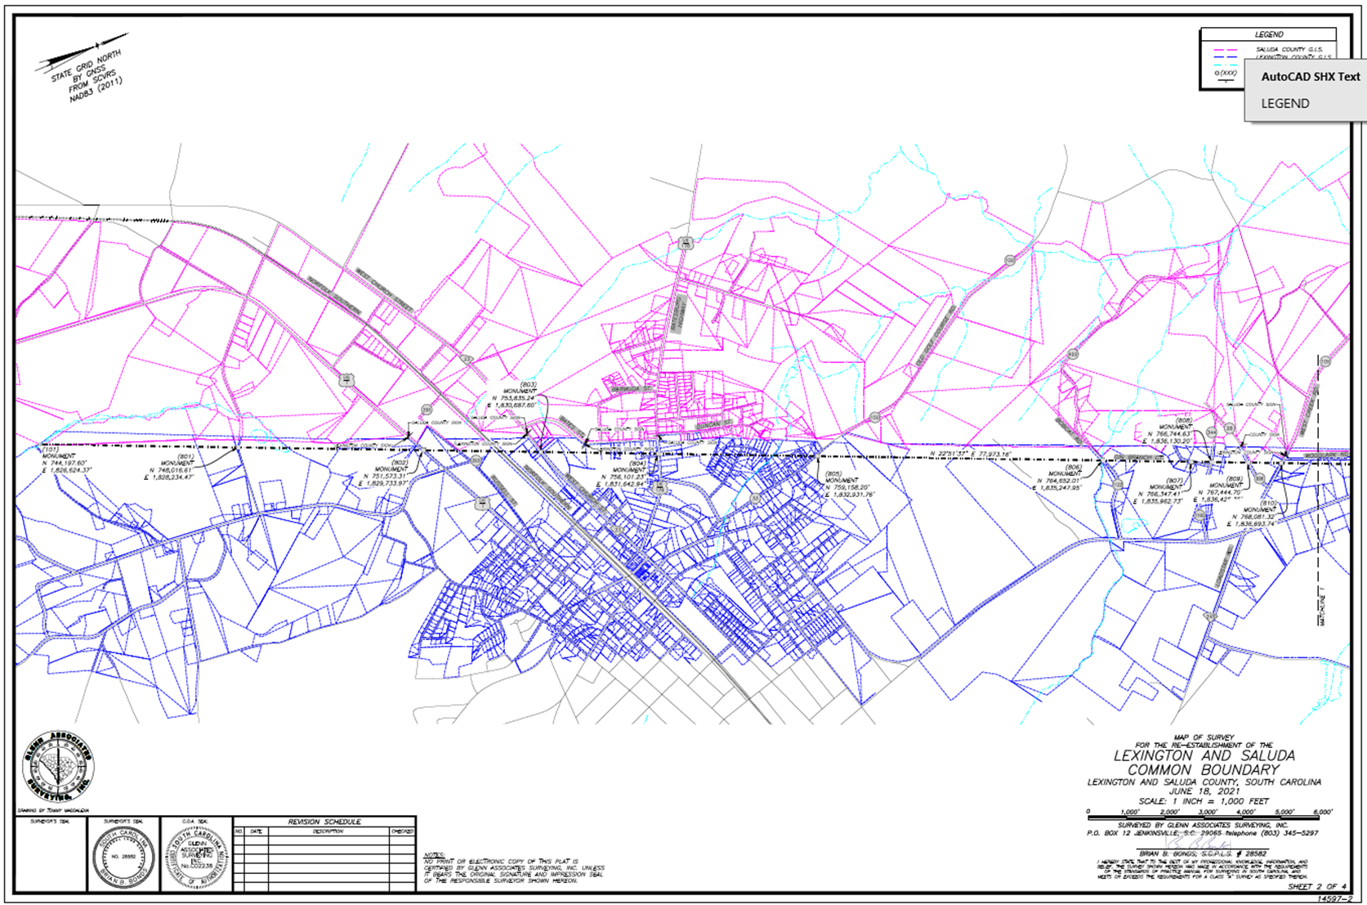

Slide 28
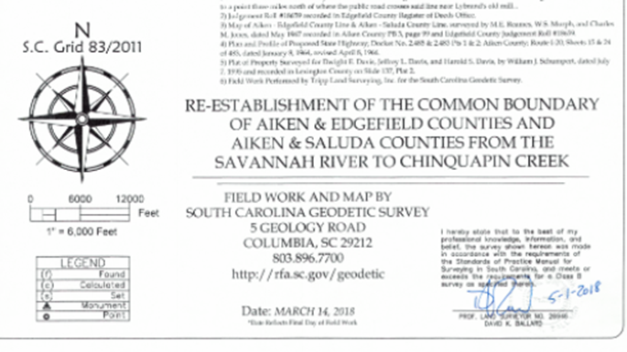
Aiken and Saluda Boundary
Established County Location
Monument “BF” Reference Plat
Monument “801” Lexington-Saluda Plat

Slide 29
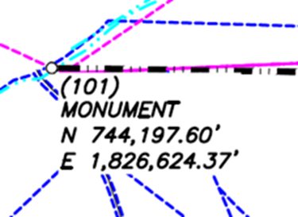
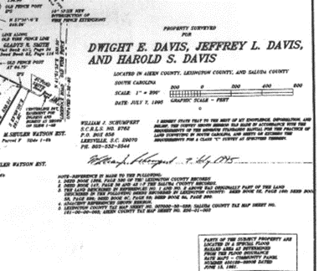
Aiken and Saluda Boundary

Slide 30
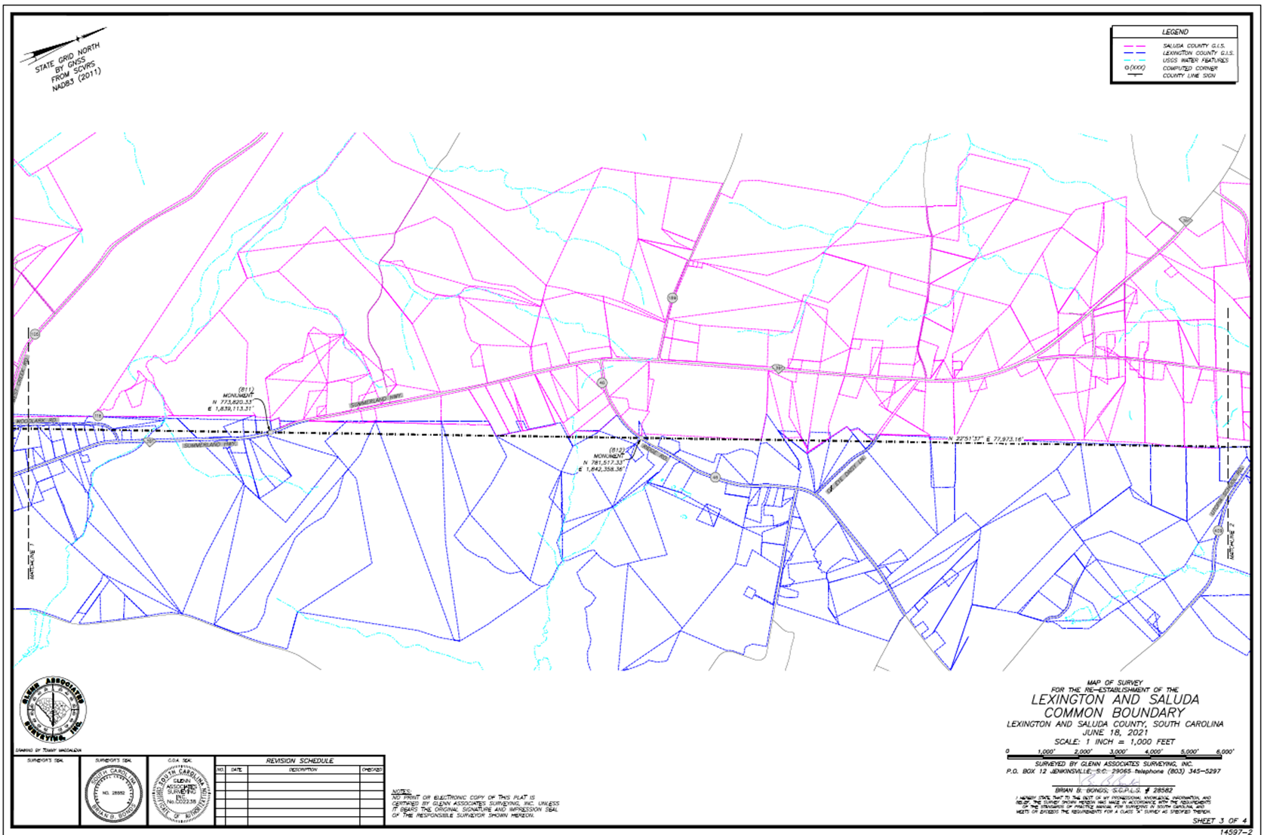

Slide 31
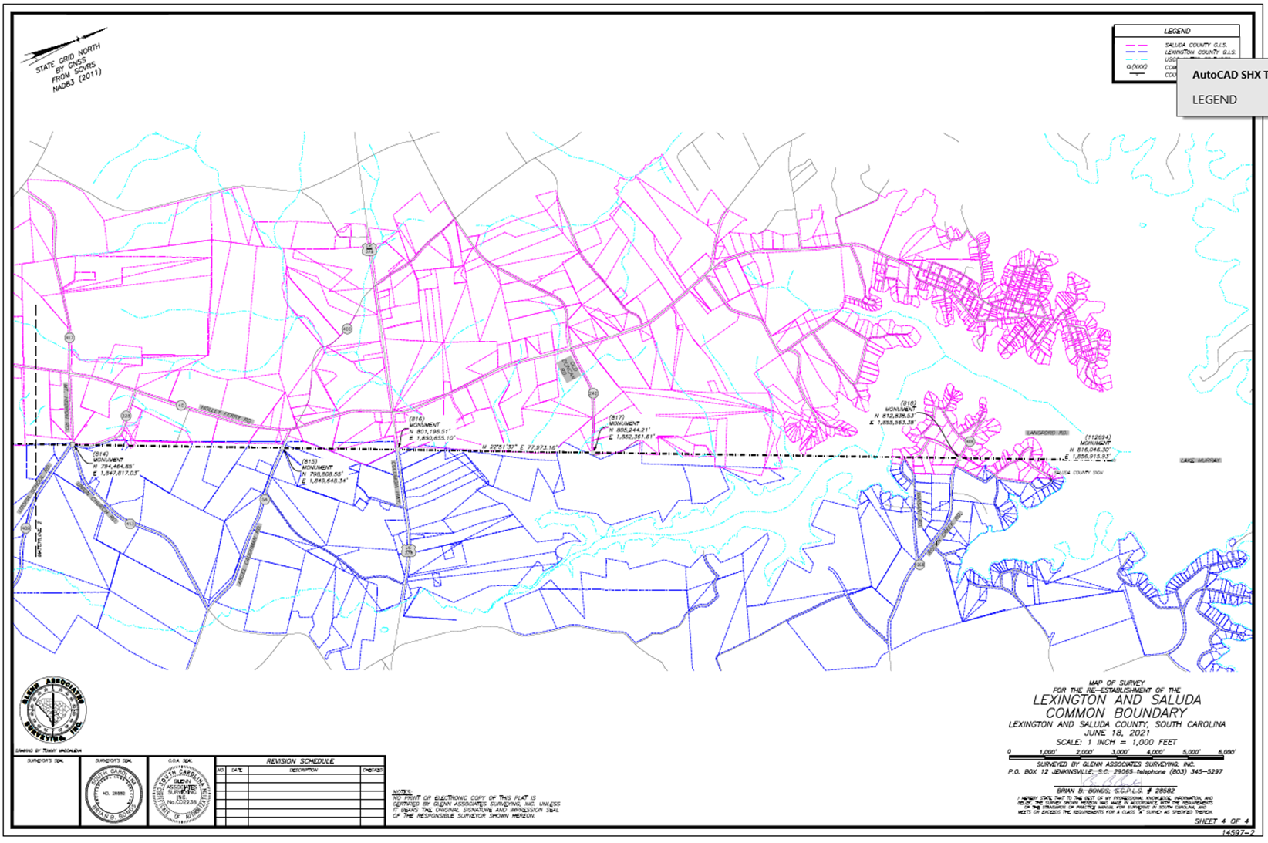

Slide 32
Lexington and Saluda Boundary
Sonar
Bathymetric
Survey

Slide 33
Lexington and Saluda Boundary
Sonar
Bathymetric
Survey

Slide 34
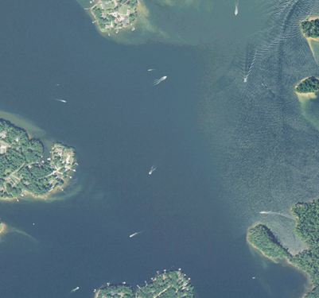
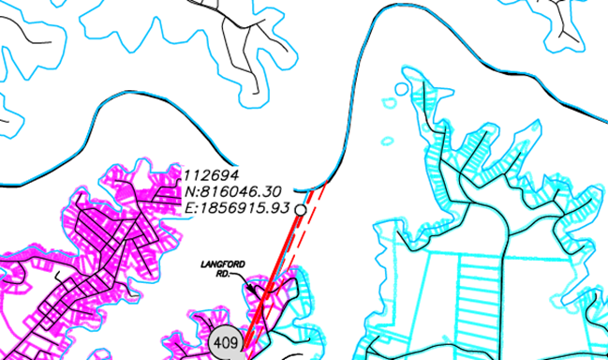
Lexington and Saluda Boundary

Slide 35
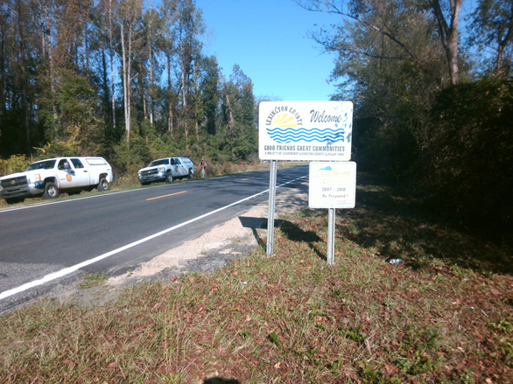
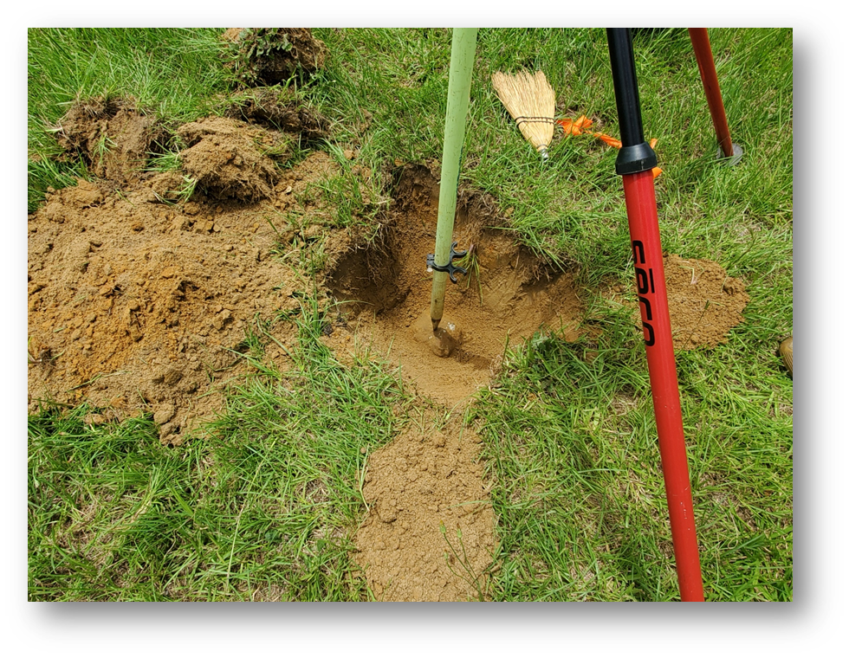
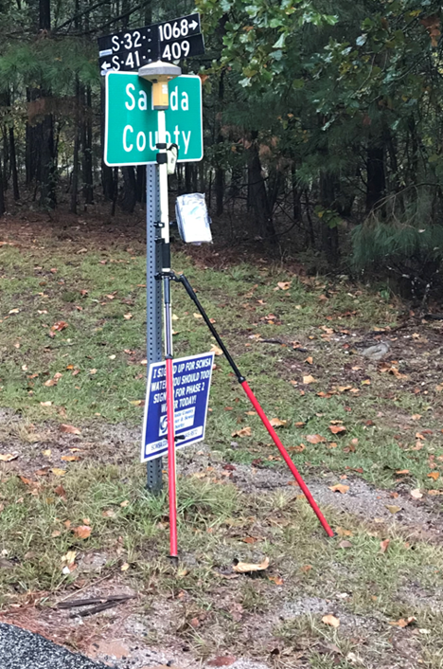

Slide 36
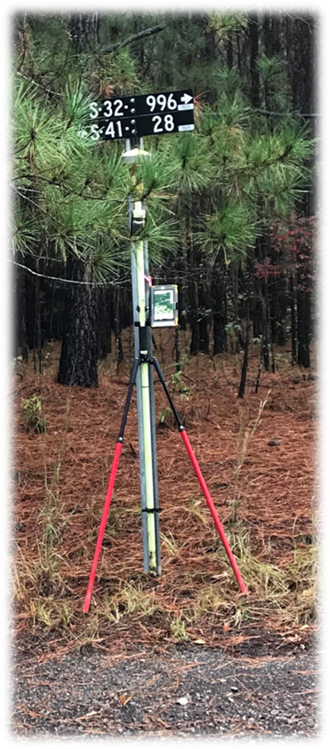
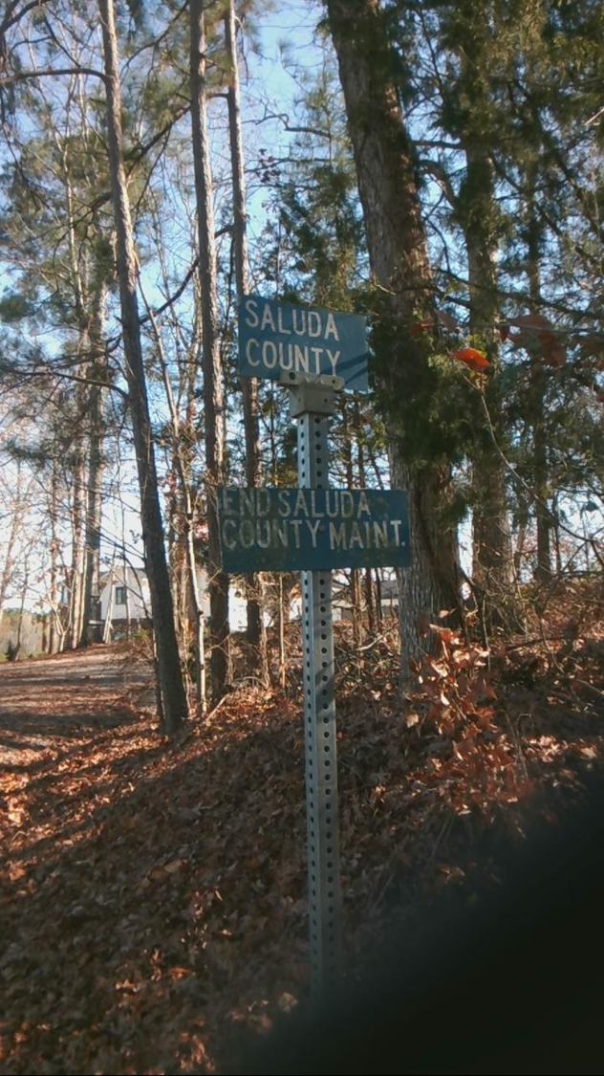
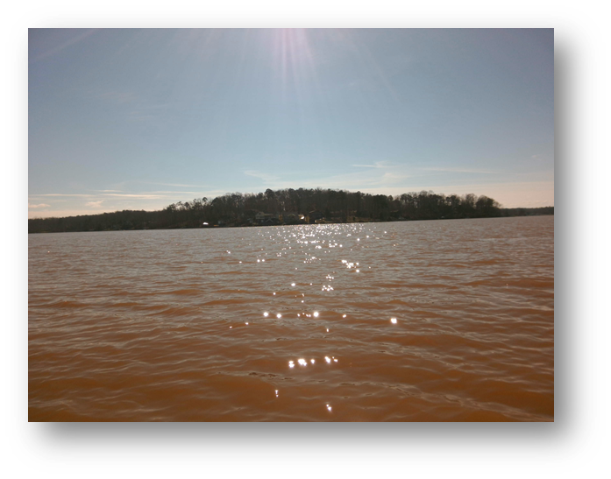

Slide 37
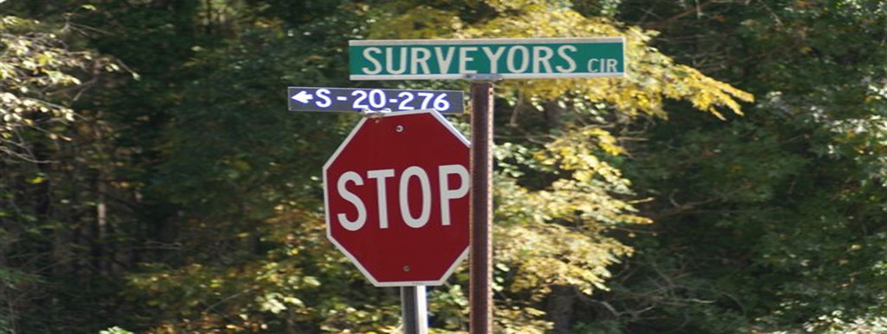
Glenn Associates Surveying, Inc

Slide 38
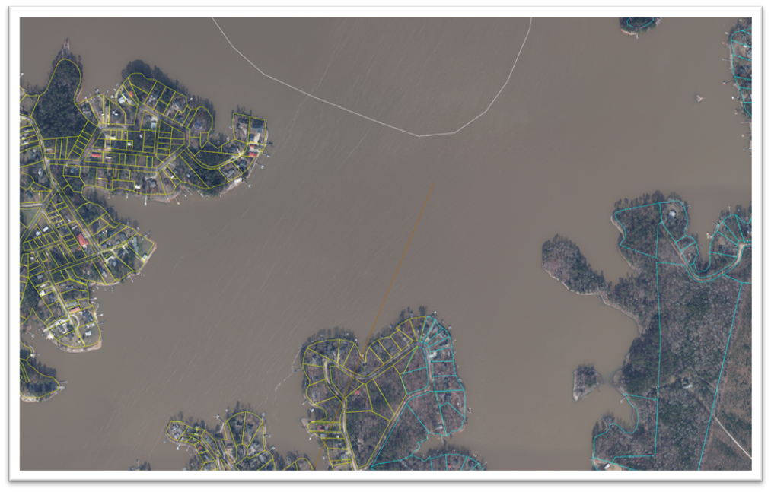
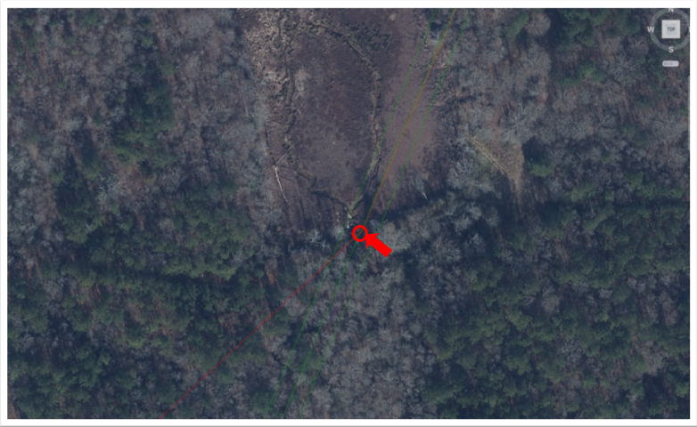
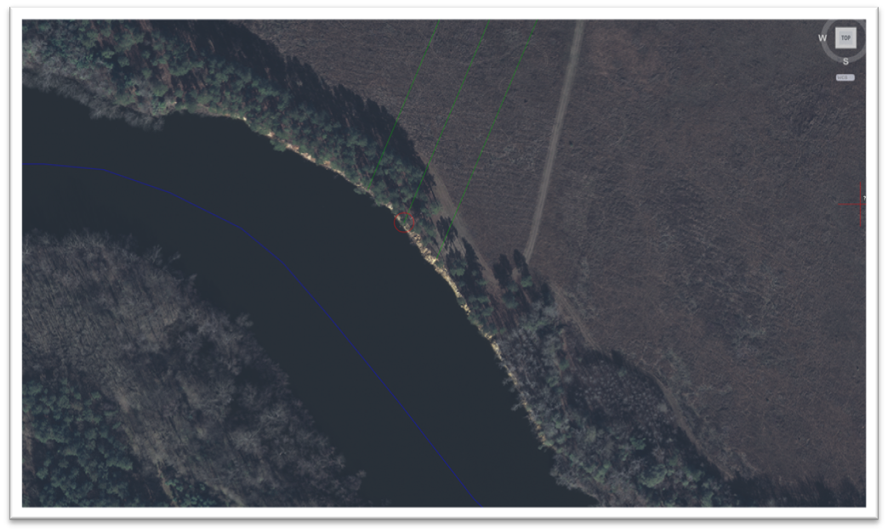

Slide 39
Questions? Or Information you would like to provide to us?
Please call 803-734-3793
Or email: boundary@rfa.sc.gov
We will work to address questions promptly or direct questions to the appropriate agency or jurisdictional entity

