Slide 1
Census and Redistricting Summer 2021
South Carolina Revenue and Fiscal Affairs Office Transforming data into solutions for South Carolina

Slide 2
SC Revenue and Fiscal Affairs Office
Official State Contact with Census
Maintain official precinct maps (SC Code of Laws §7-7-30 et seq.)
Coordination with other mapping programs
Jury Areas (SC Code of Laws §22-2-30)
Transportation Network Company (SC Code of Laws §58-23-1610)
Incorporation (SC Code of Regs 113-200(A))
Prep Work
Local Update of Census Addresses (LUCA)
Boundary and Annexation Program
Served as technical advisors to the Federal Courts
Redistricting Services
Provide redistricting services in accordance with redistricting law and principles
RFA is not providing legal advice

Slide 3
Responsibility for Redistricting
Basic Responsibilities for Redistricting
Entity: County Council
Why: Meet Constitutional requirement of one person, one vote
Who: Drawn by council (Home Rule)
How: Follow constitutional and statutory principals, and traditional redistricting principles;
Requires three readings with map and/or description passed by ordinance
When: Before next general election (§4-9-90)
UPDATE – Data release set for September 30, 2021

Slide 4
Tools, Laws, and Principles

Slide 5
Tools - The Census
The Revenue and Fiscal Affairs Office has adopted the redistricting racial field guidelines as stated by the U.S. Justice Department in the Federal Register Vol.66, No. 12., Thursday, January 18, 2001, reaffirmed in 2011 by the USDOJ Listed are the adopted guidelines.
Field | Details | Formula
Hispanic_O | Hispanic
NH_WHT | Non-Hispanic White
NH_DOJ_BLK | Non-Hispanic Black | Non-Hispanic Black + Non-Hispanic WhiteBlack
NH_DOJ_IND | Non-Hispanic American Indian and Alaska Native | Non-Hispanic Indian + Non- Hispanic WhiteIndian
NH_DOJ_ASN | Non-Hispanic Asian | Non-Hispanic Asian + Non-Hispanic WhiteAsian
NH_DOJ_HWN | Non-Hispanic Native Hawaiian and Other Pacific Islander | Non-Hispanic Hawaiian + Non Hispanic WhiteHawaiian
NH_DOJ_OTH | Non-Hispanic Some Other Race | Non-Hispanic Other + Non-Hispanic WhiteOther
NH_DOJ_OMR | Non-Hispanic Other Multiple Race | Non-Hispanic Multiple Race-NH_WhiteBlack-NH_WhiteIndian-NH_WhtieAsian-NH_WhiteHawaiian-NH_WhiteOther

Slide 6
Tools - Census Tract, Block Group, and Block

Slide 7
Tools – Software and Statistics

Slide 8
Key Principles - One Person, One Vote
14th Amendment U.S. Constitution – Equal Protection
Race cannot be used as the predominate factor
Evenwel v. Abbott (2016) - Total population can be used for satisfying one person, one vote criteria.

Slide 9
Deviating from One Person One Vote
Deviation
Congressional – Strict Standard (one person variance)
State and Local – Deviations of less than ten percent are prima facie valid, but …
Ideal Population = Total Population/# of Districts
Example: 5,000,000/10 = 500,000
Absolute Deviation – Number of persons above or below the ideal population for a district
Example: District 1 – 425,000, Ideal 500,000 = -75,000 Persons
Relative Deviation – percentage of population a district is over or under the ideal population for a district
Formula: ((Population – ideal population)/ideal population) x 100
Overall Range Deviation – Total combined range of deviation for a redistricting plan.
Formula: Largest positive + |largest negative| = overall range deviation
District | Pop | Dev. | %Dev. | Hisp | %Hisp | NH_WHT | %NH_WHT | NH_BLK | %NH_BLK | VAP | H18 | %H18 | NHWVAP | %NHWVAP | NHBVAP | %NHBVAP | AllOth | AllOthVAP
1 | 1,959 | -648 | -24.86% | 39 | 1.99% | 931 | 47.52% | 978 | 49.92% | 1,472 | 28 | 1.90% | 713 | 48.44% | 722 | 49.05% | 11 | 9
2 | 2,056 | -551 | -21.14% | 57 | 2.77% | 610 | 29.67% | 1,381 | 67.17% | 1,576 | 29 | 1.84% | 489 | 31.03% | 1,050 | 66.62% | 8 | 8
3 | 2,985 | 378 | 14.50% | 493 | 16.52% | 905 | 30.32% | 1,557 | 52.16% | 2,117 | 275 | 12.99% | 740 | 34.96% | 1,082 | 51.11% | 30 | 20
4 | 2,509 | -98 | -3.76% | 355 | 14.15% | 1,474 | 58.75% | 655 | 26.11% | 1,877 | 217 | 11.56% | 1,162 | 61.91% | 482 | 25.68% | 25 | 16
5 | 2,380 | -227 | -8.71% | 356 | 14.96% | 873 | 36.68% | 1,124 | 47.23% | 1,708 | 242 | 14.17% | 699 | 40.93% | 745 | 43.62% | 27 | 22
6 | 2,550 | -57 | -2.19% | 709 | 27.80% | 756 | 29.65% | 1,041 | 40.82% | 1,832 | 452 | 24.67% | 613 | 33.46% | 742 | 40.50% | 44 | 25
7 | 3,676 | 1,069 | 41.00% | 284 | 7.73% | 1,735 | 47.20% | 1,582 | 43.04% | 2,869 | 194 | 6.76% | 1,453 | 50.64% | 1,160 | 40.43% | 75 | 62
8 | 2,474 | -133 | -5.10% | 938 | 37.91% | 631 | 25.51% | 829 | 33.51% | 1,755 | 625 | 35.61% | 514 | 29.29% | 566 | 32.25% | 76 | 50
9 | 2,878 | 271 | 10.40% | 453 | 15.74% | 1,007 | 34.99% | 1,363 | 47.36% | 2,123 | 284 | 13.38% | 797 | 37.54% | 1,004 | 47.29% | 55 | 38
Total | 23,467 |  |  | 3,684 | 15.70% | 8,922 | 38.02% | 10,510 | 44.79% | 17,329 | 2,346 | 13.54% | 7,180 | 41.43% | 7,553 | 43.59% | 351 | 250
Target | 2,607
Dev. | High 7 @ 41.00%
 | Low 1 @ -24.86%
 | Total: 65.86%

Slide 10
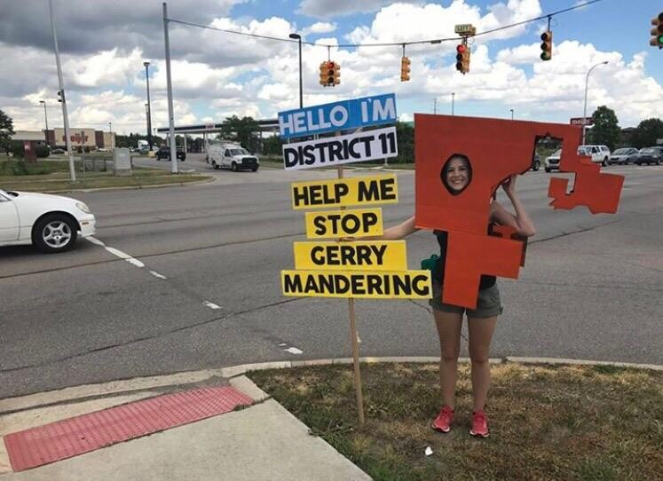
Key Issues – Racial Gerrymandering
Shaw v. Reno (1993) – First racial gerrymandering case to reach the Supreme Court. Court ruled racial gerrymandering was a violation of Equal Protection.
Bush v. Vera (1996) – Race should not be a predominate factor in drawing plans. Race can be a factor, but must be subordinate to traditional redistricting principles. If redistricting principles were subordinate to race, then strict scrutiny can apply to a redistricting plan by the court.
Strict scrutiny of a plan requires court to determine if the state had a compelling interest in creating a district with race as predominate factor.
Alabama Legislative Black Caucus v. Alabama (2015) – “A racial gerrymandering claim, however, applies to the boundaries of individual districts.”

Slide 11
Examples of Racial Gerrymandering

Slide 12
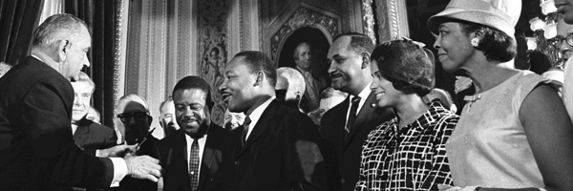
Key Issues - Voting Rights Act, Section 2
Section 2 - protects the interest of the racial minority population.
City of Mobile v. Bolden (1980) – while the plan did not have the intent of discrimination it had the effect.
Section 2 amendment in 1982 by Congress.
Typically, applies to multi-member district plans and at-large voting plans, but can also apply to single member district plans.
Burden of proof of a Section 2 claim on plaintiffs not on defendants
“Totality of circumstances” must be used in a deciding a Section 2 violation. 52 USC 10301(b)

Slide 13
Voting Rights Act – 3-Prong Test
Thornburg v. Gingles (1986) – 3 prong test for vote dilution claim.
Minority group must be large and geographically compact to draw a majority-minority district. Minority district must be able to be drawn at +50% minority VAP – Bartlett v. Strickland.
The minority group must be “politically cohesive”.
Block voting by the majority usually defeats the minority’s candidate of choice.

Slide 14
Key Issues - Voting Rights Act, Section 5
Administrative or Judicial review of plans
Any change in election law must be precleared by the U.S. Department of Justice or through a declaratory judgement filed in the United States District Court for the District of Columbia.
Applied to 9 states as a whole and parts of 6 other states.
USDOJ would analyze the plan to ensure the plan did not dilute minorities opportunity to elect candidates of choice.
Shelby v. Holder (2013) - U.S. Supreme Court ruled Section 4(b) of 1965 VRA was unconstitutional. This is the formula for which jurisdictions fall under Section 5 of the 1965 VRA. South Carolina is no longer under the provision of Section 5. Section 5 itself was not ruled upon.
Shelby does not apply to jurisdictions covered by Section 3(C) of the VRA.

Slide 15
Traditional Redistricting Principles
Contiguousness – All parts of the districts must be touching. Point contiguity is acceptable.
Compactness – Districts should be able to pass an “eye” test as well as can be measured by statistical models.
Constituent Consistency – Preserving the core of existing districts and respecting incumbents.
Communities of Interest – Examples are school districts or attendance zones, neighborhoods.
Voting Precincts – Avoid splitting precincts. General Assembly has the authority to redraw voting precincts. Precincts are typically redrawn after redistricting has occurred or a large population change in one geographic area. RFA is responsible for maintaining office maps for voting precincts (§1-11-360).

Slide 16
South Carolina – Estimated Population Change by Census Tract

Slide 17
Key Steps
Educate and prepare as soon as possible
Look at timeline between release of data and next election and consider all the logistics (data release, drafting a plan, meeting schedule, public hearing, updating voter registration, filing periods) – RELEASE SCHEDULED FOR SEPTEMBER 30, 2021
Contact our office or other professional for assistance
Help verify record of local boundary and election districts
Notify other affected entities of process and timeline
County Elections Office (needs time to process changes)
School Board or other entities that may follow same district lines
Draft necessary ordinances, help with scheduling timeline
Hold Public Hearing
Ensure proper documentation and retention of records
Consider pending annexations

Slide 18
Key Goals – Resolutions
Adhere to the court ordered constitutional requirement of one person, one vote
County Councils must adhere to a state law of population variance under 10%
Adherence to the 1965 Voting Rights Act as amended and by controlling court decisions
A redistricting plan should not have either the purpose or the effect of diluting minority voting strength and should otherwise comply with the Voting Rights Act, the Fourteenth and Fifteenth Amendments to the U.S. Constitution, and the decisions of the U.S. Supreme Court.
Ensure that parts of the districts are contiguous
All districts will be composed of contiguous geography. Contiguity by water is acceptable . Point-to-point contiguity is acceptable so long as adjacent districts do not use the same vertex as points of transversal.
Attempt to keep compact districts.
Attempt to maintain constituent consistency
Efforts will be made to preserve cores of existing districts.
Respect Communities of Interest
Where practical, districts should attempt to preserve communities of interest.
Avoid splitting voting precincts
Solicit public input

Slide 19
Final Thoughts
Proactive vs Reactive
Transparent

Slide 20
Questions? Thank You! For Further Information, Contact – Victor Frontroth Frank Rainwater 803-734-0969 803-734-3786 victor.frontroth@rfa.sc.gov frank.rainwater@rfa.sc.gov

Slide 21
Relevant Laws and Court Decisions
U.S. Constitution art. I, §2 – Sets apportionment of Congressional seats based on decennial census numbers.
S.C. Code §5-3-90 – Annexation information must be provided to 3 state agencies; DOT, Secretary of State, and DPS.
Act #88 of 2015 - RFA must be notified of annexations 30 days after an ordinance is passed.
U.S. Constitution art. I, §2, Clause 3– Calls for Census in 1790 and every ten years thereafter.
Home Rule Act of 1975, Act #282, 1975 – Gave counties and municipalities “Home Rule” authority of self-governance. It requires County Council redistricting after decennial census.
14th Amendment to the U.S. Constitution – Equal Protection.
Evenwel v. Abbott 578 U.S. 54 (2016) – Total population can be used for satisfying one person, one vote criteria.
Wesberry v. Sanders, 376 U.S. 1 (1964) – Congressional districts must be drawn as nearly equal in population as practicable.
Reynolds v. Sims, 377 U.S. 533 (1964) – Allows more population variance in legislative redistricting than congressional redistricting.
Gaffney v. Cummings, 412 U.S. 735 (1973) – The 10% population variance is not a safe haven for a one person, one vote claim.
Fraser v. Jasper County School District, Civil Action No.9:14-cv-2578-SB – South Carolina example of one person, one vote lawsuit.
1965 Voting Rights Act Section 5 – requires jurisdictions covered under the VRA to submit to the U.S. Department of Justice any changes in law impacting voting.
Dukes v. Redmond, 357 S.C. 454 (2004) – a person’s residence is the part of his property on which the dwelling is actually located.
Application of Davy, 281 A.D. 137 (1952) – a persons domicile is where a person carries on the main activities of the home.
Op. Atty. Gen. dated July 27, 1987 – in close cases the location of the sleeping accommodations in the residence is used to determine where one resides.

Slide 22
Relevant Laws and Court Decisions
Shelby v. Holder (2013) – 570 U.S. 529 (2013) – South Carolina is no longer under Section 5 of the VRA according to the historical formula requiring compliance
1965 Voting Rights Act Section 4(b) – formula for covering jurisdictions under Section 5 DOJ submission requirement.
1965 Voting Rights Act Section 2 – Prohibits implementing voting practices or procedures that discriminate against a person on the basis of race, color, or language.
Thornburg v. Gingles 478 U.S. 30 (1986) – 3 prong test for vote dilution claim.
U.S. v Georgetown County School District Civil Action No. 2:08-889 DCN, – South Carolina example of Section 2 lawsuit in South Carolina.
Shaw v. Reno, 509 U.S. 630 (1993)– First racial gerrymandering case to reach the Supreme Court. Racial gerrymandering is a violation of Equal Protection.
Bush v. Vera, 517 U.S. 952 (1996) – Strict scrutiny of redistricting plan if determined race was the predominate factor of redistricting.
Alabama Legislative Black Caucus v. Alabama 135 S. Ct. 1257, 1263 (2015) – “A racial gerrymandering claim, however, applies to the boundaries of individual districts.” Alabama’s criteria to try to maintain benchmark minority percentages in minority majority districts was an incorrect interpretation of retrogression under Section 5.
Calvin v. Jefferson County Board of Commissioners, Case No.4:15vc131-MW/CAS (2015)– prison population must have a “representational nexus” with the community to be included in a redistricting plan.
Rucho et al. v Common Cause et al. 139 S. Ct. 2484 (2019) - Partisan gerrymandering presents political questions beyond the reach of the federal courts

Slide 23
Relevant Laws and Court Decisions
Act 283 of 1975 – Home Rule Act
County Council must redistrict to population of less than 10% deviation.
Change of government triggered by petition of registered voters (15% municipality, 10% County) or ordinance of council. Must go through referendum.
Elliott v. Richland County 472 S.E.2d 256 (1996) – one shot at redistricting per decade.
Moye v. Caughman 217 S.E.2d 36 (1975) – Legislature has authority over redistricting of school districts. School districts are creatures of the General Assembly.
Vander Linden v. Hodges 193 F.3d 268 (1999) – Weighted voting for legislative delegation.
S.C. Code §1-11-360 – RFA has authority over precinct maps. RFA is responsible for coordinating precinct changes with members of the General Assembly.

