Slide 1
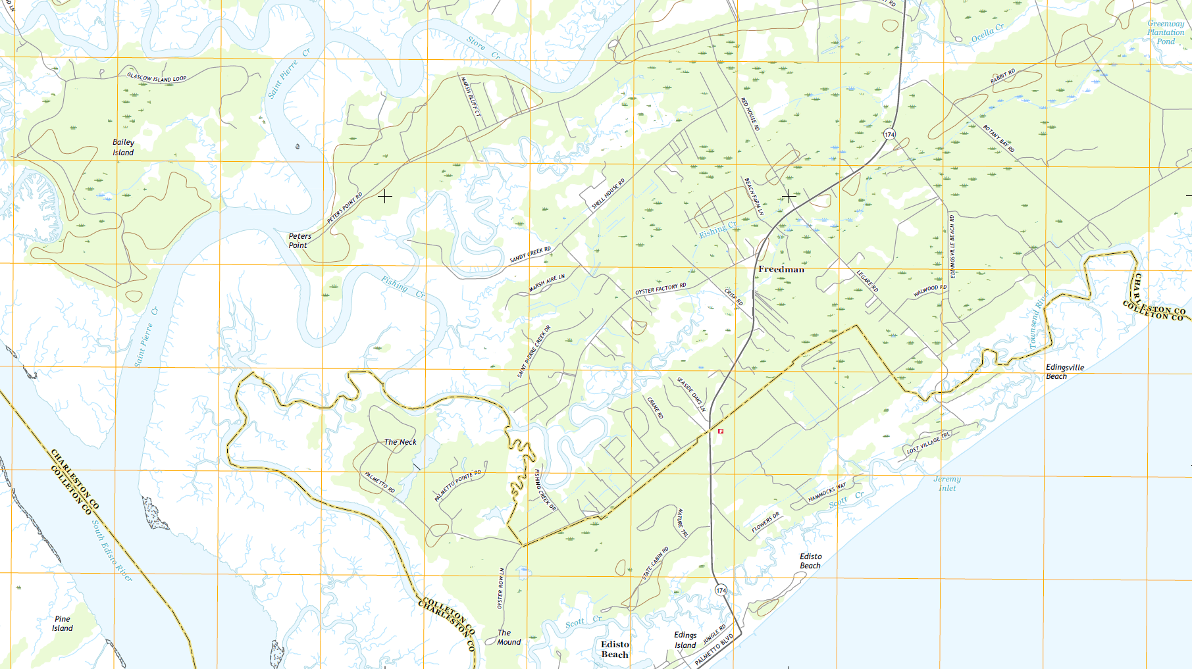

CHARLESTON/COLLETON
COUNTY LINE RE-ESTABLISHMENT
(EDISTO ISLAND)
David Ballard, PLS
Revenue and Fiscal Affairs
Geodetic Survey

Slide 2
Act No. 262 of 2014
An Act to amend Section 27-2-105
Relating to the duties of the SC Geodetic Survey (SCGS) with respect to determining county boundaries
Purpose:
    Exact and precise locations and boundaries of state’s political subdivisions are critical for services, enforcement of property rights and election of public officials.
    Passage of time and growth has led to confusion over statutory county descriptions and the locations of county boundary lines
    Technology exists now to cost-effectively provide definite and permanent markers of boundary lines
    Necessary for state government and political subdivisions
    SCGS is the appropriate instrument to vest with the necessary authority to resolve county boundary issues

Slide 3
SC Code of Law and Act 262 Of 2014
Role of South Carolina Geodetic Survey
      (1994) Dispute between two or more counties- SCGS will act as mediator to resolve the dispute
      (1994/2014) SCGS to assist counties in defining and monumenting the locations of county boundaries and positioning the monuments using geodetic surveys where counties are ill-defined, unmarked, or poorly marked
      (2014) SCGS will clarify county boundaries as defined in Chapter 3, Title 4
      (2014) SCGS will analyze archival and other evidence and perform field surveys to position geographically all county boundaries in accordance with statutory descriptions
      (2014) To amend section 27-2-105, Code of Laws of South Carolina, 1976, relating to the duties of the South Carolina Geodetic Survey (SCGS) with respect to determining county boundaries, so as to authorize and direct the SCGS to clarify county boundaries and mediate boundary disputes between counties by providing a procedure allowing the SCGS administratively to adjust county boundaries, to provide the procedures including notice that SCGS must follow in making such adjustments, to provide that affected parties may appeal these adjustments to the Administrative Law Court in a de novo hearing, to provide the method of determining the effective date of these administrative county boundary adjustments and the notice requirements for these adjustments to be effective and to provide that nothing contained in this administrative process restricts the authority of the General Assembly by legislative enactment to adjust or otherwise clarify county boundaries by legislative enactment.
Op. S.C. Atty. Gen. 2016 (S.C.A.G. March 1, 2016)
Op. S.C. Atty. Gen. 2018 (S.C.A.G. May 22, 2018)

Slide 4
Steps for Clarifying Boundaries
Notify County Administrators in advance of planned work
Conduct historical research for documentary evidence of boundaries
Perform field work to locate monuments and corroborating evidence and position on State Plane Coordinates
Share preliminary findings with county officials for impact analysis and to plan public meetings
Receive feedback and input from local officials and public
Review and update findings, as appropriate
Work to build cooperation with affected parties

Slide 5
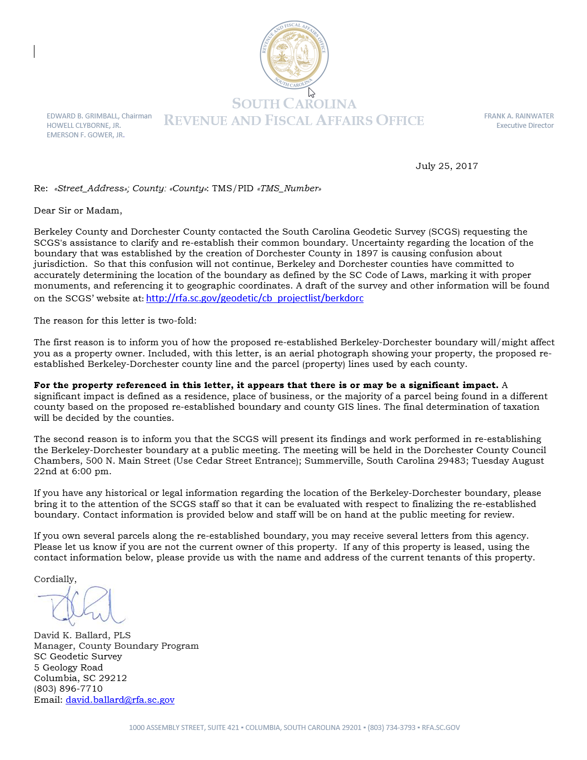
Public Meeting Notification (Example)

Slide 6
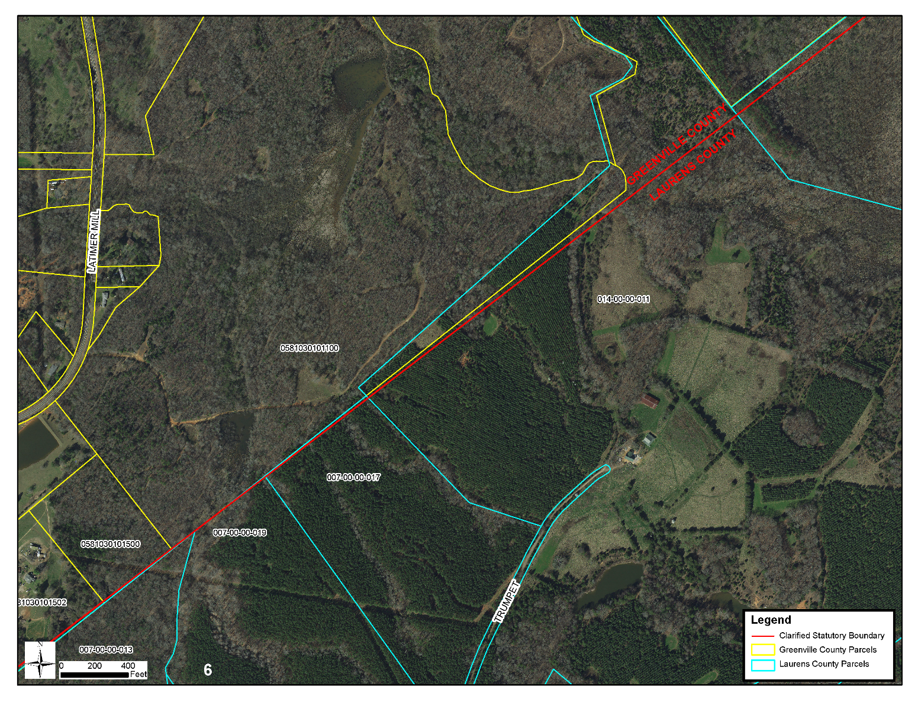
Public Meeting Notification (Example)

Slide 7
Scatter Gram of Differences
Between Observations
2 – Five Minute Sessions
RMSE(2-D) = 0.020m @95%
0.015m = ~0.05’
Axis Units in Meters

Slide 8

Scatter Gram of Differences
Between Observations
2 – Five Minute Sessions
RMSE(2-D) = 0.020m @95%
0.015m = ~0.05’
Axis Units in Meters

Slide 9
Act 262 of 2014
Steps for Clarifying Boundaries
SC Code of Law SECTION 27-2-105
SCGS Requirements:
    Upon reestablishing county boundary, SCGS shall certify its work and within 30 days of certification:
        Provide copies to the administrator of each affected county;
        Provide written notification to affected parties
        Provide notice and copies to the public through its official website and or other means it considers appropriate; and
        Notify as it determines appropriate, other affected state and federal agencies
    (Initiates 60 Day Appeal Process)
  Certified Surveys submitted to Secretary of State, Register of Deeds Offices, and South Carolina Department of Archives with Cover Letter
  Date of the cover letter is the date the surveys become effective
  Introduce Legislation to update Code of Law to reflect clarified boundary with State Plane Coordinates

Slide 10
SC Code of Law SECTION 27-2-105
Affected Parties Disagreeing with SCGS:
    May file request for a contested case hearing with the SC Administrative Law Court
    This decision may be appealed
    “Affected Party”
              Governing body of an affected county
              Governing body of a political subdivision of this State
              An elected official, other than a statewide elected official
              A property owner or an individual residing in the certification zone
              A business entity located in the certification zone
              A nonresident individual who owns or leases real property situated in the certification zone

Slide 11
Chapter 5, Title 4
Change of Boundaries
  S.C. Code § 4-5-120: Procedure for annexing part of county- governing body or 10 percent of registered voters petition in writing, shall deposit with the clerk of court an amount of money sufficient to cover the expenses of surveys , plats, annexation commission and the election to be held to determine whether the proposed annexation shall be effected and then file such resolution or petition in the office of the clerk of court
  S.C. Code § 4-5-130: Appointment of Commission for annexation- once presented to the governor then within 30 days the governor shall appoint a commission of four persons
  S.C. Code § 4-5-140: Employment of Surveyors- commission may contract for survey and location of the proposed change of line and for such purpose may employ 3 surveyors
  S.C. Code § 4-5-170: Governor shall order election; voting place; eligible electors- to be held in an area sought to be transferred and an election to be held in the county to which the area is proposed to be transferred
  Propose and adopt Legislation

Slide 12
CHARLESTON/COLLETON
COUNTY LINE RE-ESTABLISHMENT
(EDISTO ISLAND)

Slide 13
Act 259 of 1987
“AN ACT TO ALTER THE COUNTY LINES OF CHARLESTON AND COLLETON COUNTIES BY ANNEXING A CERTAIN PORTION OF CHARLESTON COUNTY TO COLLETON COUNTY…”
“Beginning at Point "A", the Eastern point of Colleton County on Edisto Beach, running Northwesterly along the centerline of Scott Creek to Point "B" on E. side Highway 174 at the centerline of Scott Creek, thence Southwesterly along the centerline of Scott Creek (the Northern boundary of Edisto Beach, Colleton County) to the intersection of Scott Creek with the centerline of Big Bay Creek, Point "C", thence along the centerline of Big Bay Creek in the direction of the flood tide to Point "D"; thence S 46 E 700 feet Southeastward on the centerline of Capt. John Cut to Point "E" at the centerline of Fishing Creek, thence along the centerline of Fishing Creek in the direction of the flood tide to Point "F"; then S 12 W 2700 feet to Point "G", the boundary of Tax Lot 4 of TMS 80-0-0, thence S 29 E 1200 feet along the boundary of Tax Lot 4, of TMS 80-0-0, to Point "H", thence N 67 E 2750 feet to Point "I" along the Northwestern boundary of Tax Lot 5 of TMS 80-0-0, thence N 40 30 E 2600 feet to Point "J", thence N 50 E 1200 feet along the Northwestern boundary of Tax Lot 5 of TMS 80-0-0 to Point "K", on the East side of S. C. Highway 174, thence S 45 E 35.4 feet to Point "L", thence N 60 E 3800 feet along the Northern boundary of TMS 22-0-0 to Point "M", thence N 77 E 1900 feet to Point "N", thence S 43 E 2600 feet to Point "O", thence along the centerline of the Creek in the direction of the ebb tide to the highwater line of the Atlantic Ocean, Point "P", thence along the highwater line of the Atlantic Ocean S 60 30 W 10,000 feet to Point "A" at the center of an inlet, the point of beginning.”

Slide 14
SC CODE of LAW
-Section 4-3-40. Charleston County:
SC Code of Law has not been Updated to Show this Annexation
-Section 4-3-150 & 4-3-160: Colleton County:
SC Code of Law has not been Updated to Show this Annexation

Slide 15
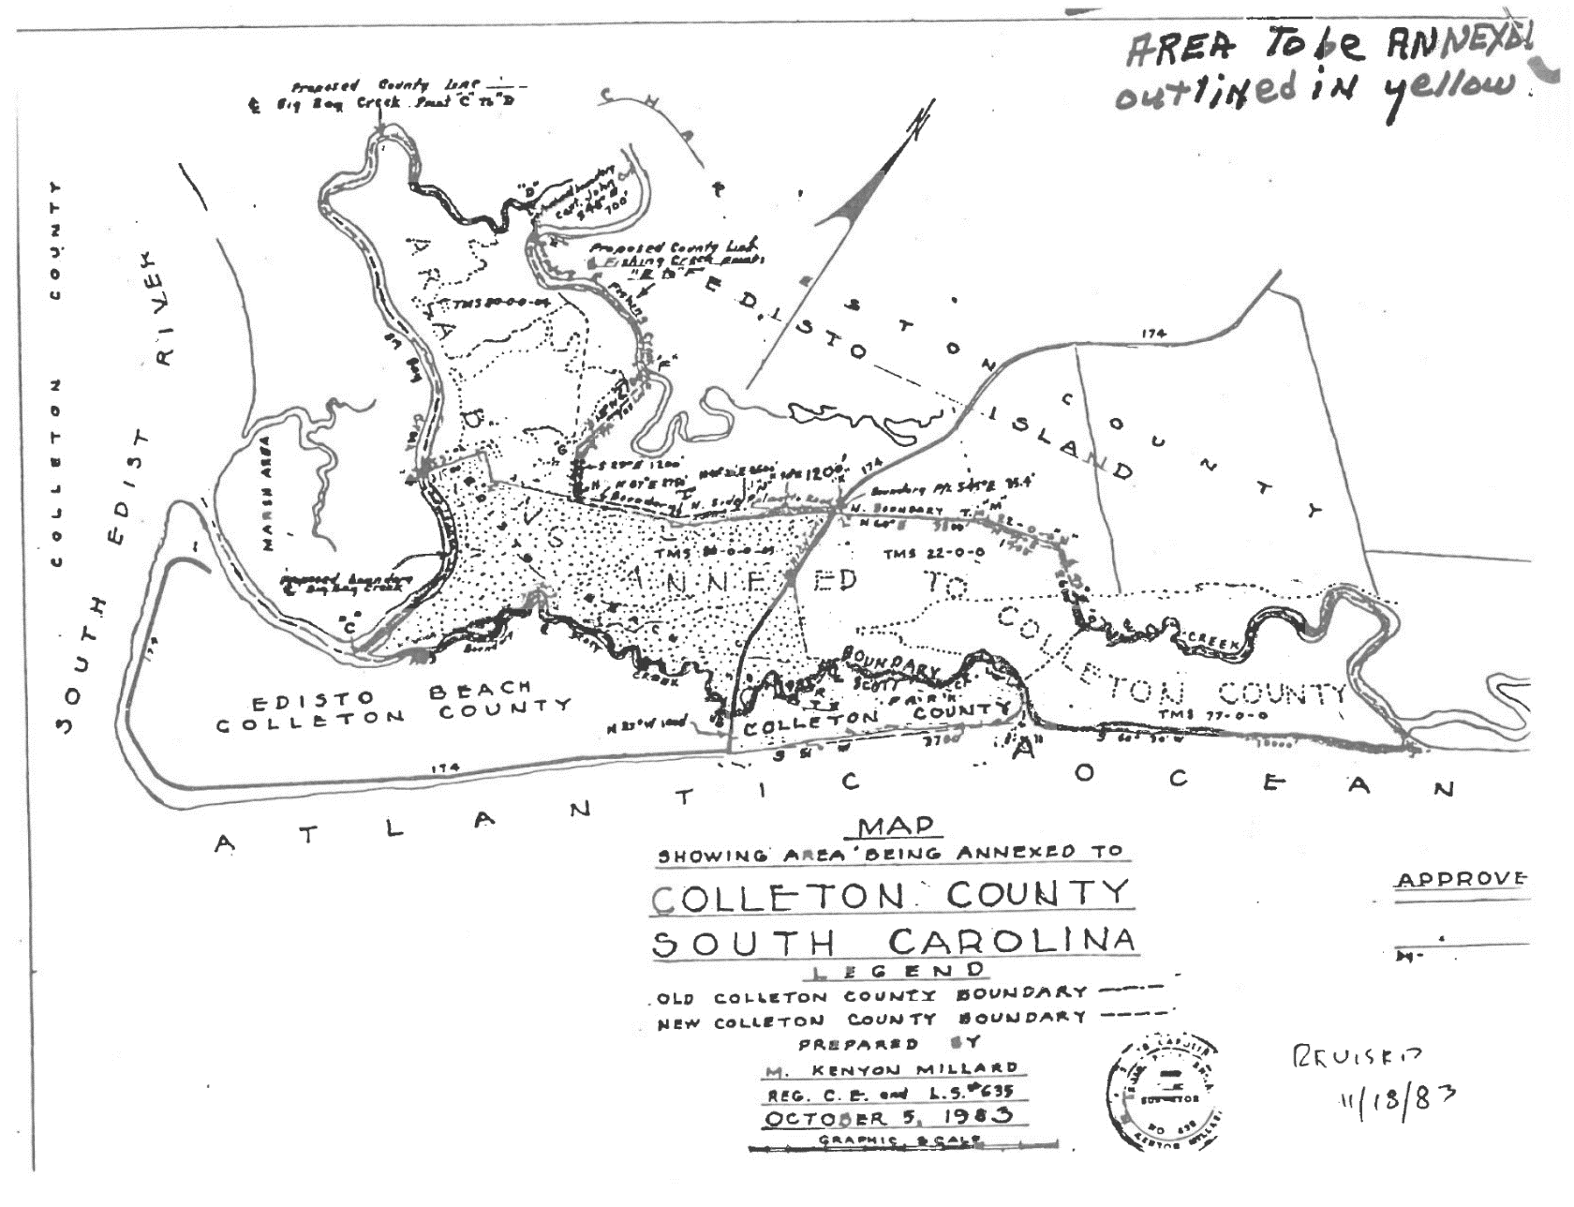
1983 Annexation Map

Slide 16
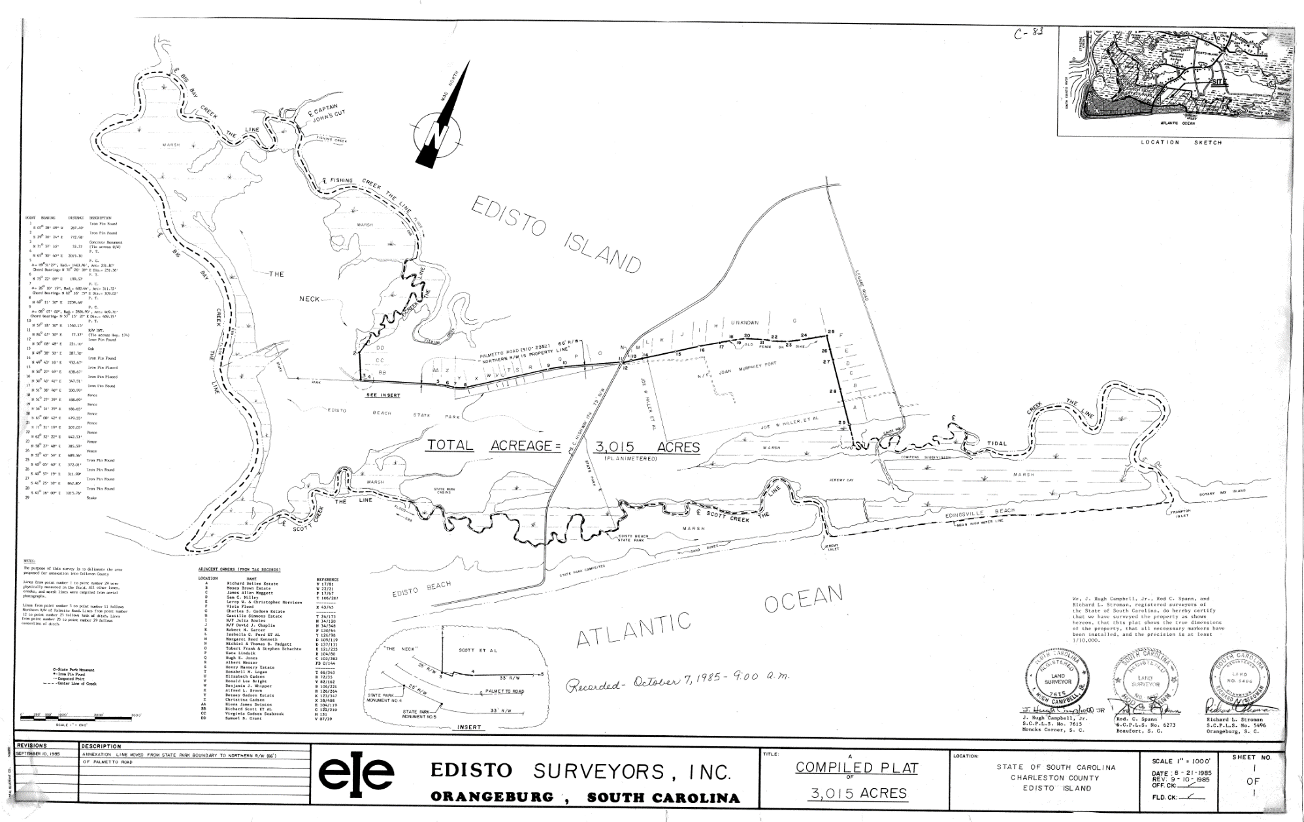
Colleton Plat Book C pg 83; Revised 1985 Annexation Plat

Slide 17
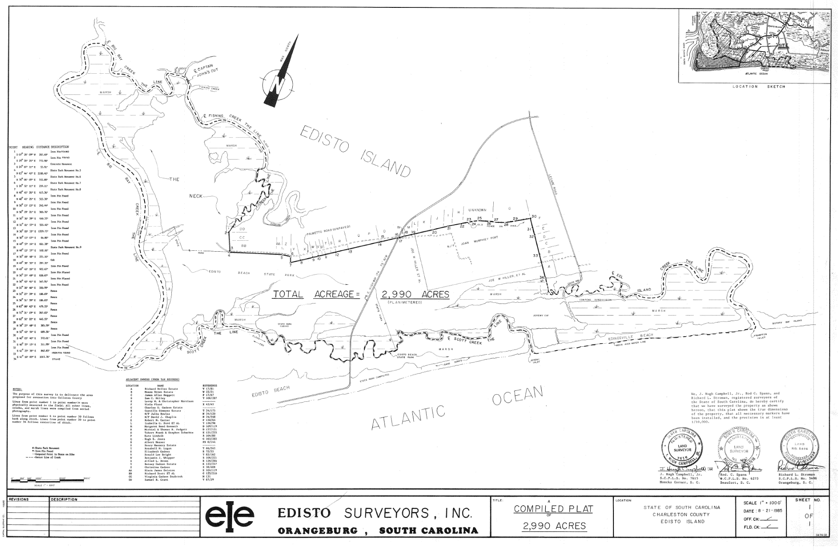
1985 Annexation Plat

Slide 18
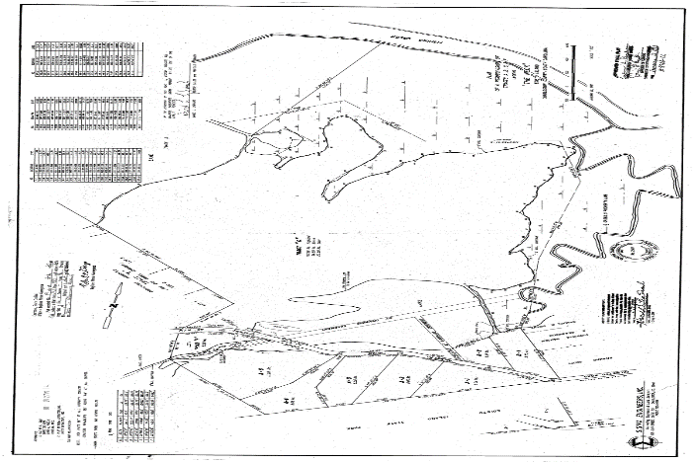
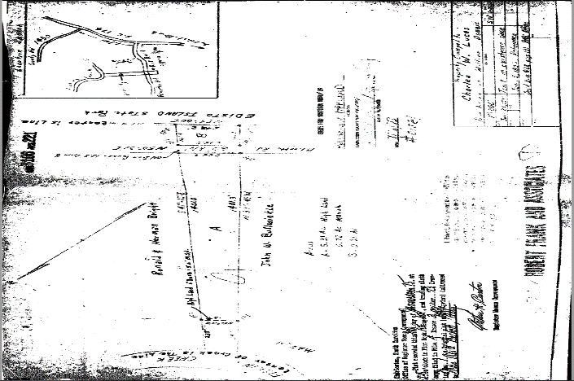
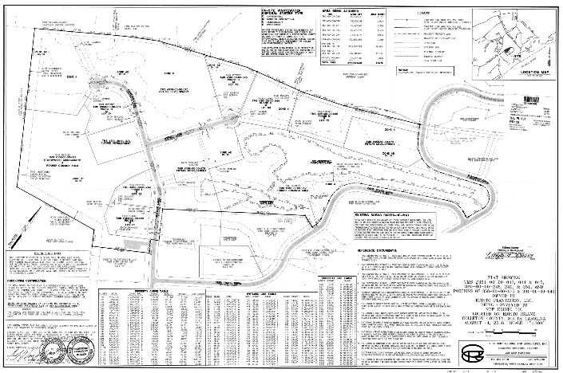
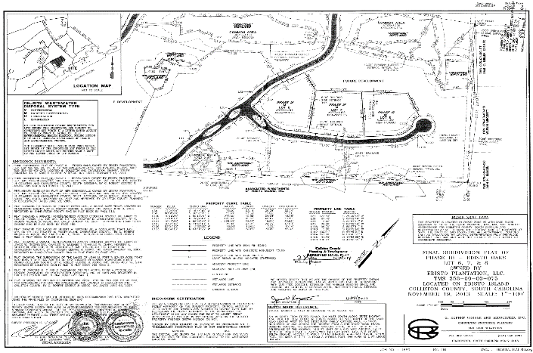
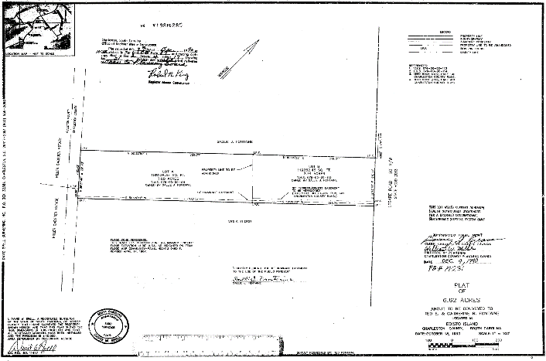
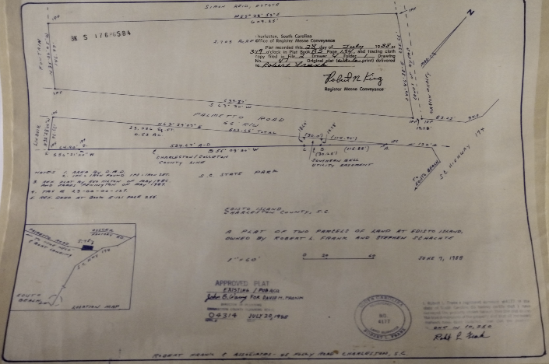
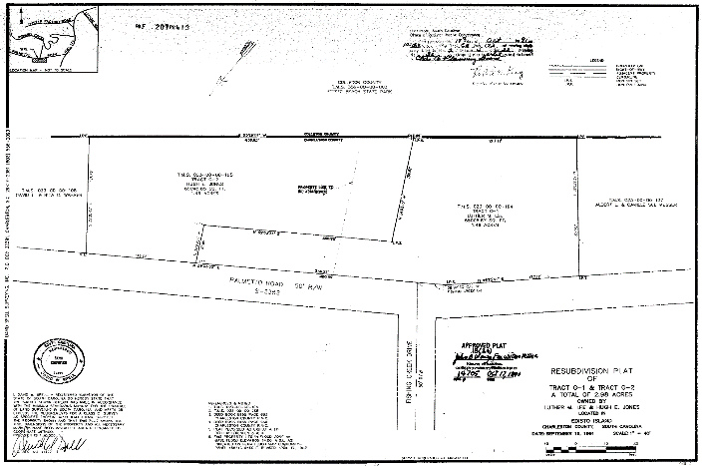
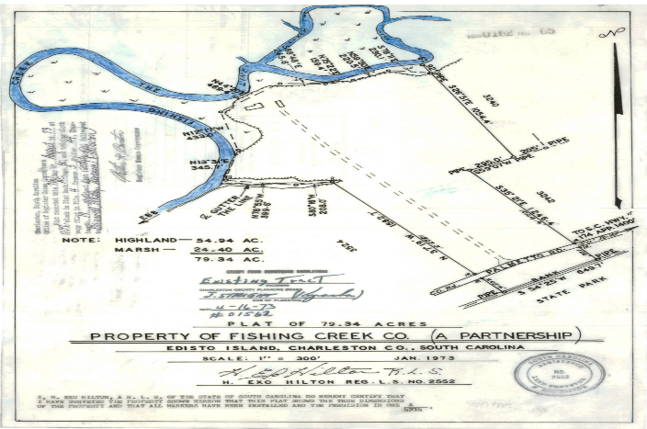
Various Plats from Charleston and Colleton Counties

Slide 19
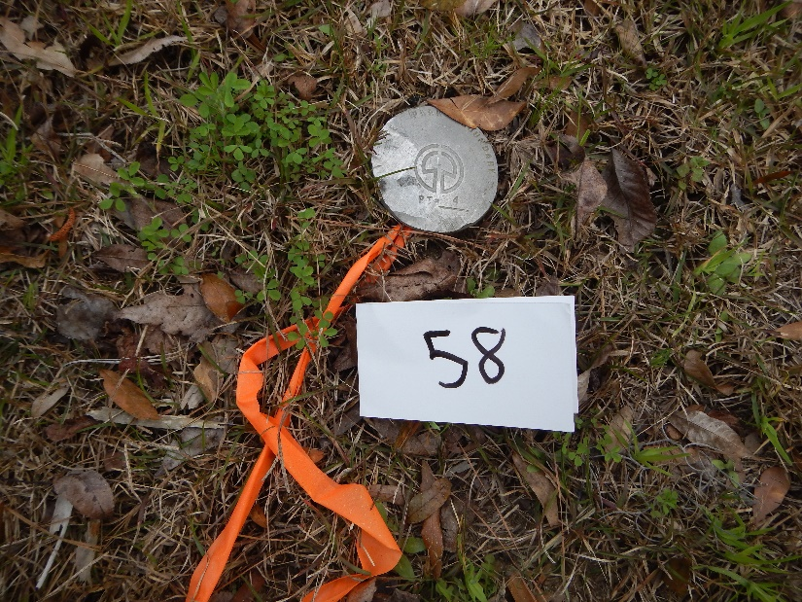
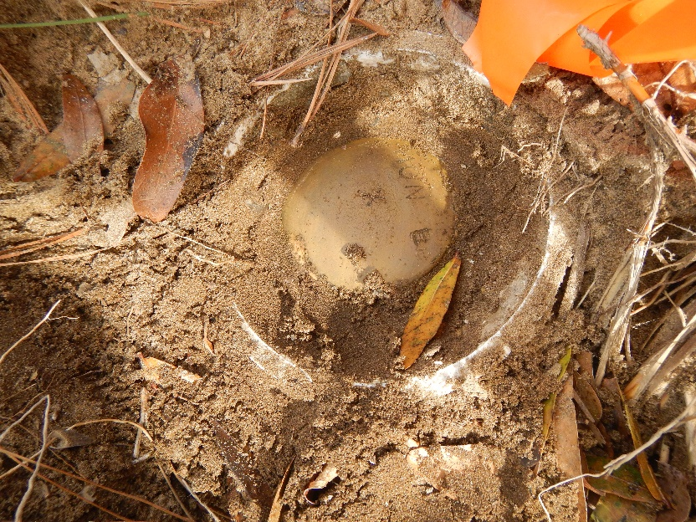
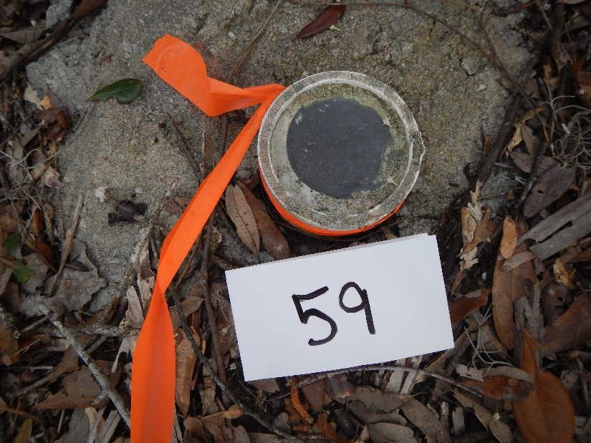
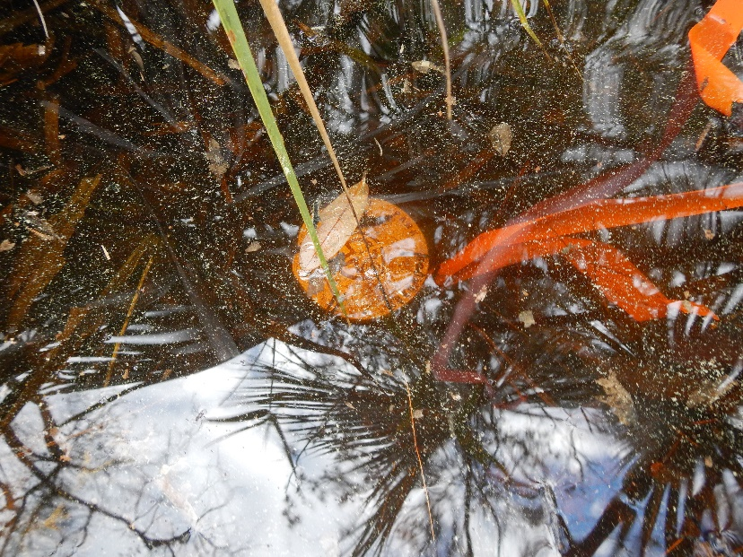
Edisto State Park Boundary Survey

Slide 20
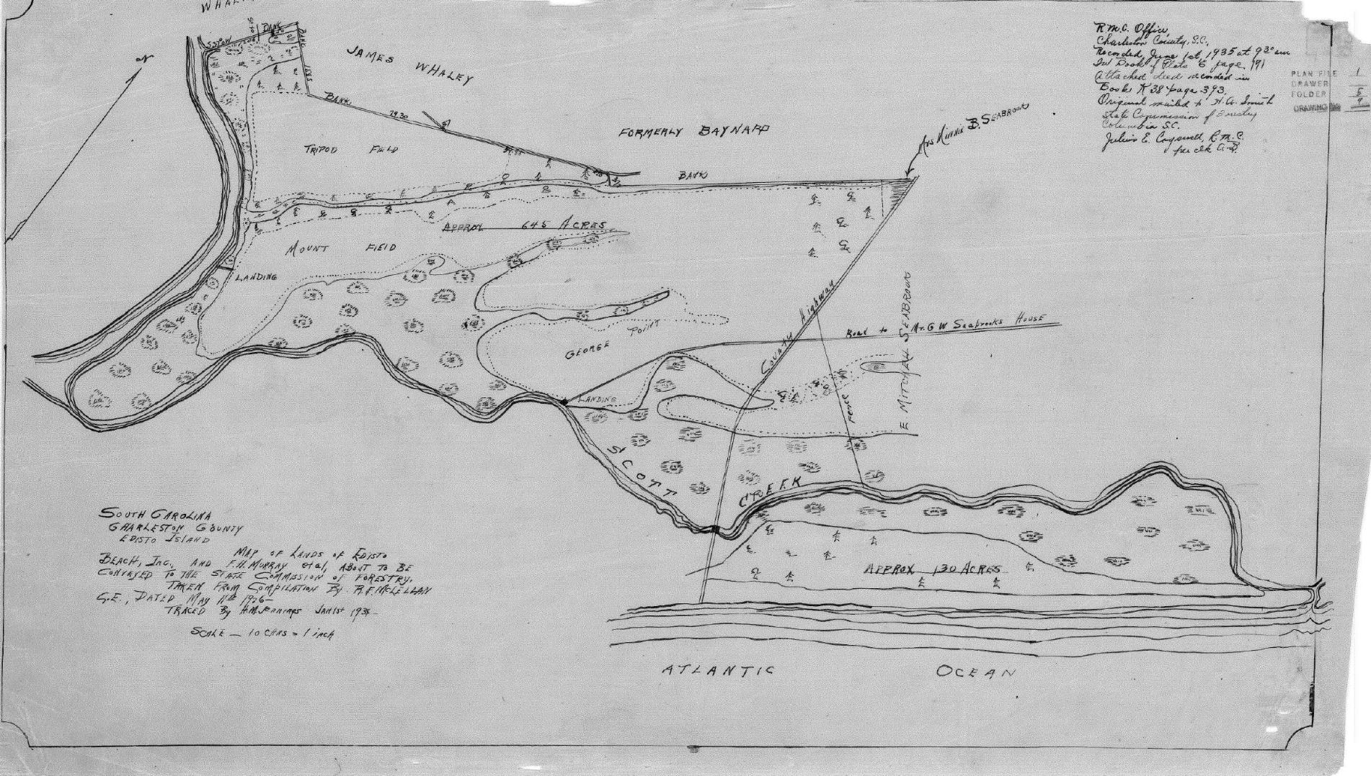
Charleston Plat Book E pg 191

Slide 21
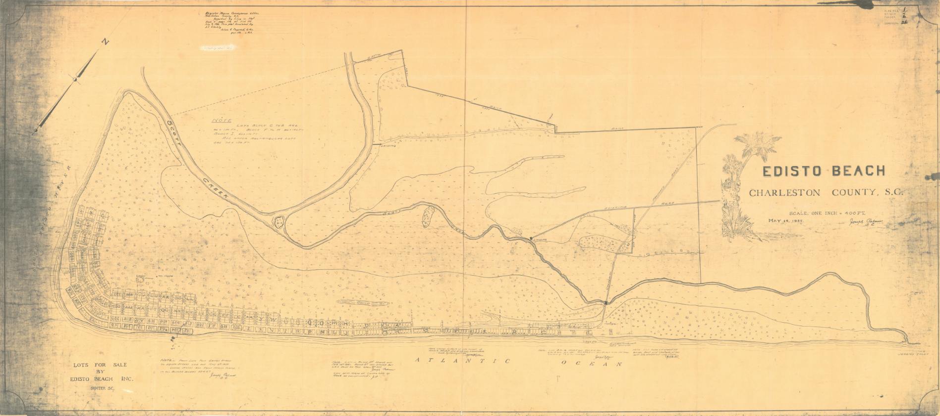
Charleston Plat Book E pg 192

Slide 22
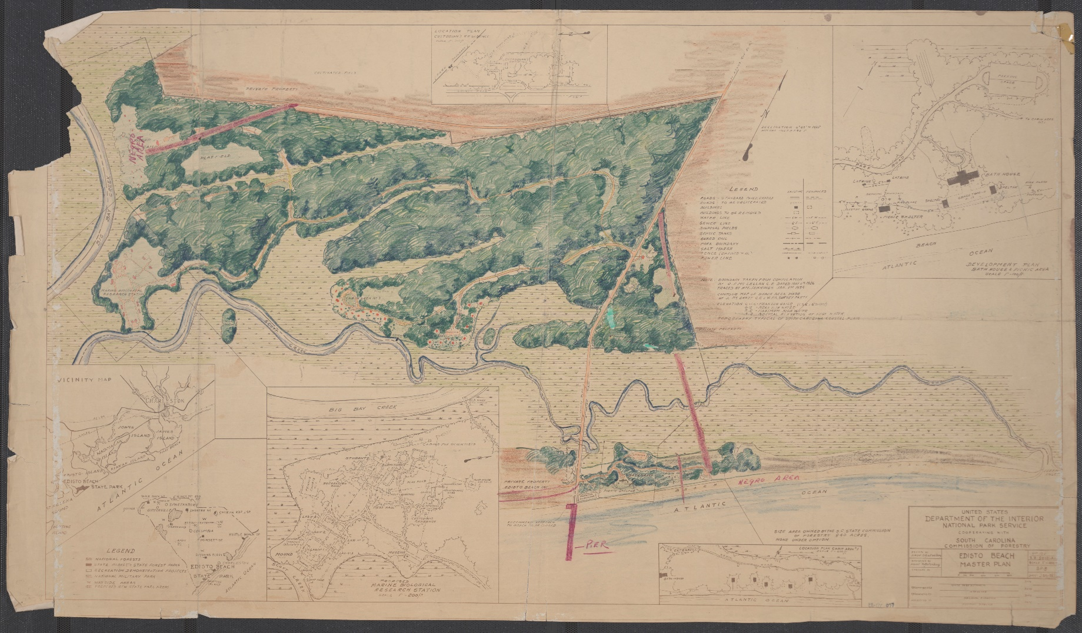
Edisto Beach Master Plan

Slide 23
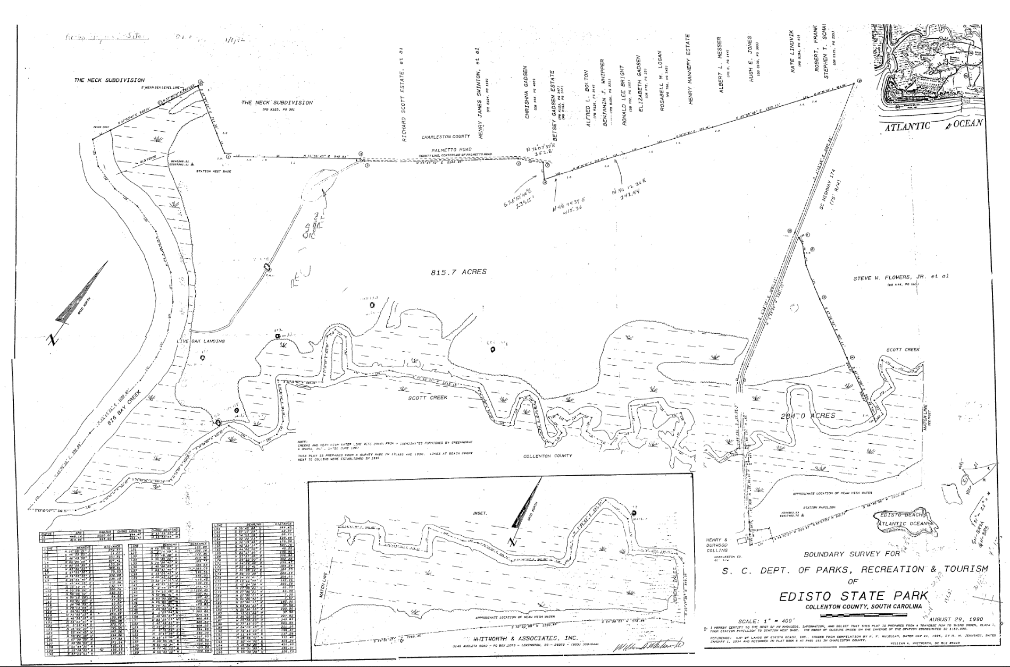
Edisto State Park Boundary Survey

Slide 24
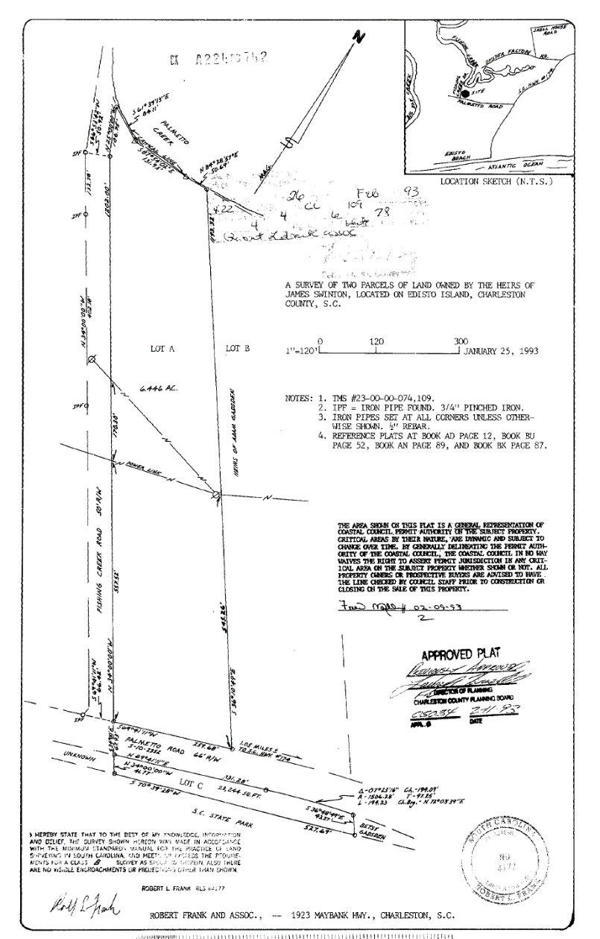
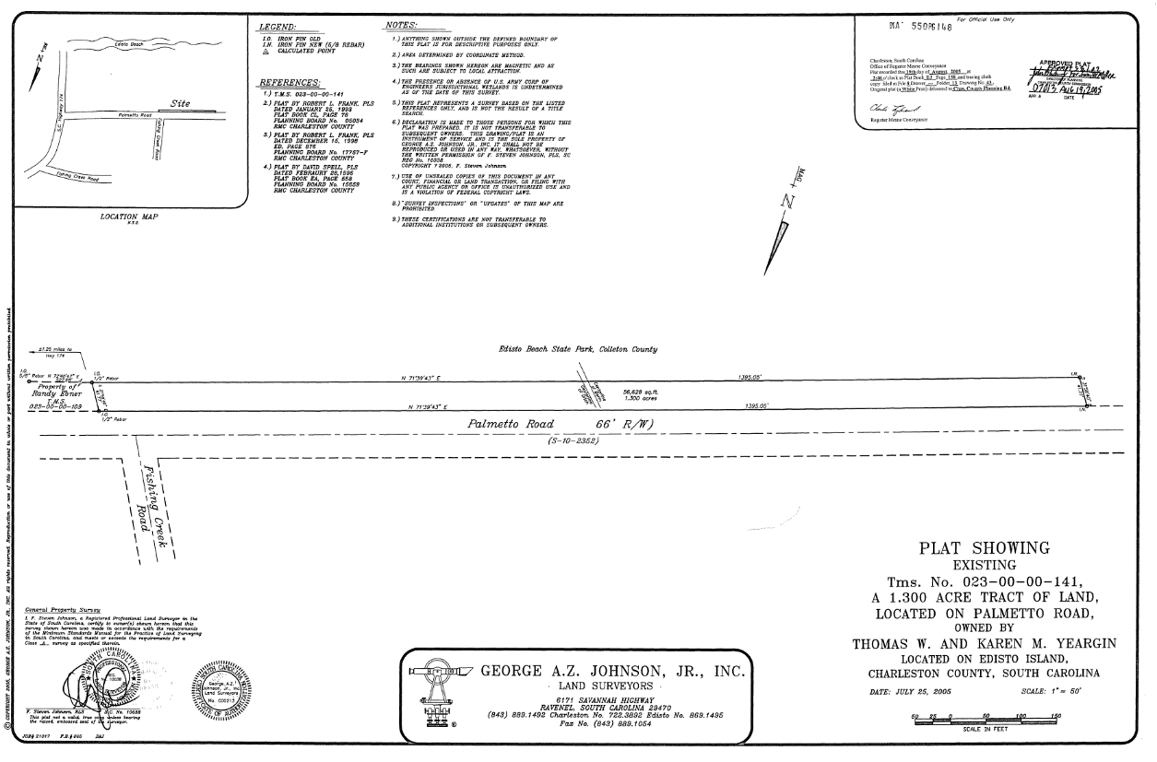
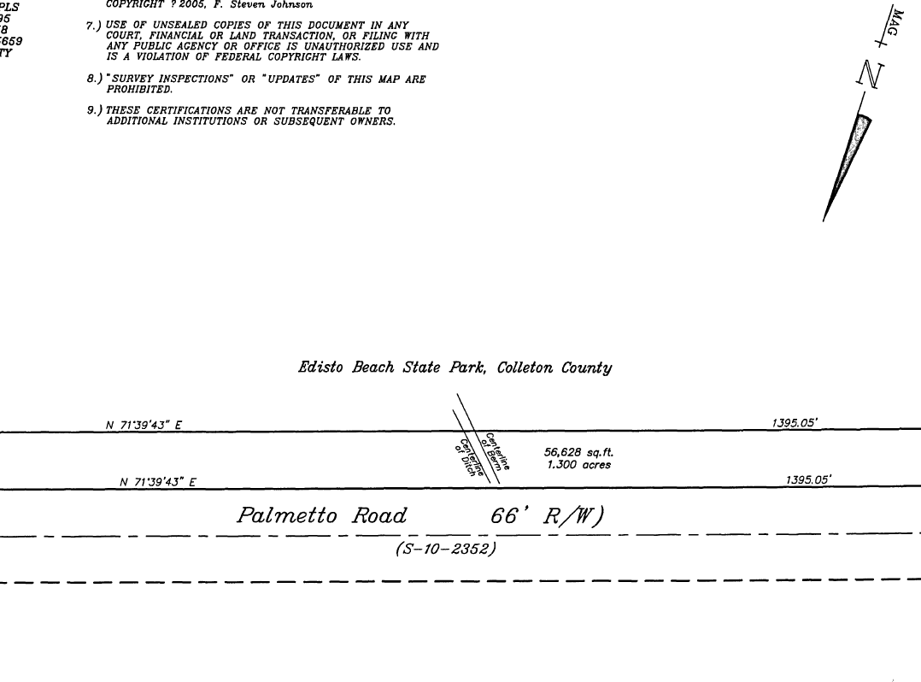
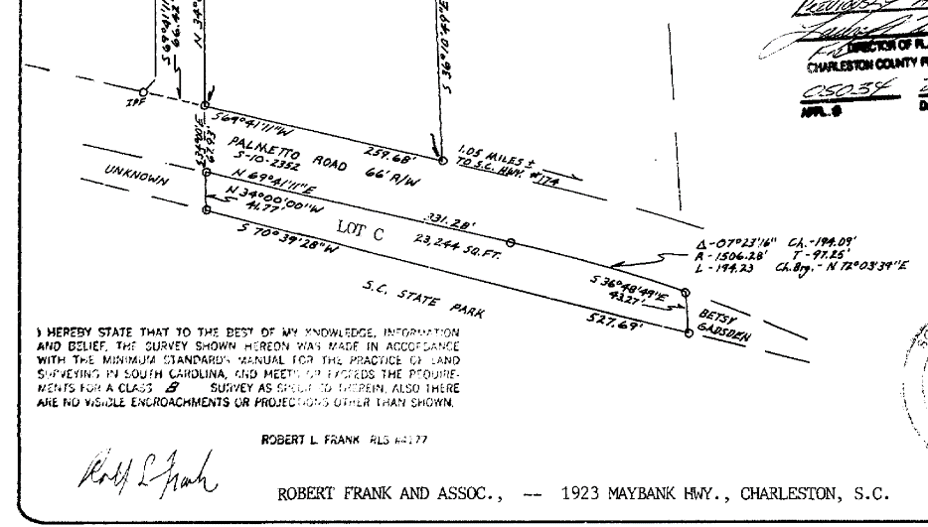
Charleston Plat Book CL pg 109
Charleston Plat Book EJ pg 158

Slide 25
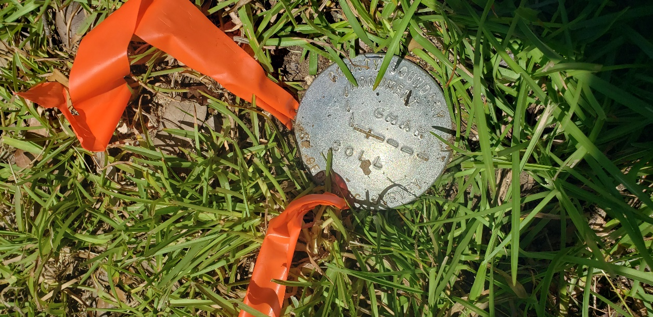
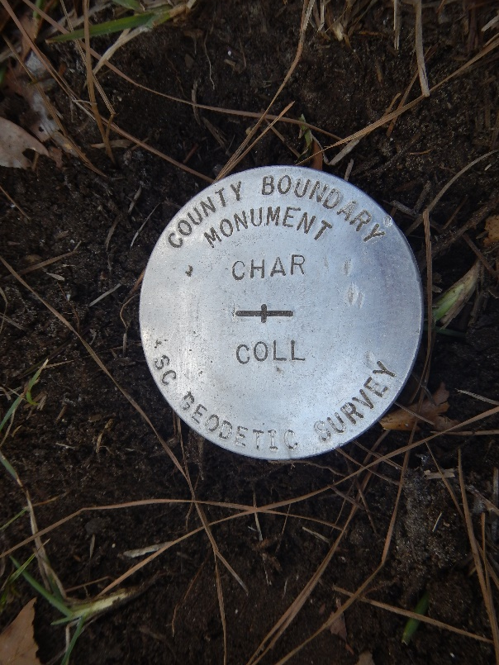
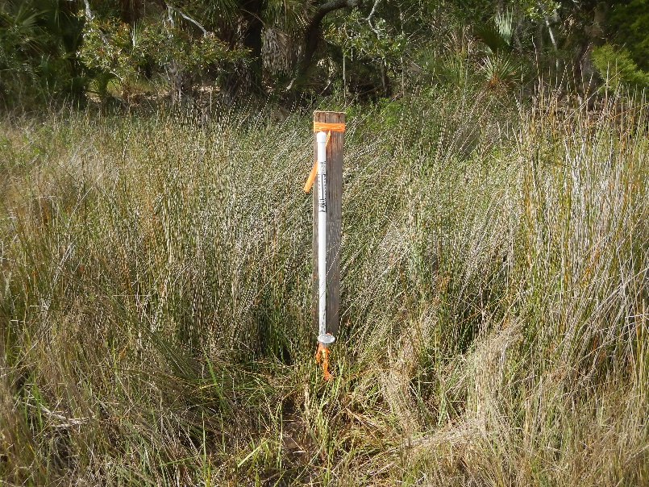
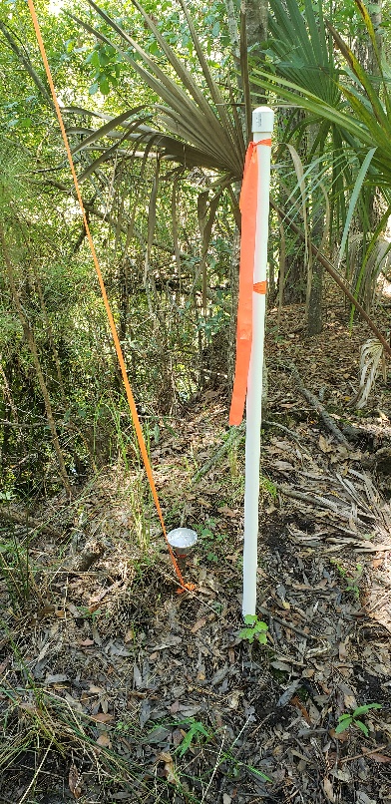

Slide 26
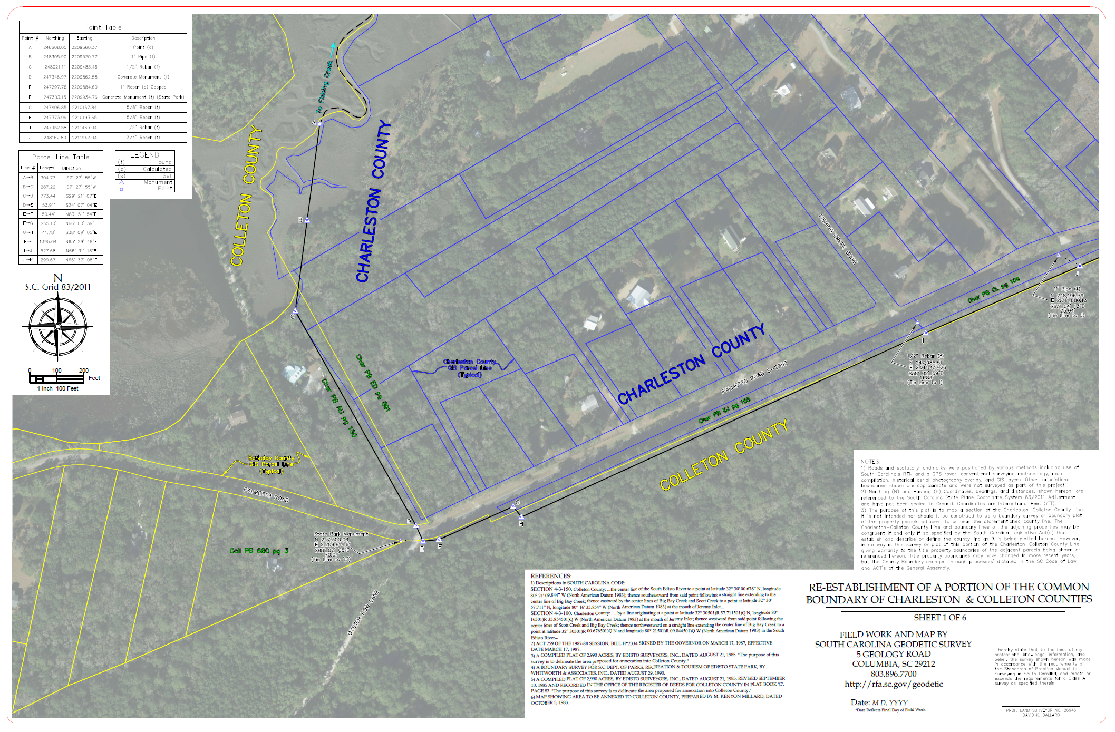
http://rfa.sc.gov/geodetic/cb_projectlist/charcoll

Slide 27
SIGNIFICANT IMPACTS?
A significant impact for this section of boundary has been defined as a residence or a place of business being found in a different county based on the re-established boundary.
Reviewed Close to 57 Properties Along the nearly 3.32 Mile Section of Re-established Boundary:
Determined 0 Significant Impacts
(Per the Definition Above)

Slide 28
QUESTIONS?
Or Information You Would Like to Provide?
PLEASE CALL: 803-734-0959
or EMAIL: boundary@rfa.sc.gov
We Will Work to Address Questions Promptly or Direct Questions to the Appropriate Agency or Jurisdictional Entity

