Slide 1
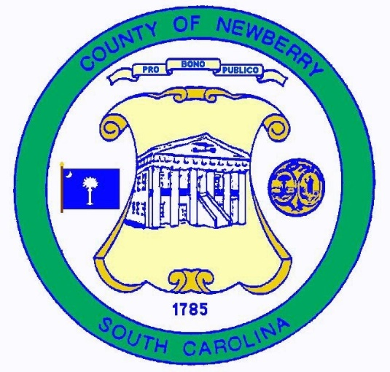

Newberry – Union
County Line
From the Enoree River to the Tyger River
Prepared by: CESI
2019

Slide 2

Act No. 262 of 2014
An Act to amend Section 27-2-105
Relating to the duties of the SC Geodetic Survey (SCGS) with respect to determining county boundaries
Purpose:
    Exact and precise locations and boundaries of state’s political subdivisions are critical for services, enforcement of property rights and election of public officials.
    Passage of time and growth has led to confusion over statutory county descriptions and the locations of county boundary lines
    Technology exists now to cost-effectively provide definite and permanent markers of boundary lines
    Necessary for state government and political subdivisions
    SCGS is the appropriate instrument to vest with the necessary authority to resolve county boundary issues

Slide 3
SC Code of Law and Act 262 Of 2014
Role of South Carolina Geodetic Survey
      (1994) Dispute between two or more counties- SCGS will act as mediator to resolve the dispute
      (1994/2014) SCGS to assist counties in defining and monumenting the locations of county boundaries and positioning the monuments using geodetic surveys where counties are ill-defined, unmarked, or poorly marked
      (2014) SCGS will clarify county boundaries as defined in Chapter 3, Title 4
      (2014) SCGS will analyze archival and other evidence and perform field surveys to position geographically all county boundaries in accordance with statutory descriptions
      (2014) To amend section 27-2-105, Code of Laws of South Carolina, 1976, relating to the duties of the South Carolina Geodetic Survey (SCGS) with respect to determining county boundaries, so as to authorize and direct the SCGS to clarify county boundaries and mediate boundary disputes between counties by providing a procedure allowing the SCGS administratively to adjust county boundaries, to provide the procedures including notice that SCGS must follow in making such adjustments, to provide that affected parties may appeal these adjustments to the Administrative Law Court in a de novo hearing, to provide the method of determining the effective date of these administrative county boundary adjustments and the notice requirements for these adjustments to be effective and to provide that nothing contained in this administrative process restricts the authority of the General Assembly by legislative enactment to adjust or otherwise clarify county boundaries by legislative enactment.
Op. S.C. Atty. Gen. 2016 (S.C.A.G. March 1, 2016)
Op. S.C. Atty. Gen. 2018 (S.C.A.G. May 22, 2018)

Slide 4
Steps for Clarifying Boundaries
Notify County Administrators in advance of planned work
Conduct historical research for documentary evidence of boundaries
Perform field work to locate monuments and corroborating evidence and position on State Plane Coordinates
Share preliminary findings with county officials for impact analysis and to plan public meetings
Receive feedback and input from local officials and public
Review and update findings, as appropriate
Work to build cooperation with affected parties

Slide 5
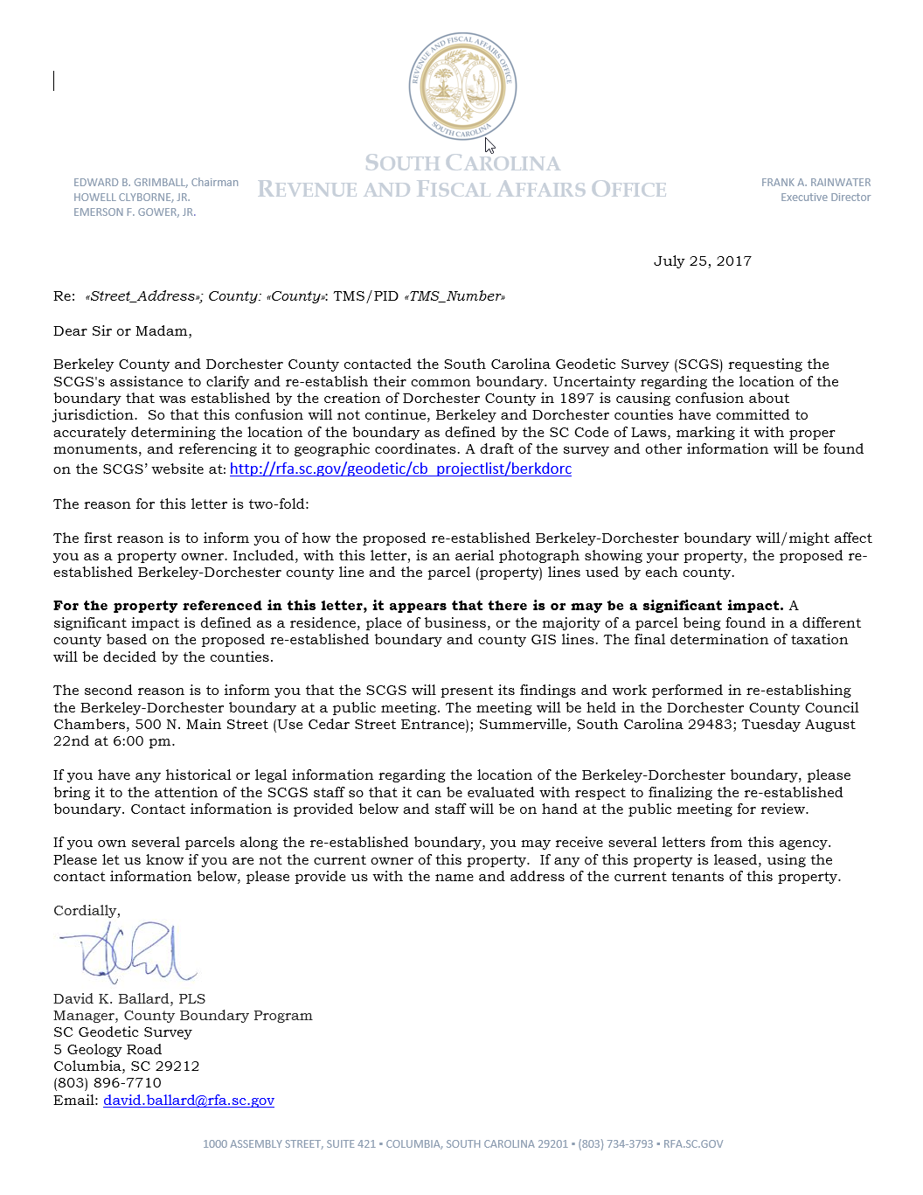
Public Meeting Notification

Slide 6
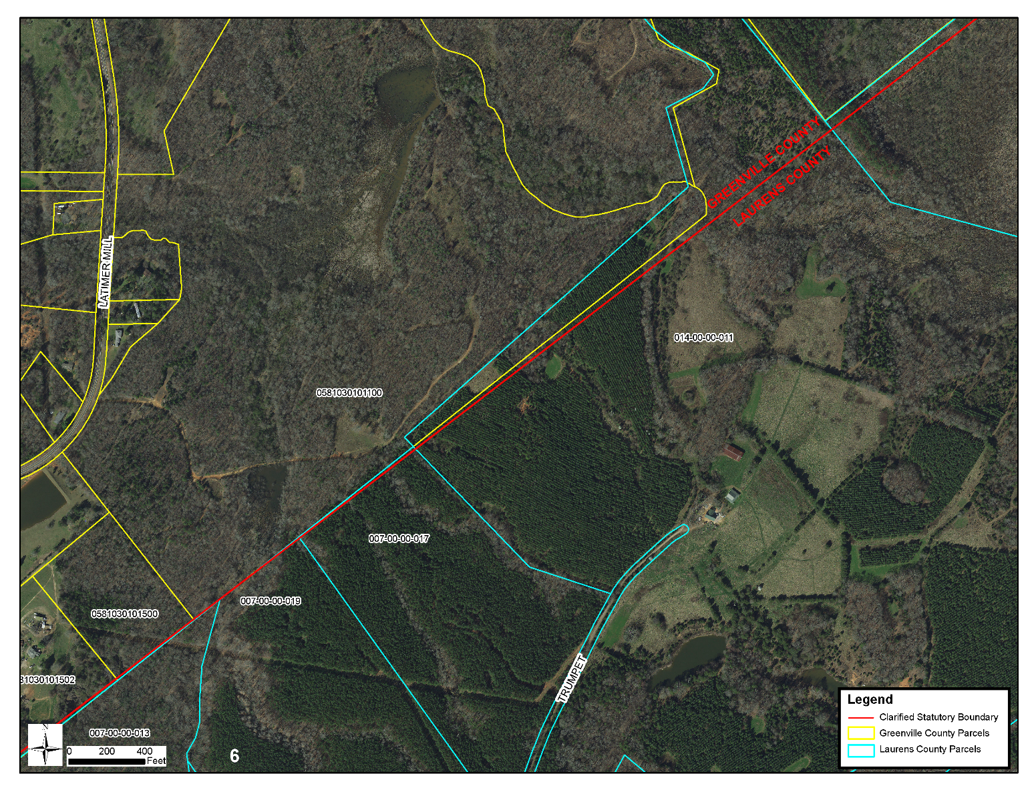
Public Meeting Notification

Slide 7
Scatter Gram of Differences
Between Observations
2 – Five Minute Sessions
RMSE(2-D) = 0.020m @95%
0.015m = ~0.05’
Axis Units in Meters

Slide 8
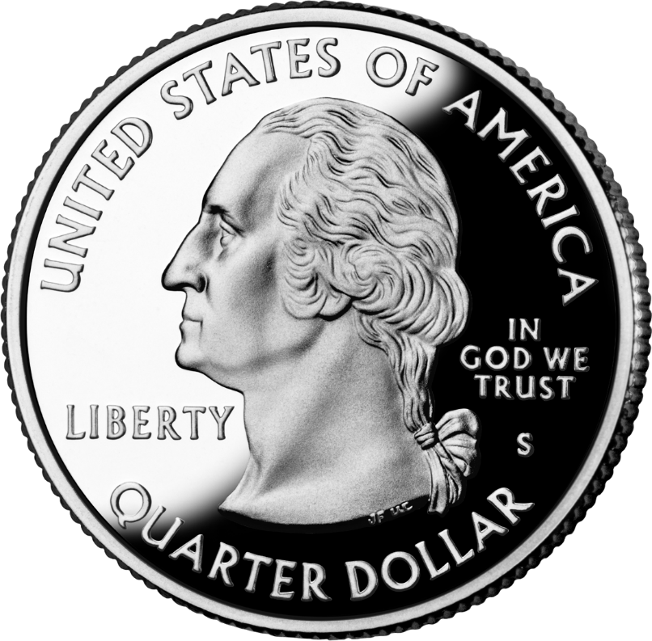
Scatter Gram of Differences
Between Observations
2 – Five Minute Sessions
RMSE(2-D) = 0.020m @95%
0.015m = ~0.05’
Axis Units in Meters

Slide 9
Act 262 of 2014
Steps for Clarifying Boundaries
SC Code of Law SECTION 27-2-105
SCGS Requirements:
    Upon reestablishing county boundary, SCGS shall certify its work and within 30 days of certification:
        Provide copies to the administrator of each affected county;
        Provide written notification to affected parties
        Provide notice and copies to the public through its official website and or other means it considers appropriate; and
        Notify as it determines appropriate, other affected state and federal agencies
    (Initiates 60 Day Appeal Process)
  Certified Surveys submitted to Secretary of State, Register of Deeds Offices, and South Carolina Department of Archives with Cover Letter
  Date of the cover letter is the date the surveys become effective
  Introduce Legislation to update Code of Law to reflect clarified boundary with State Plane Coordinates

Slide 10
SC Code of Law SECTION 27-2-105
Affected Parties Disagreeing with SCGS:
    May file request for a contested case hearing with the SC Administrative Law Court
    This decision may be appealed
    “Affected Party”
              Governing body of an affected county
              Governing body of a political subdivision of this State
              An elected official, other than a statewide elected official
              A property owner or an individual residing in the certification zone
              A business entity located in the certification zone
              A nonresident individual who owns or leases real property situated in the certification zone

Slide 11
Chapter 5, Title 4
Change of Boundaries
  S.C. Code § 4-5-120: Procedure for annexing part of county- governing body or 10 percent of registered voters petition in writing, shall deposit with the clerk of court an amount of money sufficient to cover the expenses of surveys , plats, annexation commission and the election to be held to determine whether the proposed annexation shall be effected and then file such resolution or petition in the office of the clerk of court
  S.C. Code § 4-5-130: Appointment of Commission for annexation- once presented to the governor then within 30 days the governor shall appoint a commission of four persons
  S.C. Code § 4-5-140: Employment of Surveyors- commission may contract for survey and location of the proposed change of line and for such purpose may employ 3 surveyors
  S.C. Code § 4-5-170: Governor shall order election; voting place; eligible electors- to be held in an area sought to be transferred and an election to be held in the county to which the area is proposed to be transferred
  Propose and adopt Legislation

Slide 12
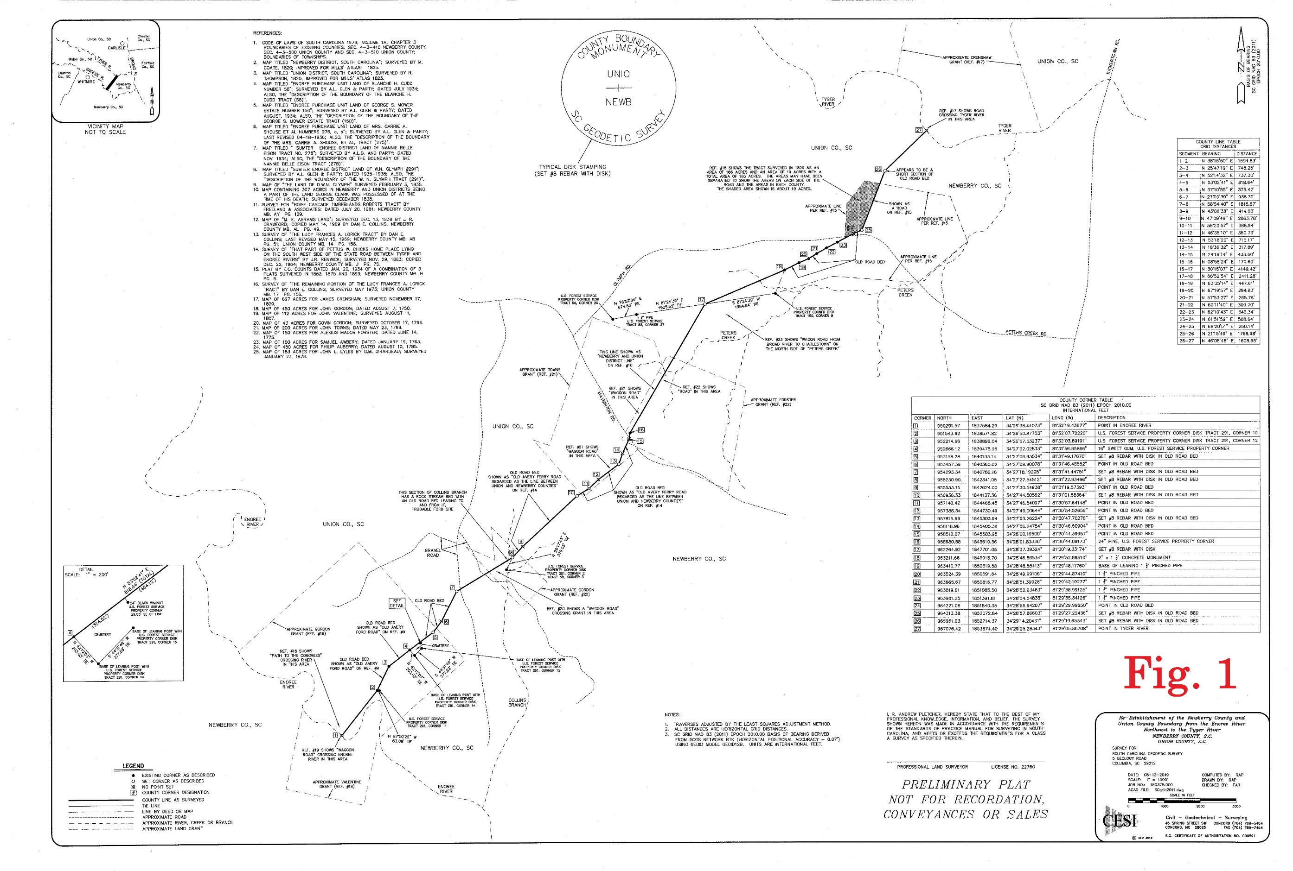
Newberry-Union County Line

Slide 13
Newberry-Union County Line
By Act No. 1263 in 1785 the SC Legislature divided the Ninety-Six District into six counties
The new counties included Newberry (Newbury) and Union counties
Between the Enoree and Tyger rivers Newberry was described as bounding on the road that ran from Anderson’s Ford to Hill’s Ford
Union had no description – it was the remnant of the district

Slide 14
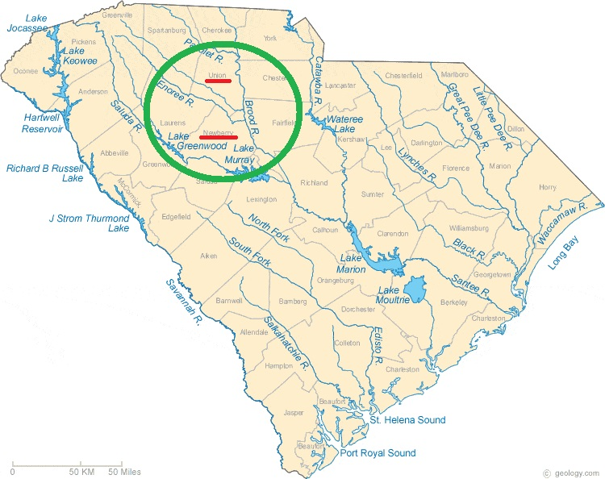
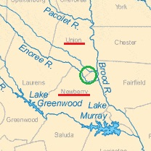
Newberry-Union County Line

Slide 15
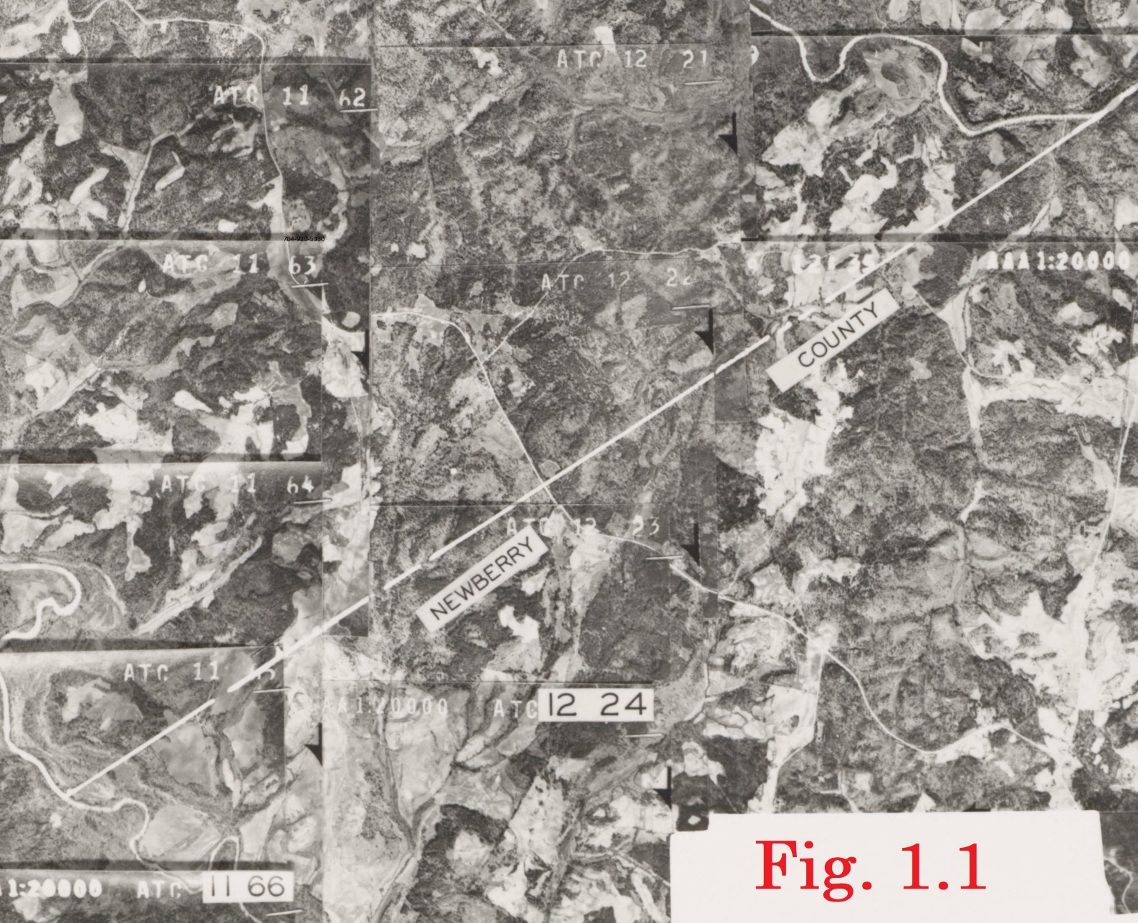
Newberry-Union County Line
In 1882 Union County got a written description
The road from Avery’s Ford on the Enoree to Crenshaw’s Ford on the Tyger
In the 1930s US Forest Service bought most of the land and the road disappeared

Slide 16
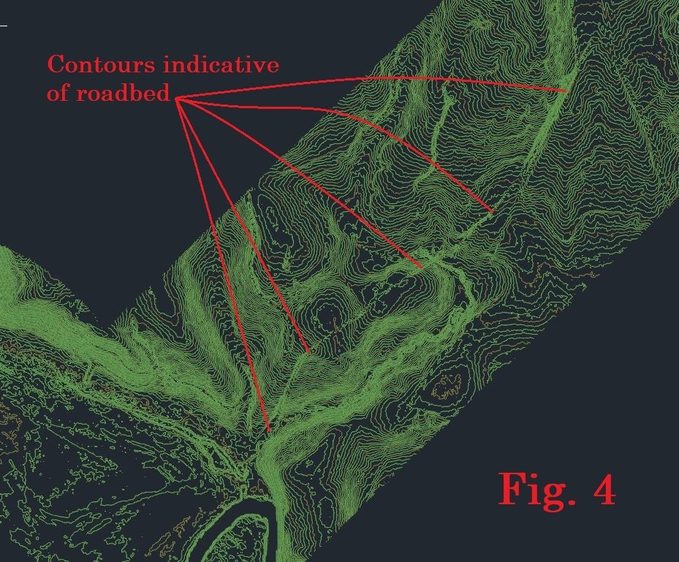
Newberry-Union County Line
The road ceased to be used and much of the land was prepared for timber planting
Since the 1930s the property has been timbered multiple times
But some sections of road remained along property lines and in other places

Slide 17
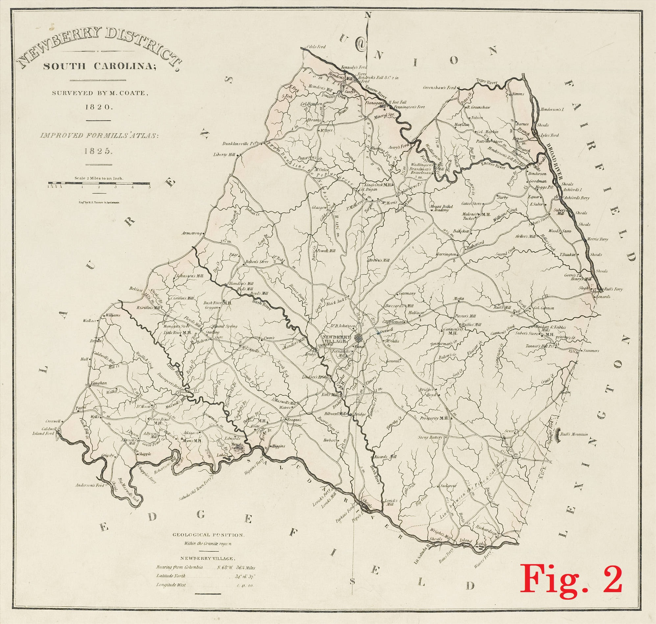
Newberry-Union County Line
Maps such as the Mills Atlas of 1820/1825 give us an idea of the general location and route of the road
Newberry County…,

Slide 18
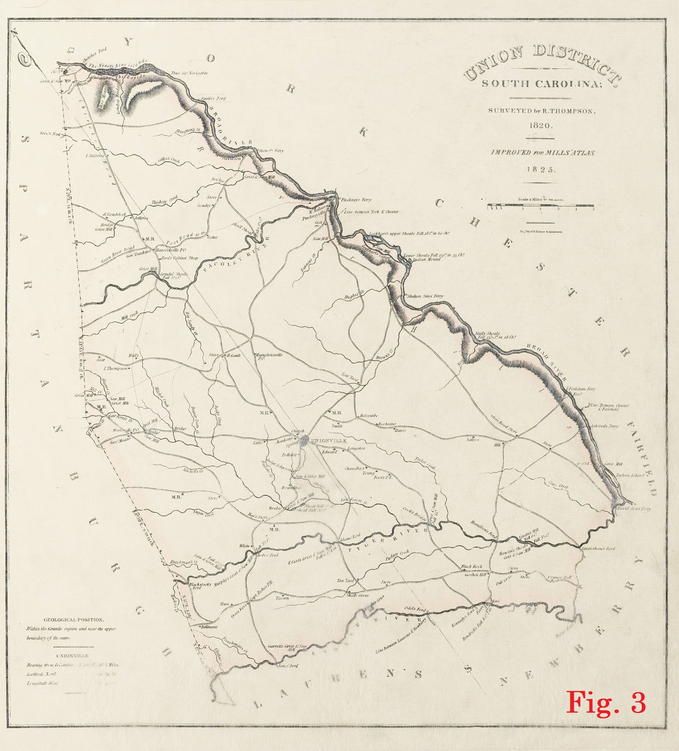
Newberry-Union County Line
…and Union County

Slide 19
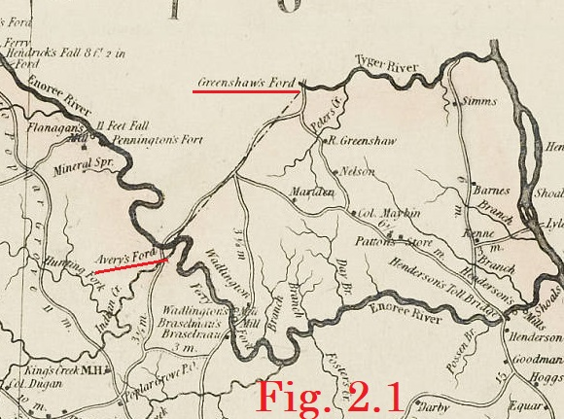
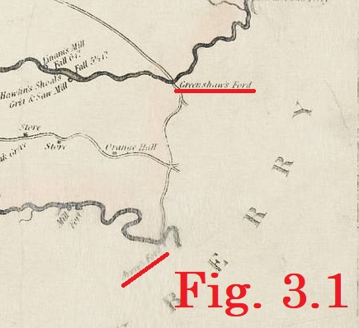
Newberry-Union County Line

Slide 20
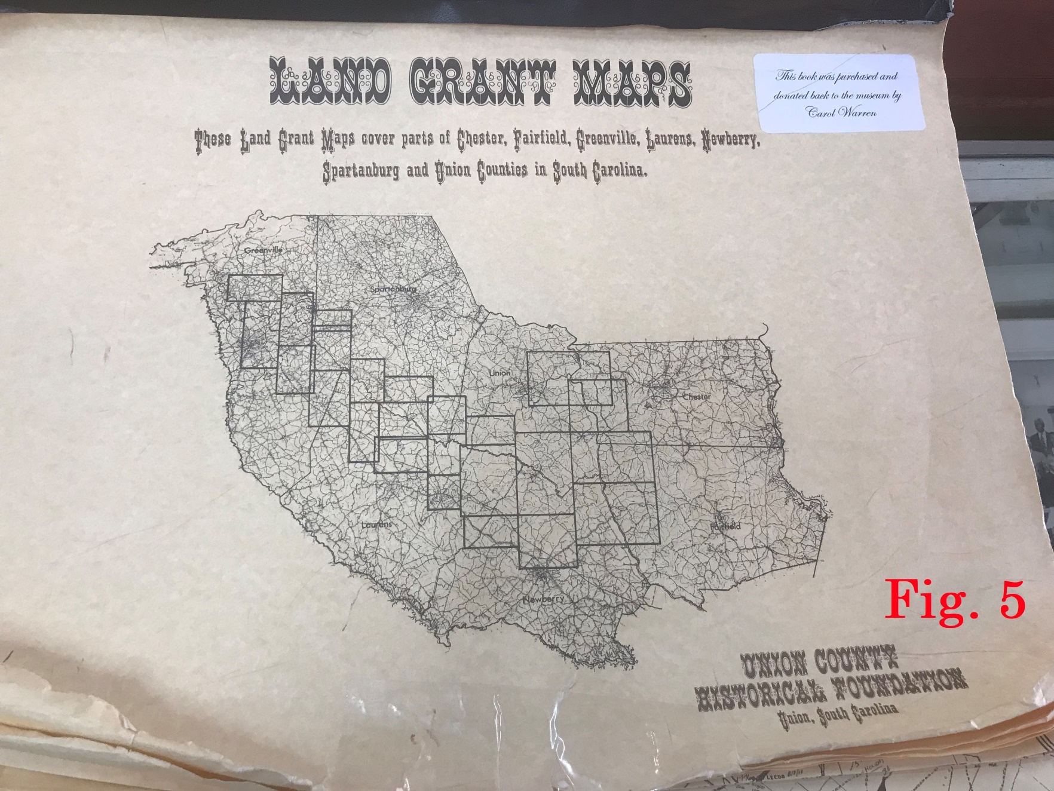
Newberry-Union County Line
Ranger Krista Shelton with the Enoree Ranger District Office in Whitmire made the Forest Services files available yielding lots of maps and abstracts
The Union County Museum shared their Land Grant Index

Slide 21
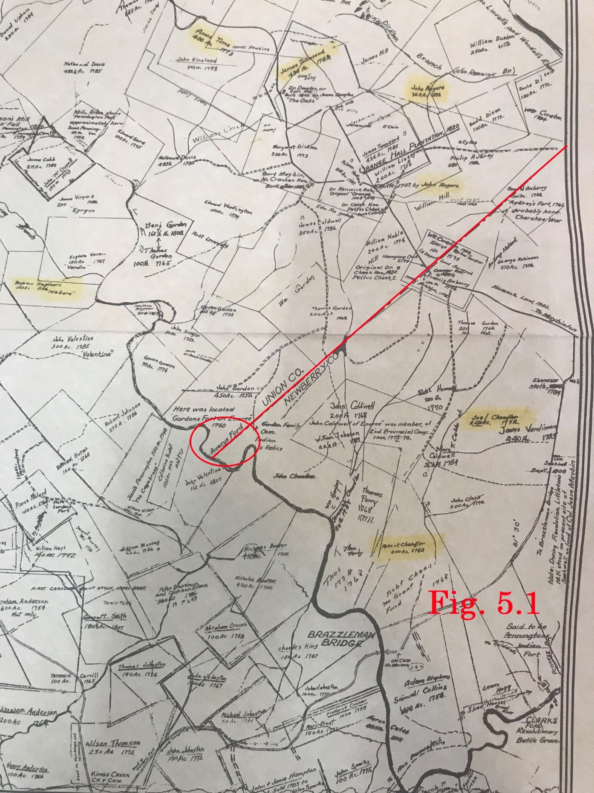
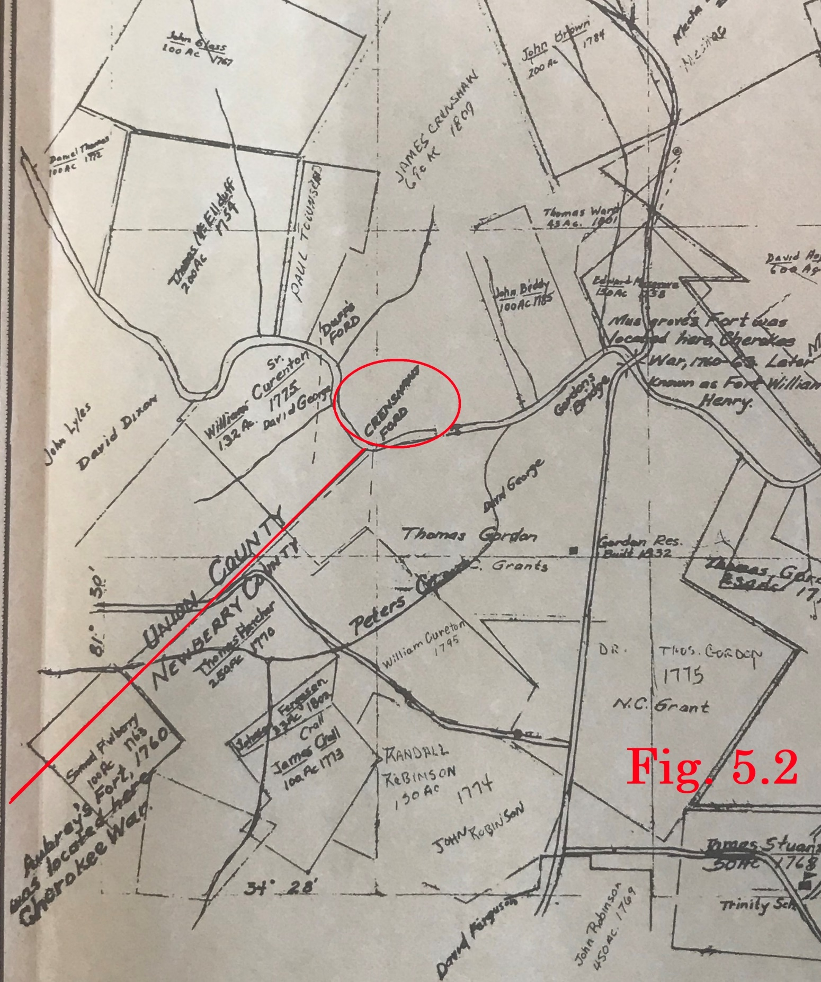
Newberry-Union County Line

Slide 22
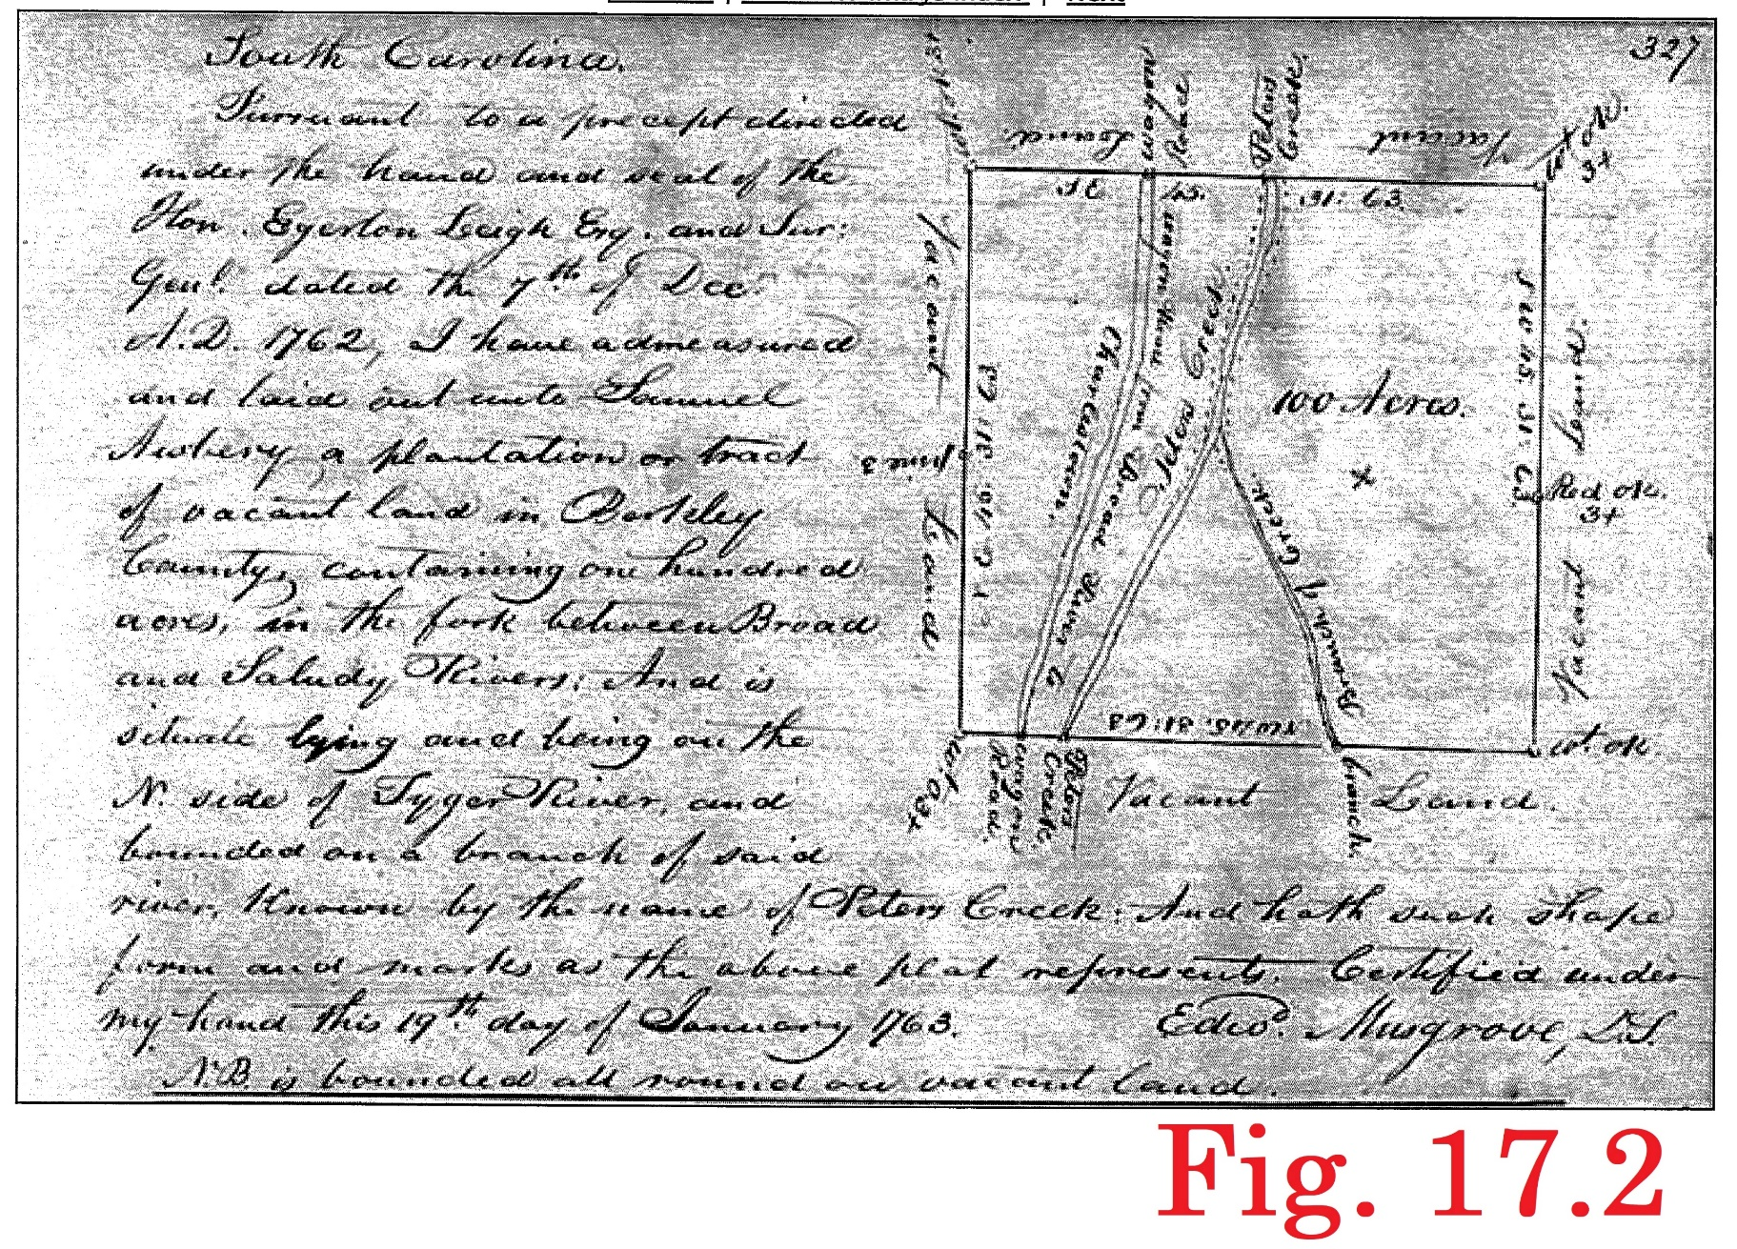
Newberry-Union County Line
We recovered about 50 grants for this area from SC Department of Archives and History
Dates range from 1750 to 1816
A number of these show the road in question

Slide 23
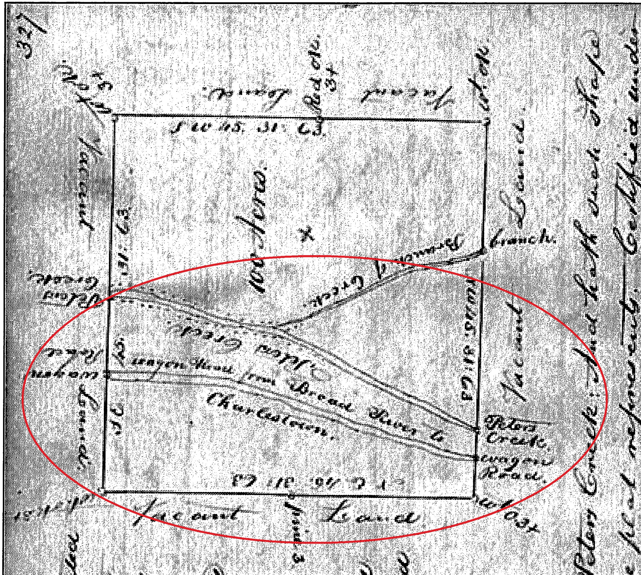
Newberry-Union County Line

Slide 24
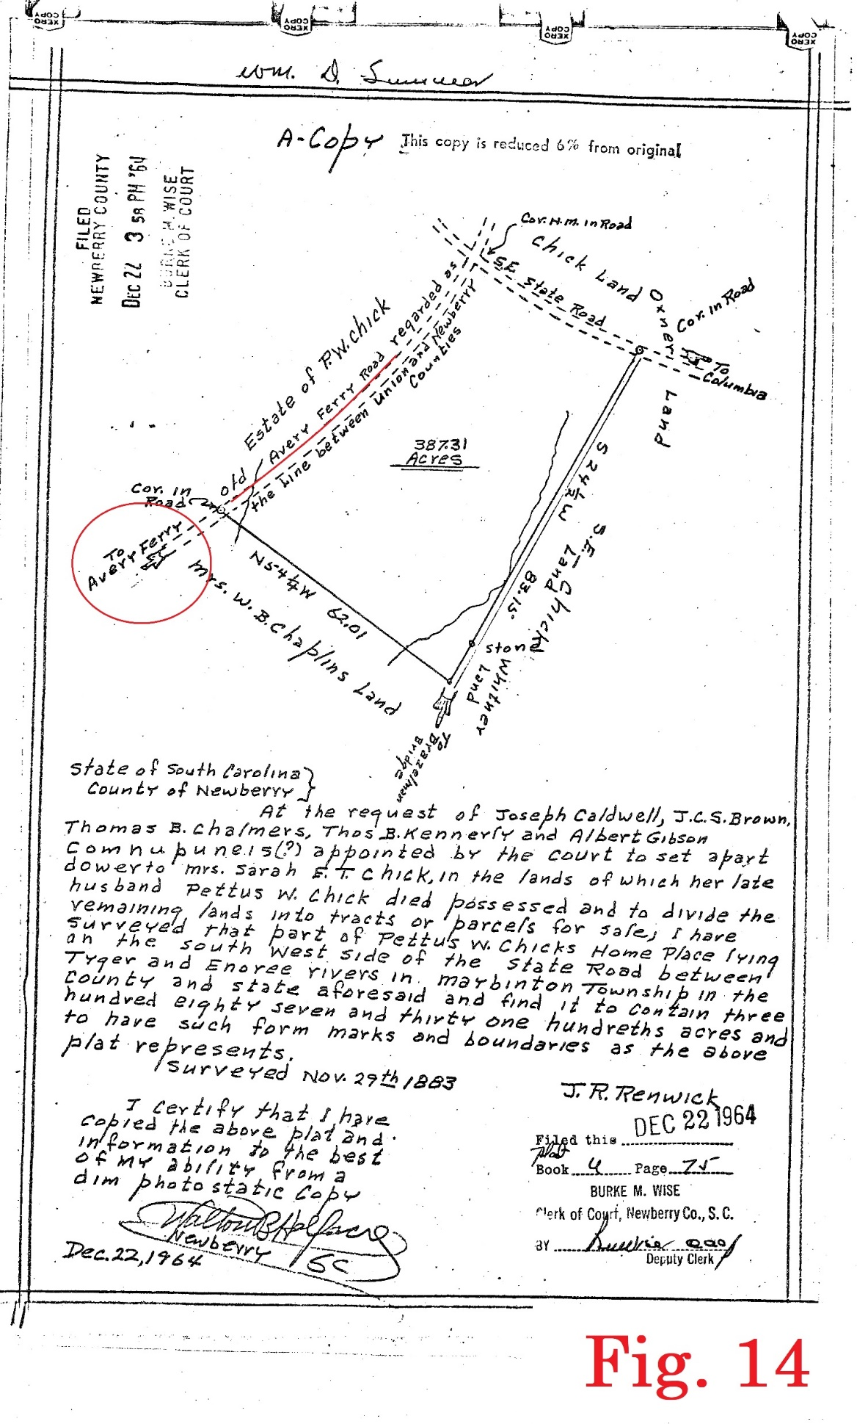
Newberry-Union County Line
Additional deeds and maps were obtained from the Register of Deeds office for both Newberry and Union counties

Slide 25
Newberry-Union County Line
Review of LIDAR topography provided by GIS Manager Tanner Arrington with SC Geologic Survey showed some areas with contours indicating an old roadbed.

Slide 26
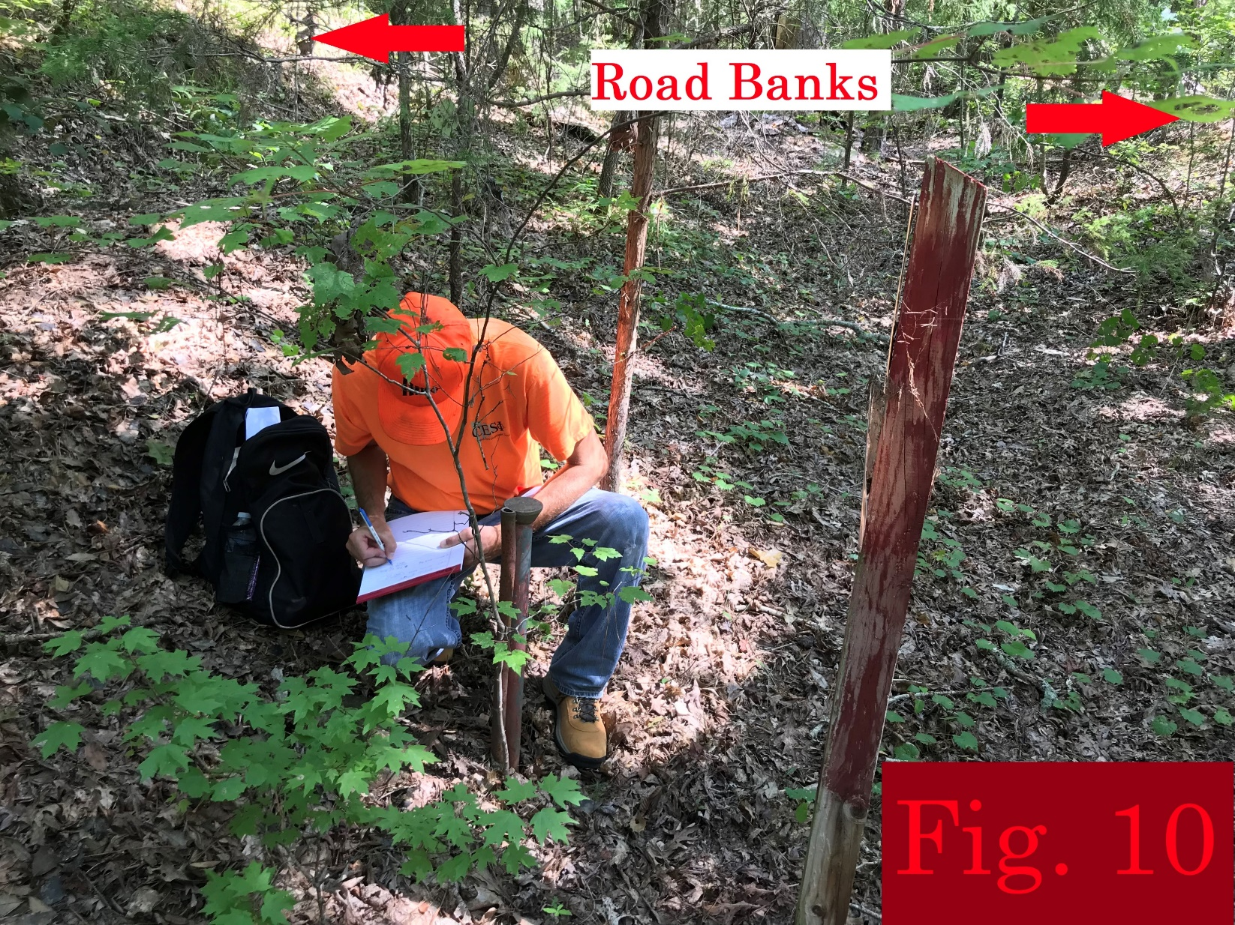
Newberry-Union County Line
An initial field visit was conducted guided by the LIDAR topo
Sections of old roadbed were found near the Enoree River, south of Maybinton Road, and at Glymph Road
Forest Service corners and other property lines were noted

Slide 27
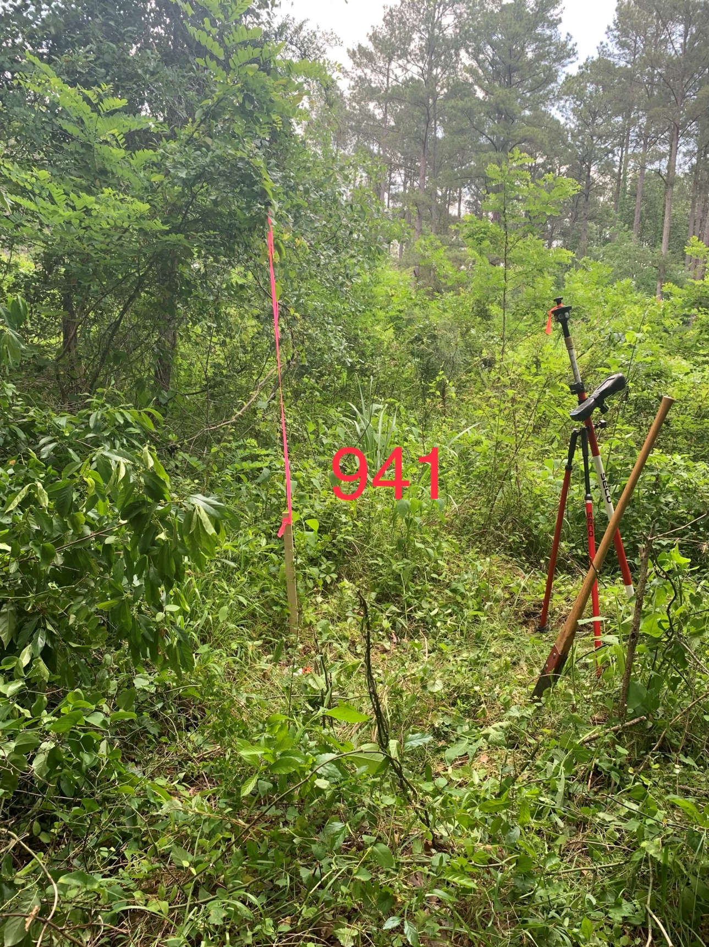
Newberry-Union County Line
Survey crews established control and located all the features identified
Using the survey locations we worked in the office to begin to fit the grants to the features on the ground

Slide 28
Newberry-Union County Line
We were fortunate to have grants that gave us the location of the fords for both rivers, and were able to start at the outside and work our way in
Additionally, unique bends in the river helped confirm locations
One of our earliest grants, the John Gordon grant of 1750, shows the ford at the Enoree River
It labels it the “Path to the Congarees” and shows something in the river which we interpret to be a shoal or sandbar

Slide 29
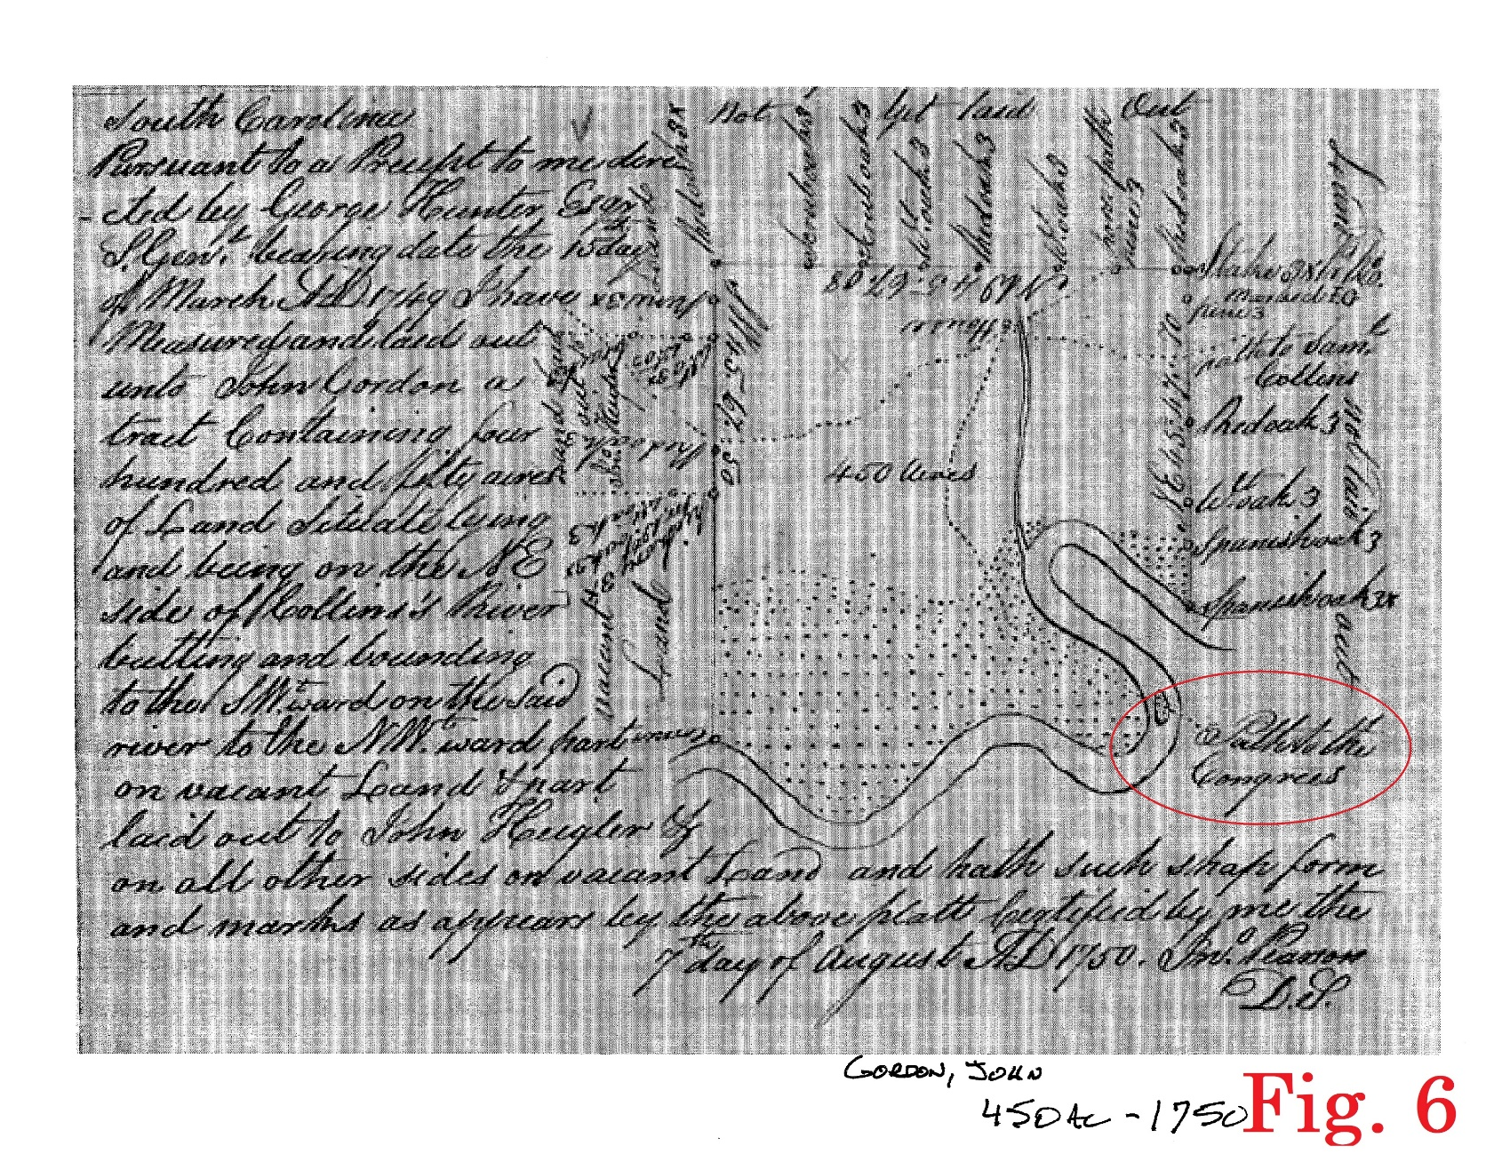
Newberry-Union County Line
The pronounced bend in the river makes this location unmistakable
Google imagery shows the bend
Google imagery also shows a shoal or sandbar in the location shown on the grant

Slide 30
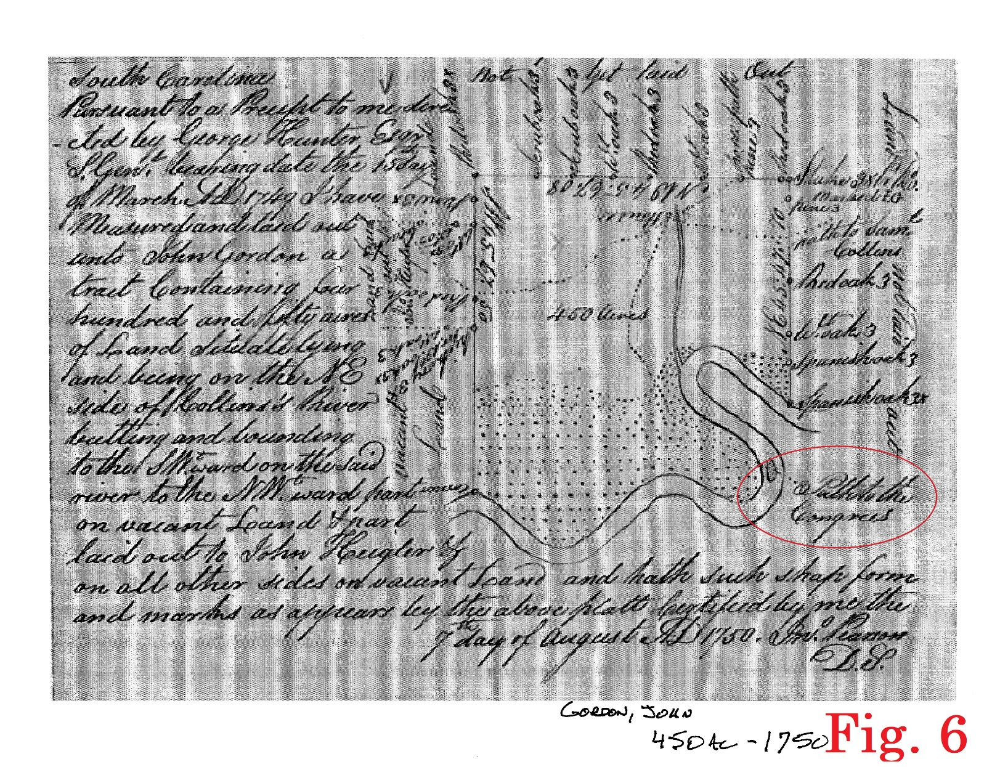
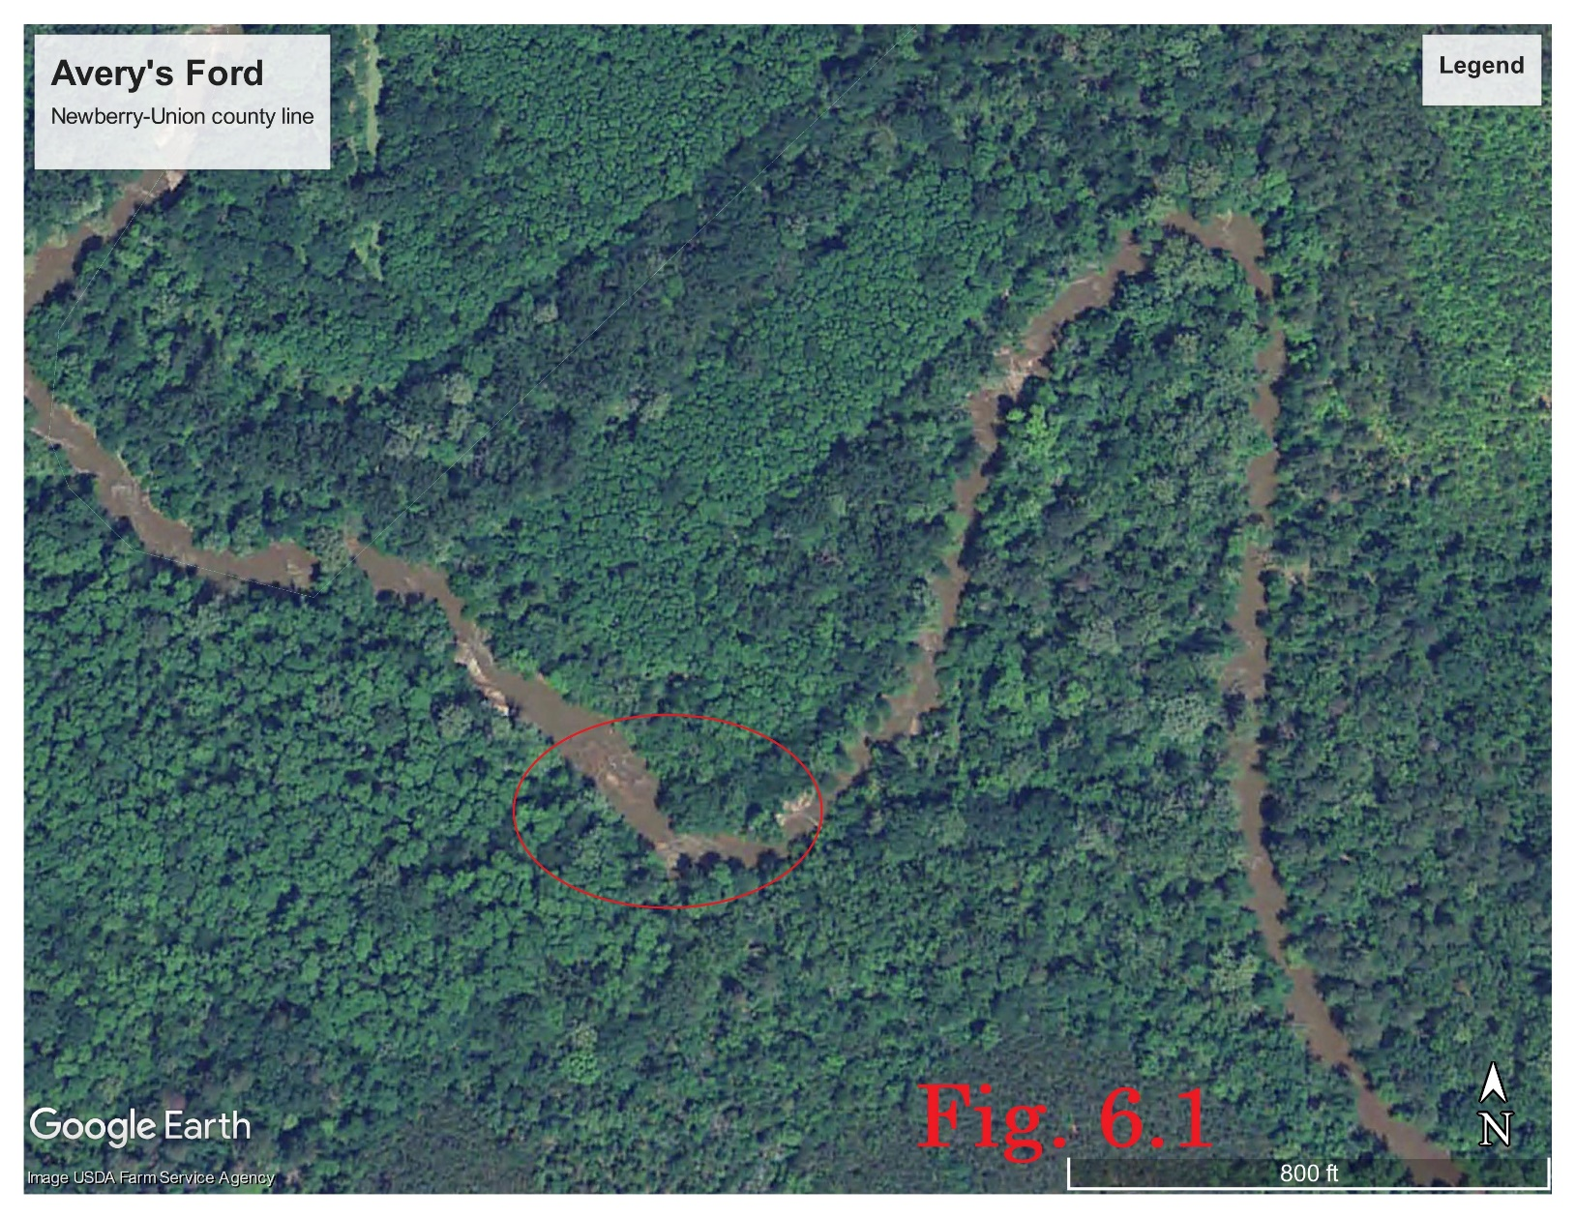
Newberry-Union County Line

Slide 31
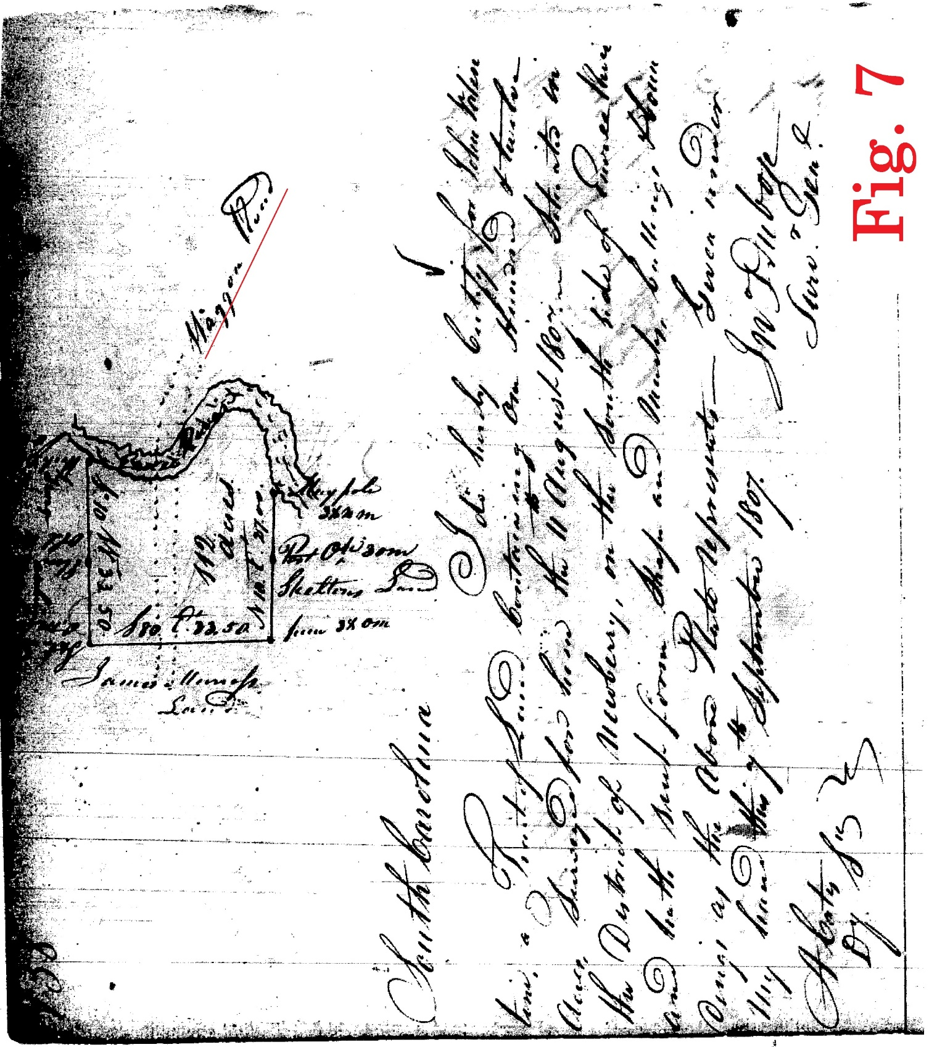
Newberry-Union County Line
And, in 1807 a grant on the south side of the river to John Valentine shows a “waggon” road in the same location

Slide 32
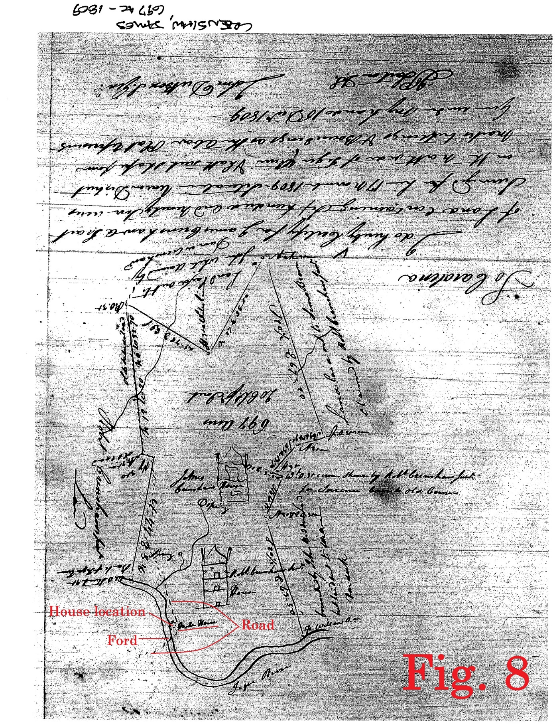
Newberry-Union County Line
At the Tyger River an 1809 grant to James Crenshaw shows the road and ford there
It also shows a house immediately adjacent the river
This would be an unusual place for a house unless there is high ground there

Slide 33
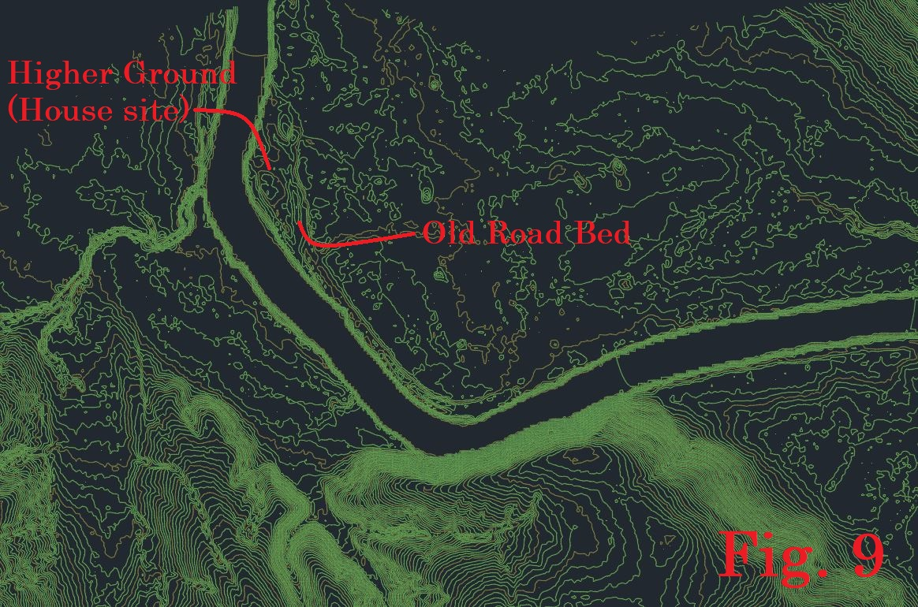
Newberry-Union County Line
Many of the lines on this grant are still property lines, so it was easy to position this grant in the real world
At the real-world location that the grant shows a house the LIDAR shows high ground – and a roadbed

Slide 34
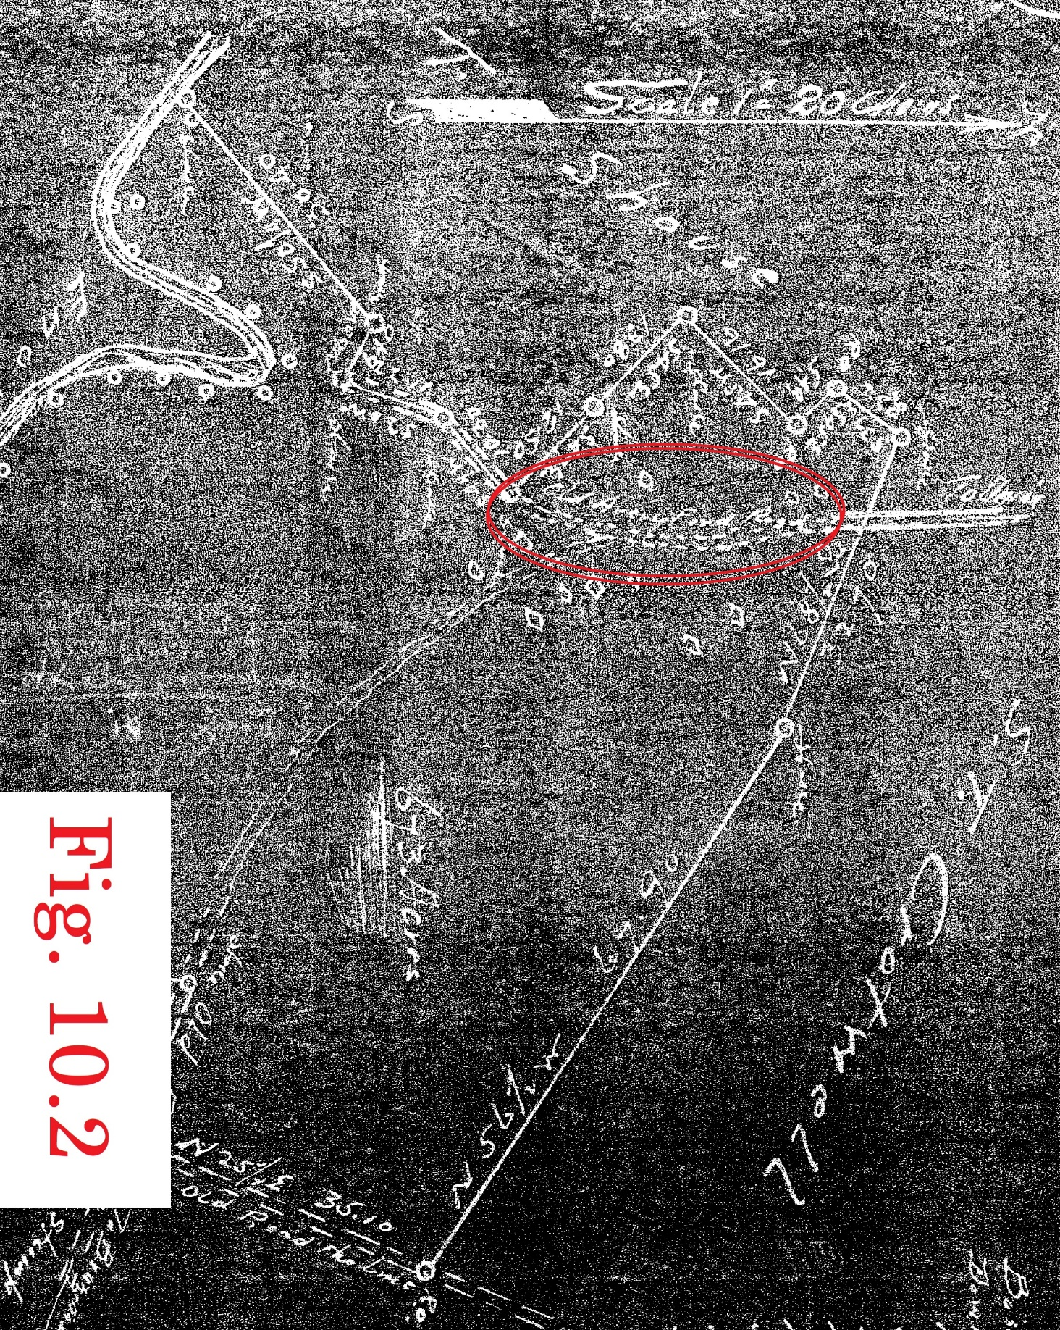
Newberry-Union County Line
With the two ends in place we started at the Enoree and worked our way toward the Tyger
There is existing roadbed for almost a mile and contemporary maps label it “Old Avery Ford Road”

Slide 35
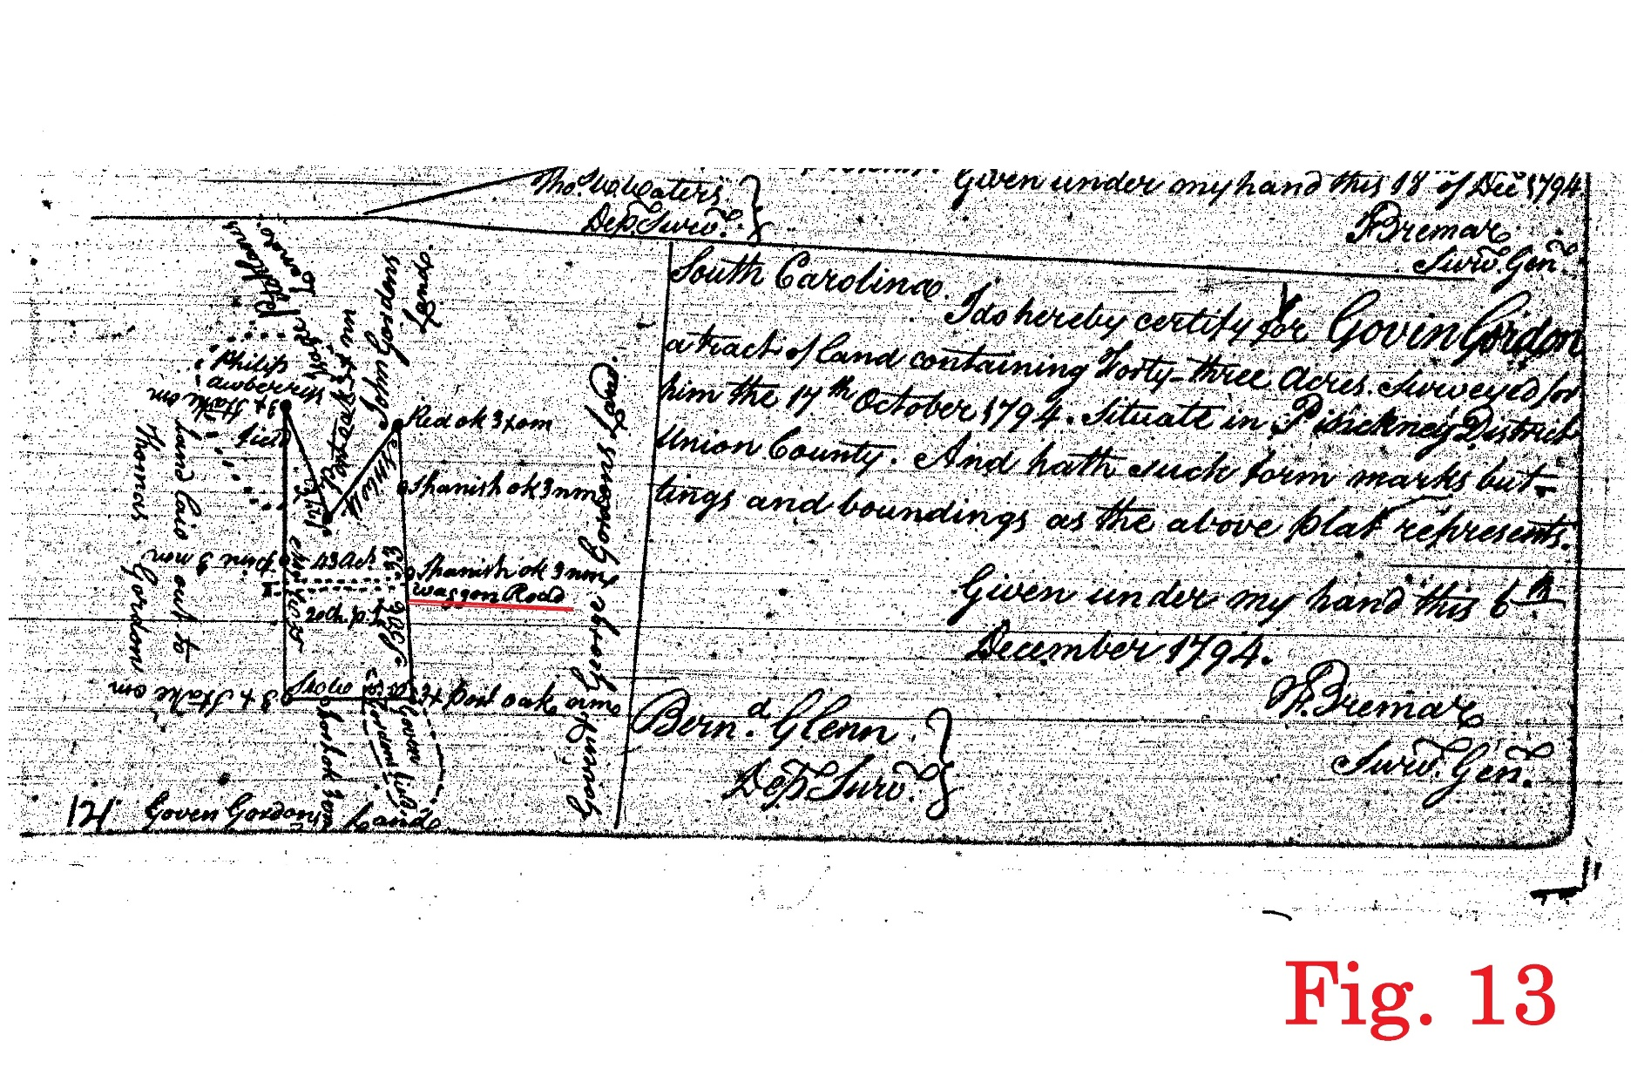
Newberry-Union County Line
There is a gap of about 1500’
The old roadbed picks up again at Collins Branch
A grant for Gordon Govin from 1794 shows a “waggon road” crossing in the location we find roadbed at Collins Branch

Slide 36

Newberry-Union County Line
From there to Maybinton Road (and the historic location of Chicks Crossroads on 1887 Lake map) the old roadbed is visible and attested by a plat from 1883 and grants from 1769 and 1775
The 1769 and 1775 grants actually continue ½ mile past Chicks Crossroads

Slide 37
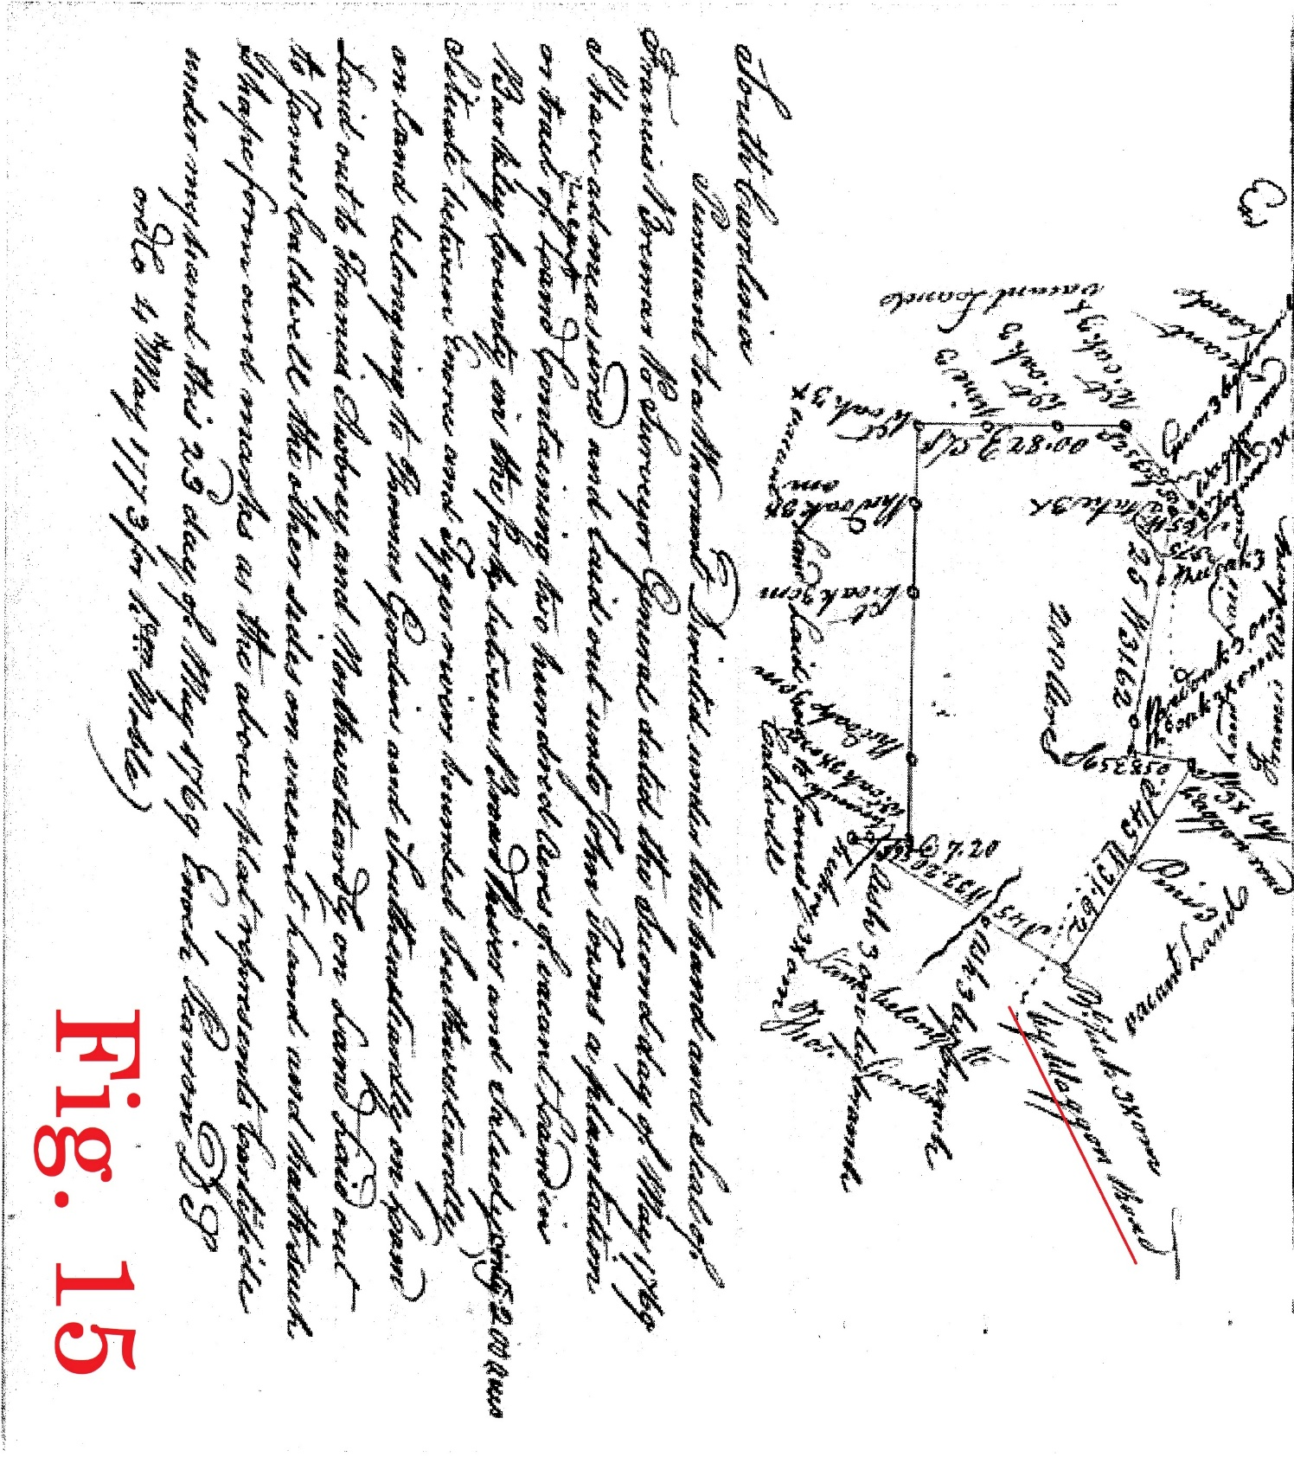
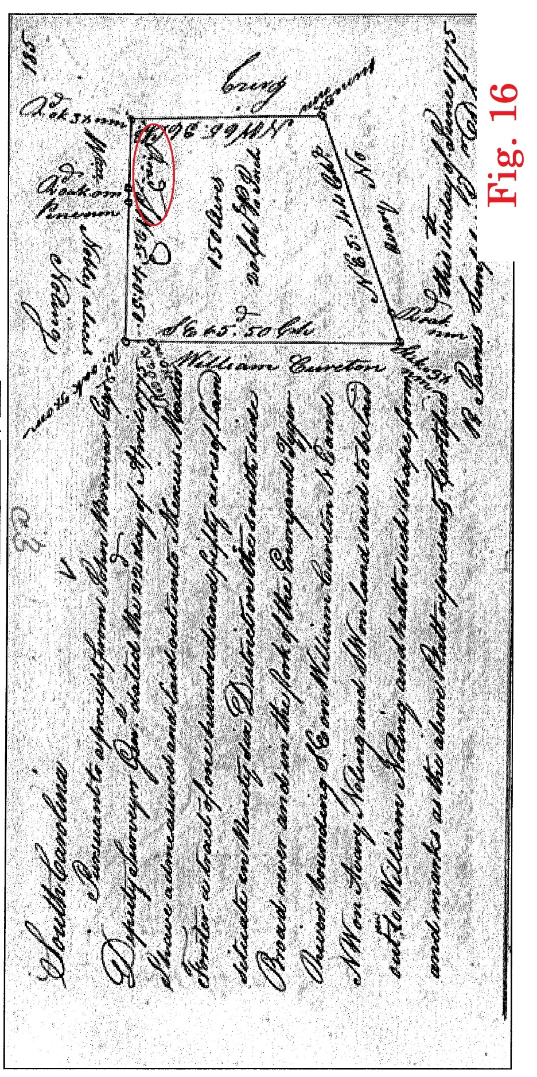
Newberry-Union County Line

Slide 38
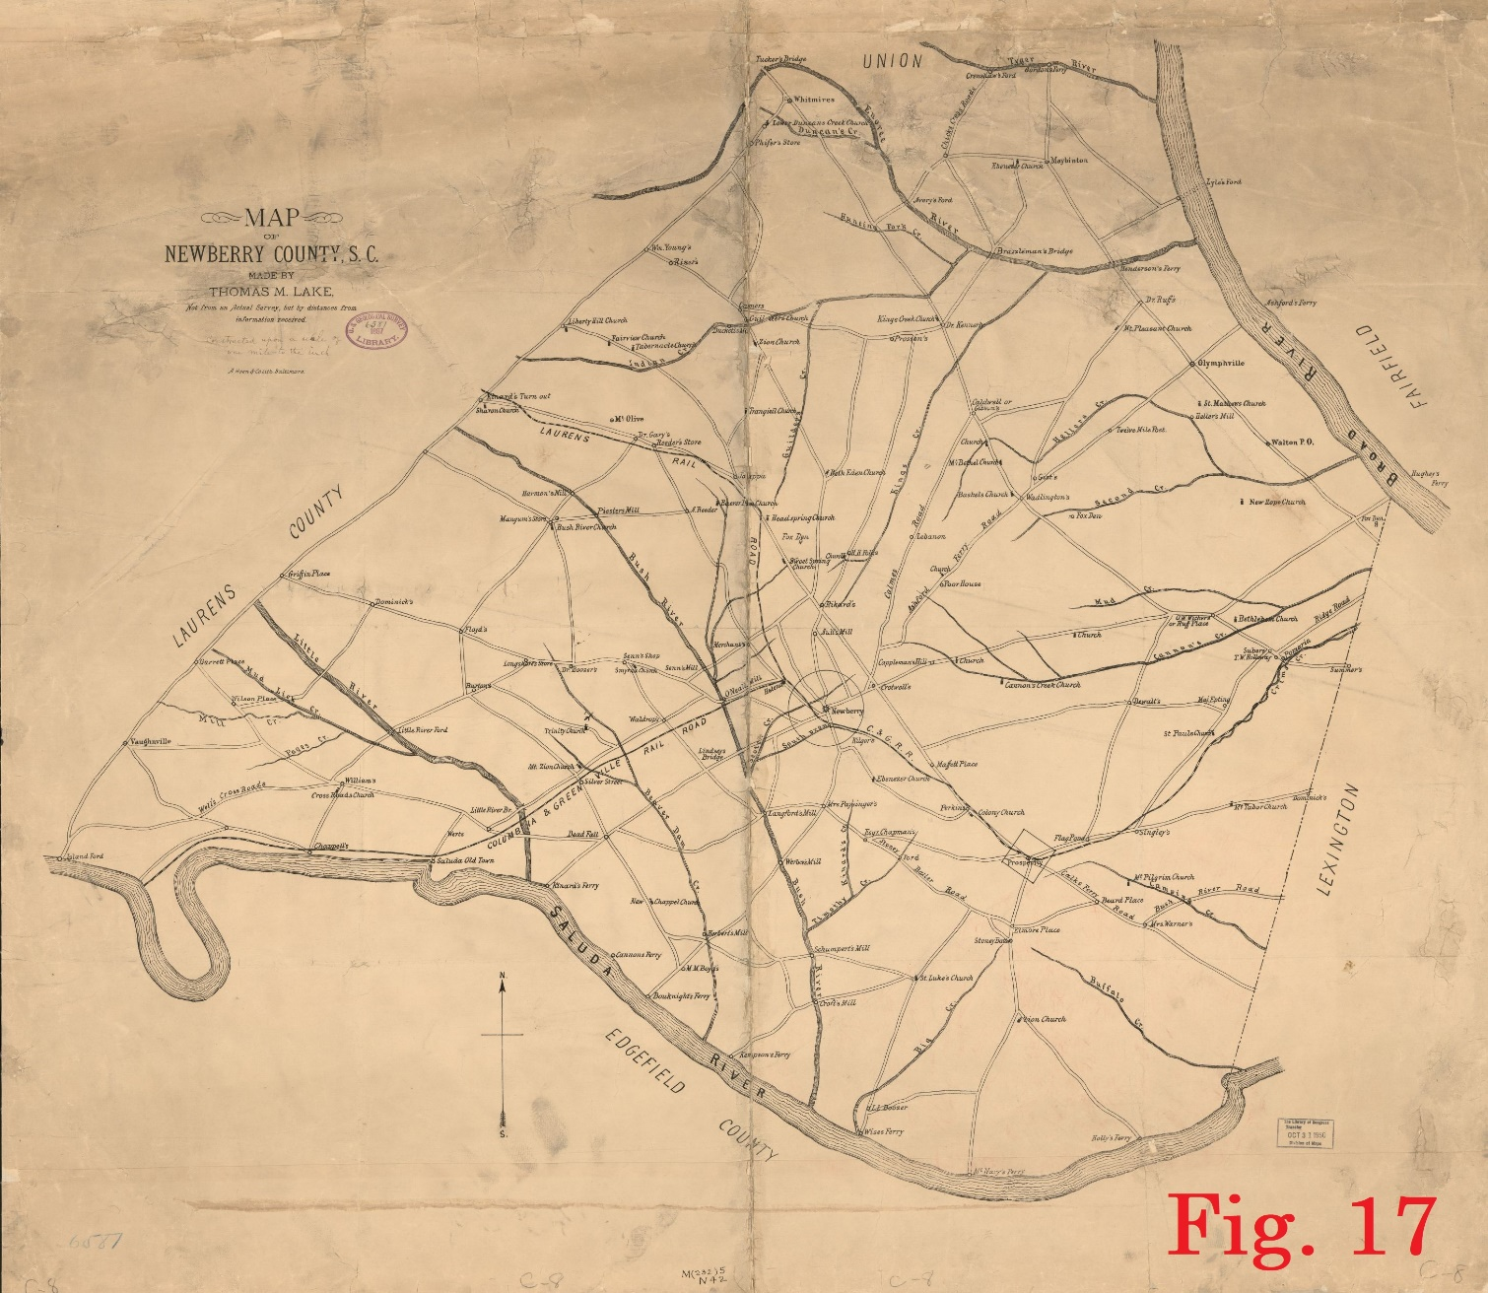
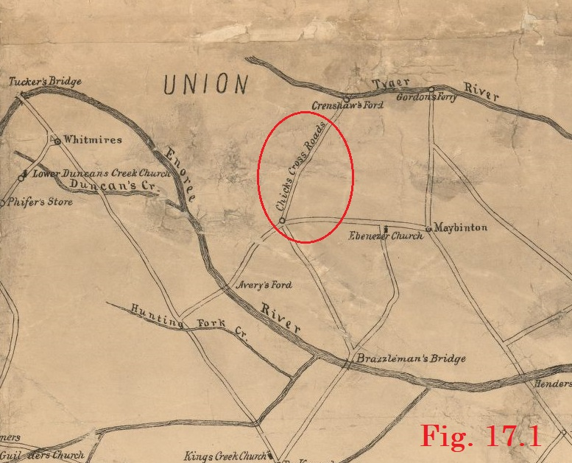
Newberry-Union County Line

Slide 39
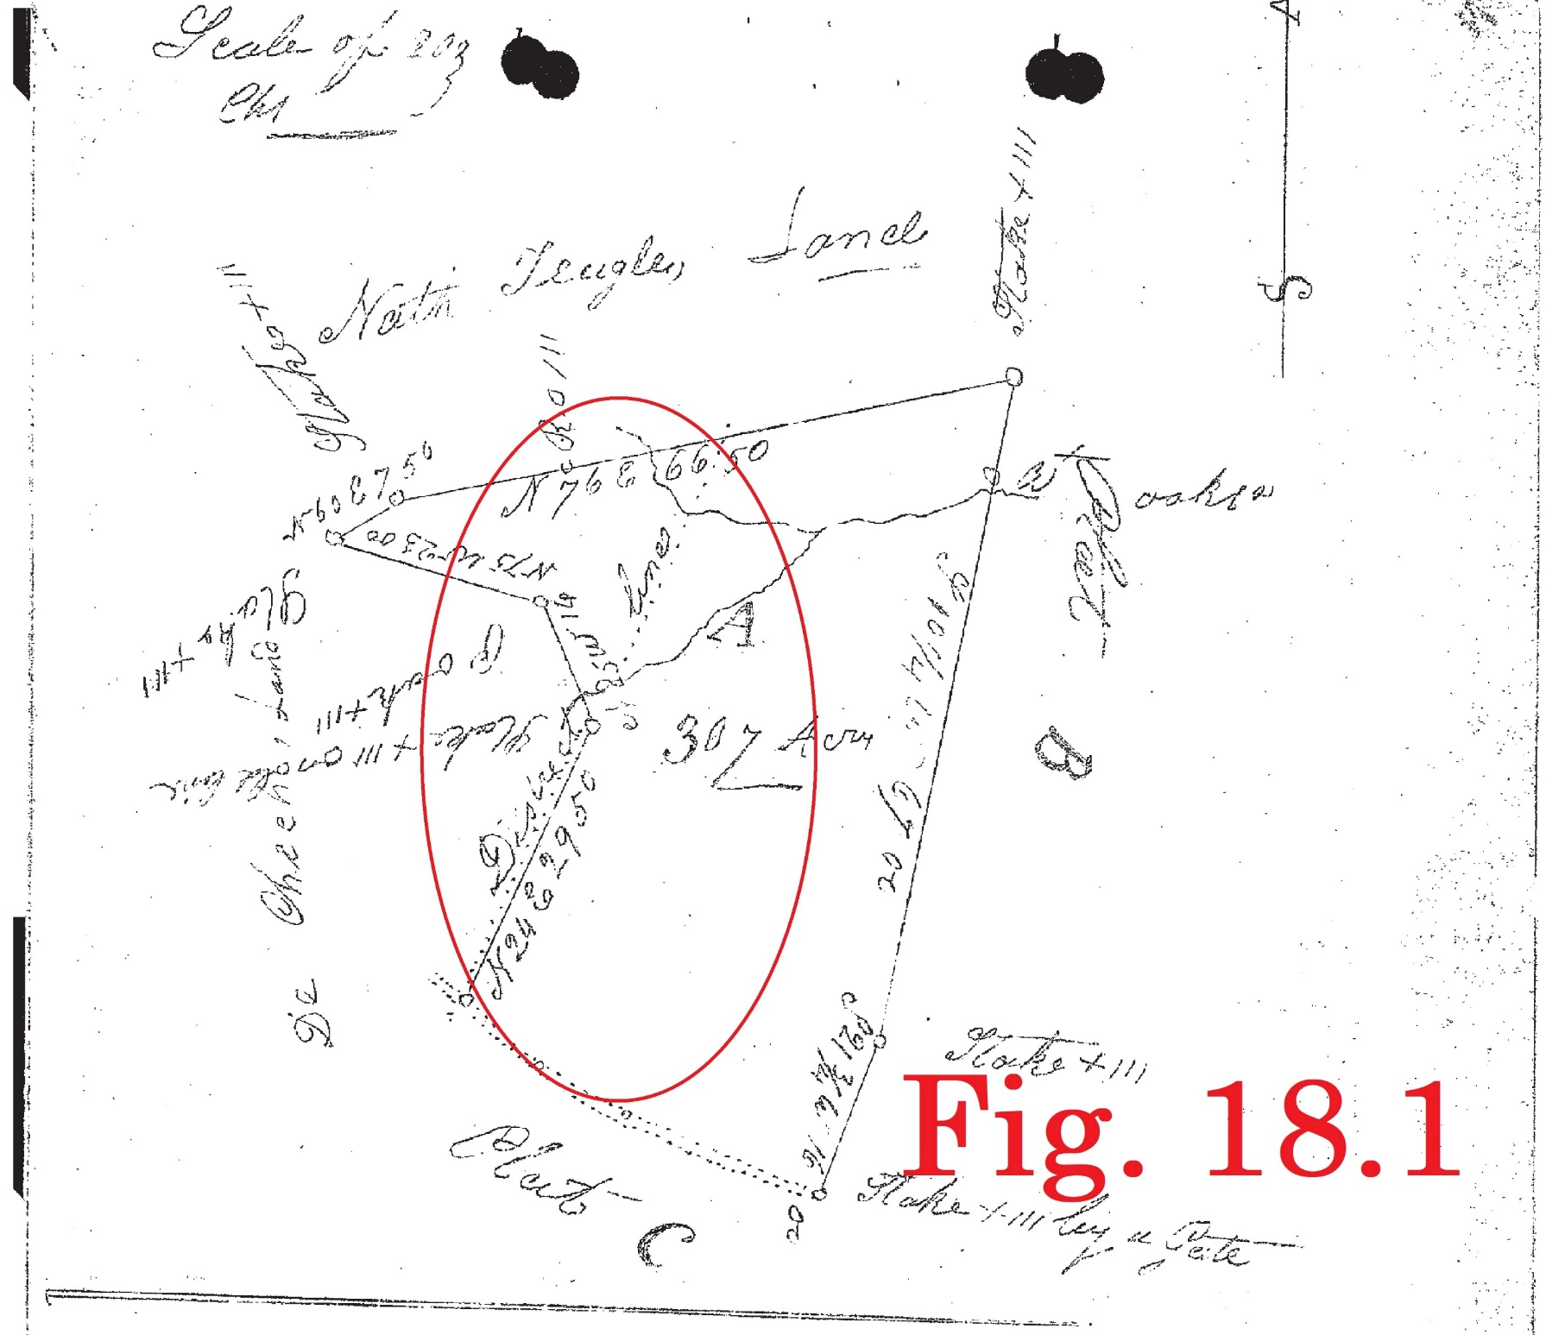
Newberry-Union County Line
North of Chicks Crossroads both the 1769 and 1775 grants show the road running approximately North 25° East
In the same location a survey from 1838 shows the road (District Line) running North 24° East across the 307 acre tract

Slide 40
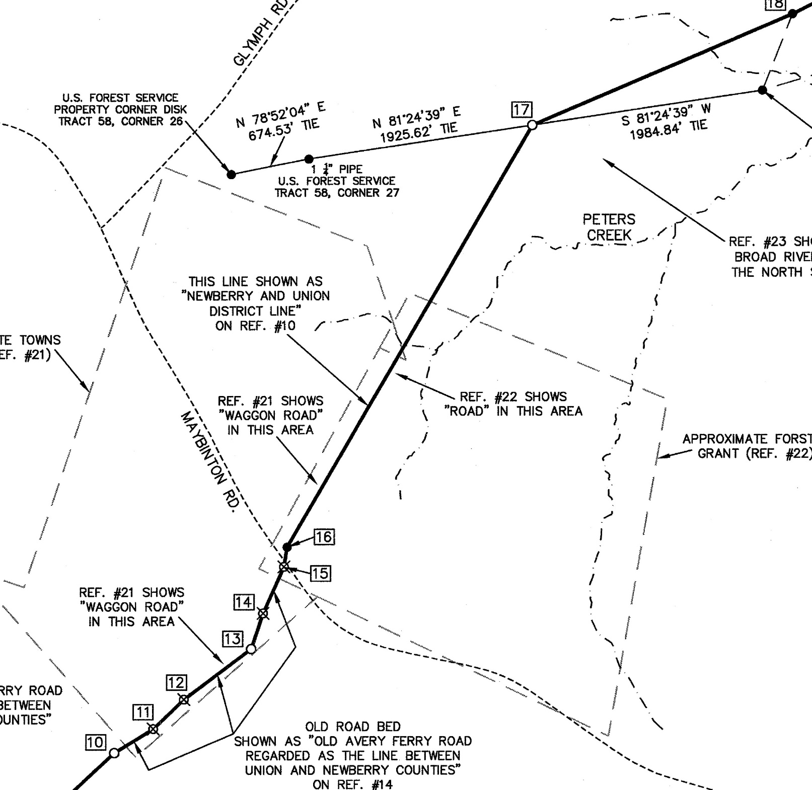
Newberry-Union County Line
The northern line of this 1838 survey still exists
Based on property corners along the northern line we were able to position the 1838 survey and intersect the “District Line” with the existing property line

Slide 41
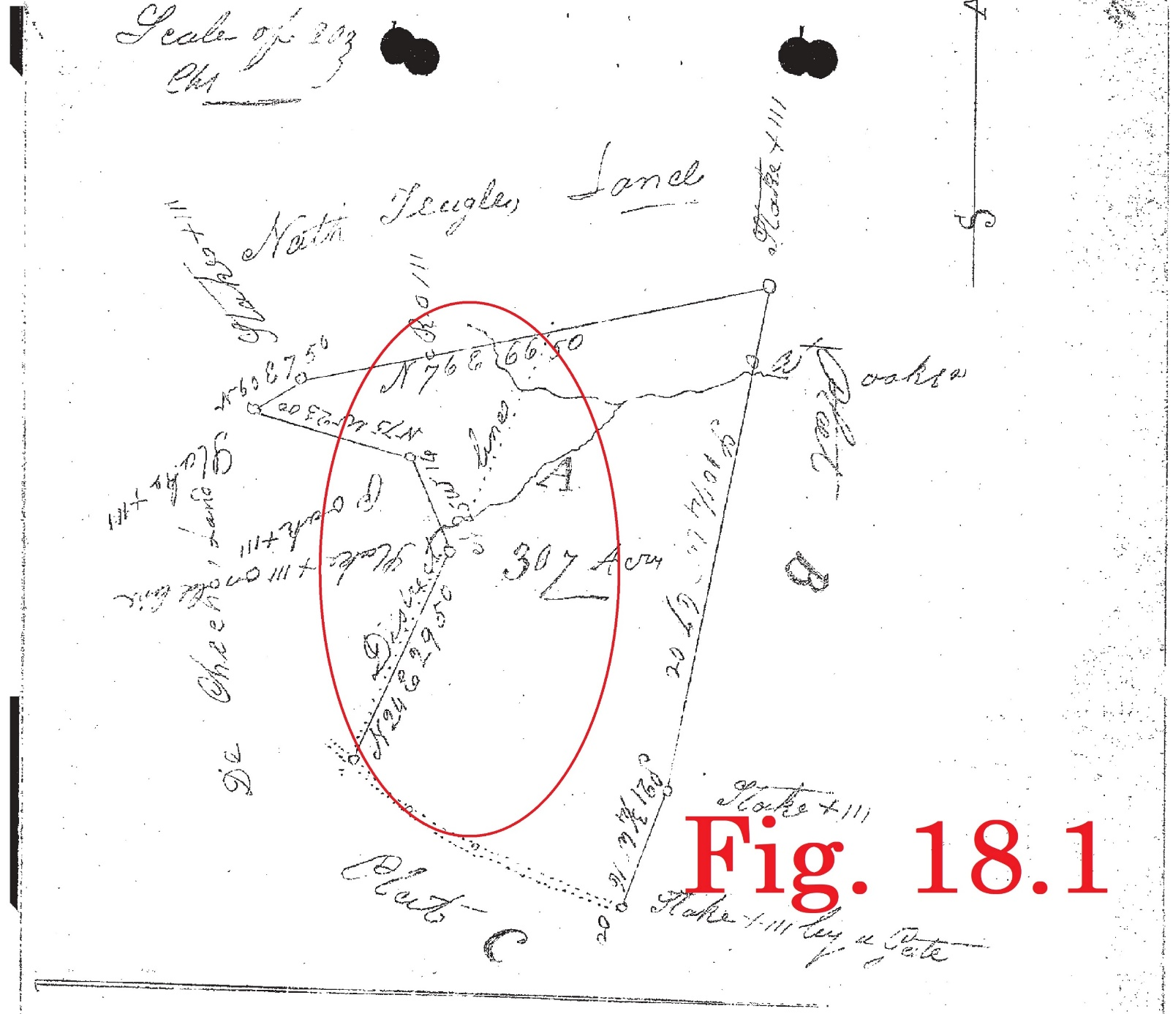

Newberry-Union County Line

Slide 42
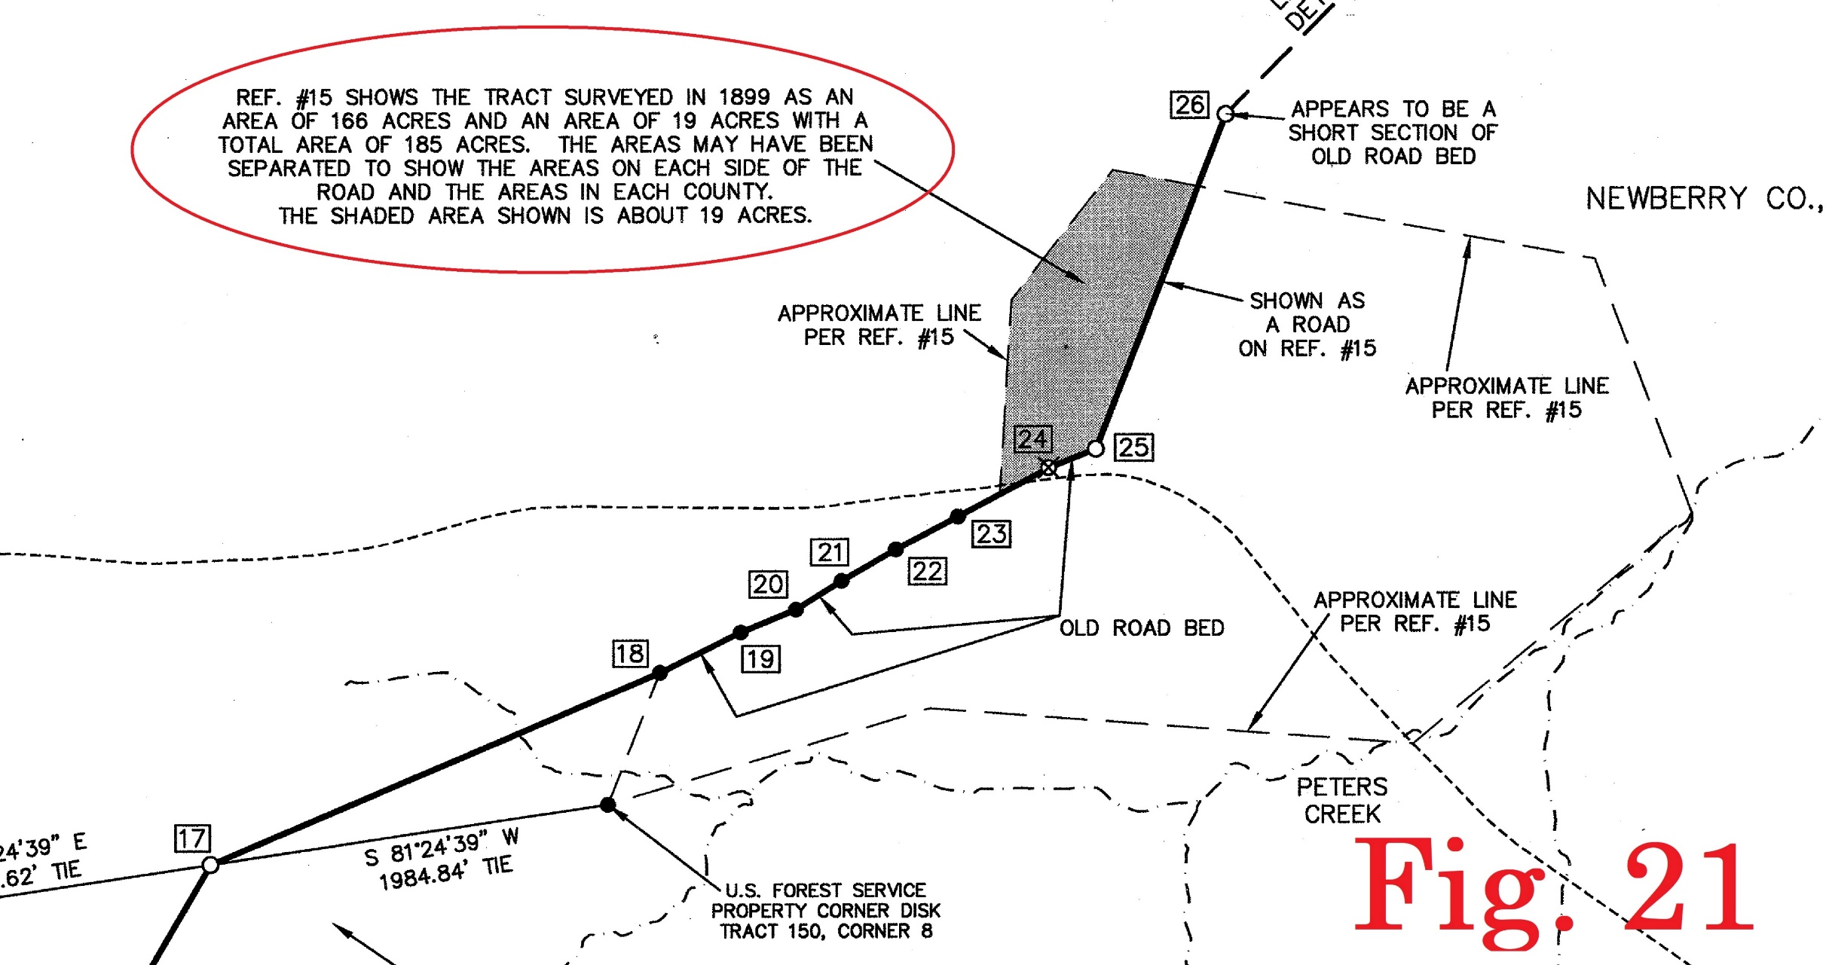
Newberry-Union County Line
The resulting intersection point lined up very well with the next section of existing roadbed and property line

Slide 43
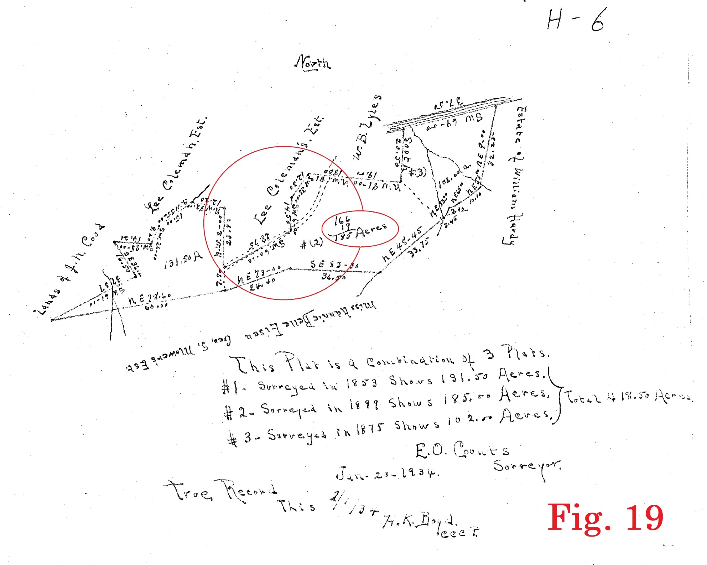
Newberry-Union County Line
The property line in the old roadbed is shown on a plat from 1899
Note the acreage is divided into 166 and 19 acres
Separated by the road?

Slide 44
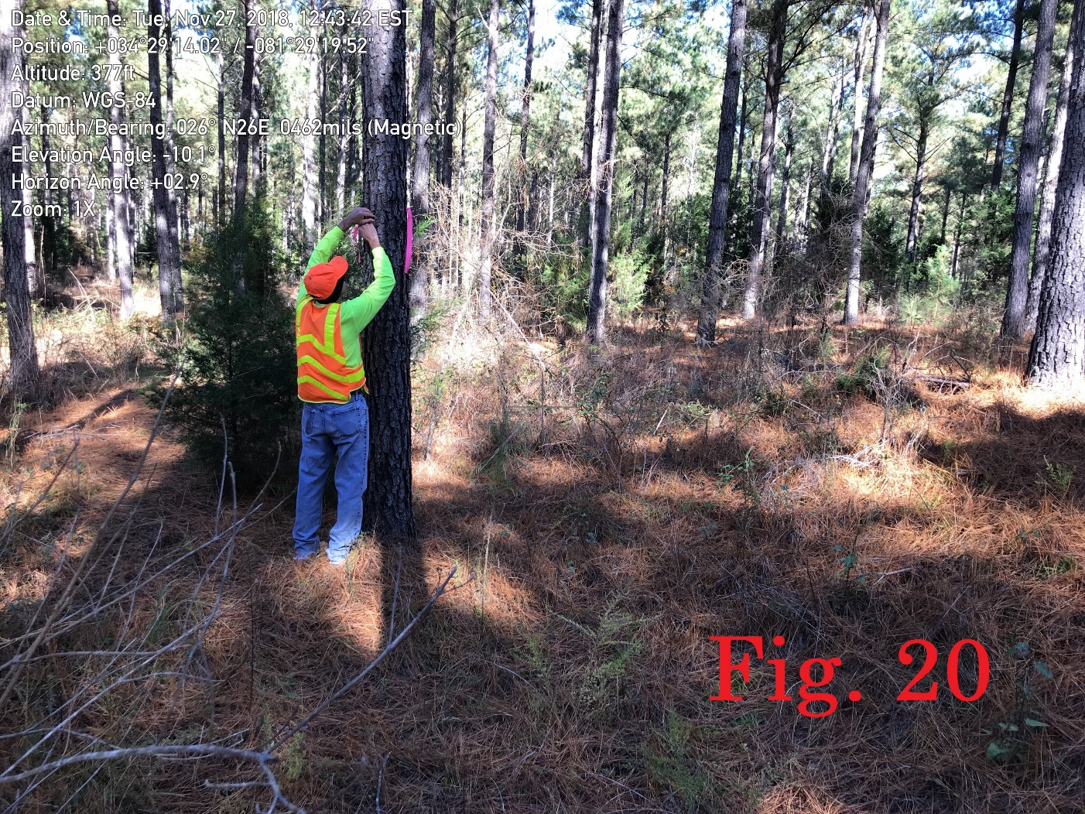
Newberry-Union County Line
The old roadbed ends just north of Glymph Road
Between there and the Tyger River we find only one small section that appears to be old roadbed

Slide 45

Newberry-Union County Line
However, when we connect that small section with the last roadbed at Glymph Road and calculate the acreage to the western line of the positioned grant it calculates almost exactly 19 acres

Slide 46
Newberry-Union County Line
From this last point on top of the ridge we can find no additional old roadbed
We believe a straight line from there to Crenshaw’s Ford is the best approximation for the road

Slide 47
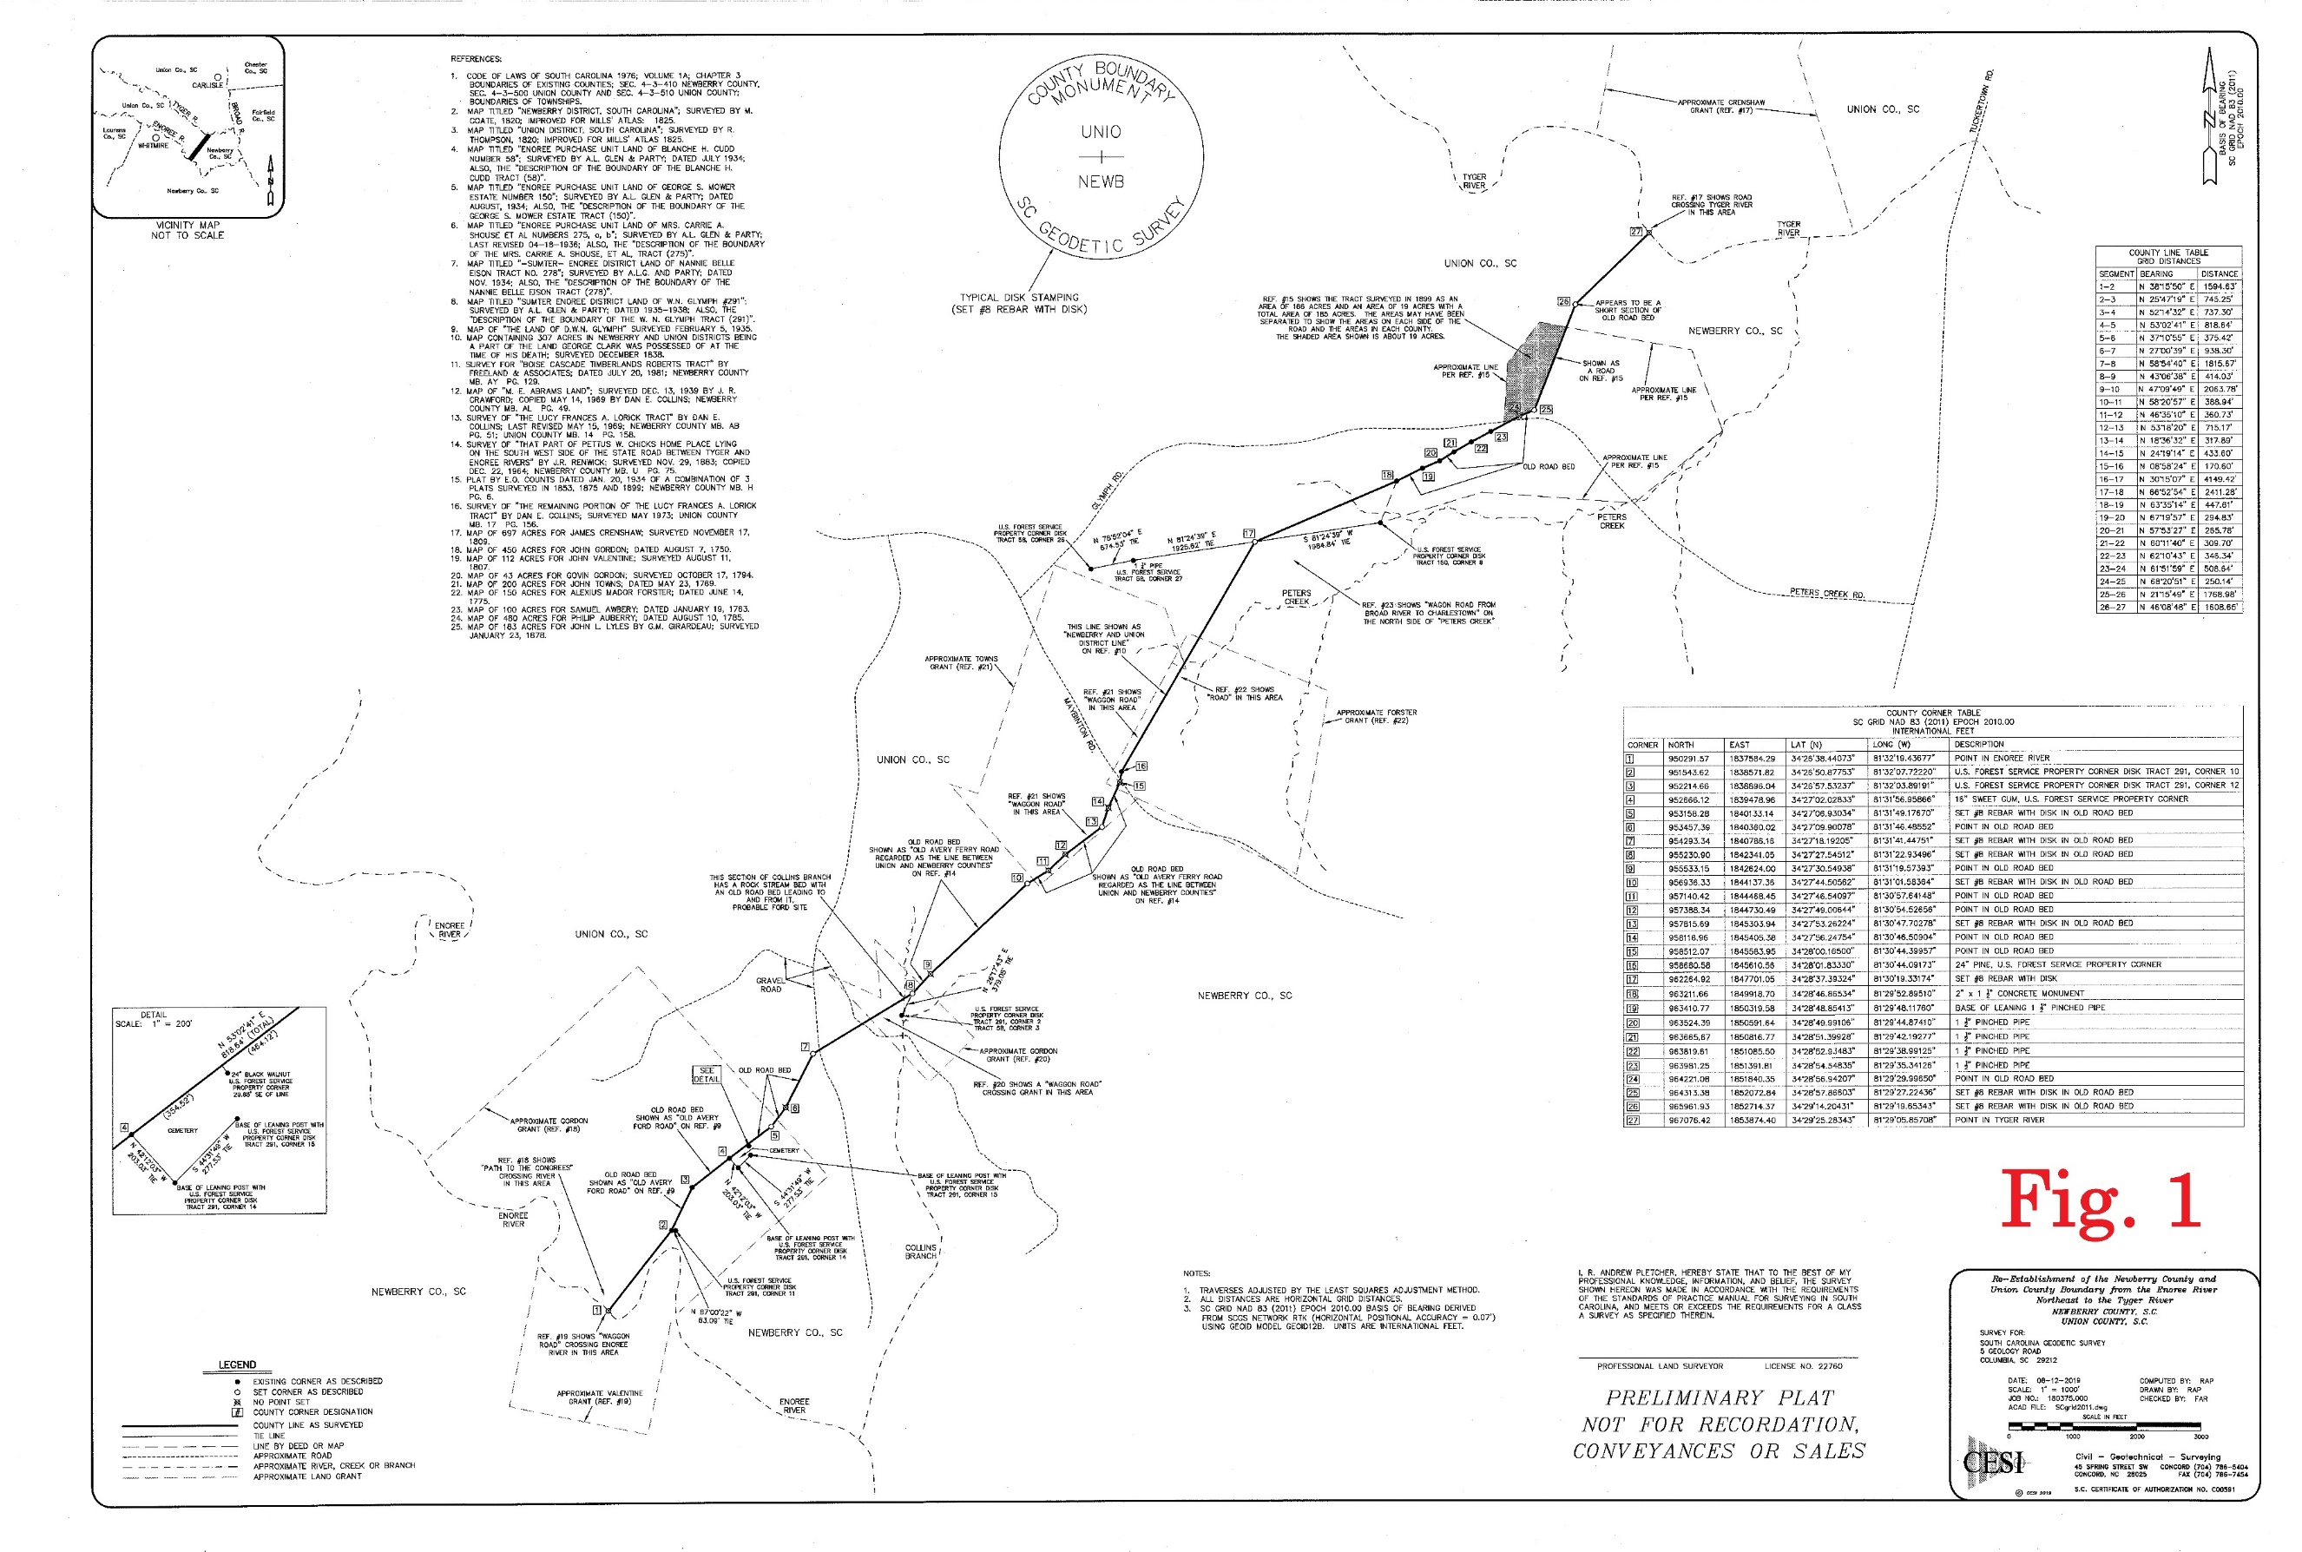
Newberry-Union County Line

Slide 48
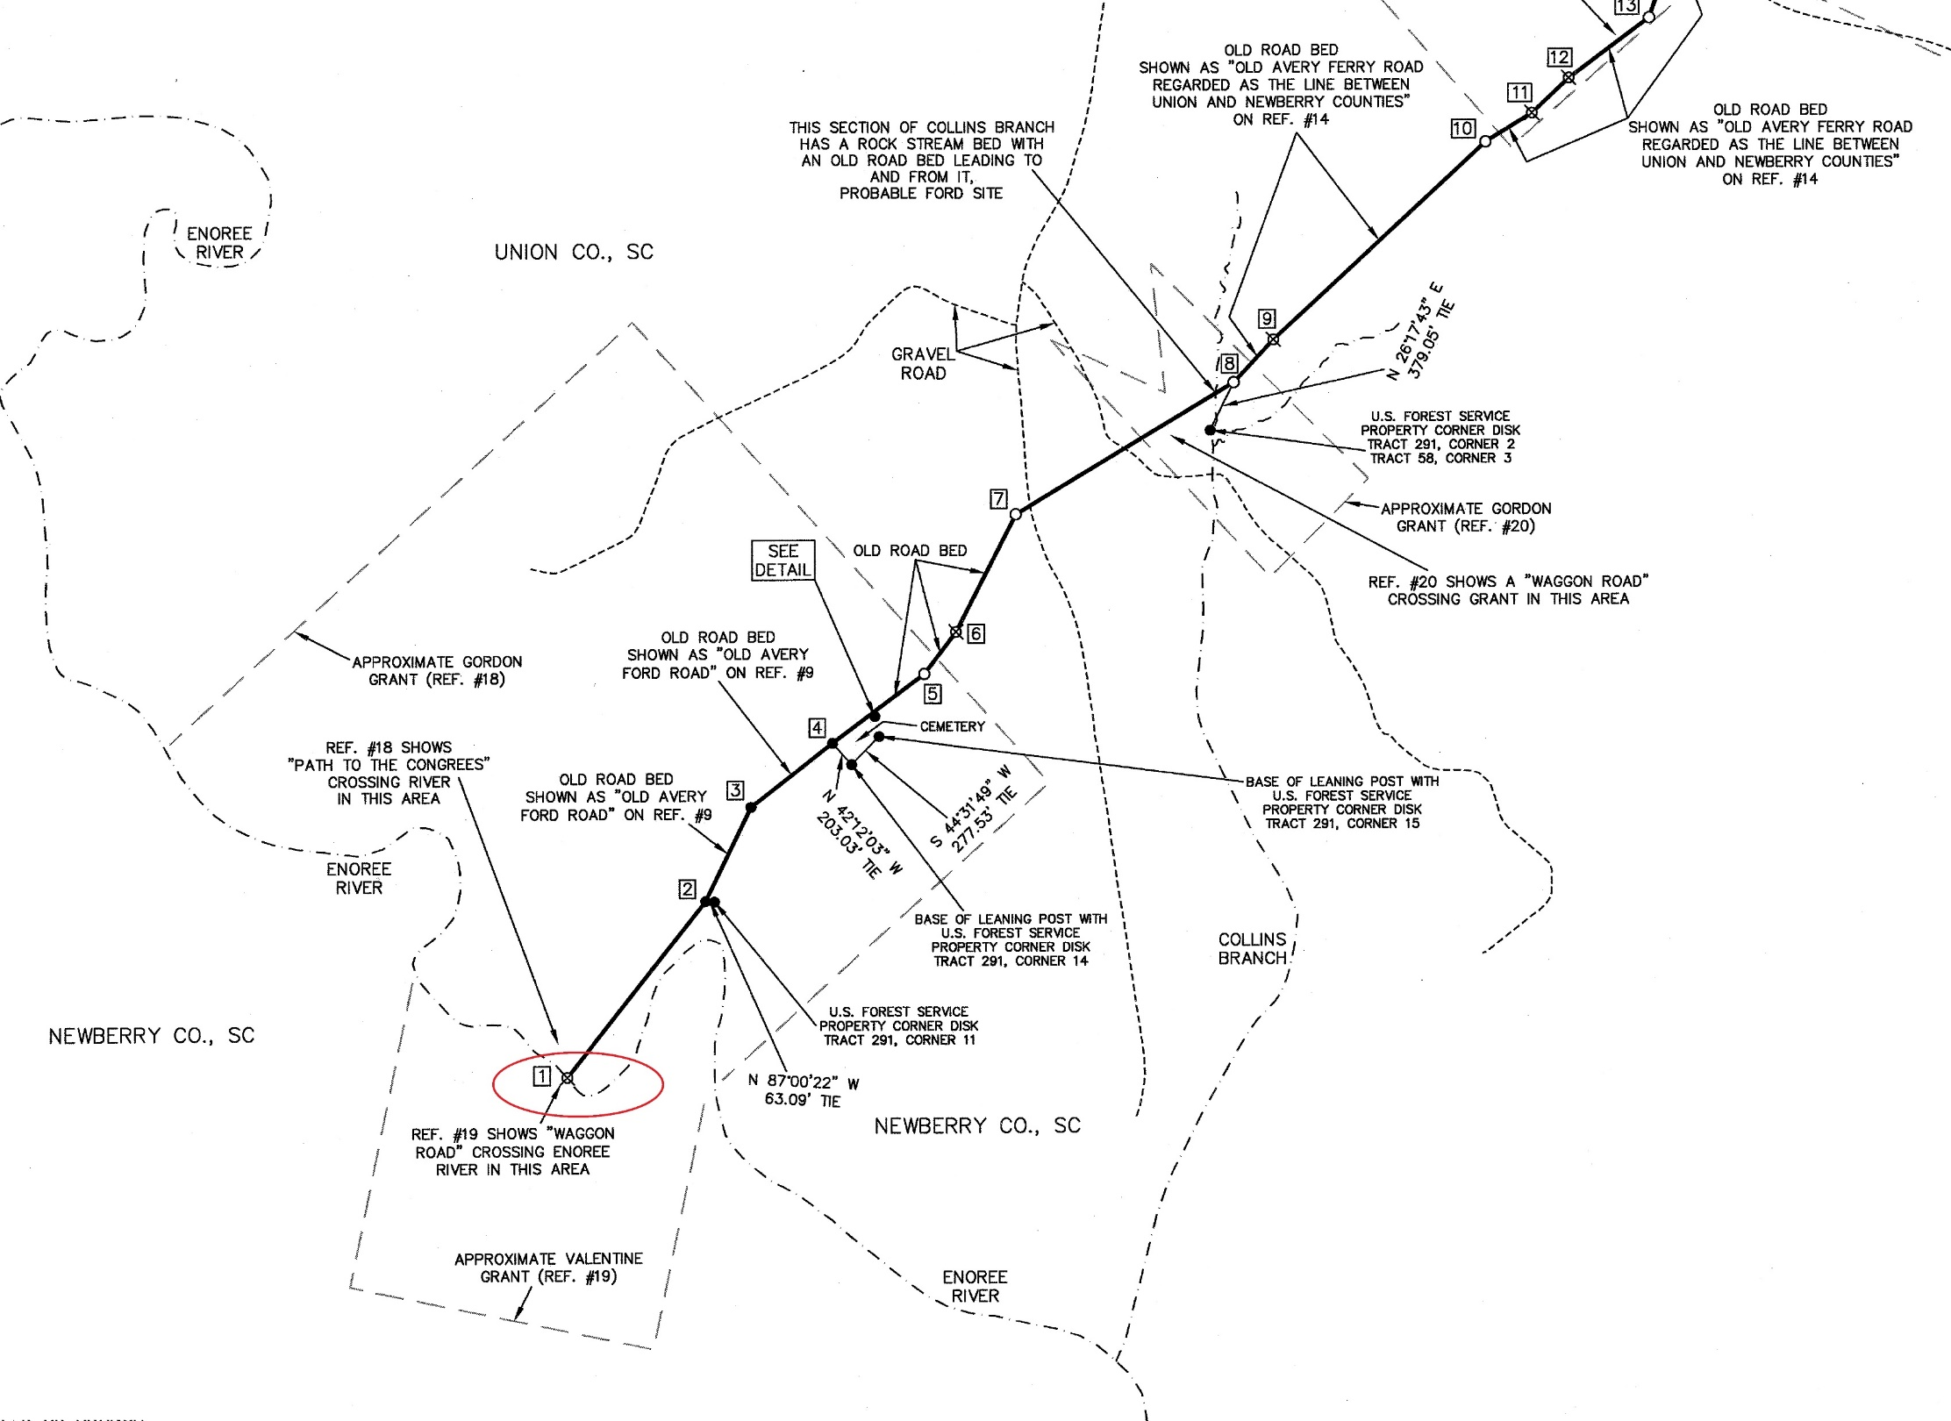
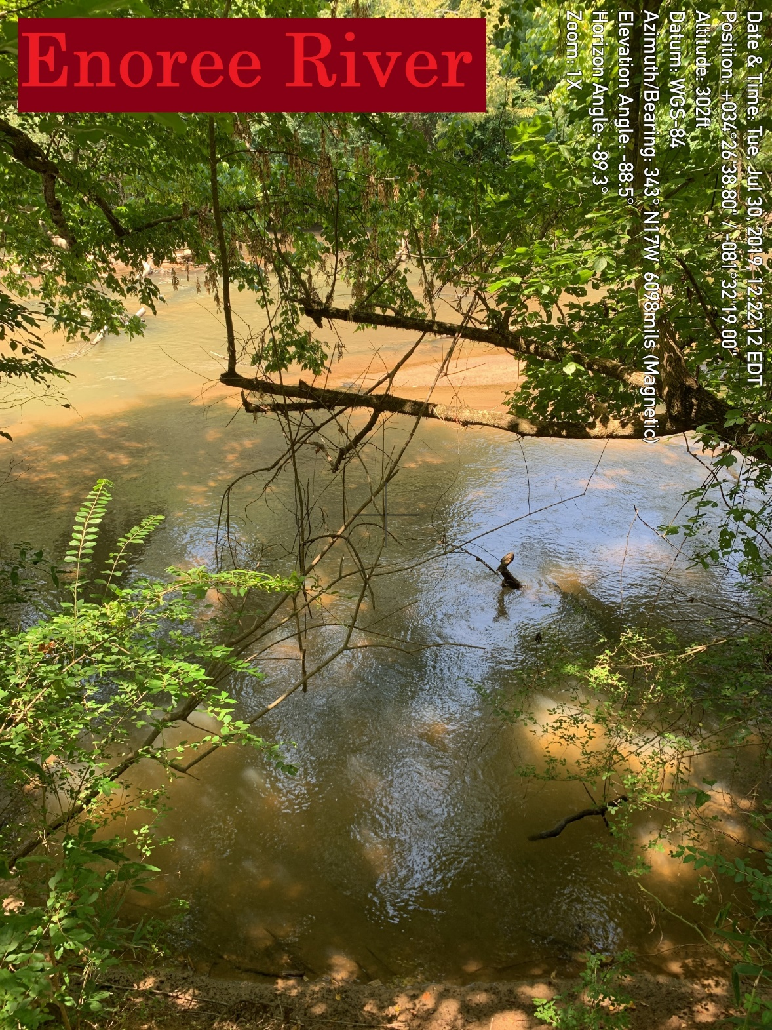
Newberry-Union County Line

Slide 49
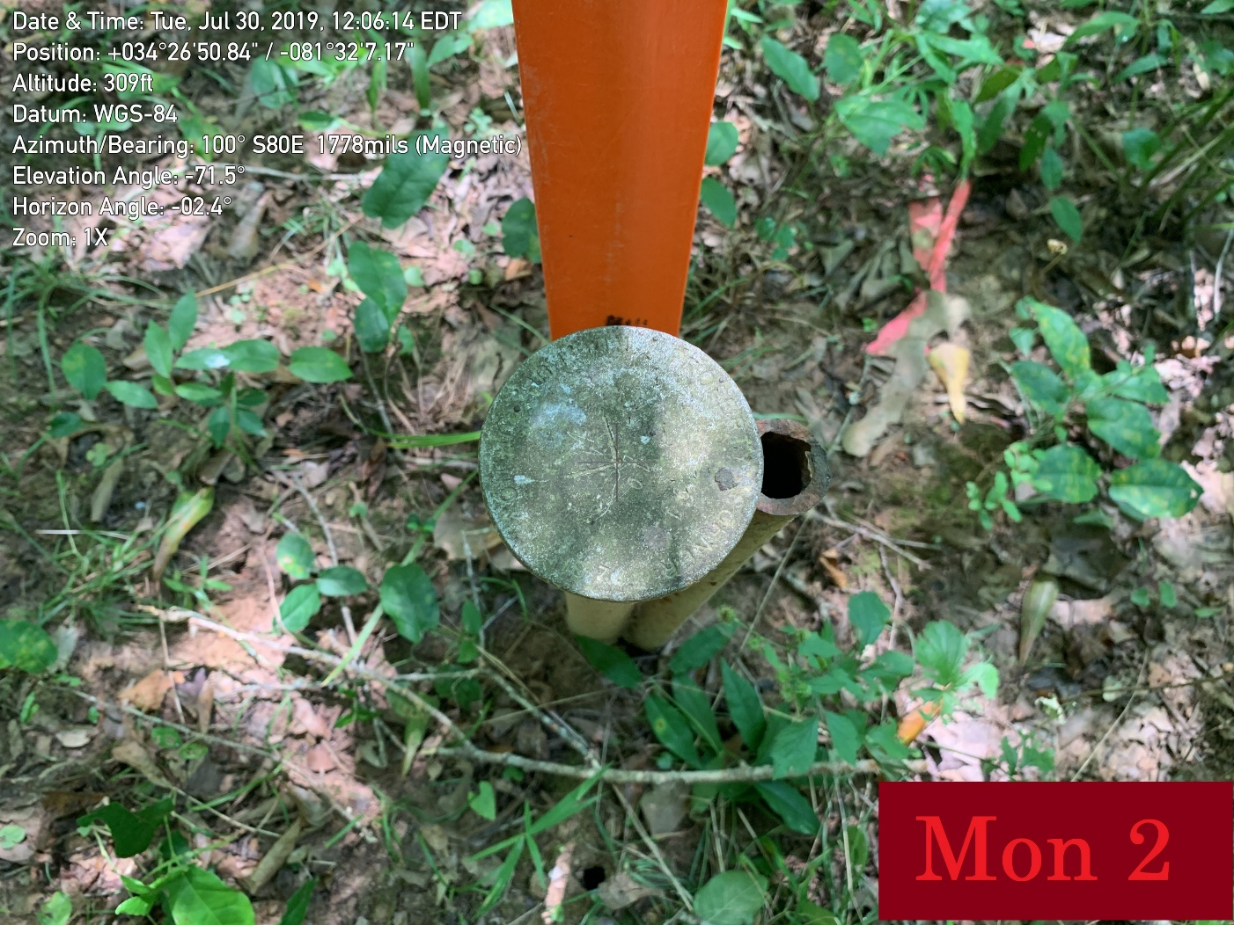
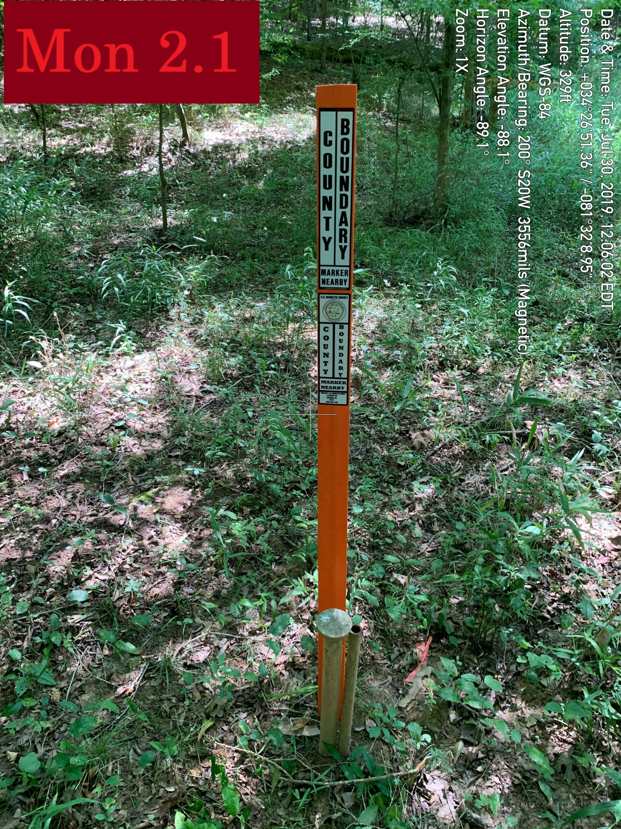
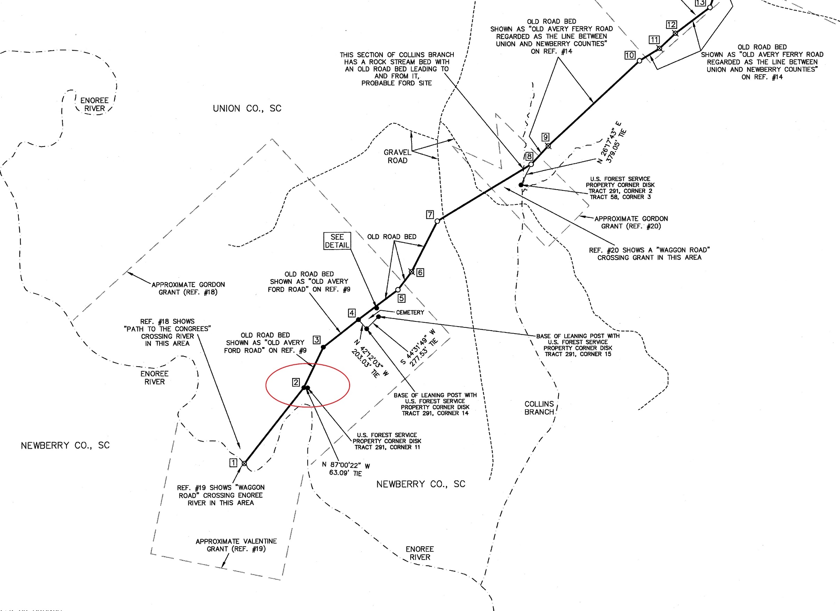
Newberry-Union County Line

Slide 50
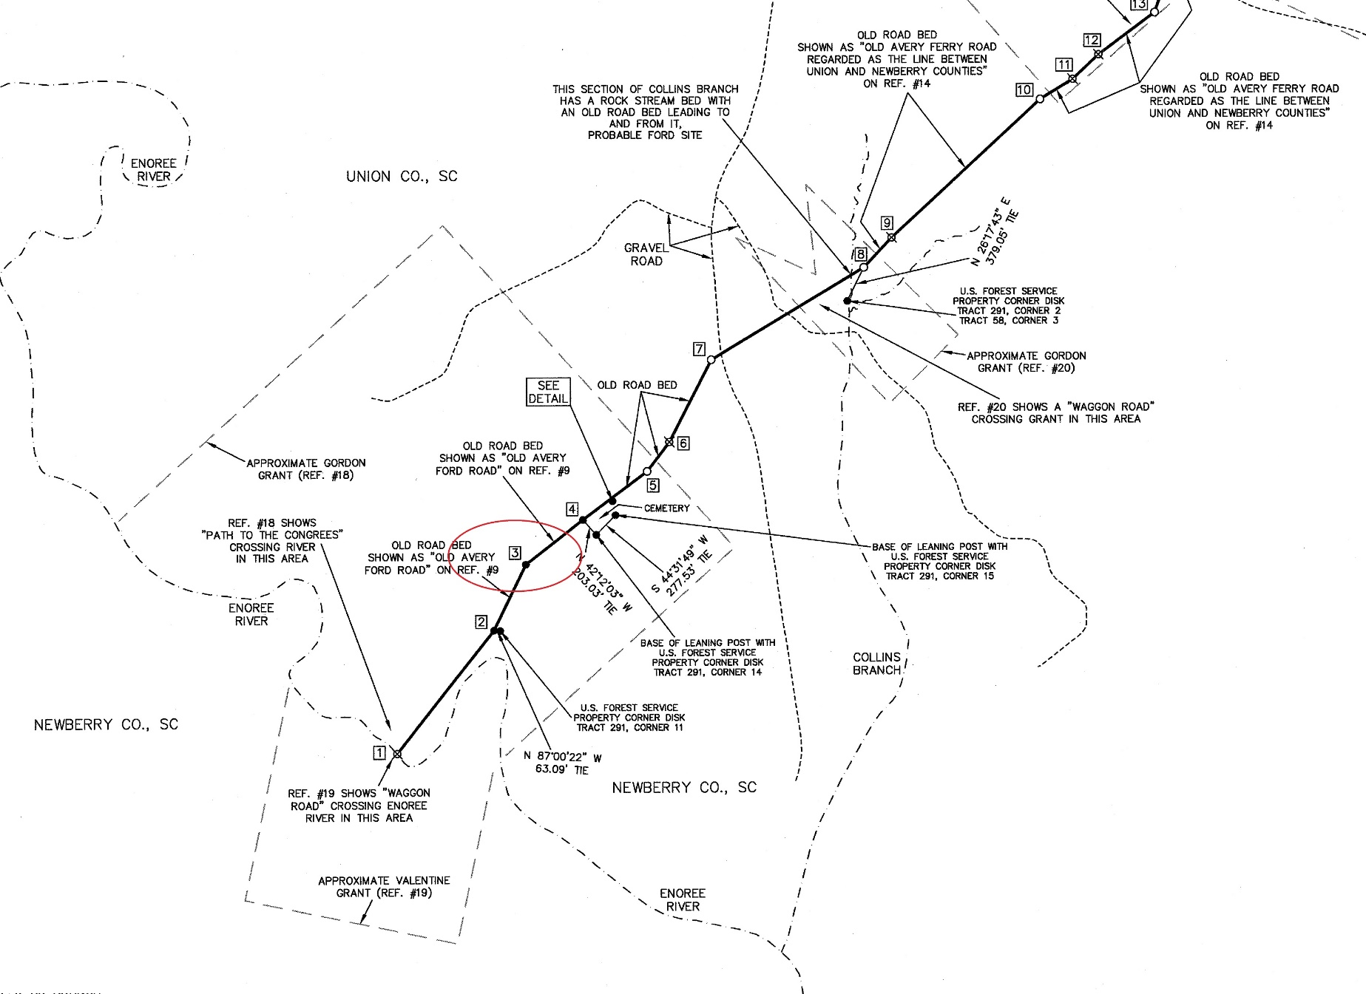
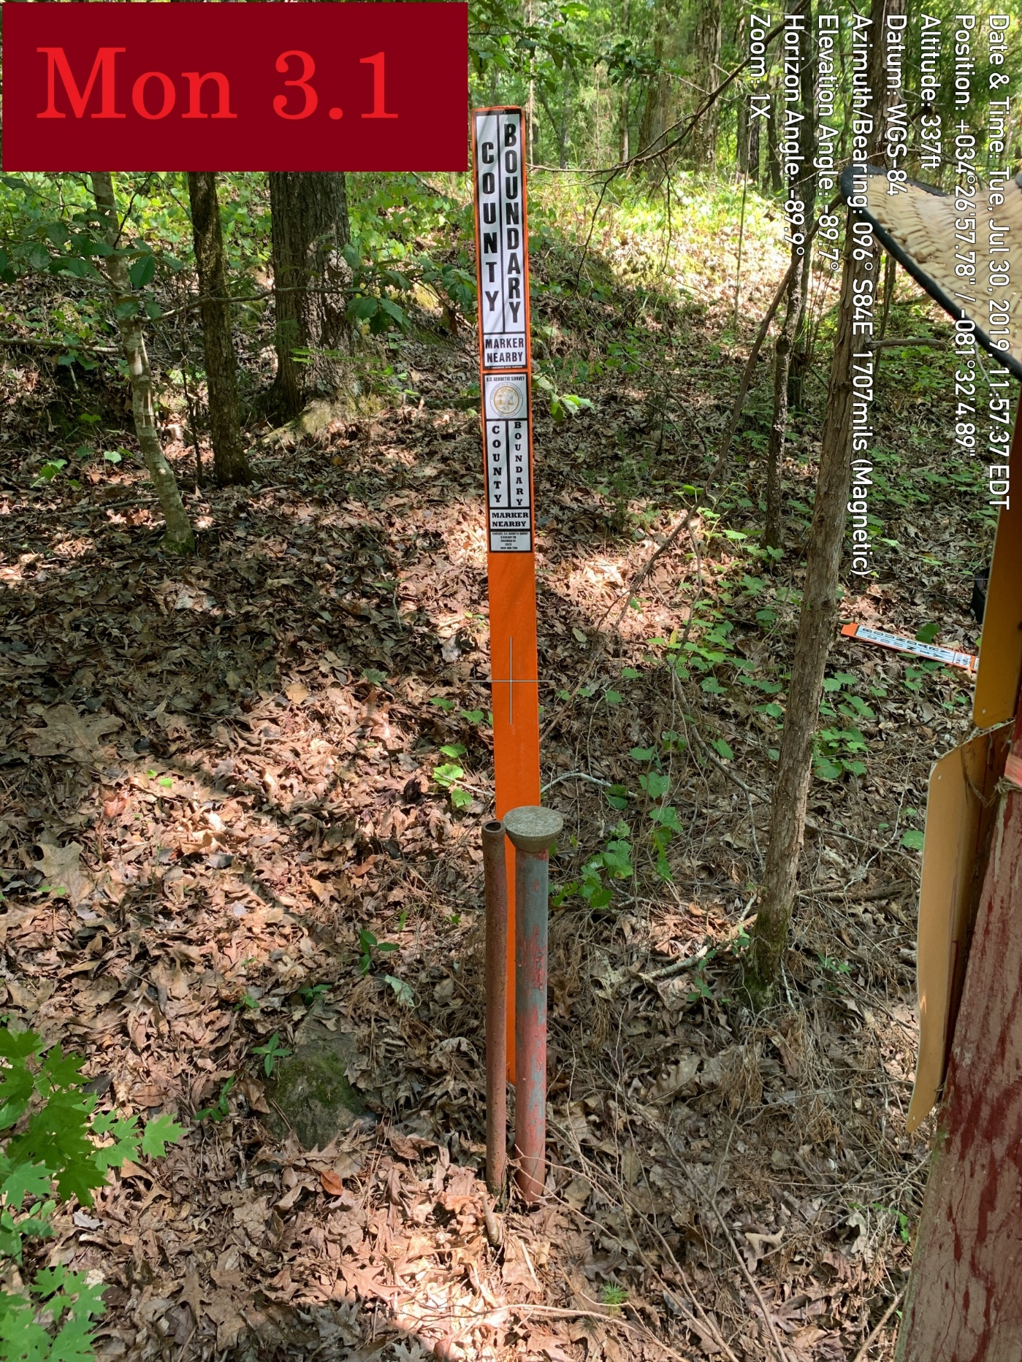
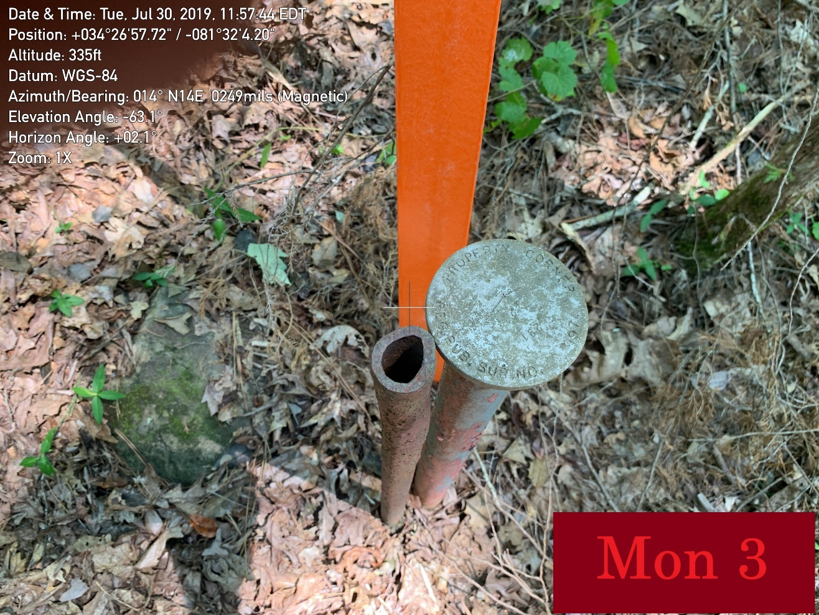
Newberry-Union County Line

Slide 51
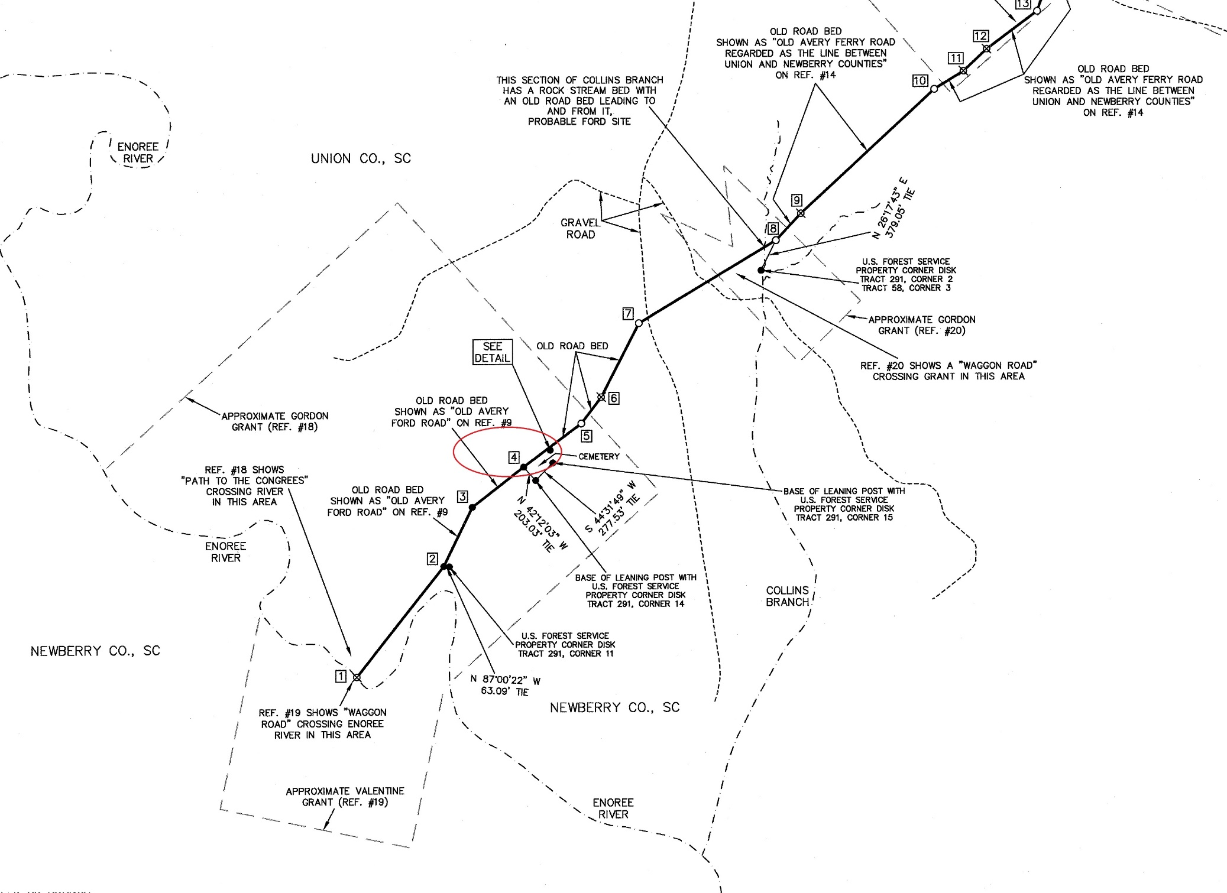
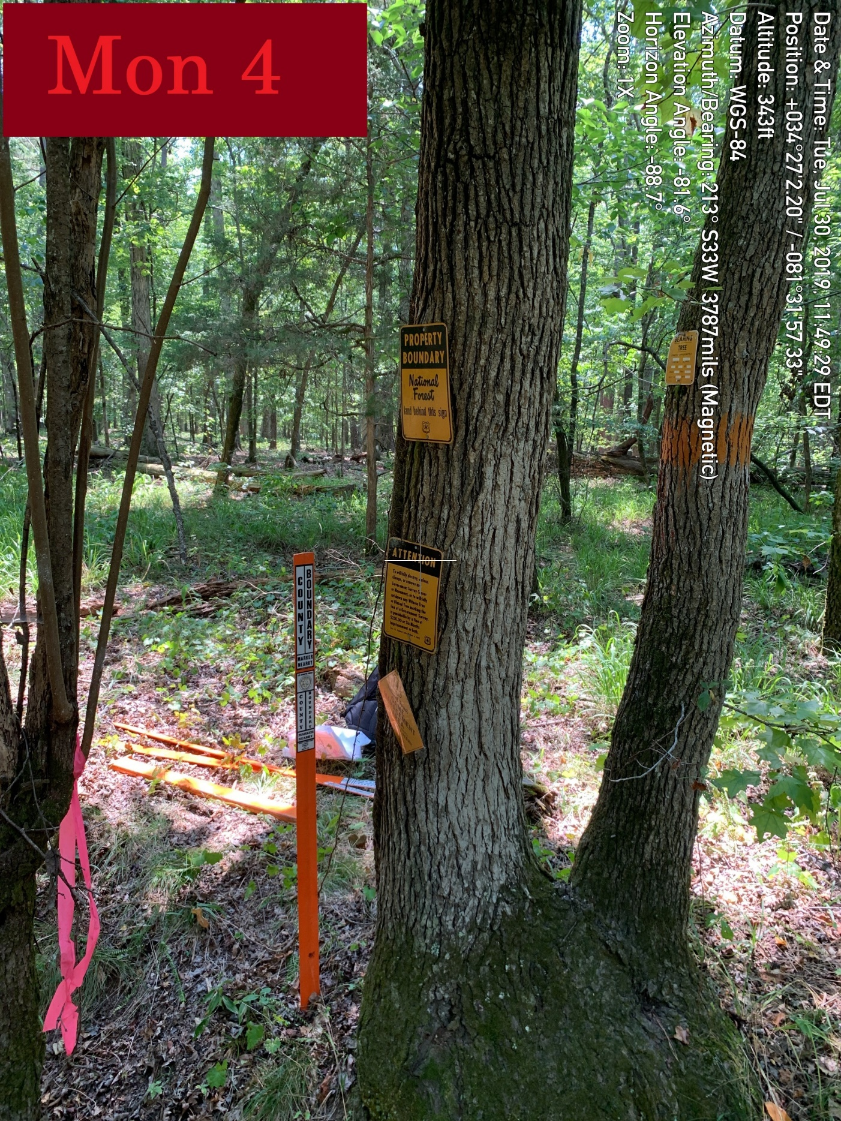
Newberry-Union County Line

Slide 52



Newberry-Union County Line

Slide 53



Newberry-Union County Line

Slide 54


Newberry-Union County Line

Slide 55



Newberry-Union County Line

Slide 56



Newberry-Union County Line

Slide 57



Newberry-Union County Line

Slide 58



Newberry-Union County Line

Slide 59



Newberry-Union County Line

Slide 60



Newberry-Union County Line

Slide 61



Newberry-Union County Line

Slide 62


Newberry-Union County Line

Slide 63



Newberry-Union County Line

Slide 64



Newberry-Union County Line

Slide 65



Newberry-Union County Line

Slide 66



Newberry-Union County Line

Slide 67



Newberry-Union County Line

Slide 68



Newberry-Union County Line

Slide 69

Newberry-Union County Line

Slide 70
Newberry-Union County Line

