Slide 1
Charleston – Dorchester County Line Rantowles Creek to Ashley River

Slide 3
Lines are Established by Legislative Acts
1976 South Carolina Code of Laws Unannotated Updated through the end of the 2013 Session
Title 4 - Counties
CHAPTER 3.
BOUNDARIES OF EXISTING COUNTIES

Slide 4
SECTION 4-3-100. Charleston County
thence northward following the center line of Rantowles Creek to its intersection with the Dorchester County line; thence following said line to its intersection with the property of Charles H. P. Duell (Middleton Gardens); thence following the eastern boundary of the property of Charles H. P. Duell (Middleton Gardens) to the ordinary high-water line on the eastern bank of the Ashley River; thence following the ordinary high-water line on the eastern bank of said river

Slide 5
SECTION 4-3-200. Dorchester County
and by a straight line running thence to a point upon Saw Mill Branch one mile northeast of the South Carolina and Georgia Railroad, and thence along said branch to the old division line between Colleton and Berkeley Counties; and thence by said old division line to the point where said line intersects the division line between Charleston and Berkeley Counties; on the southeast by Charleston County, from which it is separated by the old division line between Charleston and Colleton Counties to Lowndes' Landing, on Rantowles Creek

Slide 6
SECTION 4-3-231. Dorchester County; additional area of Charleston County transferred to Dorchester County.
The following described portion of Charleston County is hereby transferred and annexed to Dorchester County: All that tract of land now situate and lying in Charleston County, being a portion of property formerly known as "Middleton Tract" and more commonly known as "Middleton Place", said tract containing 1,085 acres more or less and constituting the southernmost portion of Middleton Place to the west of South Carolina Highway 61 and more particularly shown on the tax maps of Charleston County as T.M.S. Number 301-001 and also shown on a plat recorded in the office of the Clerk of Court for Dorchester County in Plat Book 21, at page 42, and in the R.M.C. office for Charleston County in Plat Book AC, at page 144; and All that tract of land now situate and lying in Charleston County, being a portion of property formerly known as "Middleton Tract" and more commonly known as "Middleton Place", said tract containing 130 acres, more or less, of highland and 49 acres, more or less, of marshland, and constituting the southernmost portion of Middleton Place to the east of South Carolina Highway 61 and more particularly shown on the tax maps of Charleston County as T.M.S. Number 364-011 and also shown on a plat recorded in the office of the Clerk of Court for Dorchester County in Plat Book 21, at page 42 and in the R.M.C. office for Charleston County in Plat Book AC, at page 144.

Slide 7
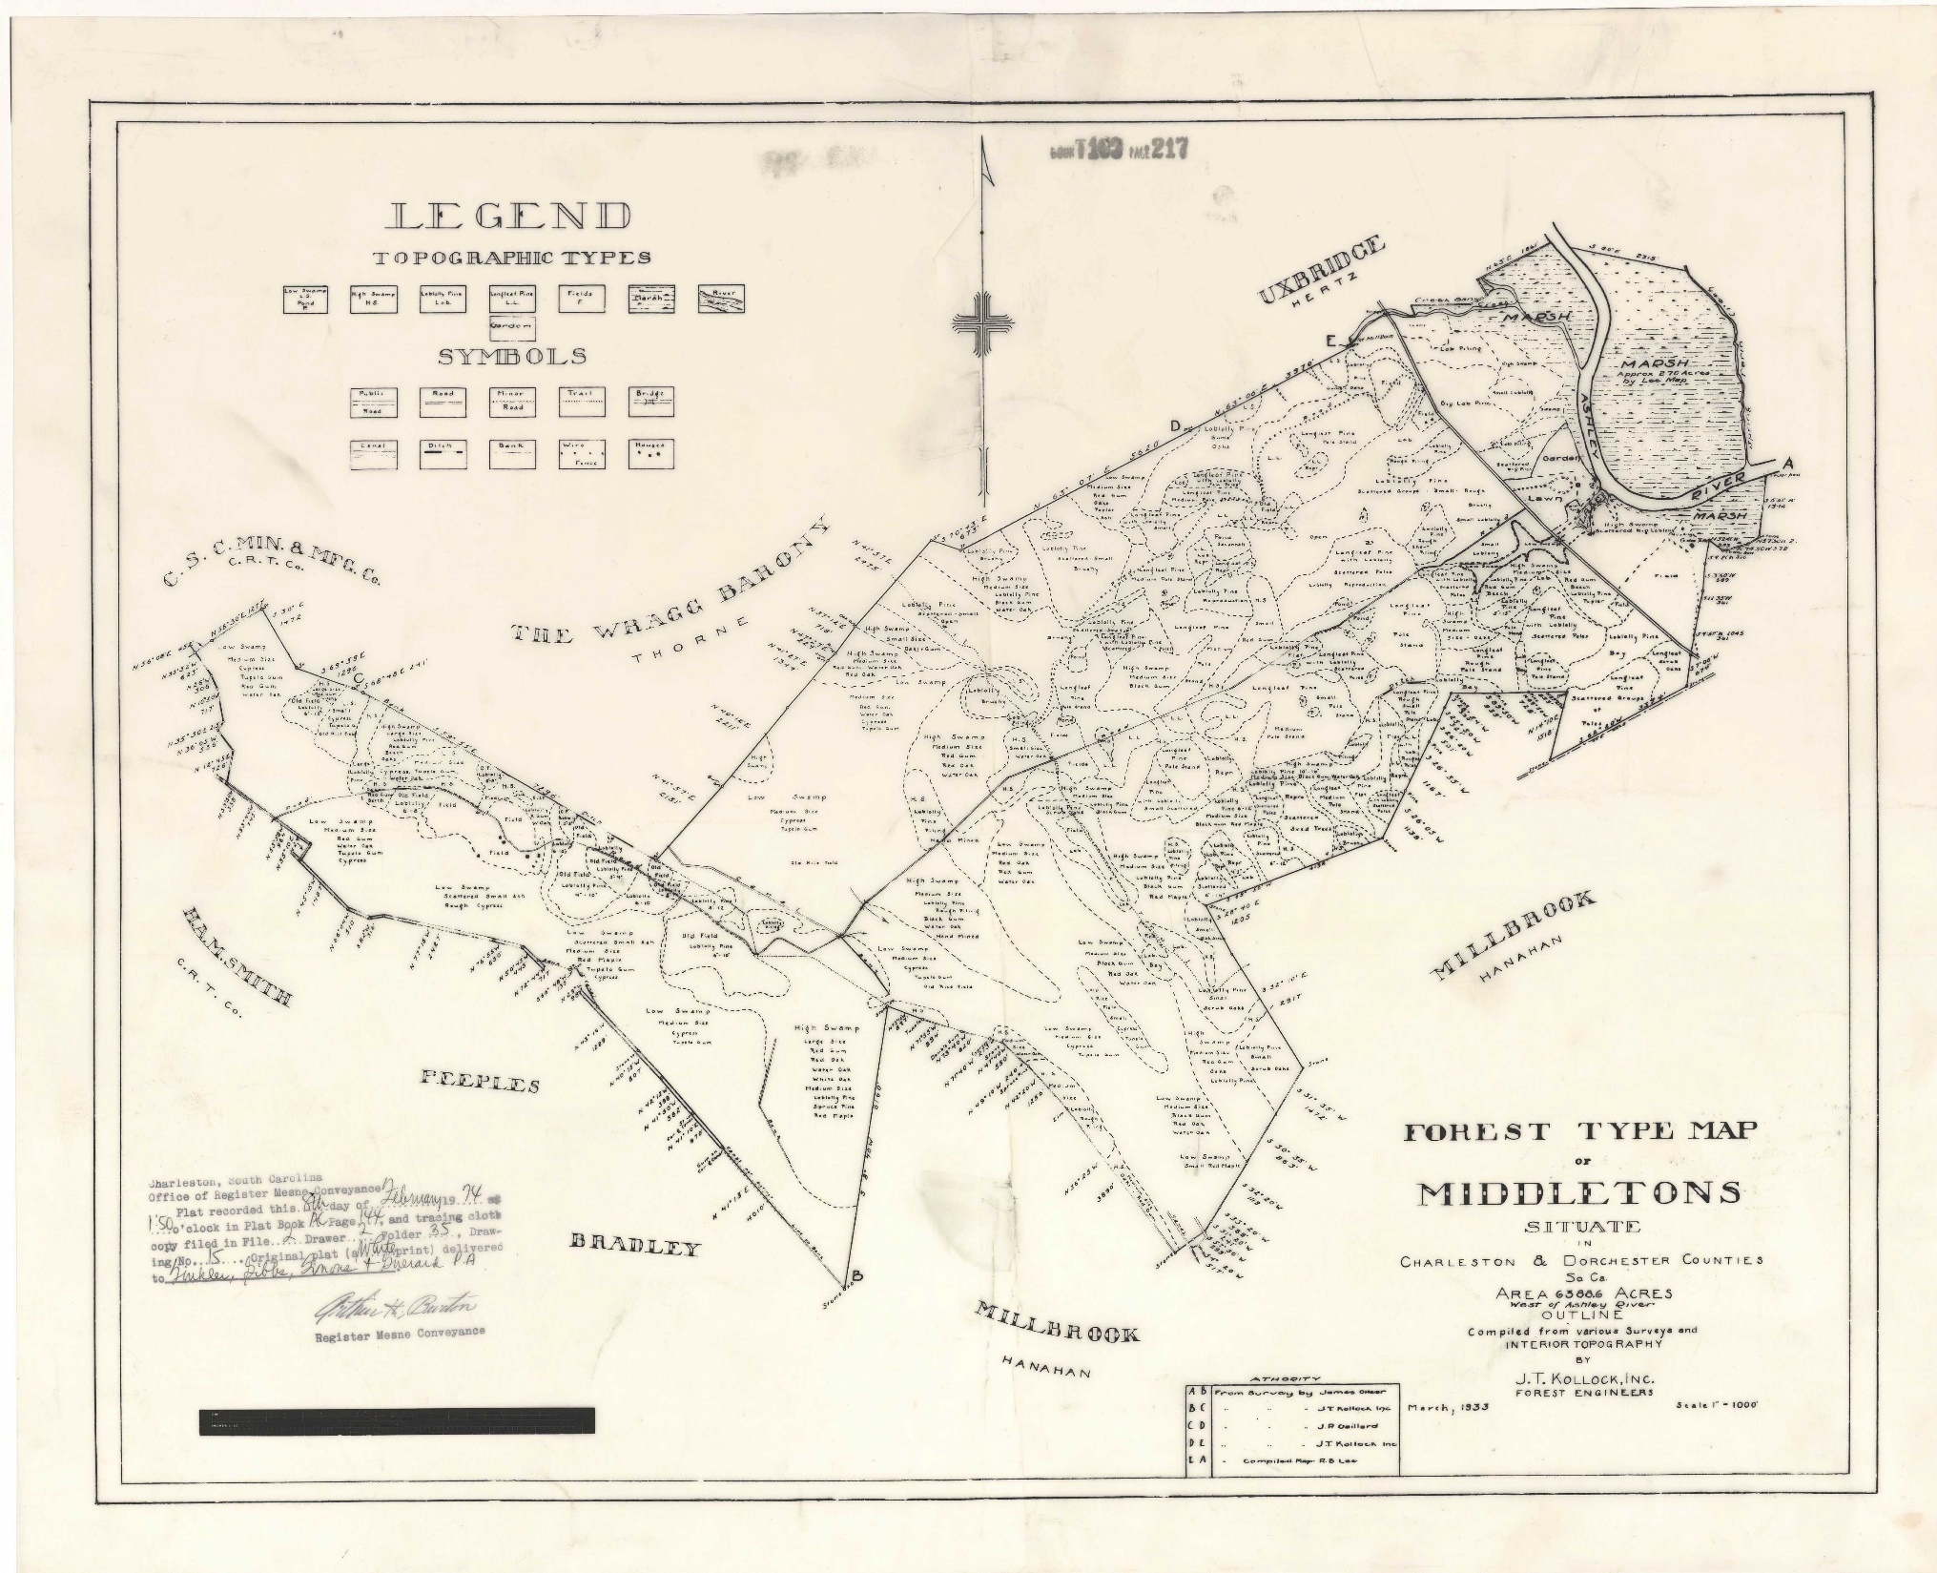

Slide 8
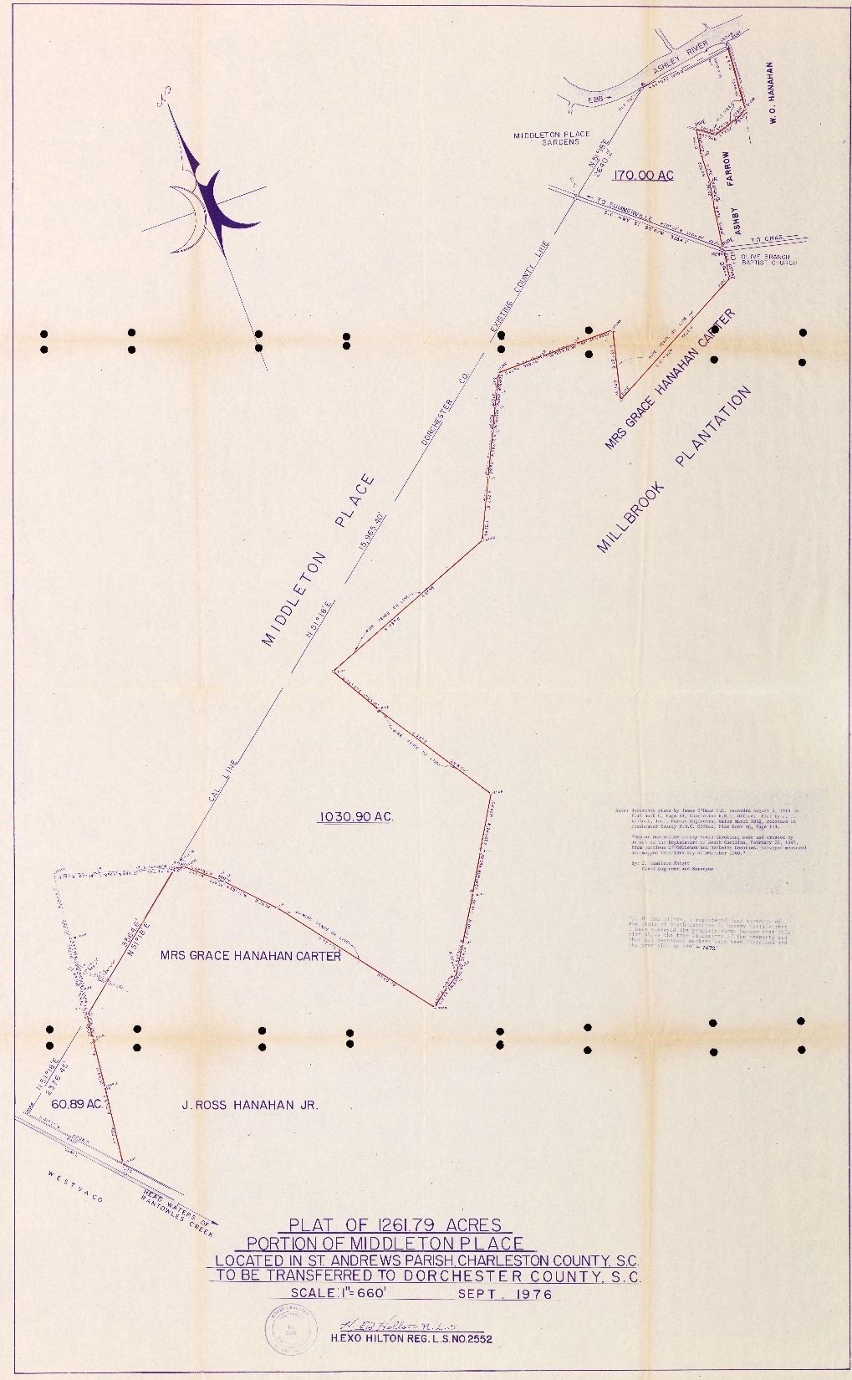

Slide 9
1985 Annexation

Slide 10
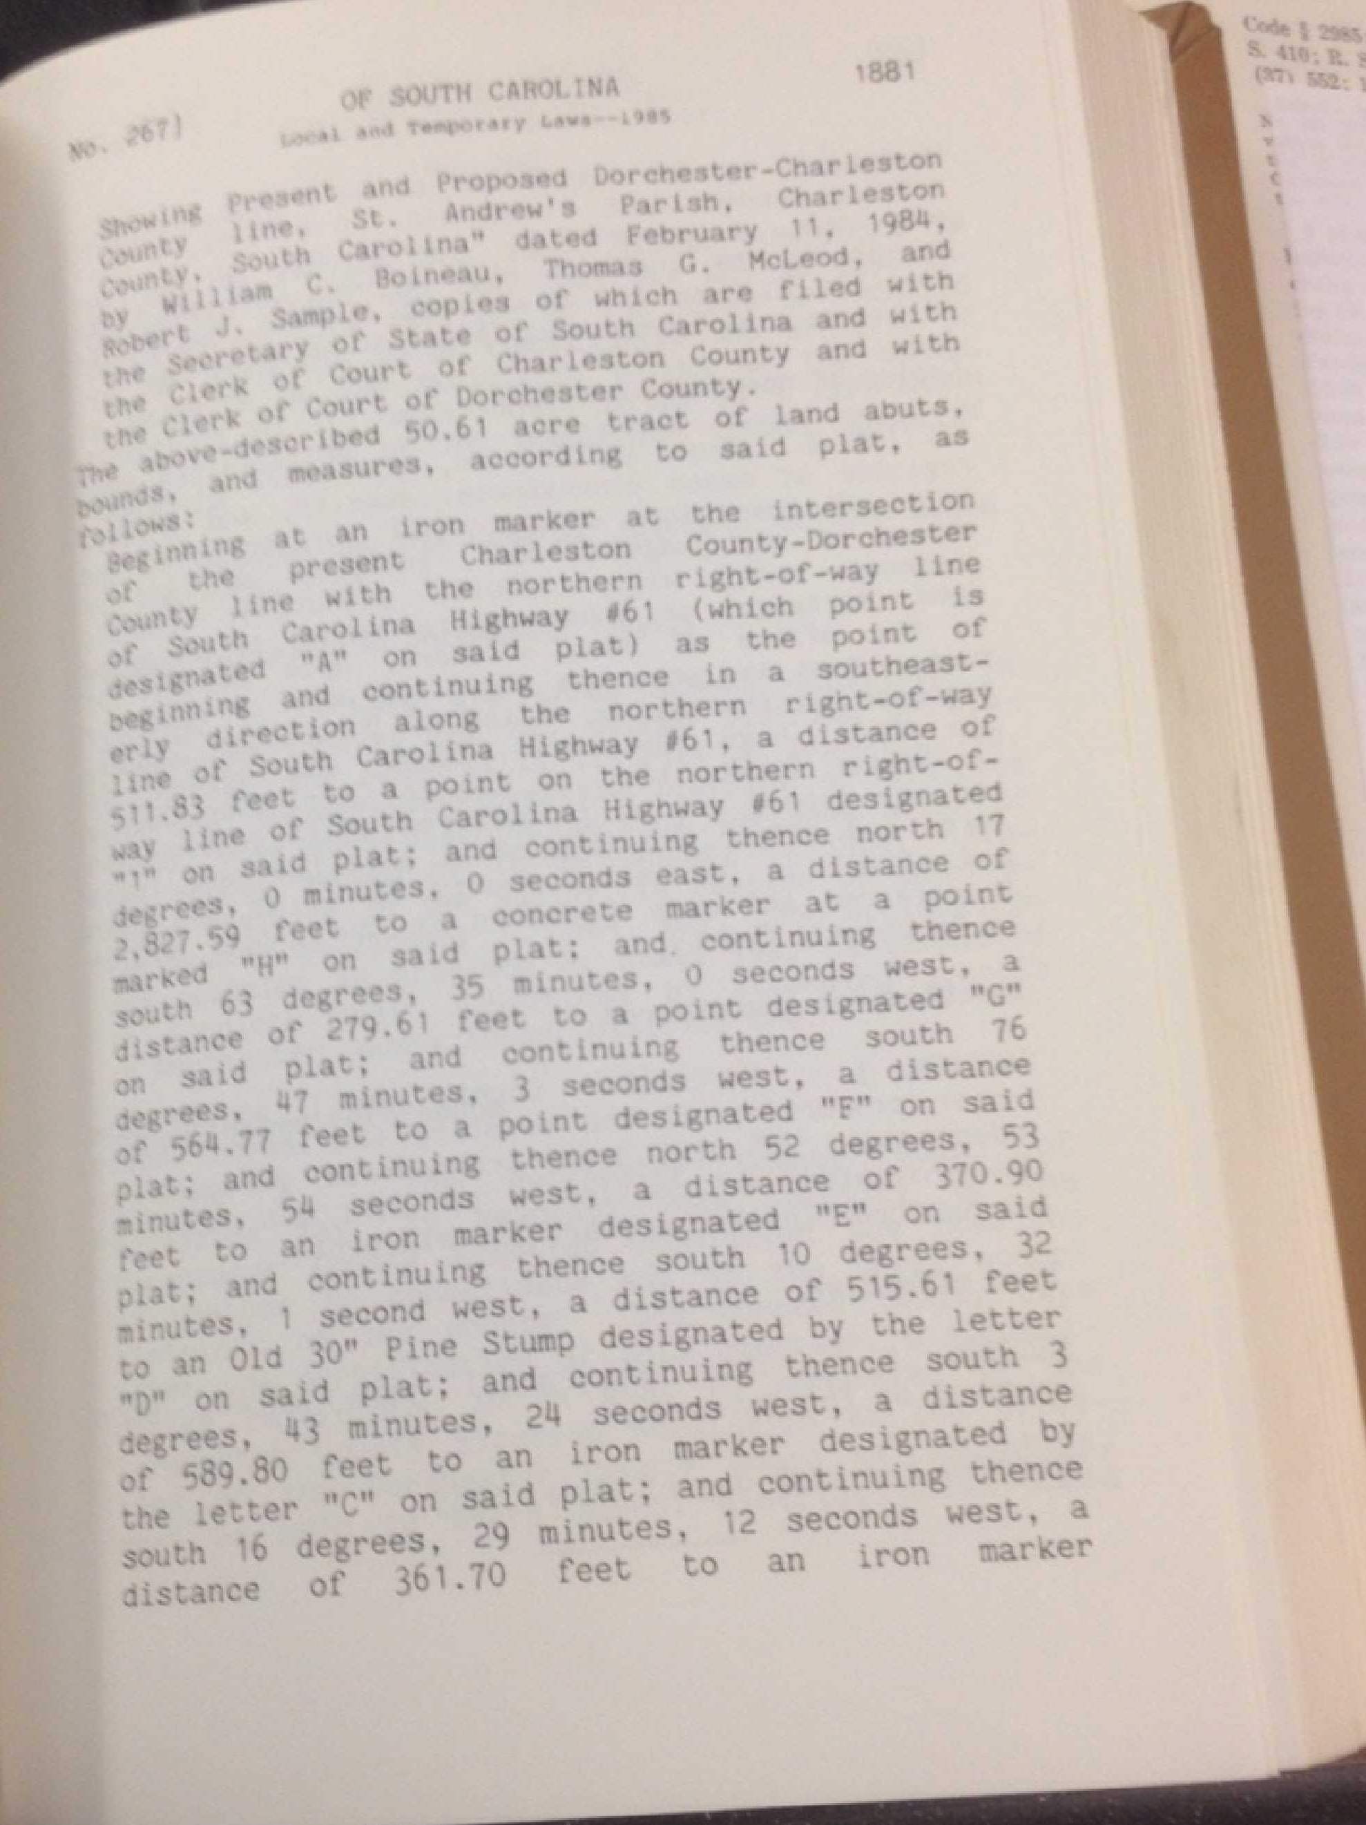

Slide 11
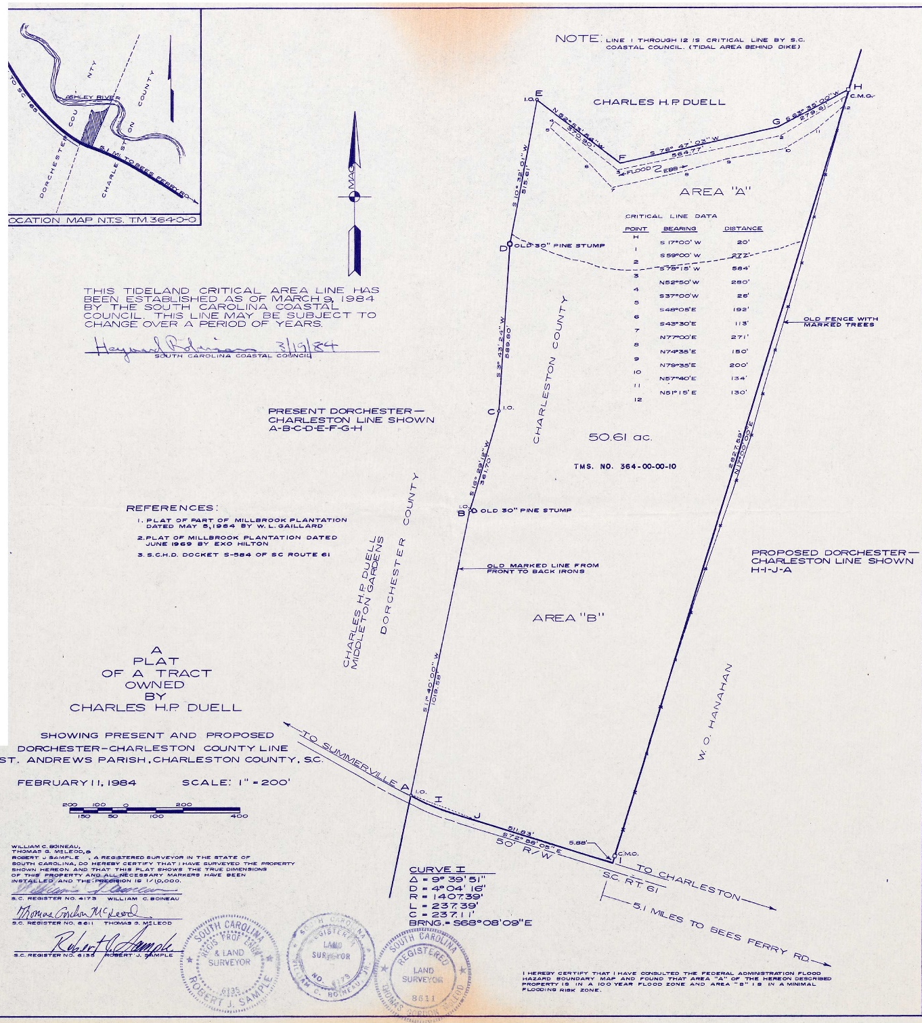
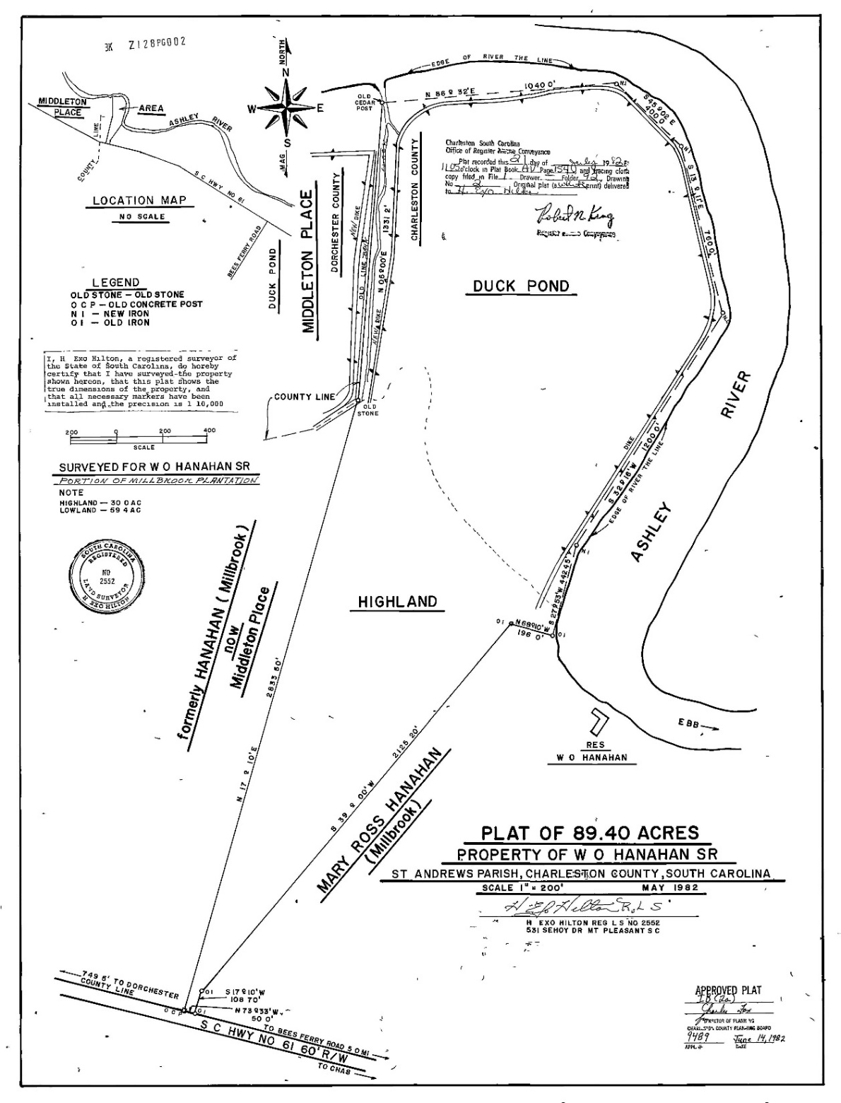

Slide 12
Field Survey Update
Both Property Owners have been very corporative and provided Cornerstone with their Foresters to help establish the current boundary.
Field Work is at 95% Complete, only monuments left to be set.
We have not encountered any boundary problems outside the “expected” normal that is seen in tracing a 40 plus year old line.

Slide 13
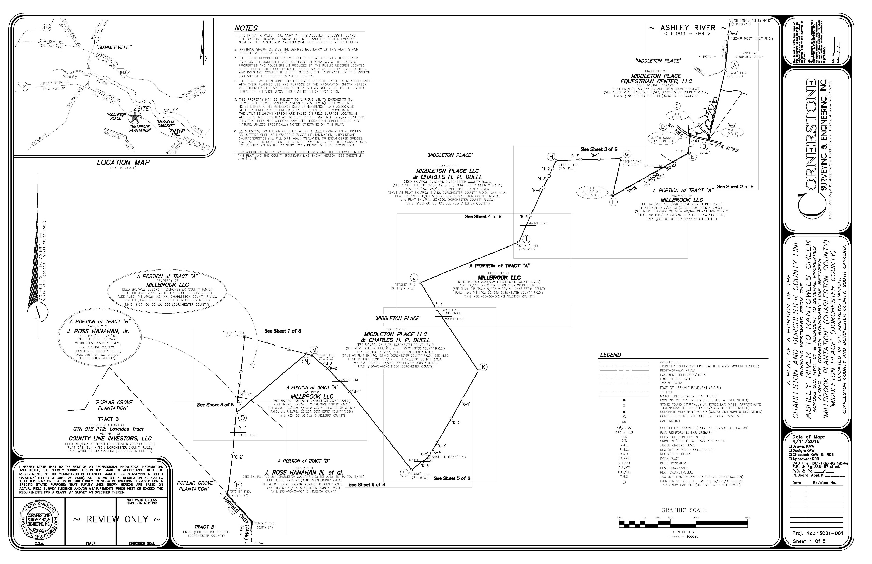

Slide 14
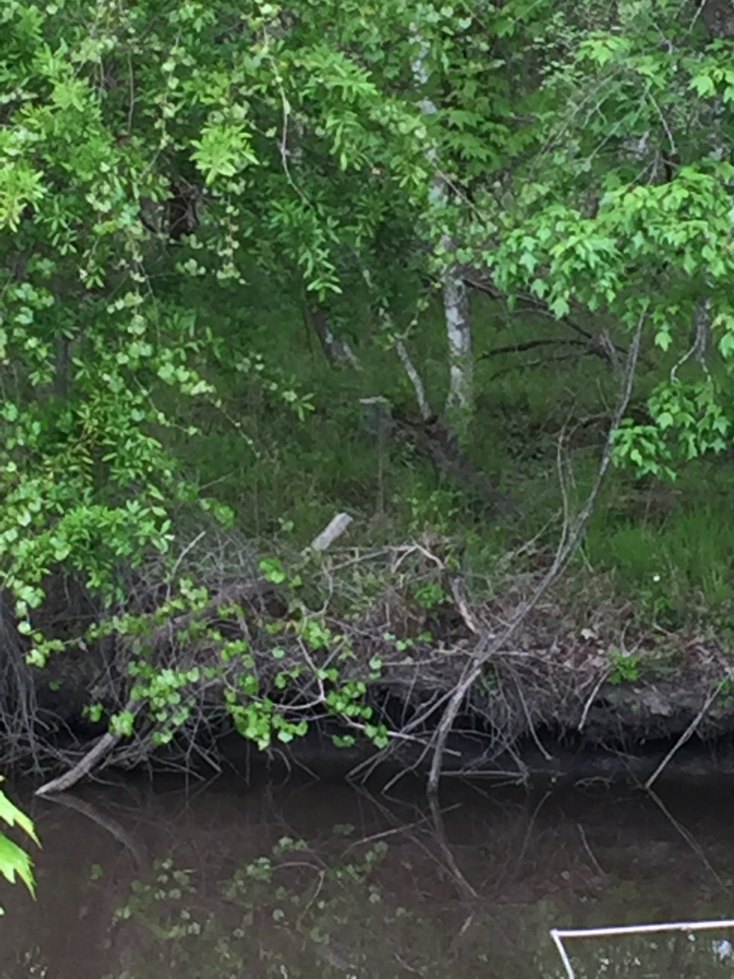
Ashley River Rantowles Creek

Slide 15
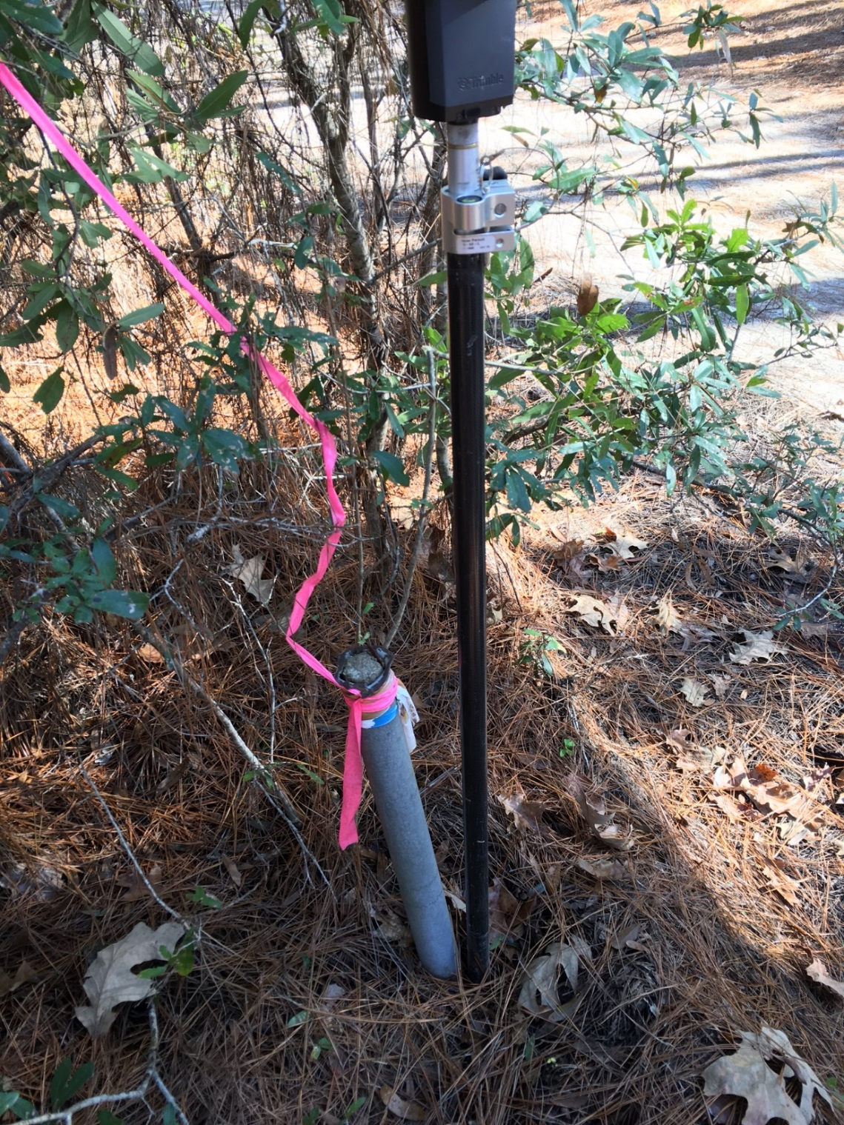
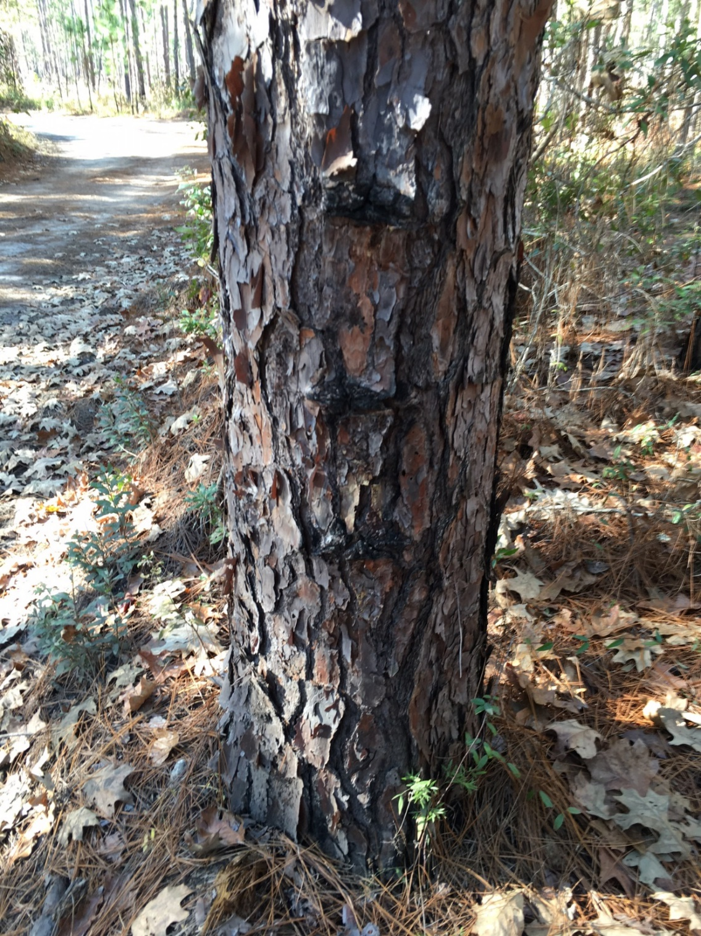

Slide 16
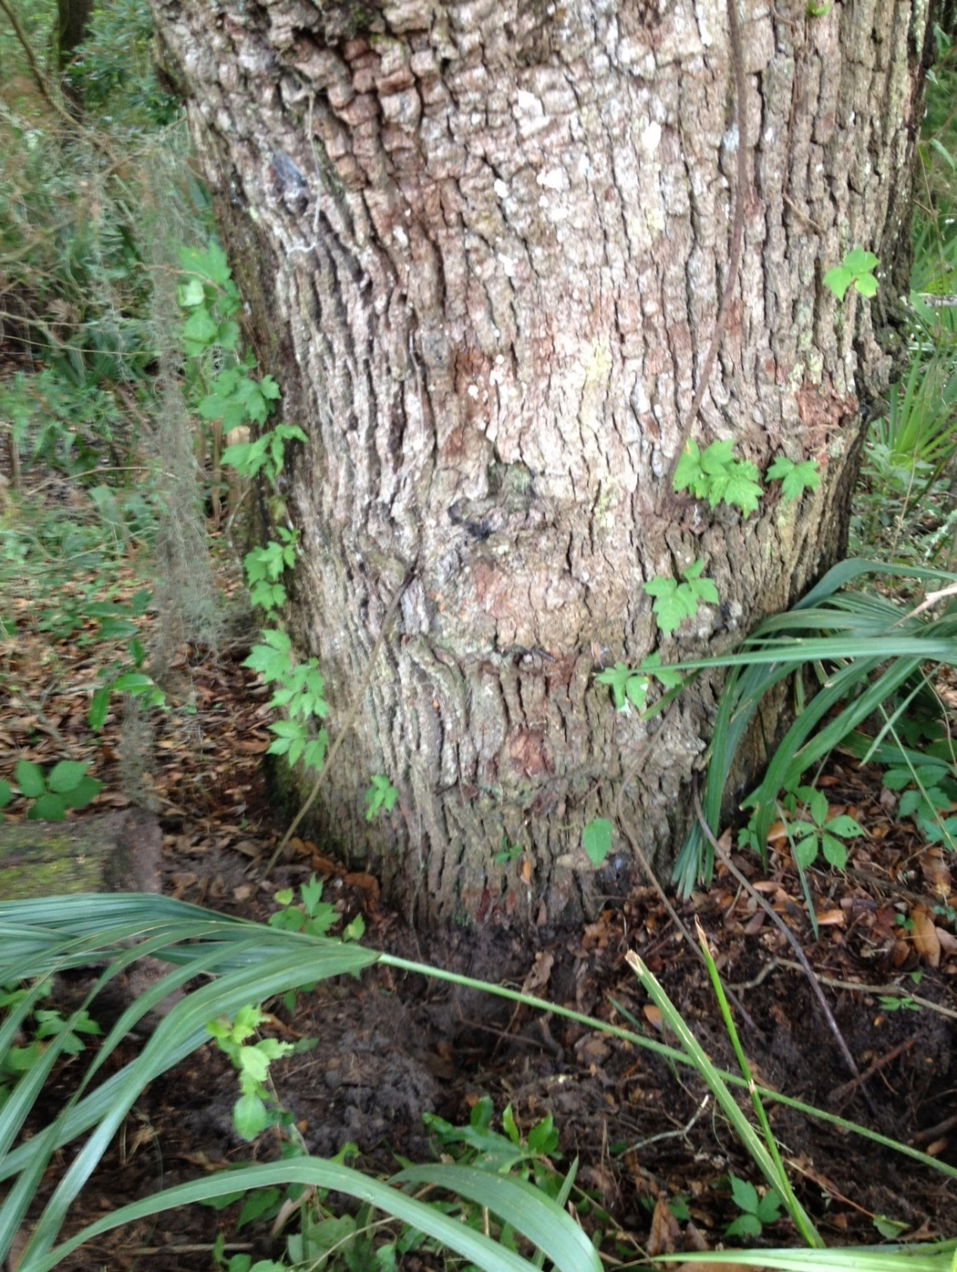
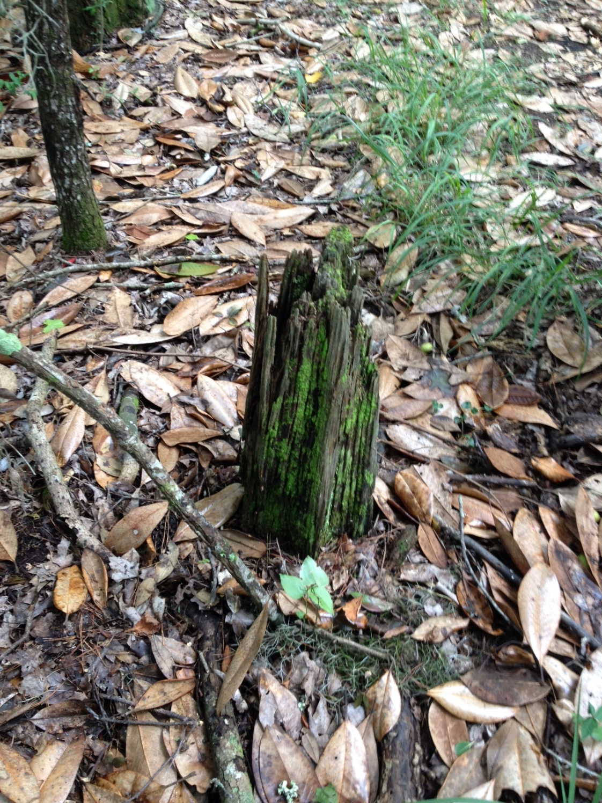

Slide 17
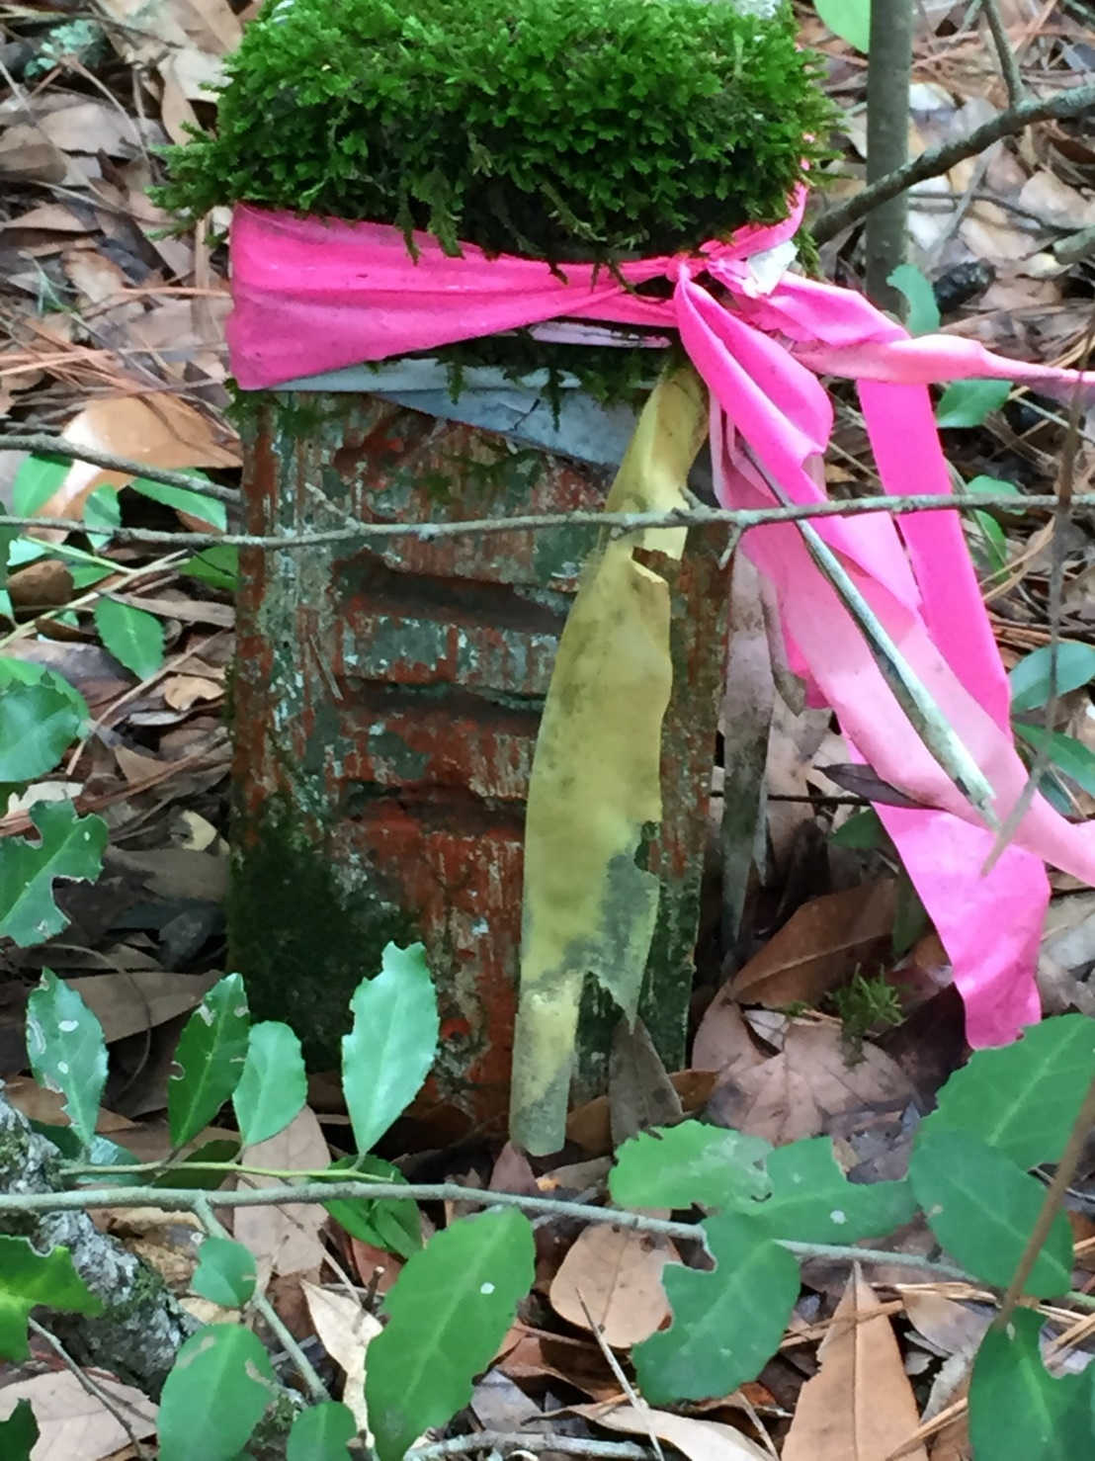
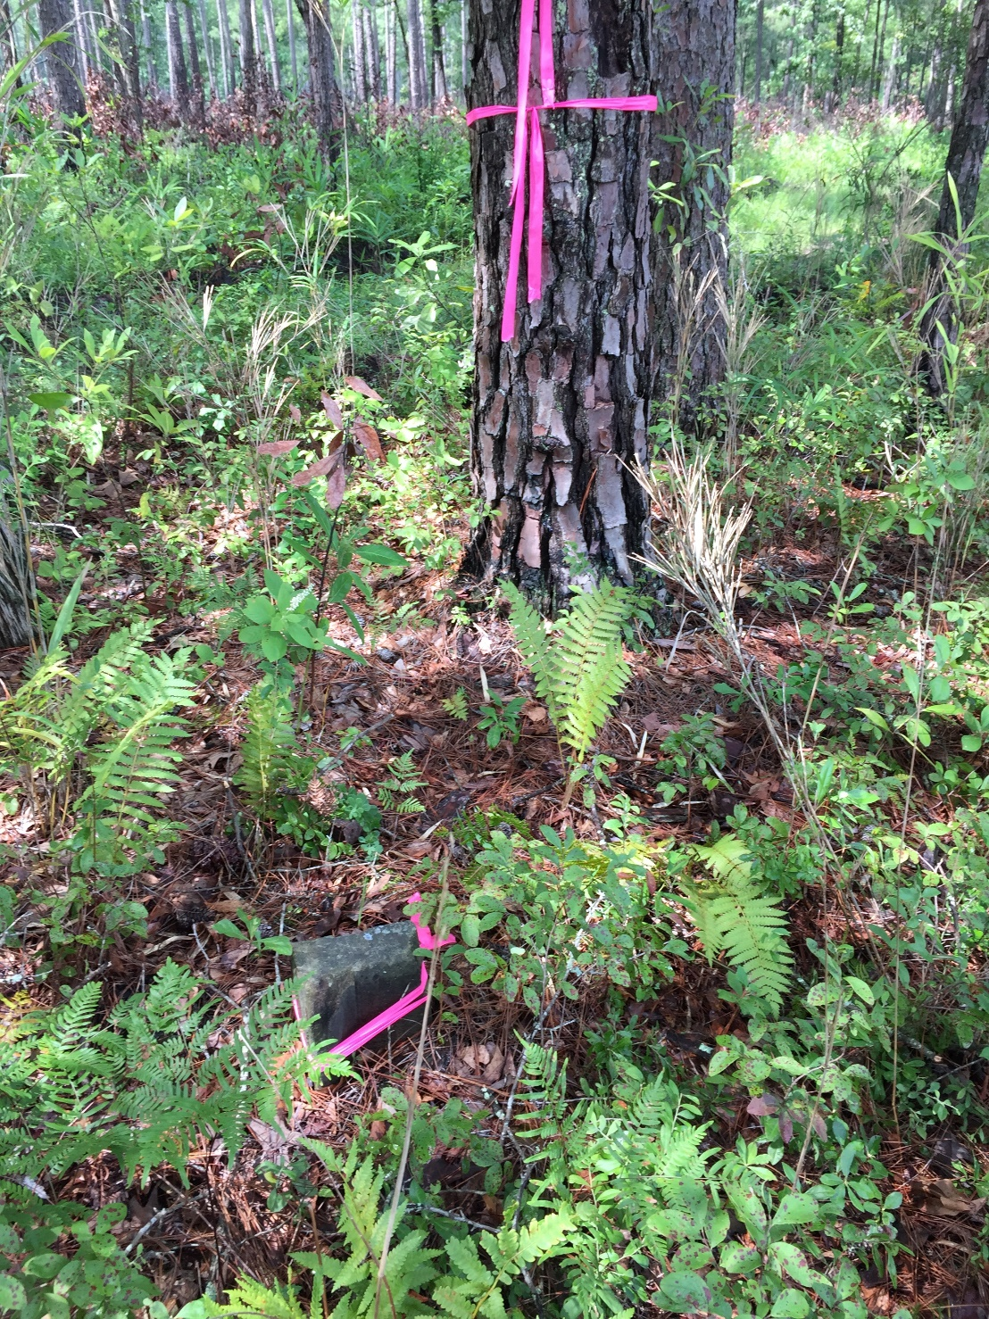

Slide 18
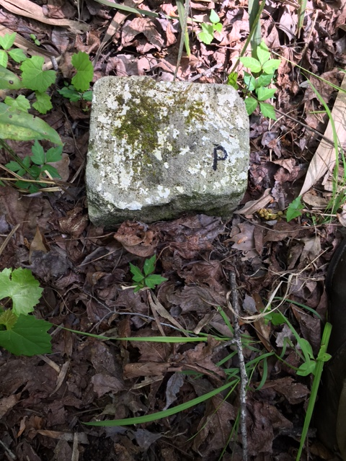
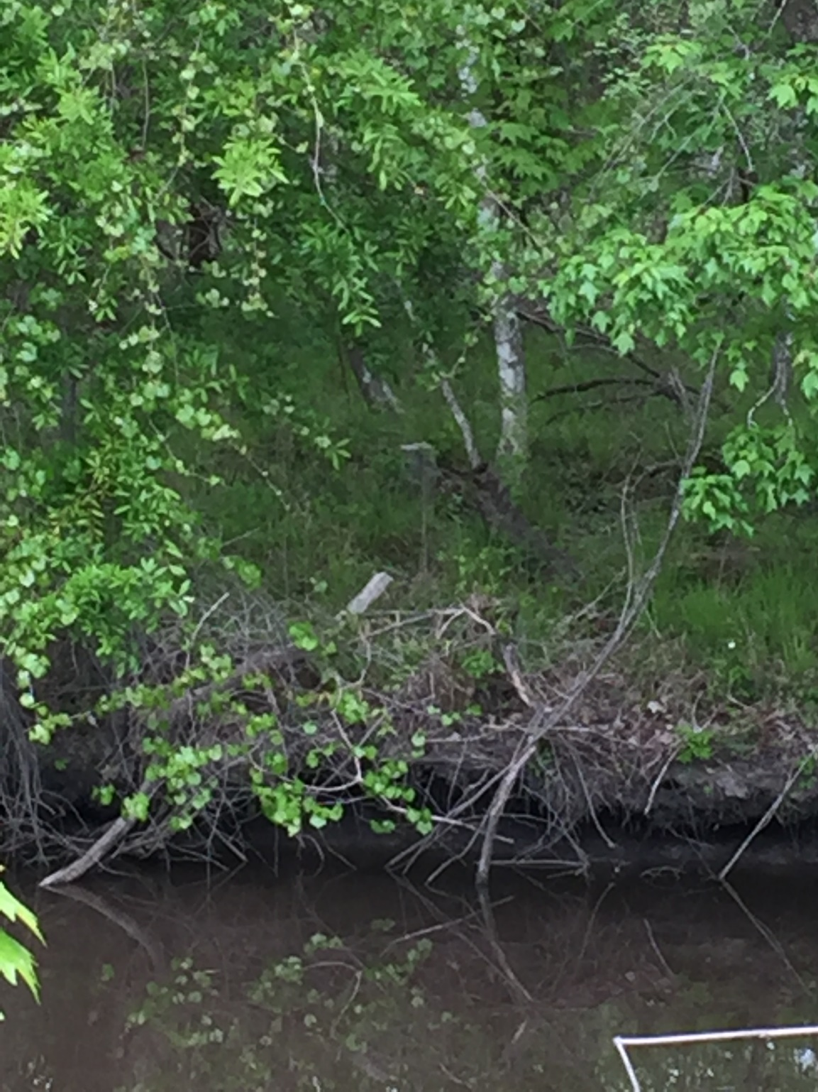

Slide 19
