Slide 1
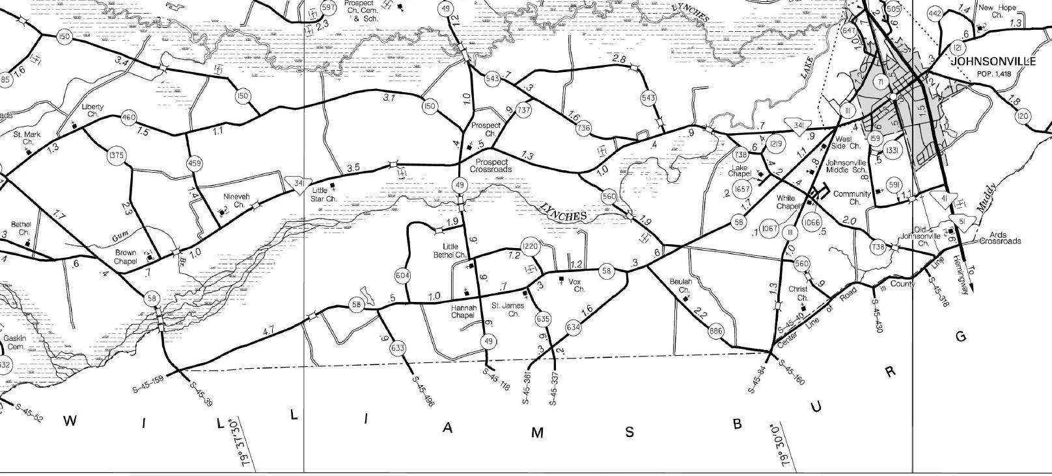
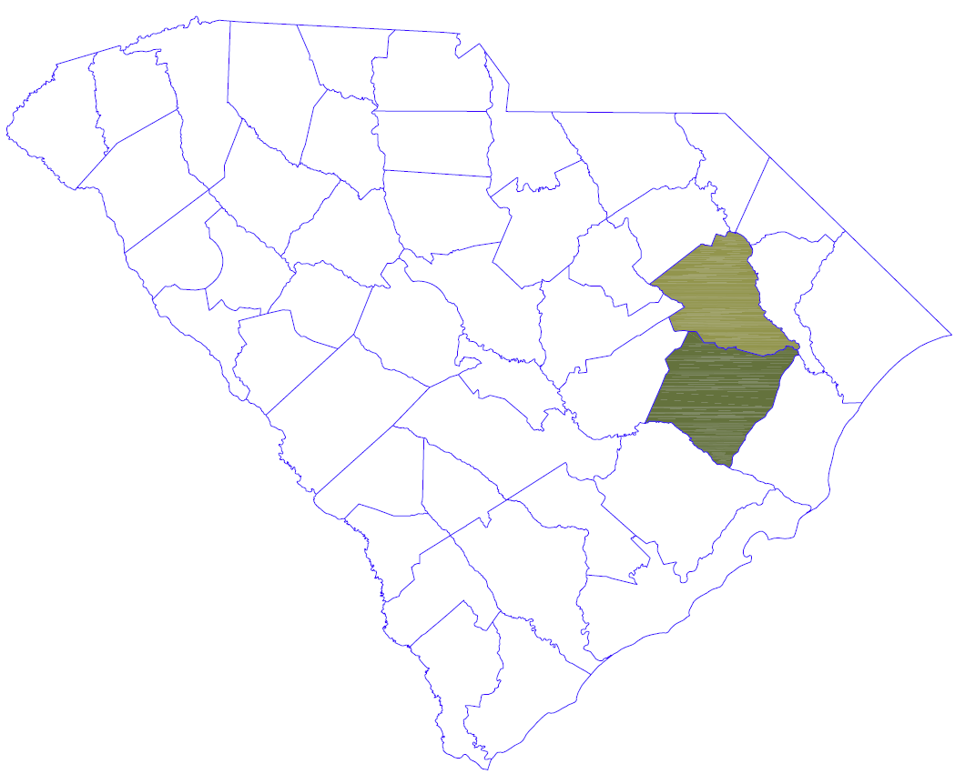
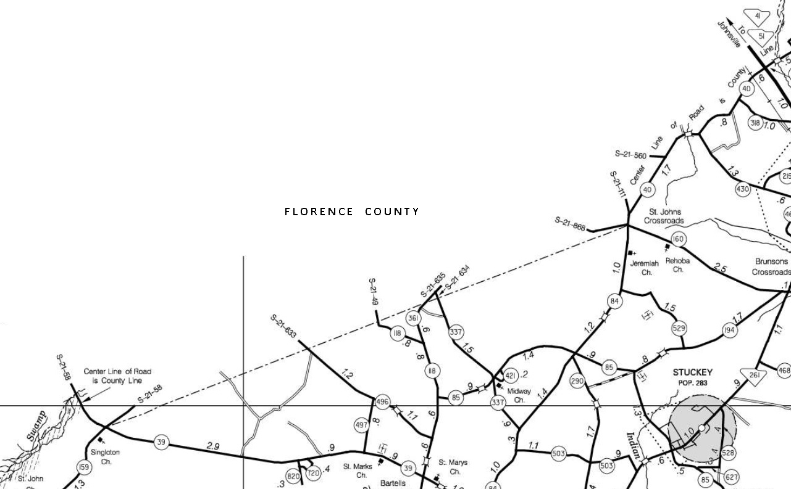

PORTION OF
FLORENCE WILLIAMSBURG
COMMON BOUNDARY
RE-ESTABLISHMENT PRESENTATION
October 24, 2016 Lake City, South Carolina

Slide 2

SC Code of Law and Act 262 Of 2014
Role of South Carolina Geodetic Survey
      (1994) Dispute between two or more counties- SCGS will act as mediator to resolve the dispute
      (1994/2014) SCGS to assist counties in defining and monumenting the locations of county boundaries and positioning the monuments using geodetic surveys where counties are ill-defined, unmarked, or poorly marked
      (2014) SCGS will clarify county boundaries as defined in Chapter 3, Title 4
      (2014) SCGS will analyze archival and other evidence and perform field surveys to position geographically all county boundaries in accordance with statutory descriptions

Slide 3
Steps for Clarifying Boundaries
Notify County Administrators in advance of planned work
Conduct historical research for documentary evidence of boundaries
Perform field work to locate monuments and corroborating evidence and position on State Plane Coordinates
Share preliminary findings with county officials for impact analysis and to plan public meetings
Receive feedback and input from local officials and public
Review and update findings, as appropriate
Work to build cooperation with affected parties

Slide 4
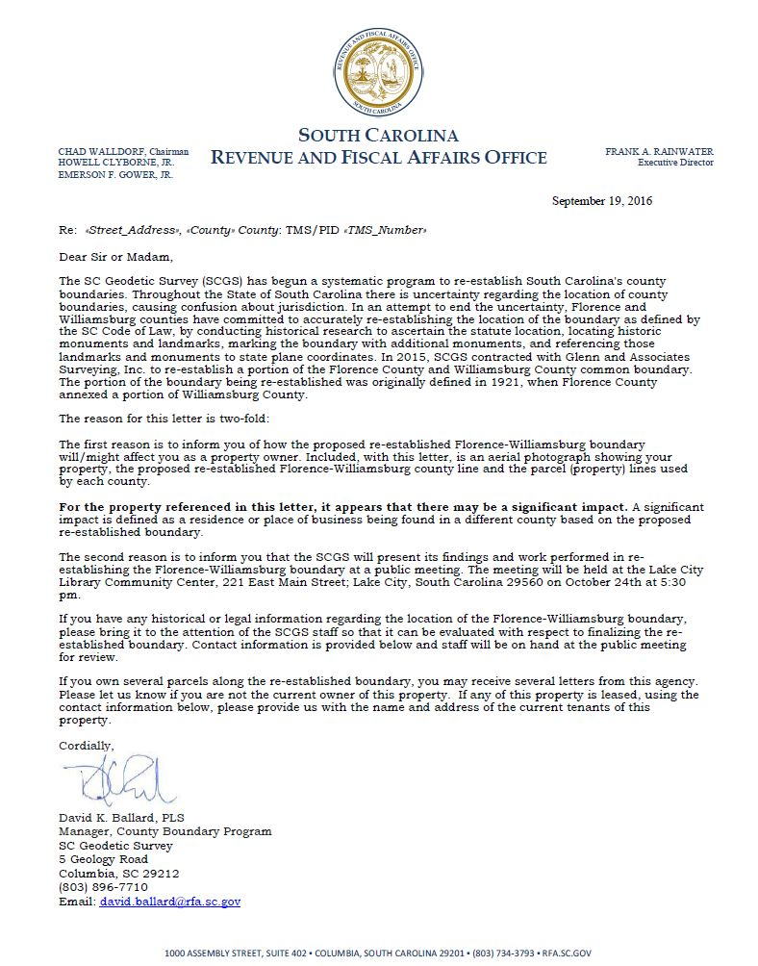
Public Meeting Notification

Slide 5
THE FLORENCE COUNTY ANNEXATION –
WILLIAMSBURG COUNTY
FLORENCE COUNTY WAS CREATED ON DECEMBER 22, 1888.
ITS PARENT COUNTIES COMPRISED OF DARLINGTON, MARION, WILLIAMSBURG, AND CLARENDON COUNTIES. AFTER FLORENCE COUNTY WAS CREATED, IT HAS UNDERGONE FOUR ANNEXATIONS.
THIS EXHIBIT IS TO PROPERLY RETRACE THE FOURTH AND FINAL ANNEXATION ALONG THE SOUTHERN ROUTE OF THE ANNEXATION. THE PETITION FOR THE FOURTH ANNEXATION OCCURRED ON MARCH 4, 1921 AND COMPRISED 45.3 SQUARE MILES.

Slide 6
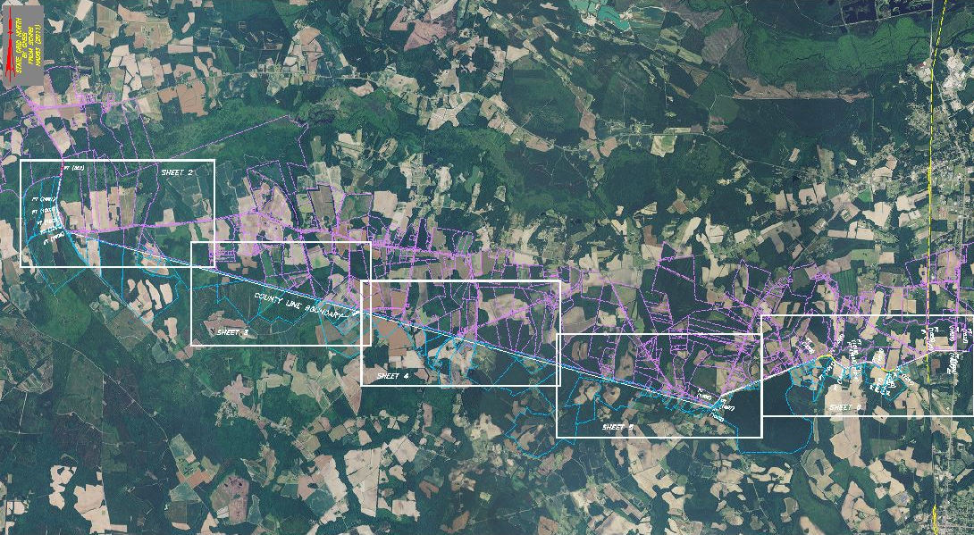
SUBJECT PORTION OF THE COMMON BOUNDARY LINE

Slide 7
THE FLORENCE COUNTY ANNEXATION-
WILLIAMSBURG COUNTY
This is a list of the items used to prepare this current plat:
Field survey data; using modern surveying practices
Physical evidence on or near the subject county line
Reference material
  South Carolina Code of Laws
  S. C. Archive Documents
  Plats of Record
  SCDOT Highway Plans
  USGS Quadrangle Maps
  Soil Survey of Williamsburg County, SC

Slide 8
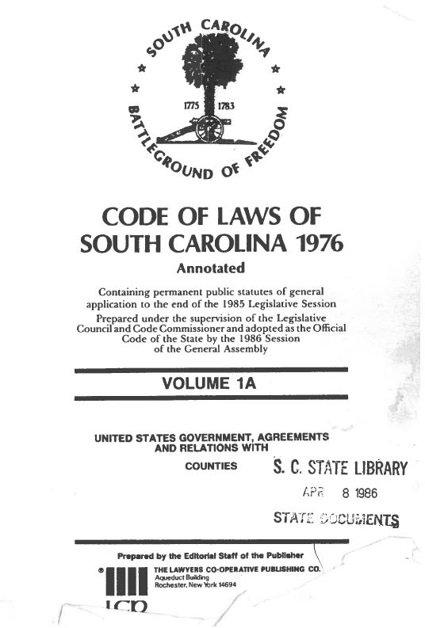
THE FLORENCE COUNTY ANNEXATION-
WILLIAMSBURG COUNTY

Slide 9
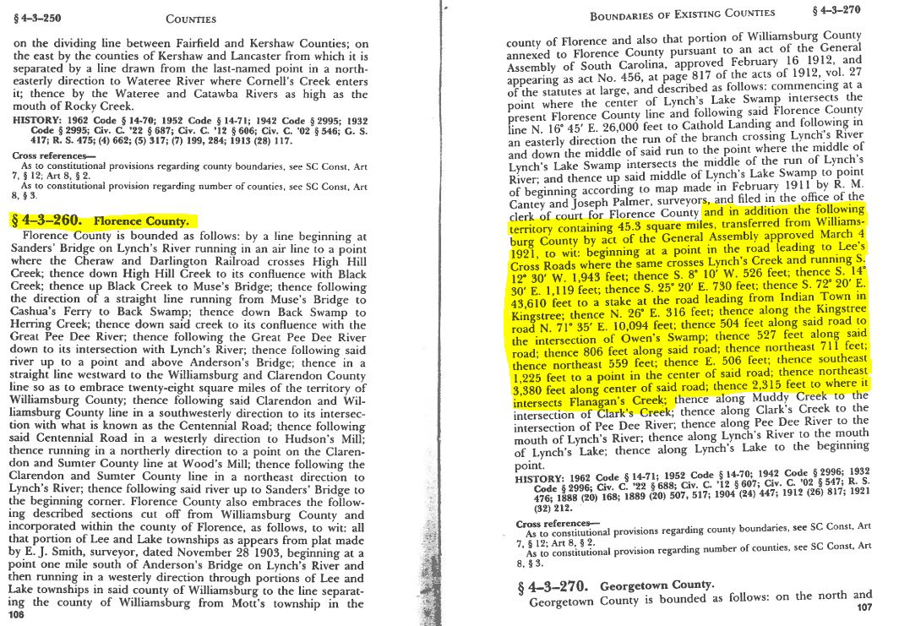
The South Carolina Code of Laws-Florence County

Slide 10
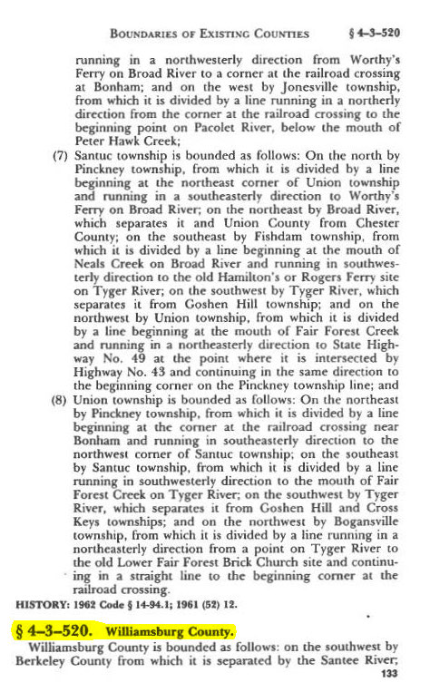
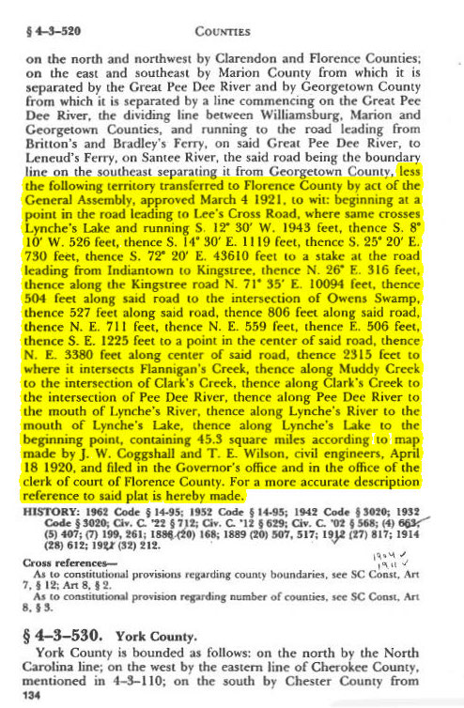
The South Carolina Code of Laws-Williamsburg County

Slide 11
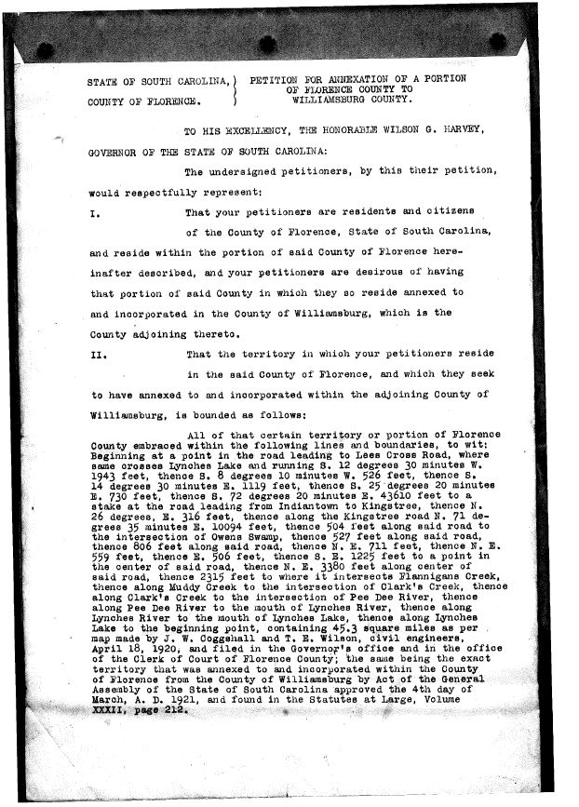
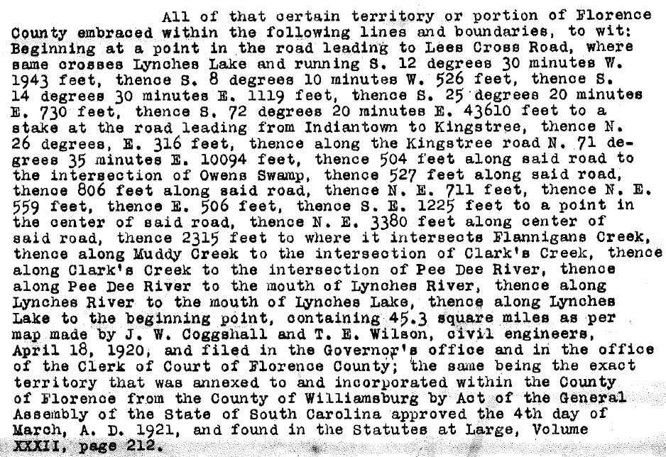
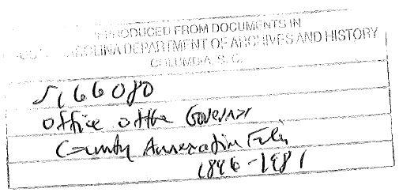
PETITION FOR ANNEXATION OF A PORTION OF
FLORENCE COUNTY TO WILLIAMSBURG COUNTY
Unsuccessful
Petition

Slide 12
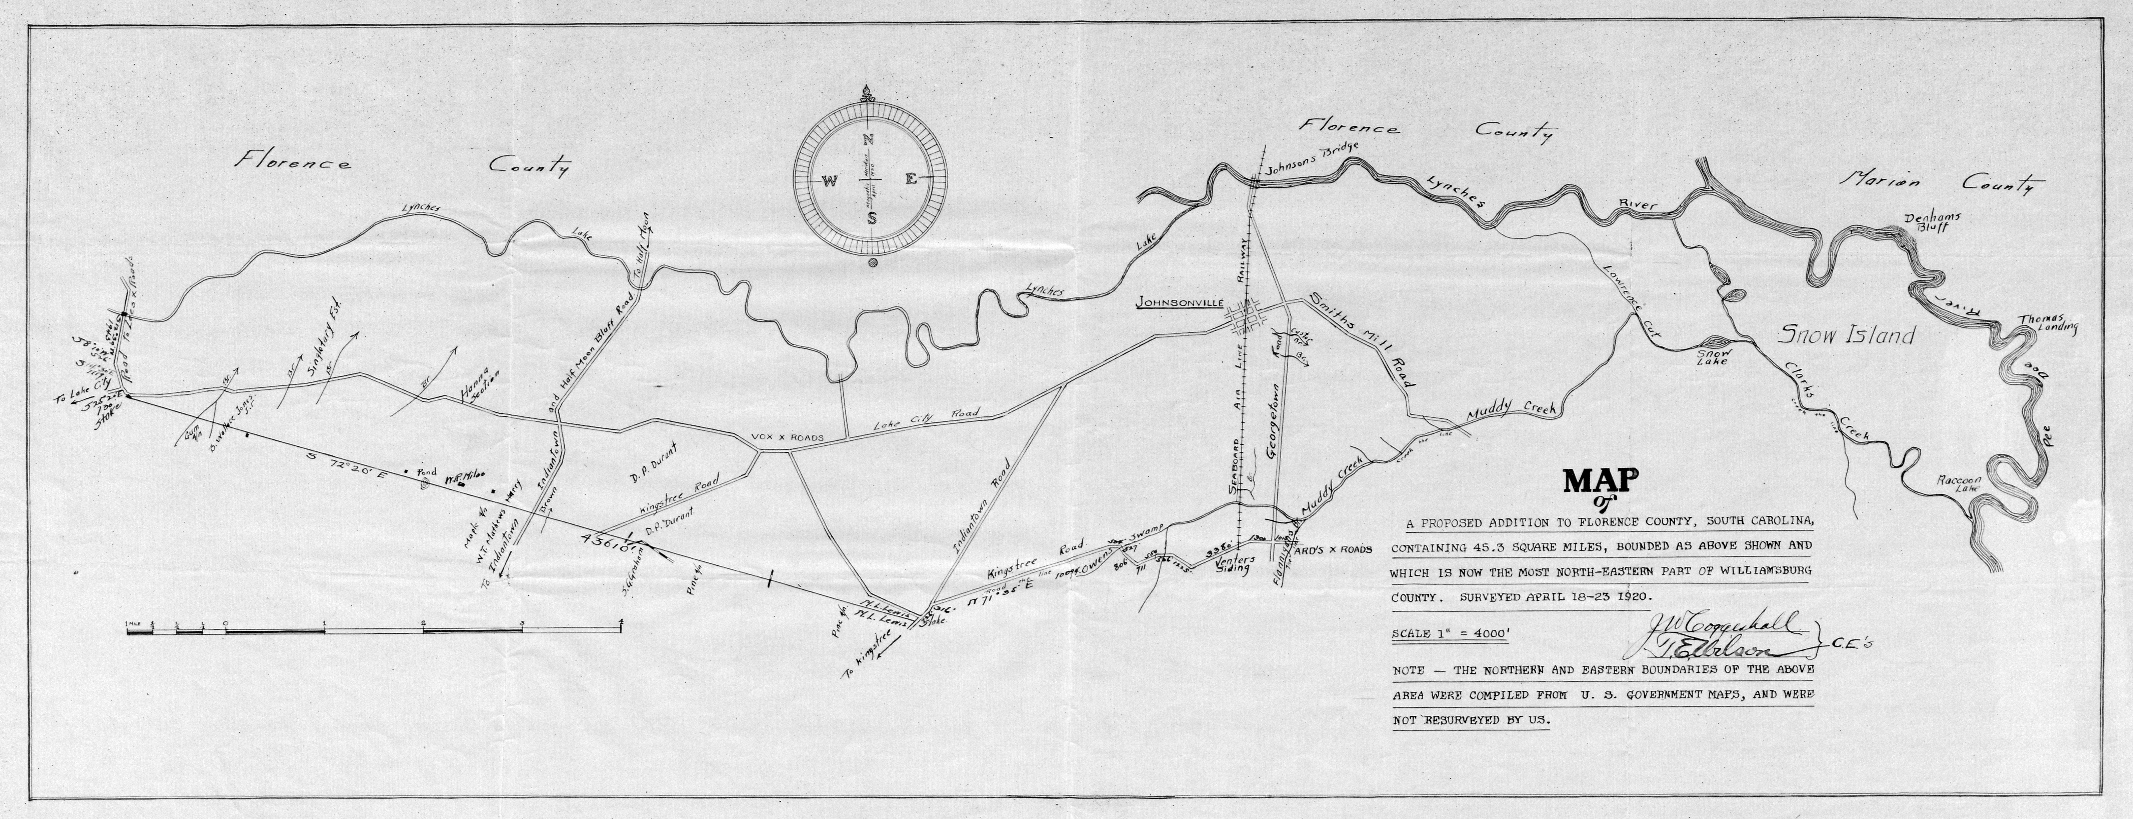
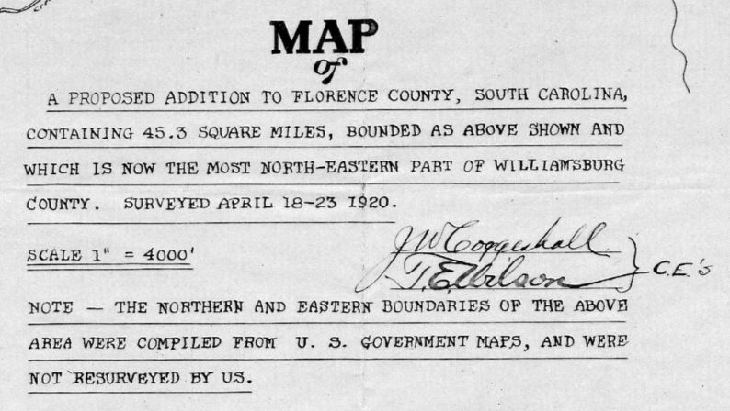
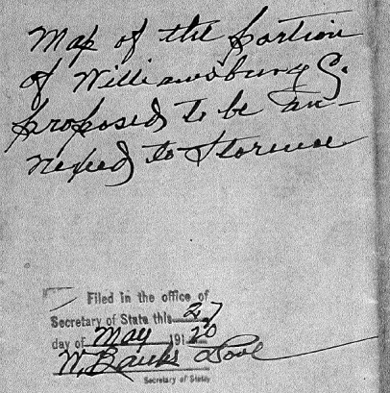
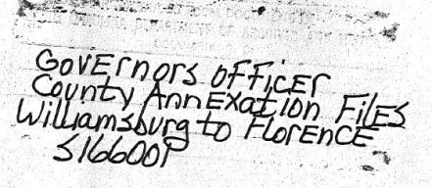
The April 18th, 1920 Coggeshall-Wilson Boundary Plat
References

Slide 13
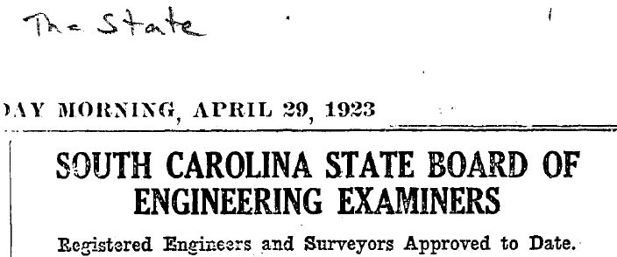
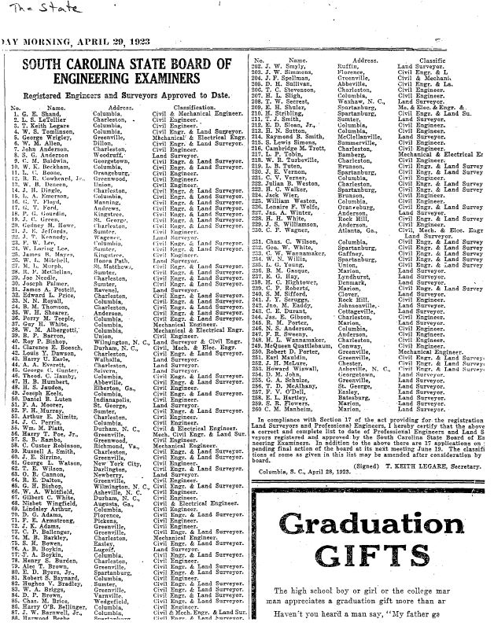
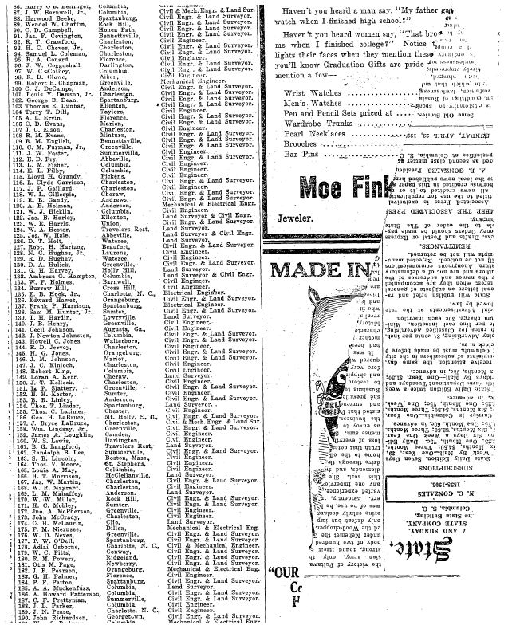

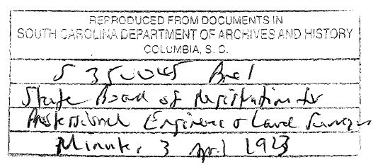
1920’s Surveyors
Reference

Slide 14
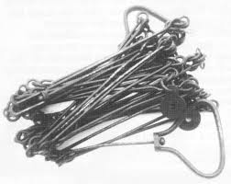
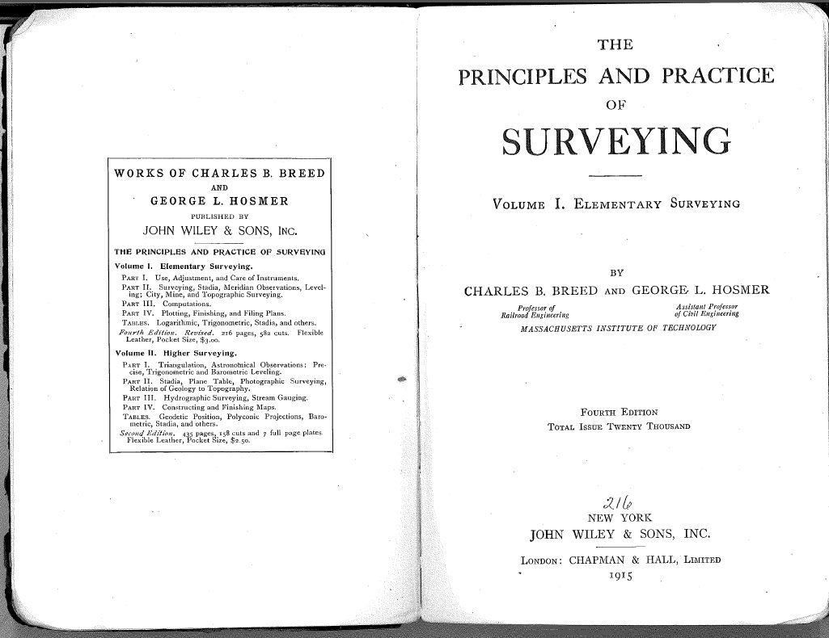
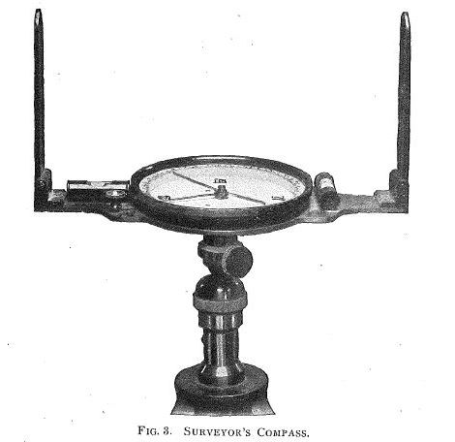
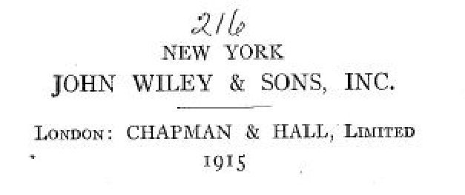
1920’s Surveying Instruments and Practice

Slide 15
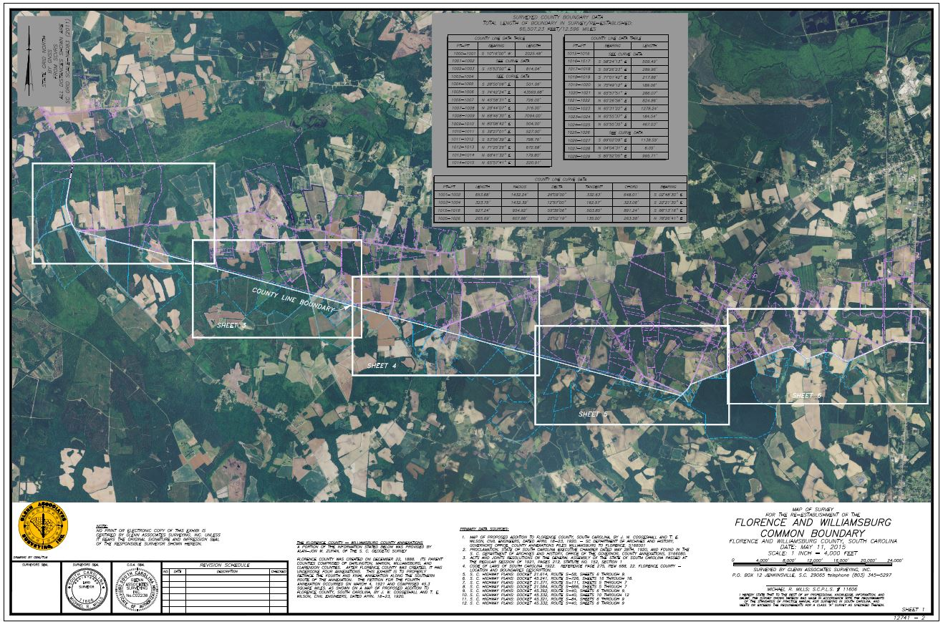
Map of Survey

Slide 16
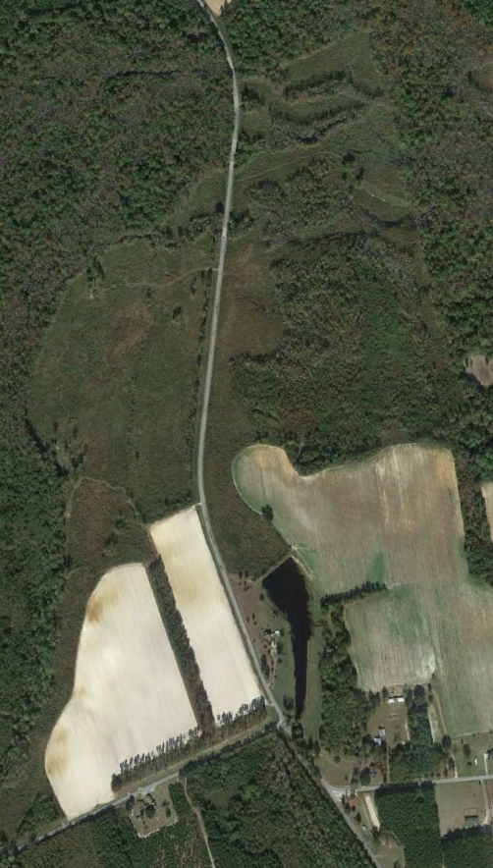
Lynches Creek along Old Georgetown Road to the
Road Intersection with Vox Highway
Section 1

Slide 17
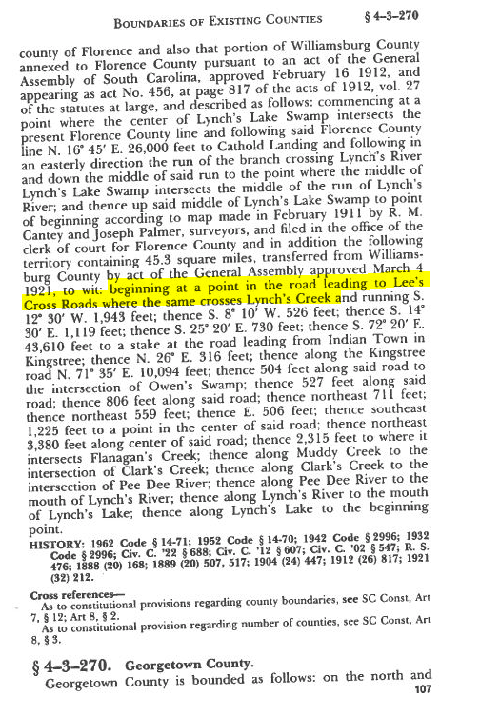
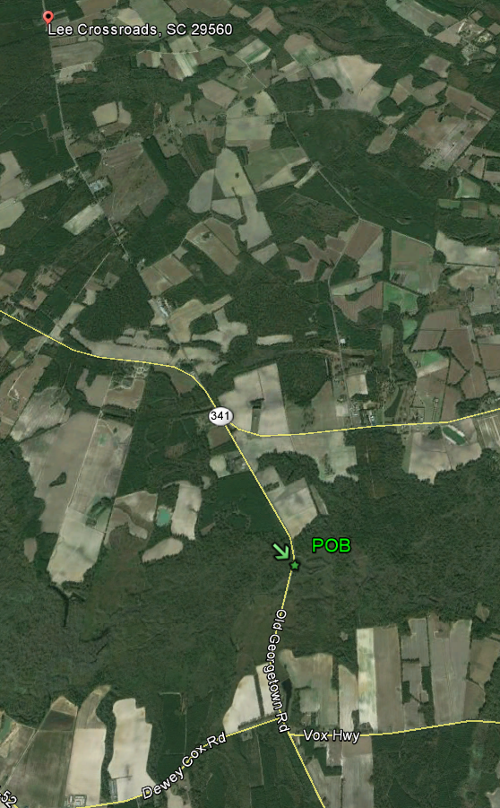
Point of Beginning
Lynches Creek

Slide 18
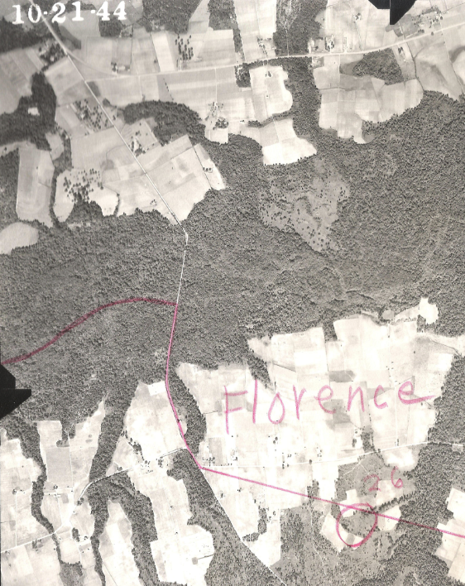
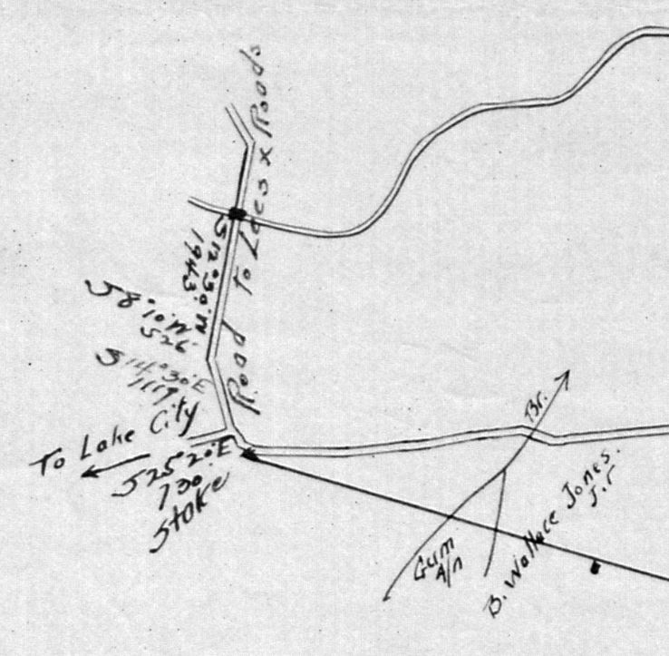
Coggeshall-Wilson Plat 1944 Aerial Photo
Aerial References:
UNIVERSITY OF SOUTH CAROLINA
THOMAS COOPER LIBRARY
SOUTH CAROLINA FORESTRY COMMISSION

Slide 19
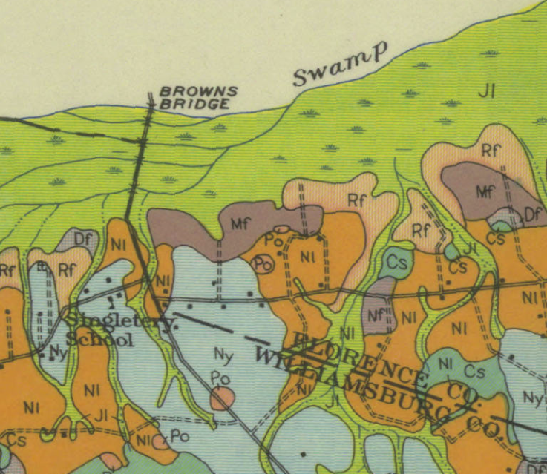
Coggeshall-Wilson Plat 1928 Williamsburg County Soil Map
References:
Soil Survey of Williamsburg County, SC
By W.J. Latimer, B.H. Hendrickson, F.R., Lesh, A.H Hasty, W.E. Tharp, and C.S. Simmons
UNIVERSITY OF SOUTH CAROLINA
USDA Historical Soil Survey Maps of SC Digital Collection

Slide 20
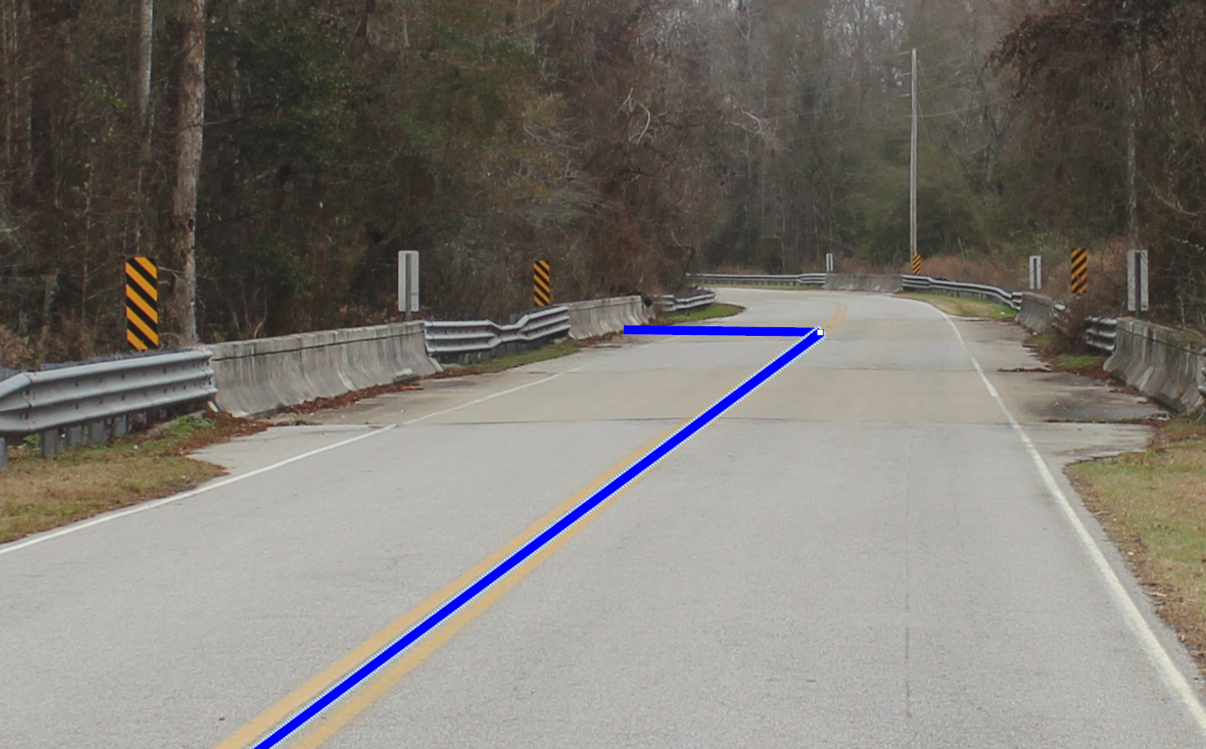
Lynches Creek and Old Georgetown Road
Probable Run of Lynches Creek
Old Georgetown Road
S 21-58
County Line

Slide 21
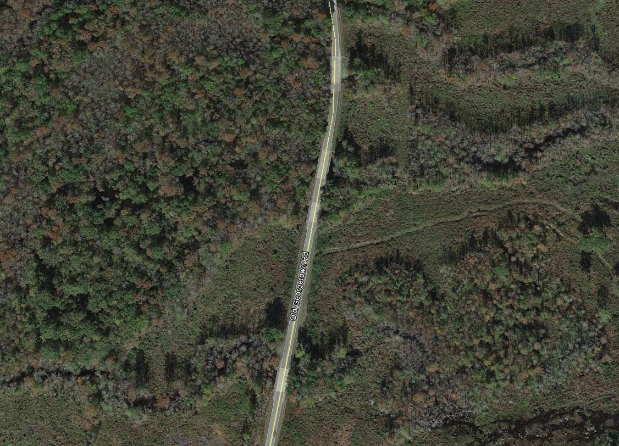
Lynches Creek and Old Georgetown Road-Aerial
Bridge
POB Coggshall-Wilson Plat
Bridge
Bridge
GIS Mapping
Bridge

Slide 22
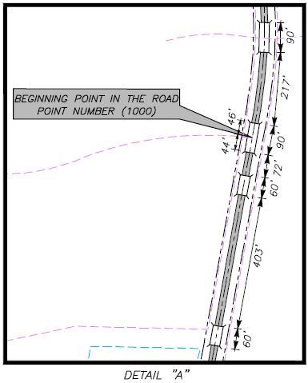
Map of Survey
Soils Map

Slide 23
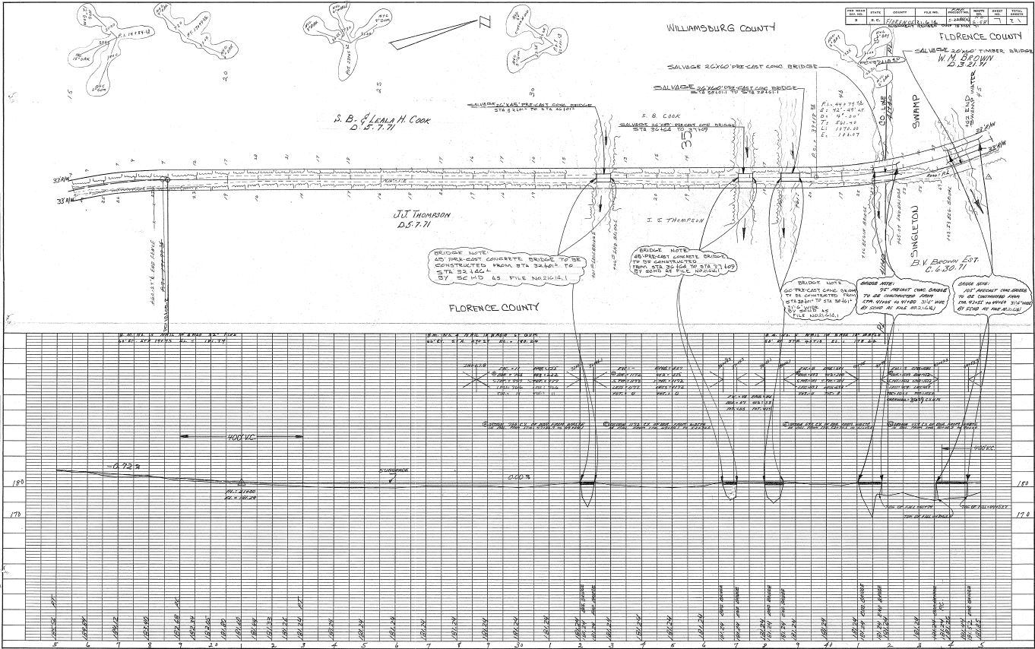
SCDOT Plans-Florence County Old Georgetown Road S 21-58
Dashed line indicates dirt road of 1971 was not outside of SCDOT R/W
GIS Line Location
Resurvey 2015 indicates County Line being at this run

Slide 24
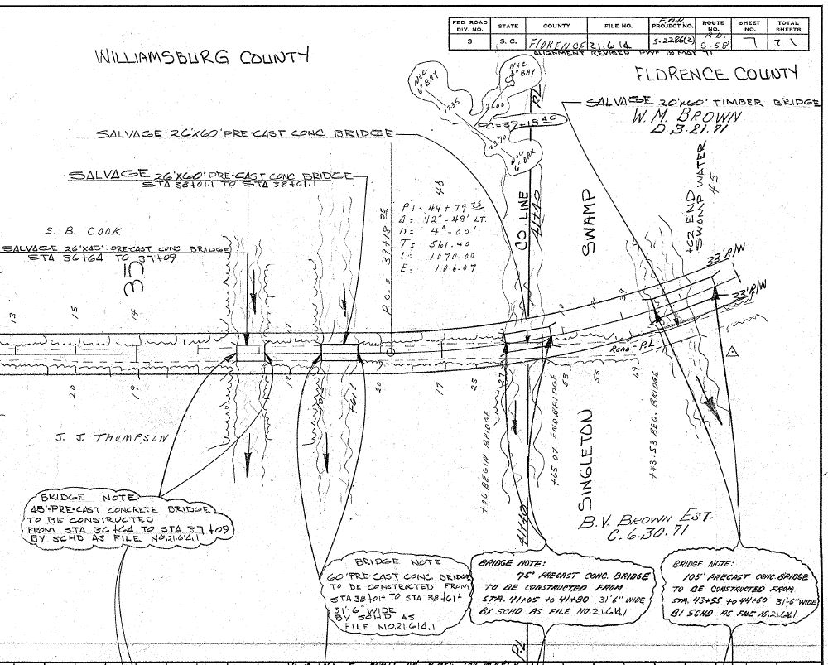
SCDOT Plans-Florence County Old Georgetown Road S 21-58

Slide 25
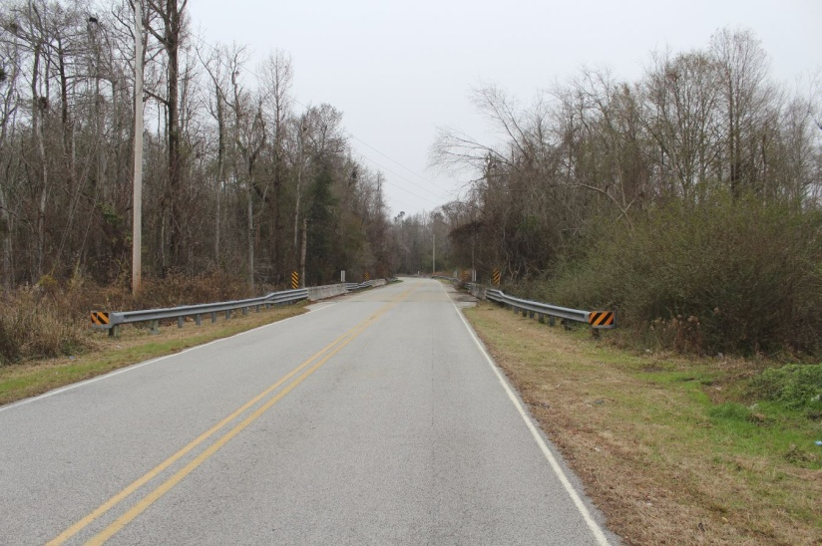
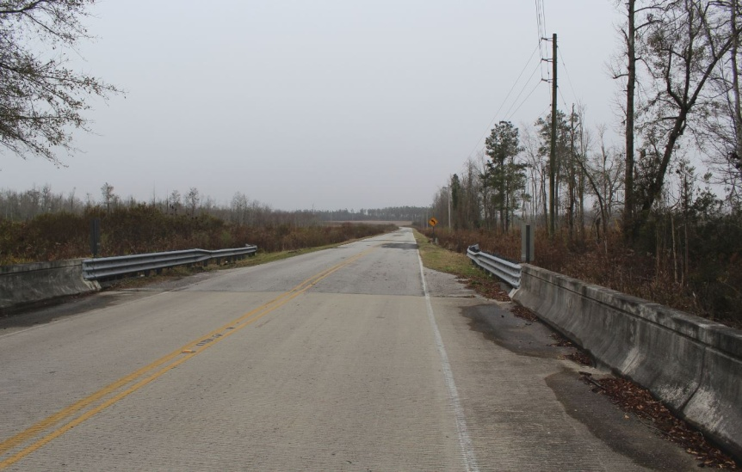
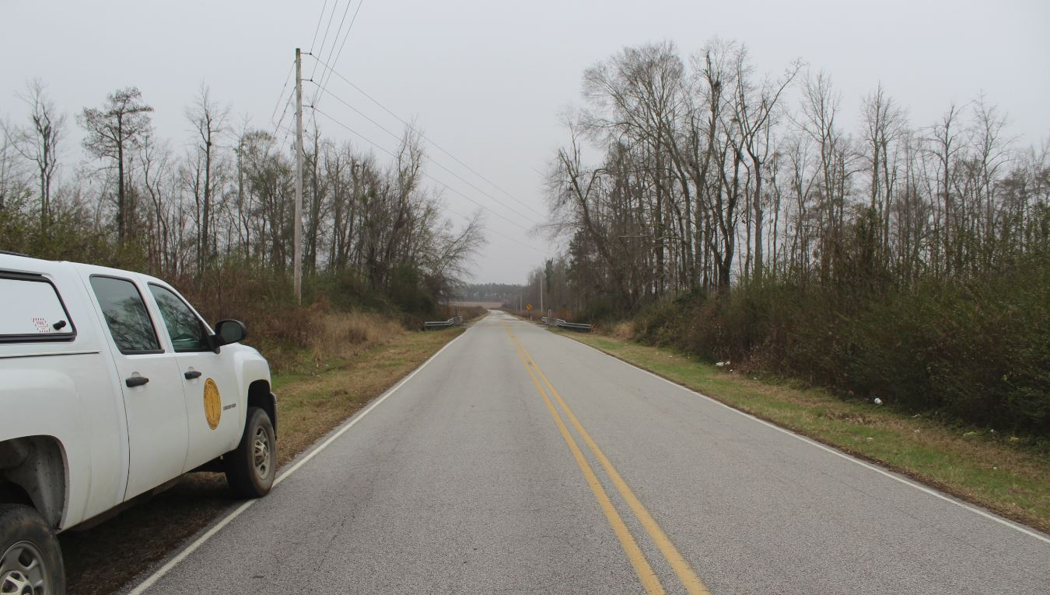
County Line along the Old Georgetown Road
North View
South View
The field evidence supports that the current road appears to be in the same location as the Coggeshall-Wilson plat. No evidence of old roadbed.
South View

Slide 26
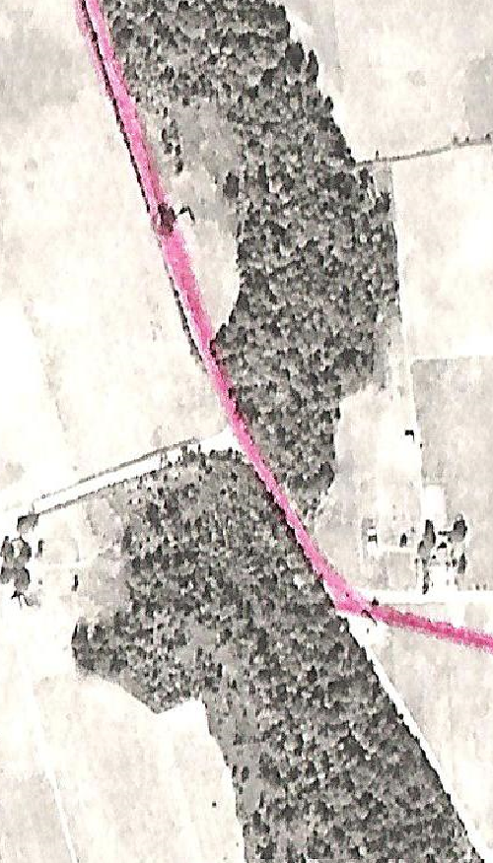
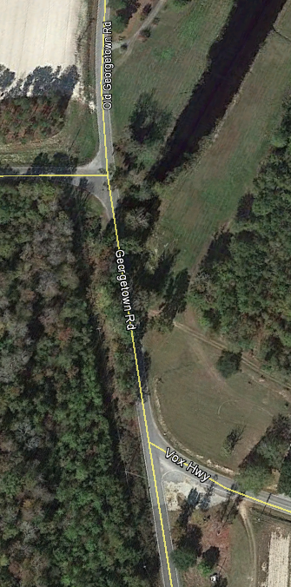
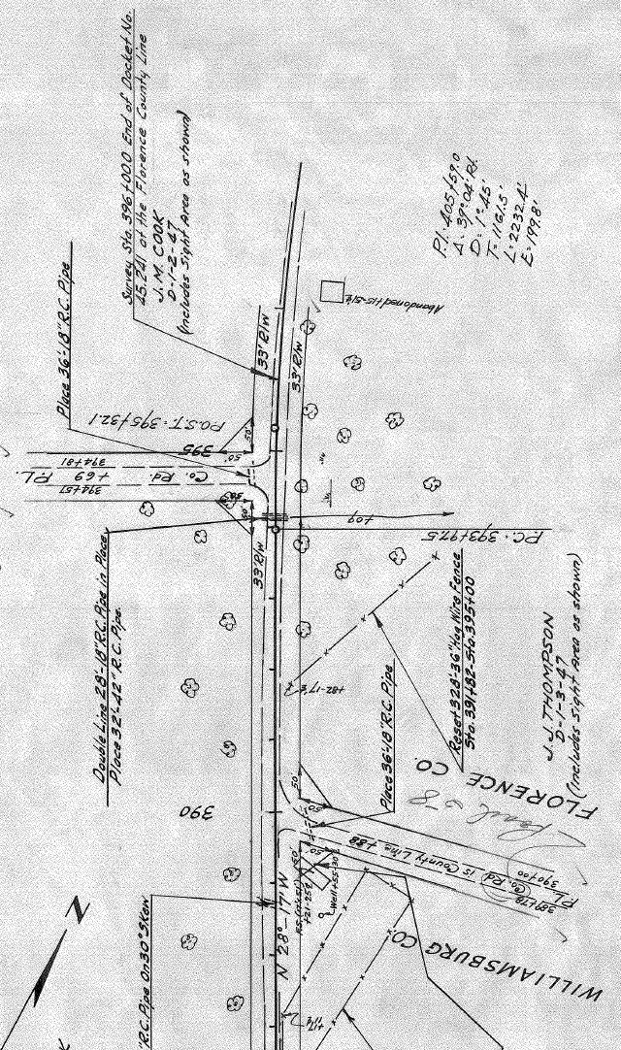
SCDOT Plans-Aerial Comparison
1944 SCDOT Plans 2013

Slide 27
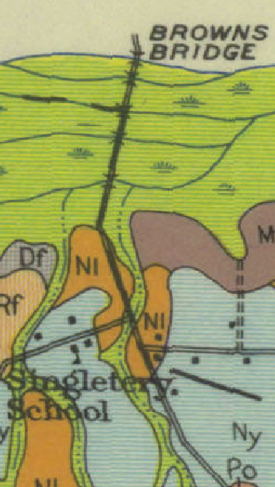
Aerial \ Soil –Coggeshall-Wilson Plat Comparison
1944 1928

Slide 28
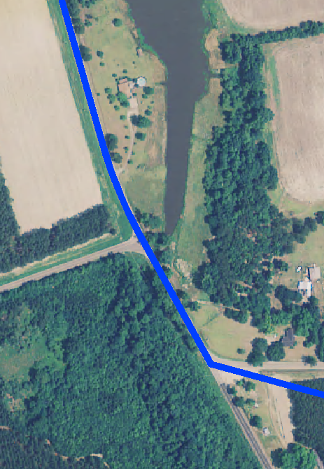
Aerial –Coggeshall-Wilson Plat Comparison
USDA 2011

Slide 29
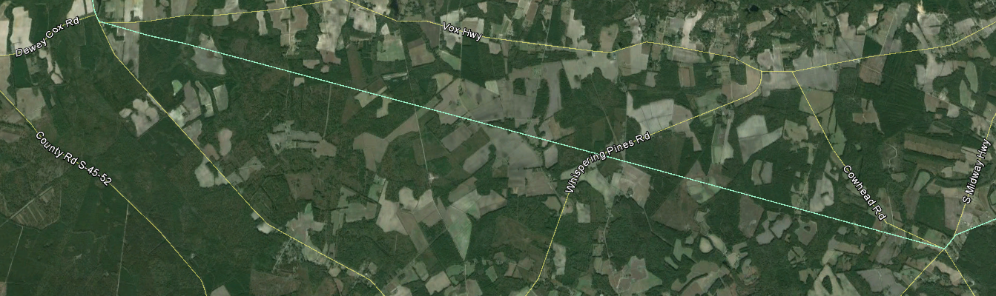
Road Intersection with Vox Highway to current Cowhead Road
Section 2

Slide 30
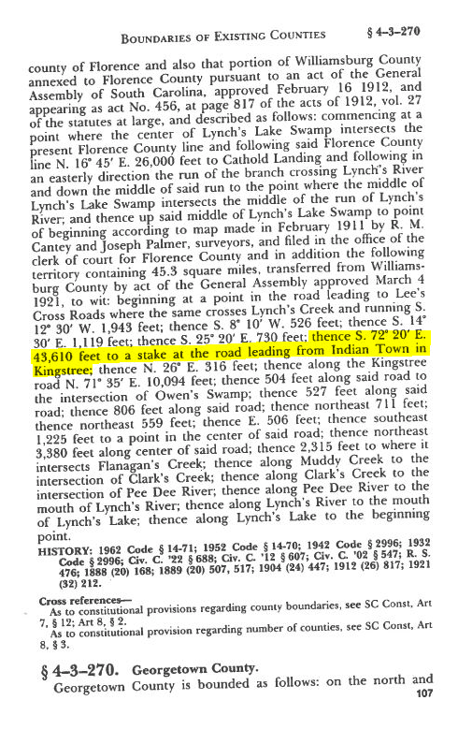
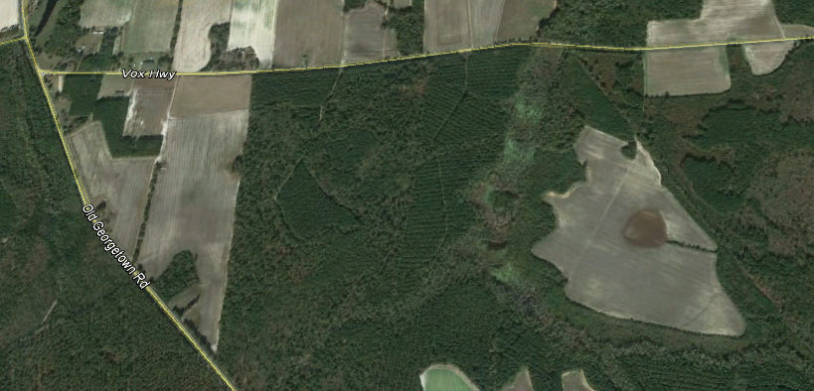
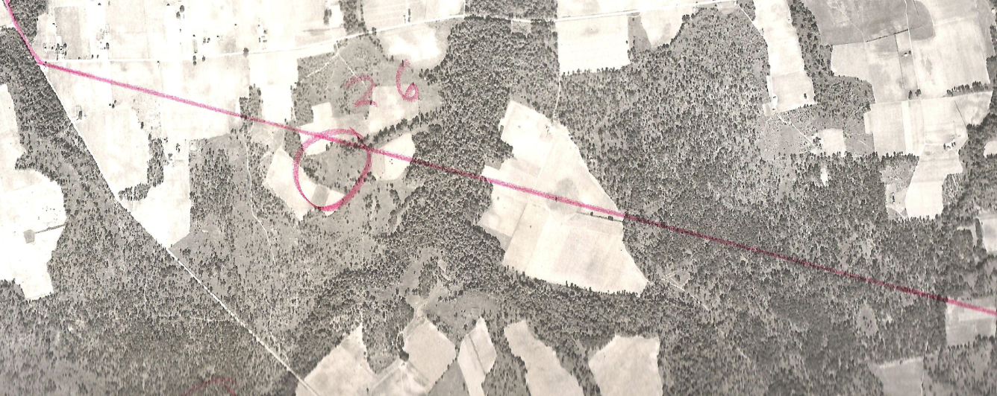
Point of Beginning Section 2
2013
1944

Slide 31
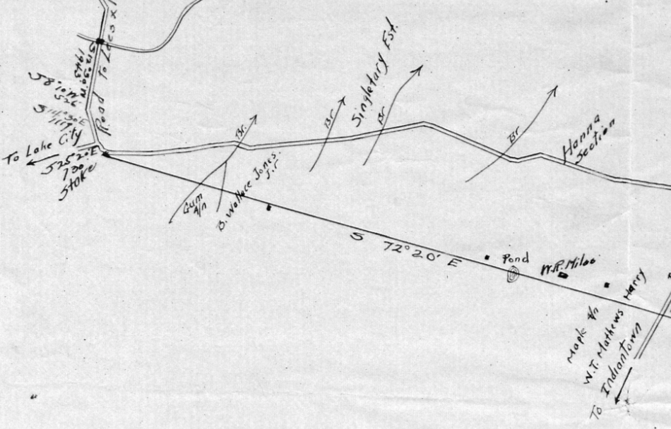
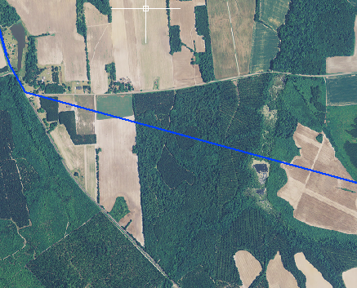

Coggeshall-Wilson Plat – 1944 Aerial
Coggeshall-Wilson Plat
1944

Slide 32

Coggeshall-Wilson Plat – 1928 Soil
Coggeshall-Wilson Plat
1928

Slide 33

Old Farm Road
Old Farm Road

Slide 34




Quail Road (Florence)-Williamson Road (Williamsburg)
S 45-496
Pavement Edge
S 21-633

Slide 35


Arrowhead Road (Florence)
South View

Slide 36



Blackberry Road (Williamsburg)

Slide 37


Whispering Pines Road at Altman Road (Williamsburg)
Altman Road

Slide 38


St . James Road ( Florence-Williamsburg)
St. James Road

Slide 39


Intersection County Road s 45-84 with Cowhead( Florence) Cow Head (Williamsburg)

Slide 40





Intersection County Road s 45-84 with Cowhead( Florence) Cow Head (Williamsburg)

Slide 41







Intersection County Road S 45-84 with Cowhead( Florence) Cow Head (Williamsburg)

Slide 42




Coggeshall-Wilson Plat
1944 Aerial Photos

Slide 43


Coggeshall-Wilson- 2015 Map of Survey
Coggeshall-Wilson Plat
2015 Resurvey Plat

Slide 44
Detail of the western end point of county boundary shown on Coggeshall-Wilson plat as S72 20E 43,610’. Resurvey of this line indicates bearing of S74 42 24E and 43,569.68’ distance.
Difference in direction can be attributed to several variables such as method of collection i.e. magnetic compass as opposed to GNSS , NAD 83 (2011) datum Local attraction or instrumental errors or errors in observation in magnetic compass.
See above cited reference of 1920’s survey that may point to less accurate methods that give possible explanation for differences in distance between the 1920 survey and the 2015 resurvey distance.

Slide 45


Coggeshall-Wilson Plat
1944 Aerial Photo

Slide 46

Coggeshall-Wilson Plat
1928 Soil Map

Slide 47
These three corners were established by overlaying alignment of the highway plans for W. County road (S 21-40) and Midway road (S 21-111 and S 45-84) onto current field survey data. (1008) is at the intersection of the alignment of highway plans for W. County road (S 21-40), and Midway road (S 21-111). (1007) is along the highway plans alignment for the referenced distance of 316' to (1007) and then turning along the highway alignment of Midway road (S 45-84) for the reference distance of 726' to (1006) as shown on the referenced Coggeshall-Wilson plat.

Slide 48

The Coggeshall-Wilson plat clearly shows a distance of 726 ‘ and 316' for describing the line length along S 21-84/S-21-111 (Midway road).
The 726’ distance is omitted from the Statue Description.

Slide 49


Plat Magnification
Additionally, the 726’ appears to be mislabeled as “N 26° E” in the Statue Description.
Scrivener's Error

Slide 50


SCDOT Plans- Highlighted comparison
Rotated View
Midway Road
Coggeshall-Wilson Plat
Represents Depicted County Line
Represents Indiantown\Midway Road
Represents Cowhead Road

Slide 51

Road Intersection Cowhead Road along W. County Road (formally Kingstree Road) to Flannigan’s Creek
Section 3

Slide 52




Point of Beginning
Section 3

Slide 53




County Road S 45-84 (Williamsburg)
W. County Line Road

Slide 54


The reference material indicates from the county boundary corner (1008) along W. County road (formally Kingstree road according to the Coggeshall-Wilson plat) is bearing N 71°35' E, 10,094'. However, by using the highway plans for this road (S 21-40) and the field survey data, the Coggeshall-Wilson plat distance appears to be in error. It is our determination that the distance is 7,094.00' instead of 10,094.00' for this line.
This conclusion is based on observed evidence of the location of the current road and by the study of highway plans and historical aerial photography and lack of evidence in the field to show the road extended to a distance of 10,094’.

Slide 55


County Road S 45-40 and S 45-430 (Williamsburg)
W. County Line Road

Slide 56

Beginning at Midway road and bearing N 68°46‘30" E along W. County road, 7,094.00' is near the start of a curve of the current road. The highway plans for W. County road (S 21-40) show an old road at or near this point (1009) that turns to an easterly direction. The Coggeshall-Wilson plat and the referenced code of laws state the county boundary in an easterly direction for 504.00' with road, and then turns southeasterly with the road for 527'. This old road eventually ties back into the current road as indicated on the highway plans (S 21-40).

Slide 57
2015 Map of Survey
As the county boundary reconvenes with road alignment of W. County line road (S 45-40) at corner (1011), it continues with the road alignment to the intersection of W. County line and Wall road. By employing the highway plans for the road and by field survey data, county line corner (1012) was determined.
From point (1012) the county line runs with the road alignment (corners 1012 through 1016) to point (1017). The county line east of point (1017), leaves the road alignment as indicated on highway plans S 21-40, docket 45.332 pt.2, sheet 11. During our field survey, a discernible road bed was determined and data collected for the old roadbed. Corners (1018), (1019), (1020), and (1021) are along old roadbed.

Slide 58
As the county boundary reconvenes with road alignment of W. County line road (S 21-40) at corner (1011), it continues with the road alignment to the intersection of W. County line and Wall road. By employing the highway plans for the road and by field survey data, county line corner (1012) was determined.
From point (1012) the county line runs with the road alignment (corners 1012 through 1016) to point (1017). The county line east of point (1017), leaves the road alignment as indicated on highway plans S 21-40, docket 45.332 pt.2, sheet 11. During our field survey, a discernible road bed was determined and data collected for the old roadbed. Corners (1018), (1019), (1020), and (1021) are along old roadbed.

Slide 59


County Road S 45-40 (Williamsburg)
W. County Line Road

Slide 60



Slide 61

County Road S 45-40 (Williamsburg)
W. County Line Road

Slide 62



County Road S 45-40 (Williamsburg)
W. County Line Road

Slide 63


County Road S 45-40 (Williamsburg)
W. County Line Road

Slide 64

Intersection of County Road S 45-40 (Williamsburg) and SC Highway 41/51
SC Hwy 51
W. County Line Road

Slide 65


County Road S 45-40 (Williamsburg) at Flanagan’s Creek

Slide 66


FLORENCE AND WILLIAMSBURG COMMON BOUNDARY

Slide 67
Act 262 of 2014
Steps for Clarifying Boundaries
SCGS Requirements:
    Upon reestablishing county boundary, SCGS shall certify its work and within 30 days of certification:
        Provide copies to the administrator of each affected county;
        Provide written notification to affected parties
        Provide notice and copies to the public through its official website and or other means it considers appropriate; and
        Notify as it determines appropriate, other affected state and federal agencies
    (Initiates 60 Day Appeal Process)
  Certified Surveys submitted to Secretary of State, Register of Deeds Offices, and South Carolina Department of Archives with Cover Letter
  Date of the cover letter is the date the surveys become effective
  Introduce Legislation to update Code of Law to reflect clarified boundary with State Plane Coordinates

Slide 68
Act 262 of 2014
Affected Parties Disagreeing with SCGS:
    May file request for a contested case hearing with the SC Administrative Law Court
    This decision may be appealed
    “Affected Party”
              Governing body of an affected county
              Governing body of a political subdivision of this State
              An elected official, other than a statewide elected official
              A property owner or an individual residing in the certification zone
              A business entity located in the certification zone
              A nonresident individual who owns or leases real property situated in the certification zone

Slide 69
SIGNIFICANT IMPACTS?
A significant impact is defined as a residence or place of business being found in a different county based on the re-established boundary.
Reviewed Over 150 Properties Along the 12.5 Mile Section of Re-established Boundary:
Determined 5 Significant Impacts
With 4 being found in Florence
And 1 being found in Williamsburg

Slide 70
QUESTIONS?

