Slide 1


Greenville – Laurens County Line
From the Saluda River to the Enoree River
Prepared by: CESI
2018

Slide 2
SC Code of Law and Act 262 Of 2014
Role of South Carolina Geodetic Survey
      (1994) Dispute between two or more counties- SCGS will act as mediator to resolve the dispute
      (1994/2014) SCGS to assist counties in defining and monumenting the locations of county boundaries and positioning the monuments using geodetic surveys where counties are ill-defined, unmarked, or poorly marked
      (2014) SCGS will clarify county boundaries as defined in Chapter 3, Title 4
      (2014) SCGS will analyze archival and other evidence and perform field surveys to position geographically all county boundaries in accordance with statutory descriptions
      (2014) To amend section 27-2-105, Code of Laws of South Carolina, 1976, relating to the duties of the South Carolina Geodetic Survey (SCGS) with respect to determining county boundaries, so as to authorize and direct the SCGS to clarify county boundaries and mediate boundary disputes between counties by providing a procedure allowing the SCGS administratively to adjust county boundaries, to provide the procedures including notice that SCGS must follow in making such adjustments, to provide that affected parties may appeal these adjustments to the Administrative Law Court in a de novo hearing, to provide the method of determining the effective date of these administrative county boundary adjustments and the notice requirements for these adjustments to be effective and to provide that nothing contained in this administrative process restricts the authority of the General Assembly by legislative enactment to adjust or otherwise clarify county boundaries by legislative enactment.
Op. S.C. Atty. Gen. 2016 (S.C.A.G. March 1, 2016)
Op. S.C. Atty. Gen. 2018 (S.C.A.G. May 22, 2018)

Slide 3

Act No. 262 of 2014
An Act to amend Section 27-2-105
Relating to the duties of the SC Geodetic Survey (SCGS) with respect to determining county boundaries
Purpose:
    Exact and precise locations and boundaries of state’s political subdivisions are critical for services, enforcement of property rights and election of public officials.
    Passage of time and growth has led to confusion over statutory county descriptions and the locations of county boundary lines
    Technology exists now to cost-effectively provide definite and permanent markers of boundary lines
    Necessary for state government and political subdivisions
    SCGS is the appropriate instrument to vest with the necessary authority to resolve county boundary issues

Slide 4
Steps for Clarifying Boundaries
Notify County Administrators in advance of planned work
Conduct historical research for documentary evidence of boundaries
Perform field work to locate monuments and corroborating evidence and position on State Plane Coordinates
Share preliminary findings with county officials for impact analysis and to plan public meetings
Receive feedback and input from local officials and public
Review and update findings, as appropriate
Work to build cooperation with affected parties

Slide 5
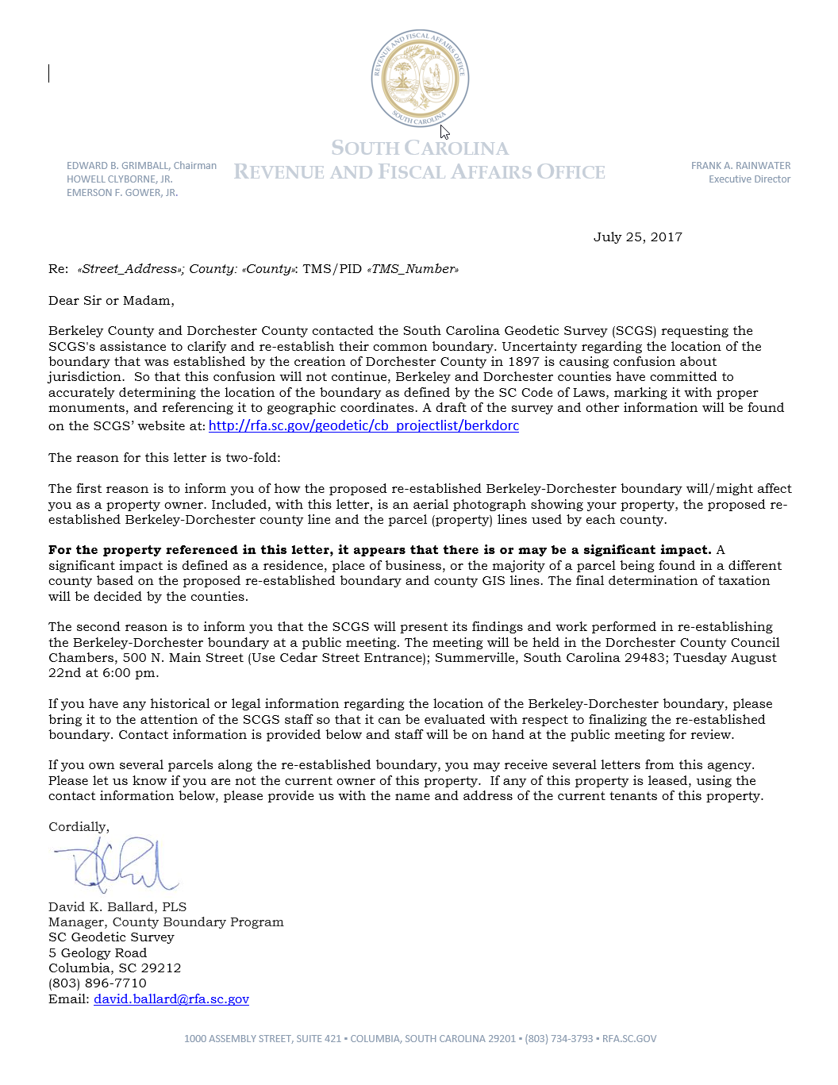
Public Meeting Notification

Slide 6
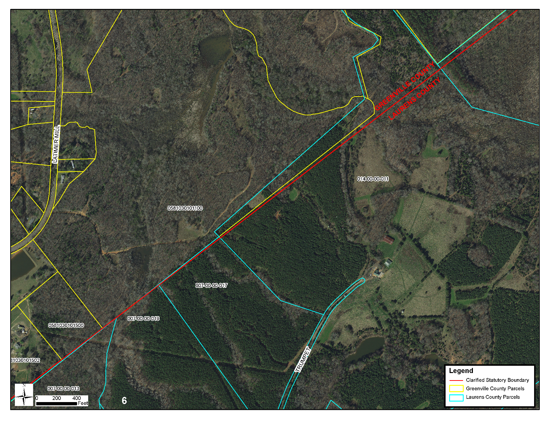
Public Meeting Notification

Slide 7
Scatter Gram of Differences
Between Observations
2 – Five Minute Sessions
RMSE(2-D) = 0.020m @95%
0.015m = ~0.05’
Axis Units in Meters

Slide 8
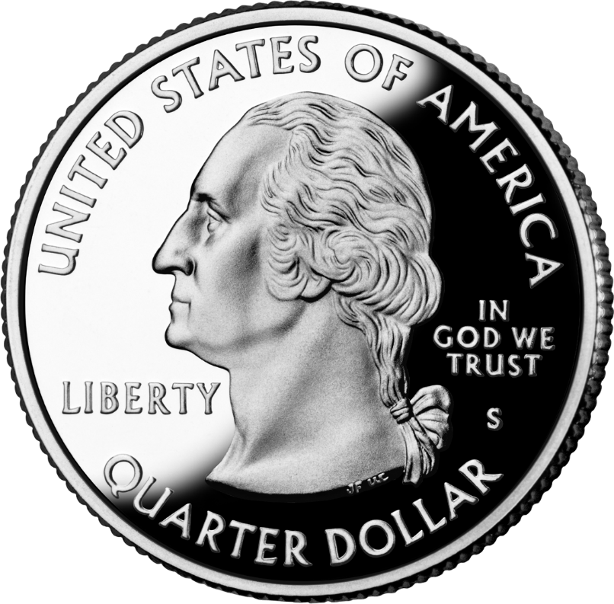
Scatter Gram of Differences
Between Observations
2 – Five Minute Sessions
RMSE(2-D) = 0.020m @95%
0.015m = ~0.05’
Axis Units in Meters

Slide 9
Act 262 of 2014
Steps for Clarifying Boundaries
SC Code of Law SECTION 27-2-105
SCGS Requirements:
    Upon reestablishing county boundary, SCGS shall certify its work and within 30 days of certification:
        Provide copies to the administrator of each affected county;
        Provide written notification to affected parties
        Provide notice and copies to the public through its official website and or other means it considers appropriate; and
        Notify as it determines appropriate, other affected state and federal agencies
    (Initiates 60 Day Appeal Process)
  Certified Surveys submitted to Secretary of State, Register of Deeds Offices, and South Carolina Department of Archives with Cover Letter
  Date of the cover letter is the date the surveys become effective
  Introduce Legislation to update Code of Law to reflect clarified boundary with State Plane Coordinates

Slide 10
SC Code of Law SECTION 27-2-105
Affected Parties Disagreeing with SCGS:
    May file request for a contested case hearing with the SC Administrative Law Court
    This decision may be appealed
    “Affected Party”
              Governing body of an affected county
              Governing body of a political subdivision of this State
              An elected official, other than a statewide elected official
              A property owner or an individual residing in the certification zone
              A business entity located in the certification zone
              A nonresident individual who owns or leases real property situated in the certification zone

Slide 11
Chapter 5, Title 4
Change of Boundaries
  S.C. Code § 4-5-120: Procedure for annexing part of county- governing body or 10 percent of registered voters petition in writing, shall deposit with the clerk of court an amount of money sufficient to cover the expenses of surveys , plats, annexation commission and the election to be held to determine whether the proposed annexation shall be effected and then file such resolution or petition in the office of the clerk of court
  S.C. Code § 4-5-130: Appointment of Commission for annexation- once presented to the governor then within 30 days the governor shall appoint a commission of four persons
  S.C. Code § 4-5-140: Employment of Surveyors- commission may contract for survey and location of the proposed change of line and for such purpose may employ 3 surveyors
  S.C. Code § 4-5-170: Governor shall order election; voting place; eligible electors- to be held in an area sought to be transferred and an election to be held in the county to which the area is proposed to be transferred
  Propose and adopt Legislation

Slide 12
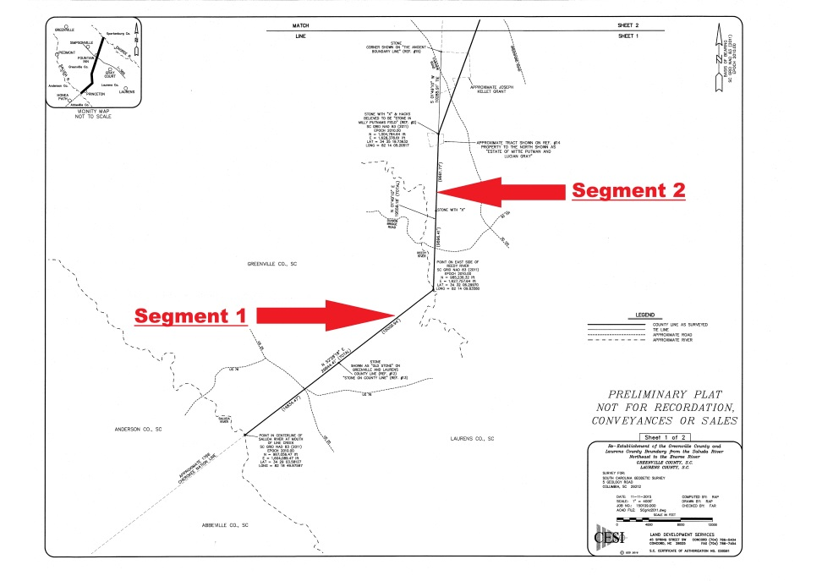
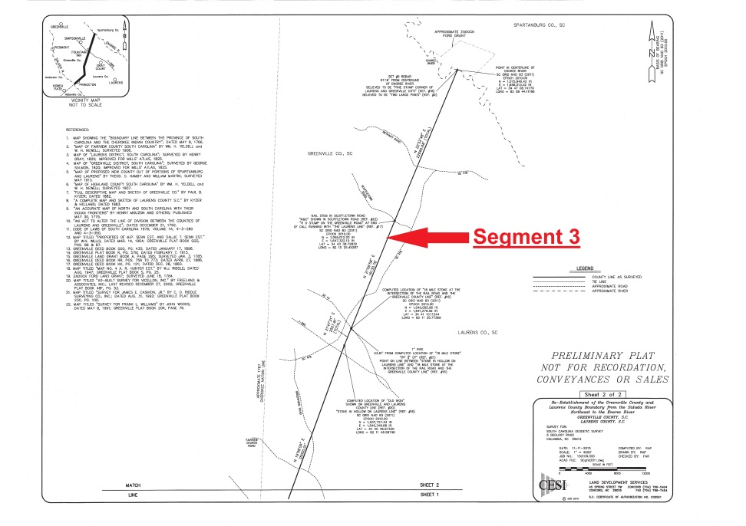
Greenville-Laurens County Line

Slide 13
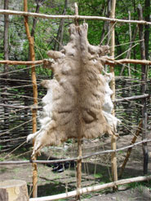
Greenville-Laurens County Line
From about 1715 until mid-century the Cherokee were South Carolina’s most dependable western ally and its largest domestic trading partner

Slide 14
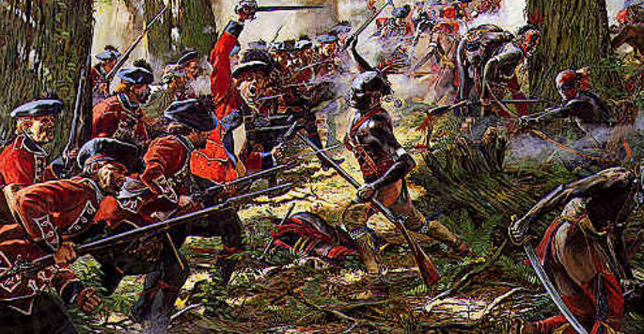
Greenville-Laurens County Line
However, escalating tensions over encroaching settlements and competition for resources led to the Cherokee War of 1760

Slide 15
Greenville-Laurens County Line
The Crown was eager to avoid another bloody and costly conflict and urged colonial governments to establish treaties with the Cherokee, to demarcate Boundaries representing the limits of colonial expansion, and to enforce those Boundaries with the inflowing settlers headed for empty land on the frontier

Slide 16
Greenville-Laurens County Line
Governor Bull and the South Carolina colonial government acted first and met with the Cherokee at Fort Prince George on 19 October 1765
Both parties agreed the dividing line would run through Dewise’s Corner (near and possibly the namesake of present day Due West) and agreed to meet there and mark the boundary together

Slide 17
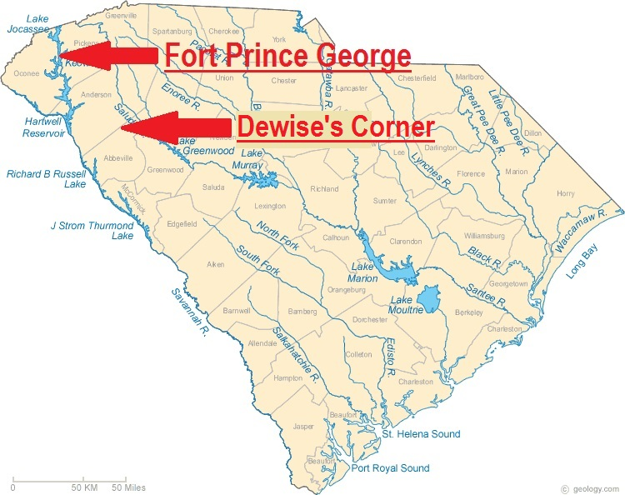
Greenville-Laurens County Line

Slide 18
Greenville-Laurens County Line
The demarcation began at Dewises (Devises) Corner on 24 April 1766
Representing the Colony of South Carolina were Boundary Commissioner Edward Wilkinson and Surveyor John Pickens
Representing the Crown was Assistant Indian Superintendent Alexander Cameron

Slide 19
Greenville-Laurens County Line
Representing the Cherokee were chiefs Kittasgusta, Tiftoe of Keowee, Emy of Estatoe, Usteneka Atassitic or Jud’s Friend, Uheneka or the Wolf, and Katchee for half-breed Willie
Along with about thirty warriors

Slide 20
Greenville-Laurens County Line
In Cameron’s words, “We began at the Line at Dewise’s Corner and proceeded Southwest 50 (degrees) to Savannah River; The Indians blazed Trees as we went and made the Boundary very clear and strong as they term it…”
“The distance from Dewis’s (sic) Corner to the River (as near as we could make it) is 27 miles;”

Slide 21
Greenville-Laurens County Line
“The Course of the line from Dewis’s Corner to the Reedy River, where the line terminates is N.E. 50 (degrees), and the distance is 18 miles”
A copy of Pickens’ survey map is stored at the British National Archives at P.R.O., C.O. 700, Maps, Carolina/26

Slide 22
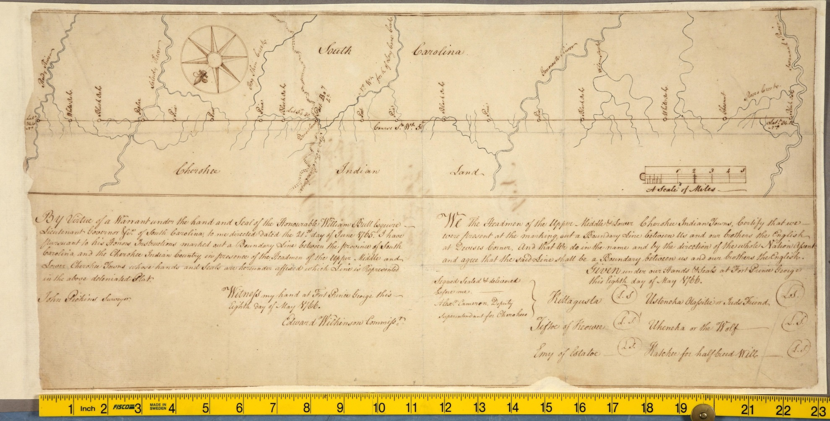
Greenville-Laurens County Line

Slide 23
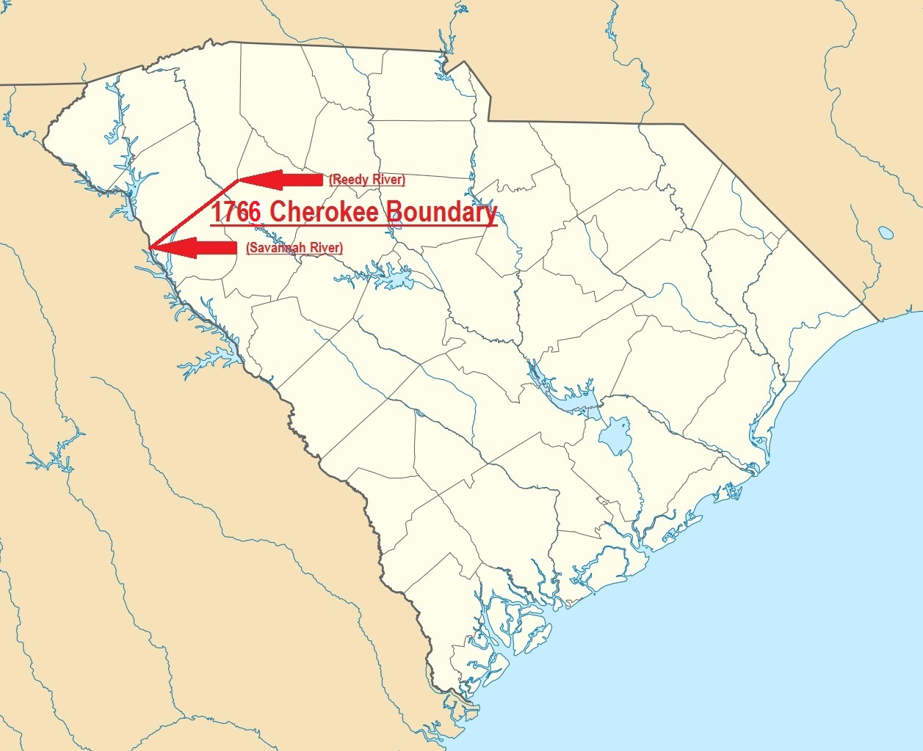
Greenville-Laurens County Line

Slide 24
Greenville-Laurens County Line
Similarly, William Tryon, the new colonial governor of North Carolina, came to the Reedy River in 1767 to meet with the Cherokee and establish a boundary
In 1767 both colonies assumed that the land north of the Reedy River would become part of North Carolina
Tryon met at the Reedy with the Cherokee on 3 June 1767

Slide 25
Greenville-Laurens County Line
Representing North Carolina was Gov. Tryon, his Boundary Commissioners John Rutherford, Robert Palmer, and John Frohock.
Representing the Crown was Assistant Indian Superintendent Alexander Cameron
Gov. Tryon also had an escort from the Rowan militia

Slide 26
Greenville-Laurens County Line
Representing the Cherokee were the chiefs Ustenuah Ottassatic or Jud’s Friend, Ecoy or the Good Warrior of Estatoe, Saluy or the Young Warrior of Estatoe, Tufftoe the Warrior of Keowee, Wolf of Keowee, Chenesto of Sugar Town, and around 30 other Cherokee

Slide 27
Greenville-Laurens County Line
Surveying and marking the Boundary began about noon the next day, 4 June 1767
The survey started at a marked Elm, or “Waughoe” on the south bank of the Reedy River, the termination point of the 1766 Cherokee Boundary with South Carolina
The boundary was to run due north to the mountains, and then in a straight line to Col. Chiswell’s lead mines in Virginia

Slide 28
Greenville-Laurens County Line
That first day the line was run about 2 miles, running through Gov. Tryon’s camp and ending just north of the campsite
The balance of the day was spent by all parties celebrating King George III’s 29th birthday
There was feasting, musket volleys, toasts, and Gov. Tryon participated with the Cherokee in a War Dance

Slide 29
Greenville-Laurens County Line
It was reported that the Cherokee returned to their camp about 10 PM in a very good humor
Surveying and Marking the line continued the next day but only went another 2 miles, perhaps due to a late start that morning
The line was continued on Saturday, 6 June 1767, and by noon was up to “Raburns Creek” where Gov. Tryon bid everyone farewell and departed for Salisbury

Slide 30
Greenville-Laurens County Line
Surveying and marking the line continued for about 50 miles until the Commissioners and the Cherokee topped the first mountain
Looking northeast at an unbroken, undulating, rugged mountain region extending from that point to Col. Chiswell’s Virginia lead mines all present, colonists and Cherokee, agreed to a new course of action…

Slide 31
Greenville-Laurens County Line
Stop there, name the mountain Tryon Mountain in honor of the Governor, and go home
Gov. Tryon’s proclamation of 13 July 1767 states that the boundary as surveyed from the Reedy River to Tryon Mountain and the unsurveyed boundary from there to Chiswell’s mines would be the official boundary between North Carolina and the Cherokee

Slide 32
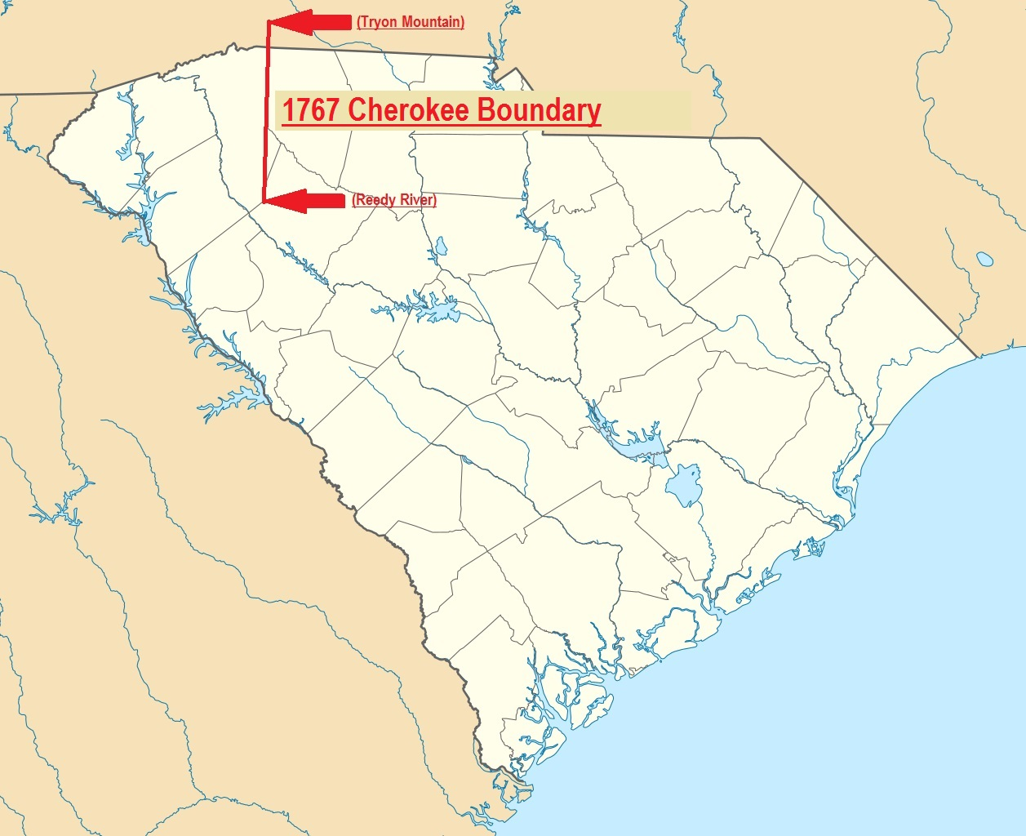
Greenville-Laurens County Line

Slide 33
Greenville-Laurens County Line
In 1785 Laurens County was created out of the Ninety-Six District with the 1766 Cherokee Boundary as its western border between the Saluda River and the Reedy River, and the 1767 Cherokee Boundary as its western border from the Reedy to the Enoree River
By Act #1560, adopted in 1792, a new pie shaped wedge was annexed from Laurens to Greenville County north of the Reedy

Slide 34
Greenville-Laurens County Line
The new dividing line was to “run from the Ford on the Enoree river, opposite Zadock’s Ford, in a direct course to the widow Killit’s on Raburn’s creek” thence with the original line to the Reedy River
It appears this line was surveyed in 1793 by Daniel Wright and James Harrison but no map of that survey has yet been found

Slide 35
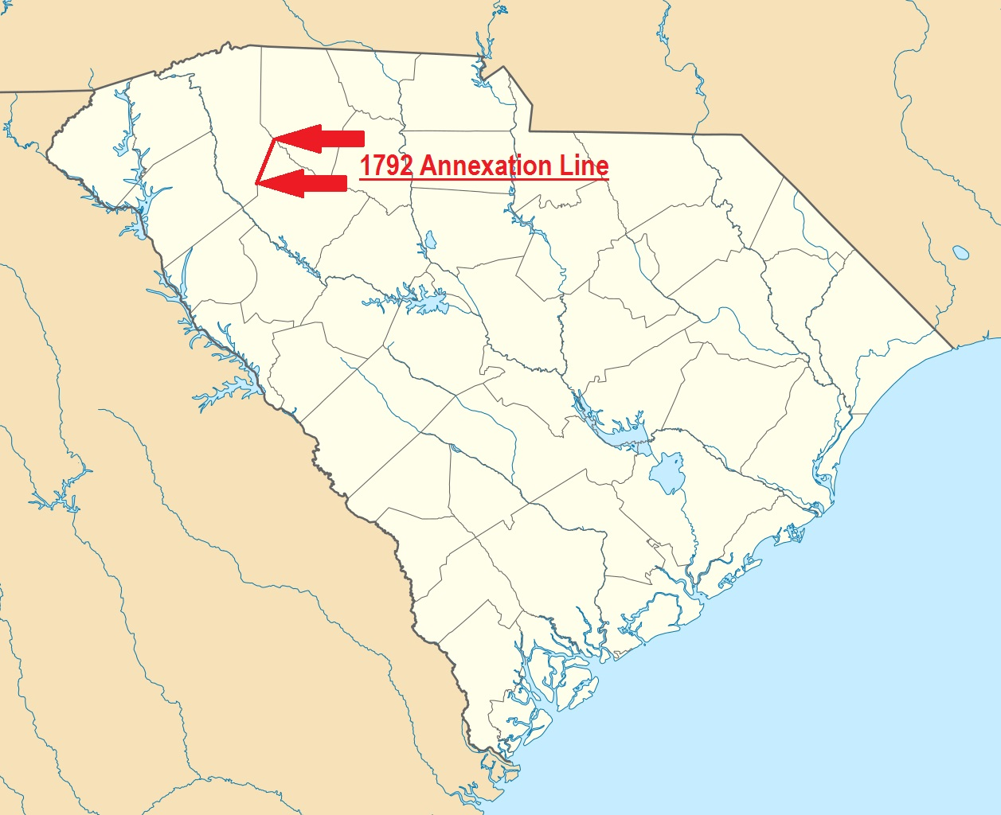
Greenville-Laurens County Line

Slide 36
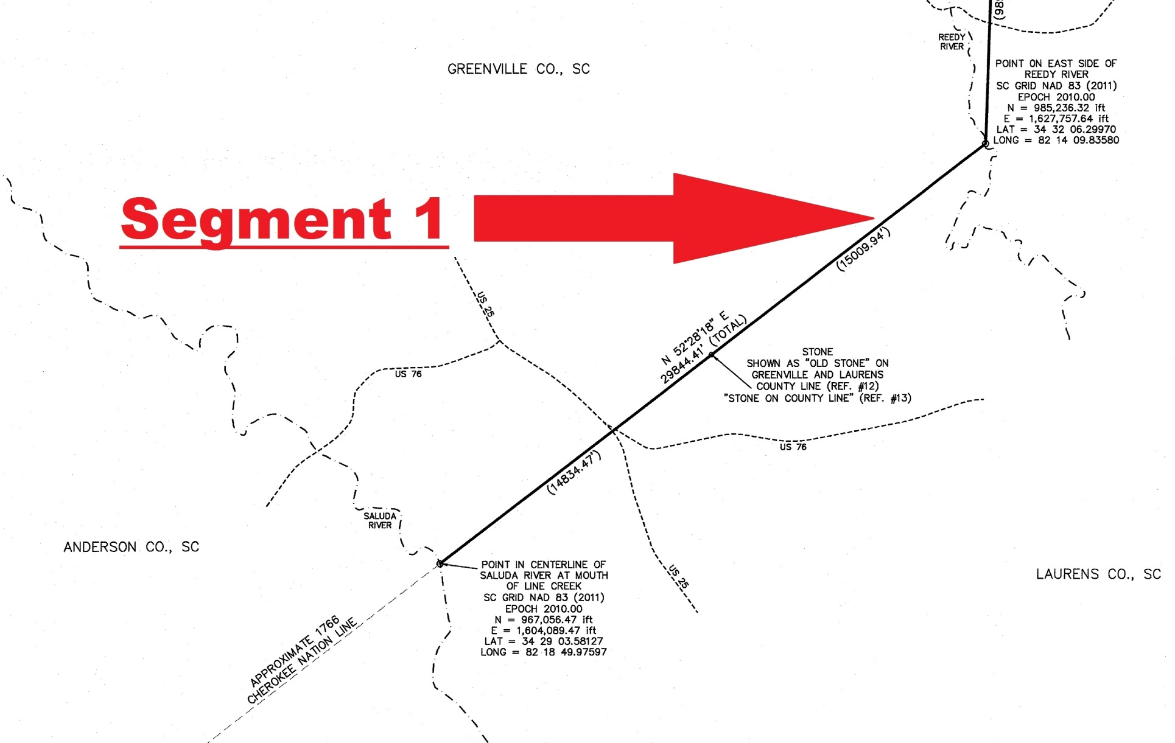
Greenville-Laurens County Line

Slide 37
Greenville-Laurens County Line
Laurens County came into existence by Act #1263 adopted 12 March 1785
Laurens was one of six counties created out of the Ninety-Six District
Paragraph I specifies “beginning at the Island Ford, thence up Saluda River to the Indian boundary, thence along said boundary to the Enoree river…”

Slide 38
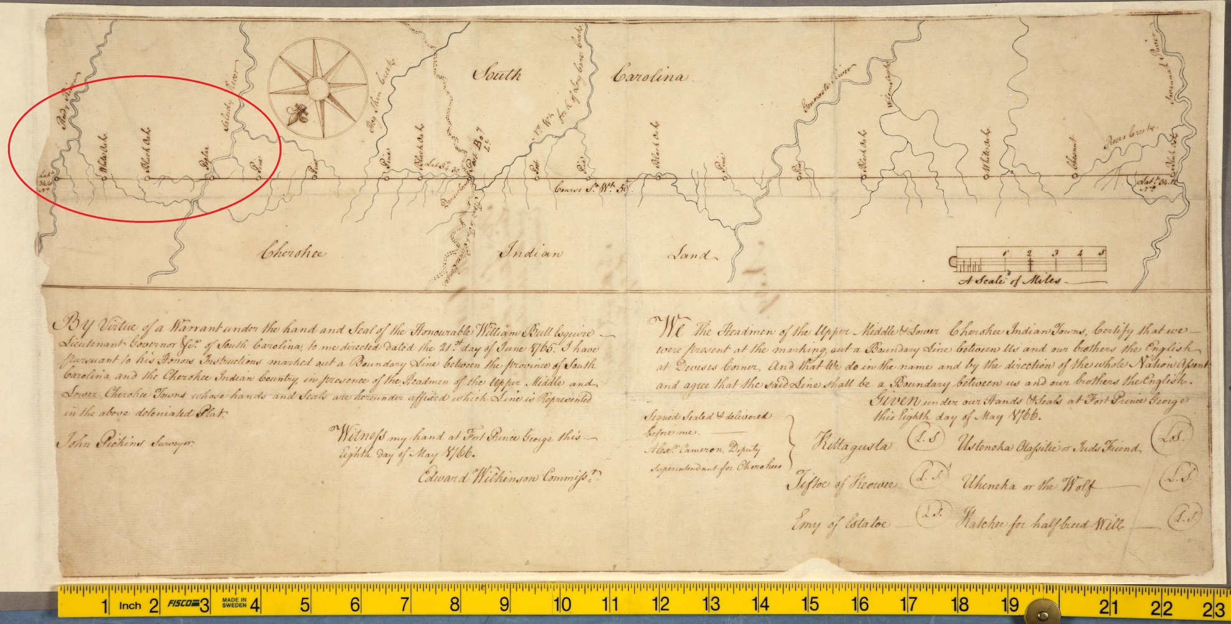
Greenville-Laurens County Line

Slide 39
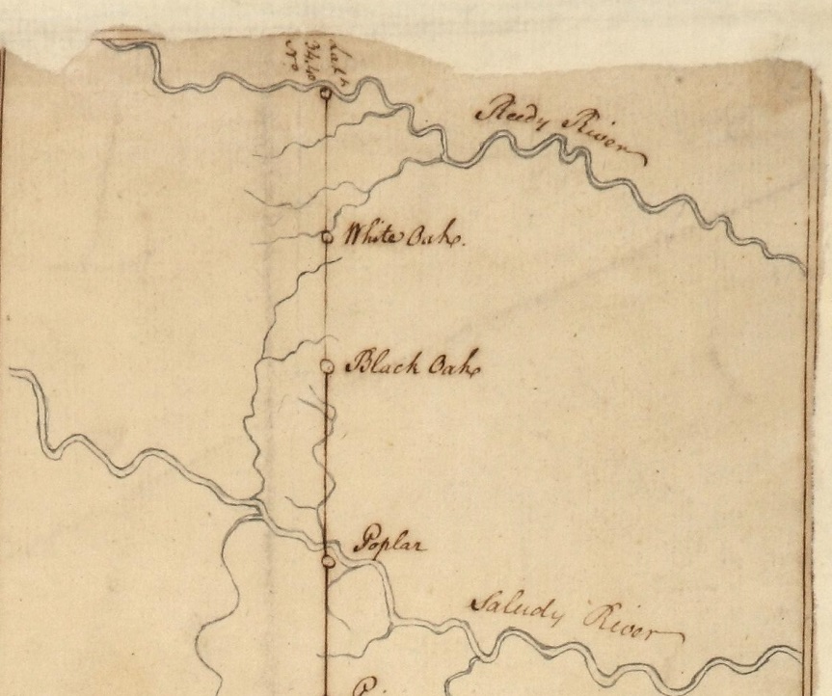
Greenville-Laurens County Line

Slide 40
Greenville-Laurens County Line
South Carolina Statute 4-3-350 states that Greenville and Laurens counties are “divided by a line commencing at the mouth of Line Creek, where it enters the Saluda River, and running 5 miles and 45 chains to a water oak, marked L.G. on the Reedy River…”
The 1766 Cherokee Boundary map by Pickens depicts the line crossing the mouth of Line Creek at the Saluda River

Slide 41
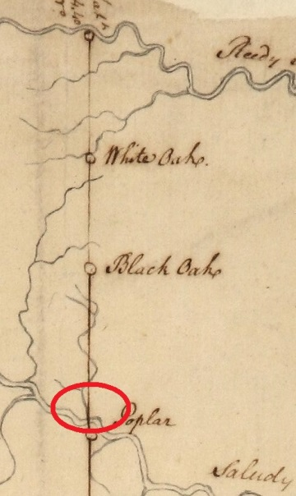
Greenville-Laurens County Line

Slide 42
Greenville-Laurens County Line
Field investigation located the mouth of Line Creek at the Saluda River
There was no evidence that the location of the mouth has migrated over time
A field visit to the approximate location of the Cherokee Indian Boundary at Reedy River found no marked trees or other evidence of the boundary on either side of the River

Slide 43
Greenville-Laurens County Line
Searches were made in Greenville and Lauren county records and South Carolina Department of History and Archives for grants made along the Cherokee Boundary between the Saluda and Reedy rivers
Several were found that could be placed on the ground on the basis of geographical features shown or grant line artifacts visible in the GIS data

Slide 44
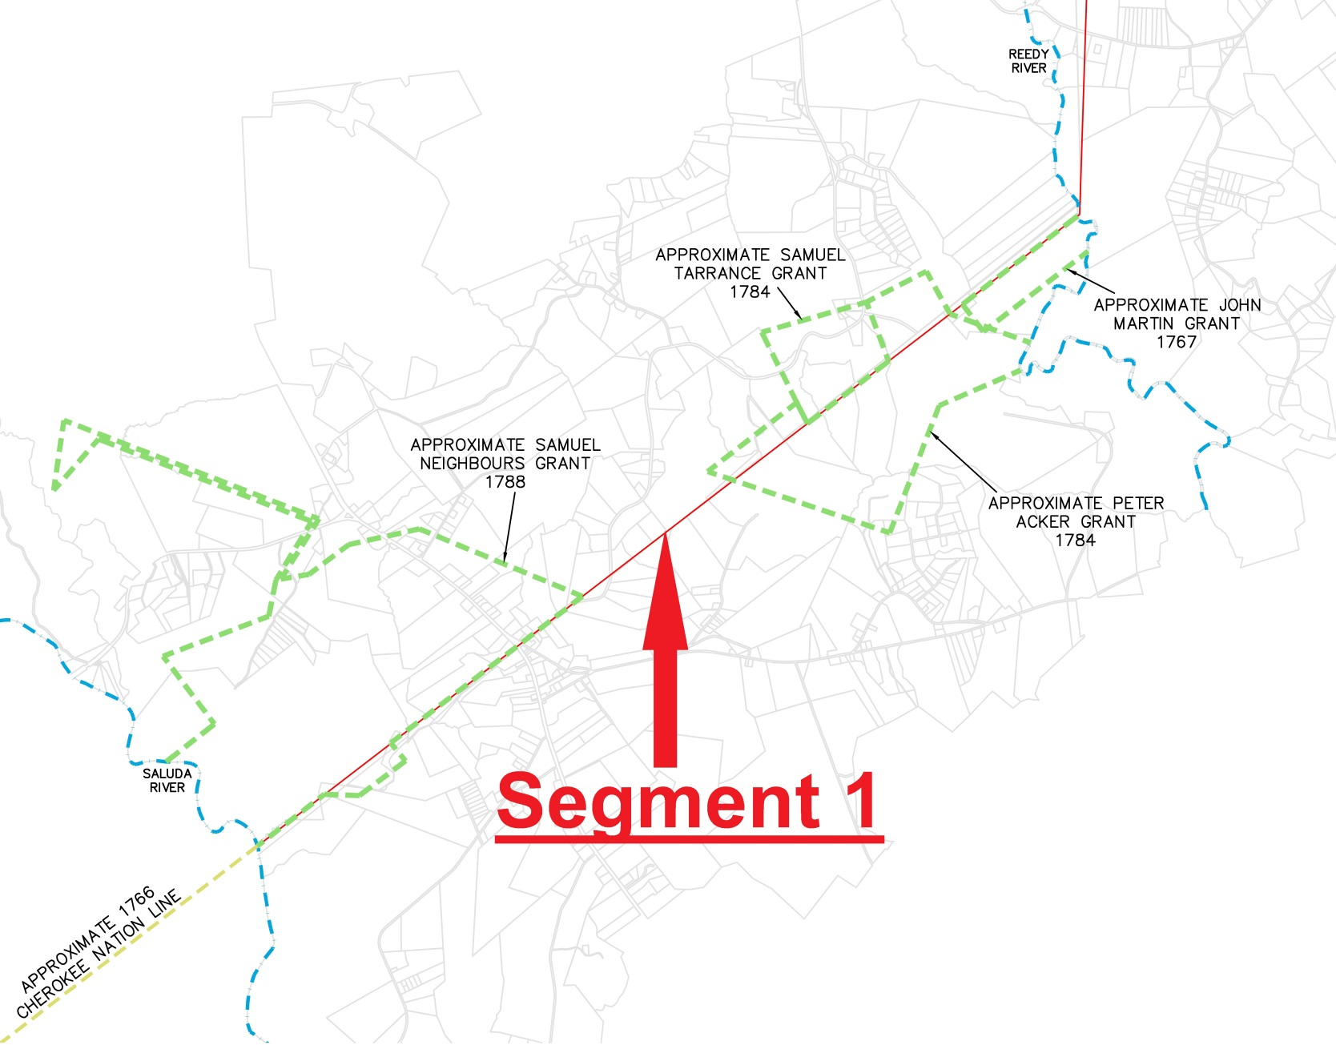
Greenville-Laurens County Line

Slide 45
Greenville-Laurens County Line
As one example, the 17 September 1767 John Martin grant has the Reedy River as its northern boundary
It states “bounding on the N.W. on land laid out to the Cherokee Indians”
The northwest corner is labeled “Wahoo 3X, old mark of land laid out to the Cherokee Indians”

Slide 46
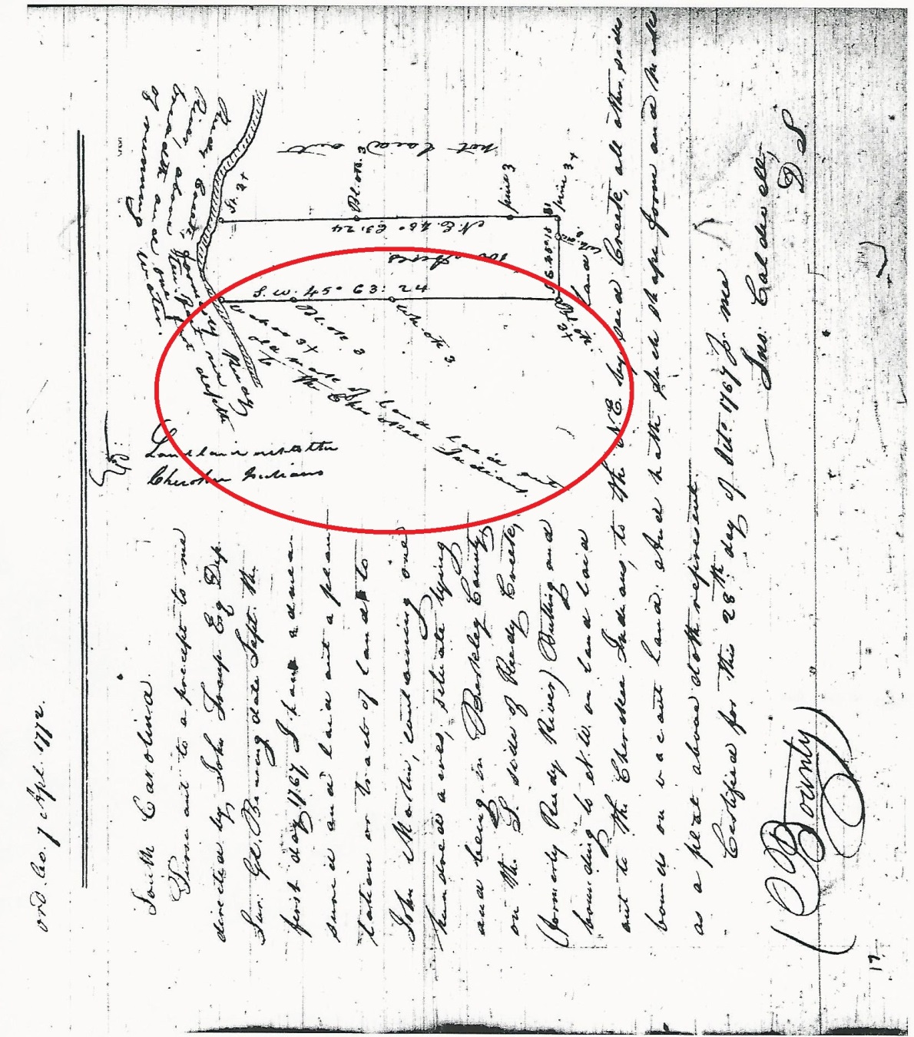
Greenville-Laurens County Line

Slide 47
Greenville-Laurens County Line
However most of the properties covered by these grants have been combined into large tracts that cross the county line and the property corners that had once followed the Cherokee Boundary are now interior property corners and have not been maintained and are thus lost to our recovery efforts
We then looked for the oldest evidence of the Cherokee/county boundary in the records for existing property corners along the line

Slide 48
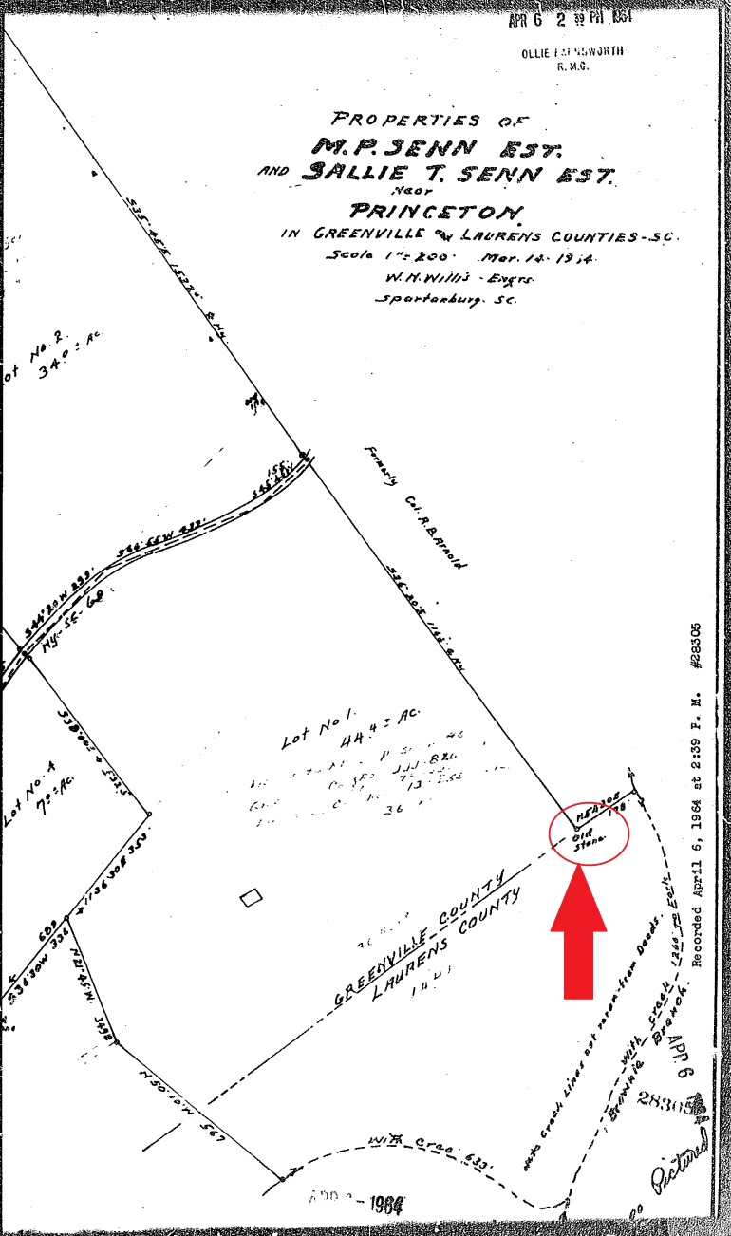
Greenville-Laurens County Line
Greenville Parcel 0581030101100 has a back deed dating from 17 January 1896, recorded Deed Book GGG, Page 435 which calls for a “stone on the County line.”
Adjoining Parcel 0581030101500, Plat Book GGG, Pages 86 & 87 shows “Old Stone”

Slide 49
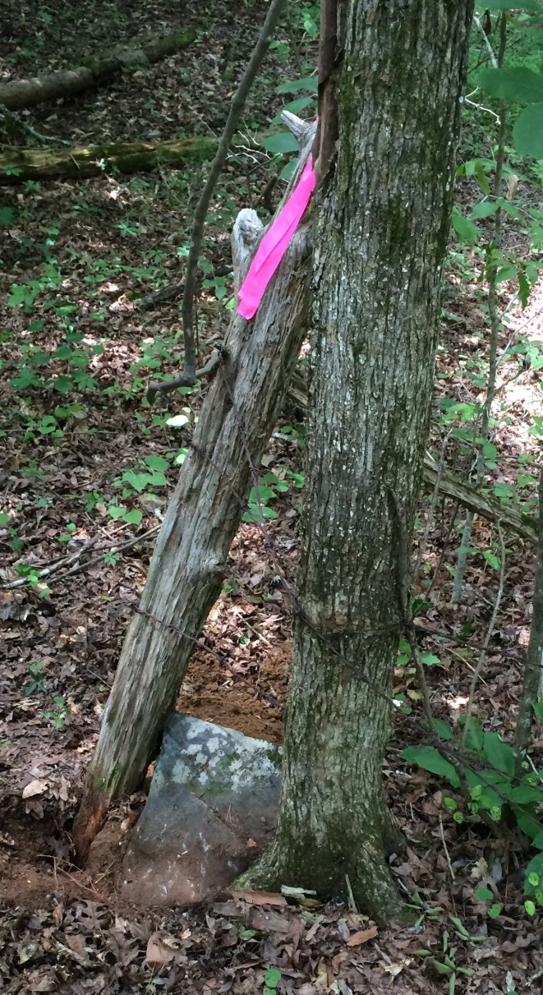
Greenville-Laurens County Line
Locating this stone, along with the location of the mouth of Line Creek, provided the best evidence available for the original location of the Cherokee Boundary of 1766
However, we sought additional evidence to vet the resulting alignment

Slide 50
Greenville-Laurens County Line
The original 1766 Cherokee Boundary extended from the Savannah to the Reedy rivers
Alexander Cameron stated they had started at Dewise’s Corner and had run to the Savannah, then had returned to Dewise’s Corner and run about 18 miles to the Reedy River
Research in this vicinity found Anderson County Map Book 1651, Pages 5 & 6

Slide 51
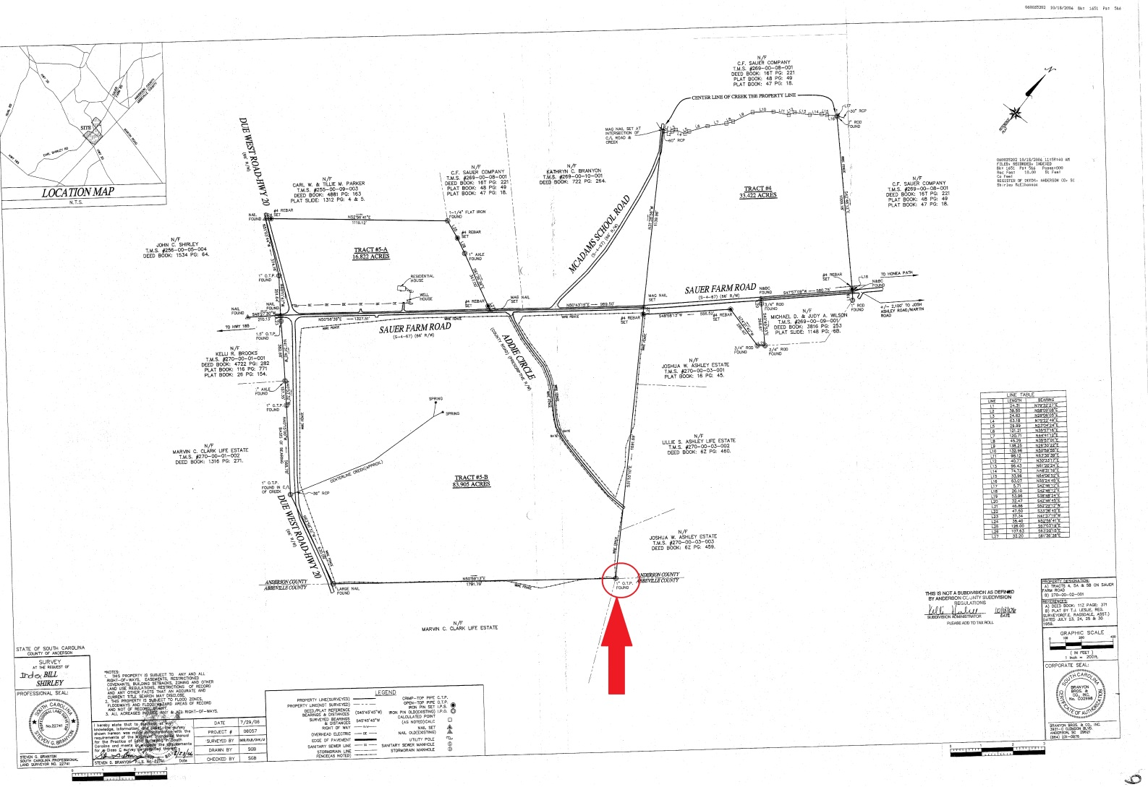
Greenville-Laurens County Line

Slide 52
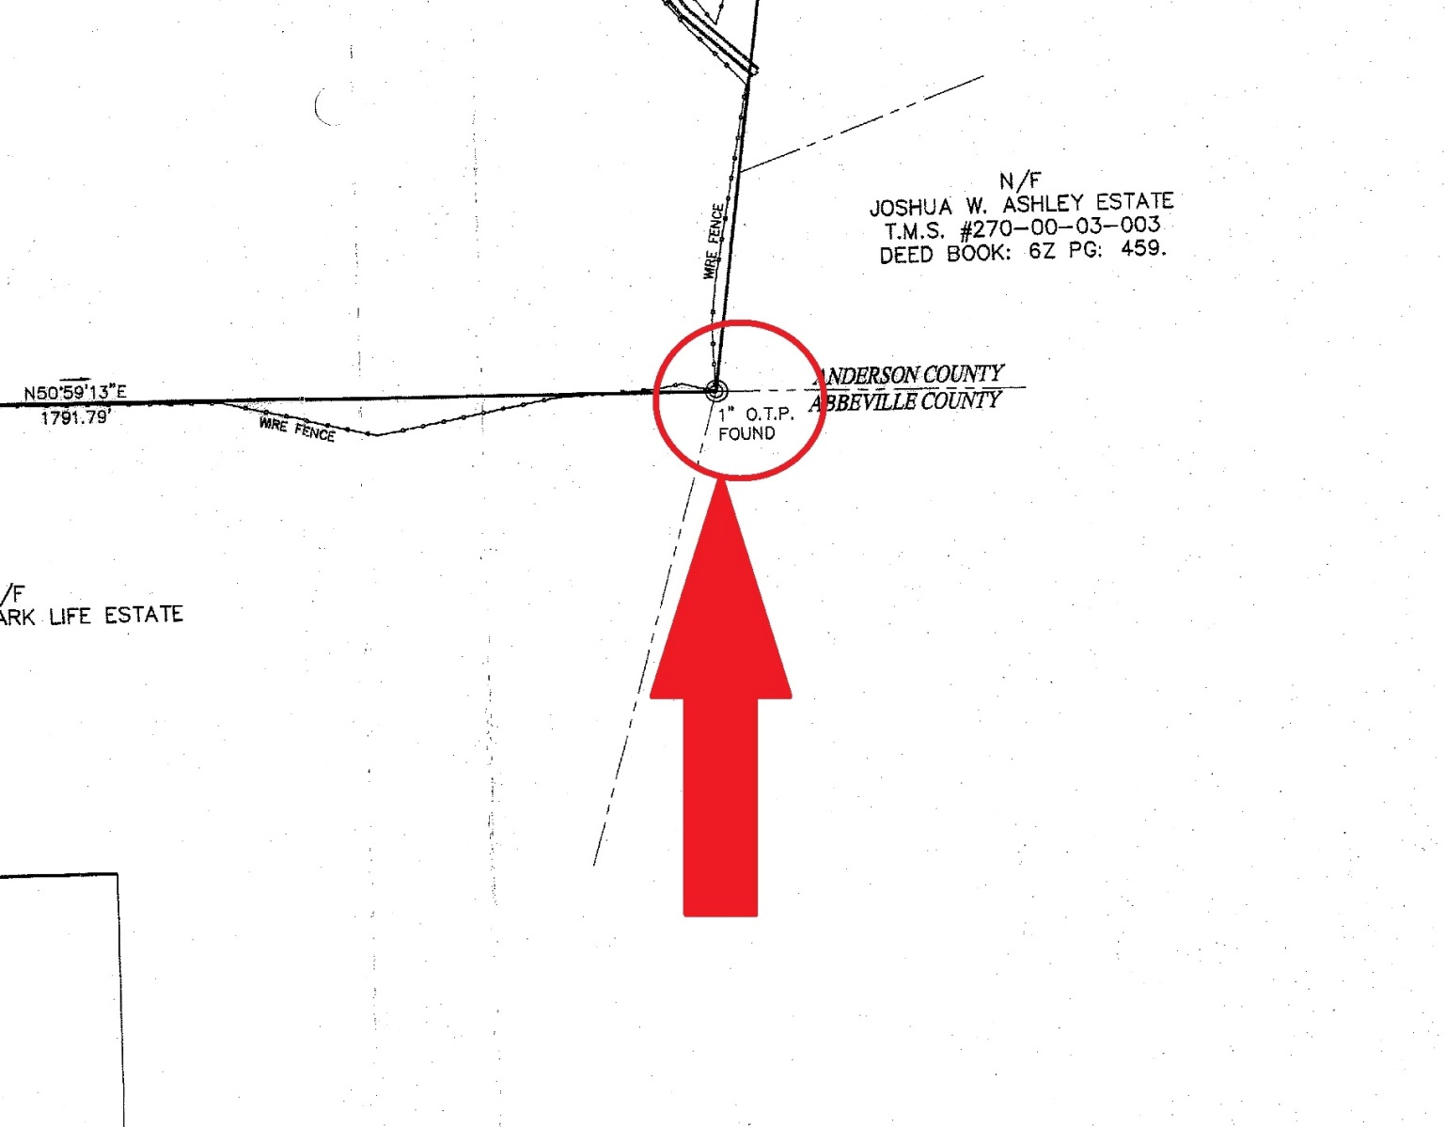
Greenville-Laurens County Line

Slide 53
Greenville-Laurens County Line
Field crews located the 1” Open Top Pipe in the field and obtained SC Grid coordinates
This location is over 9 miles from the Saluda River, however, a projection of the line created using the “Old Stone” on the county line and the mouth of Line Creek misses the 1”OTP by only 176’
That result satisfied us that the “Old Stone” and the mouth of Line Creek were the correct points to use and the alignment was correct

Slide 54
Greenville-Laurens County Line
The Pickens Survey give a bearing along the line of S 50 W, but no distance
A survey of the Laurens District in 1820 by Henry Gray (and revised for Mill’s Atlas in 1825) shows a bearing along this line of S 46 W, distance of 5 miles and 45 chains, and ends at a Water Oak marked L.G.
It appears this map was the basis for South Carolina Statute 4-3-350

Slide 55
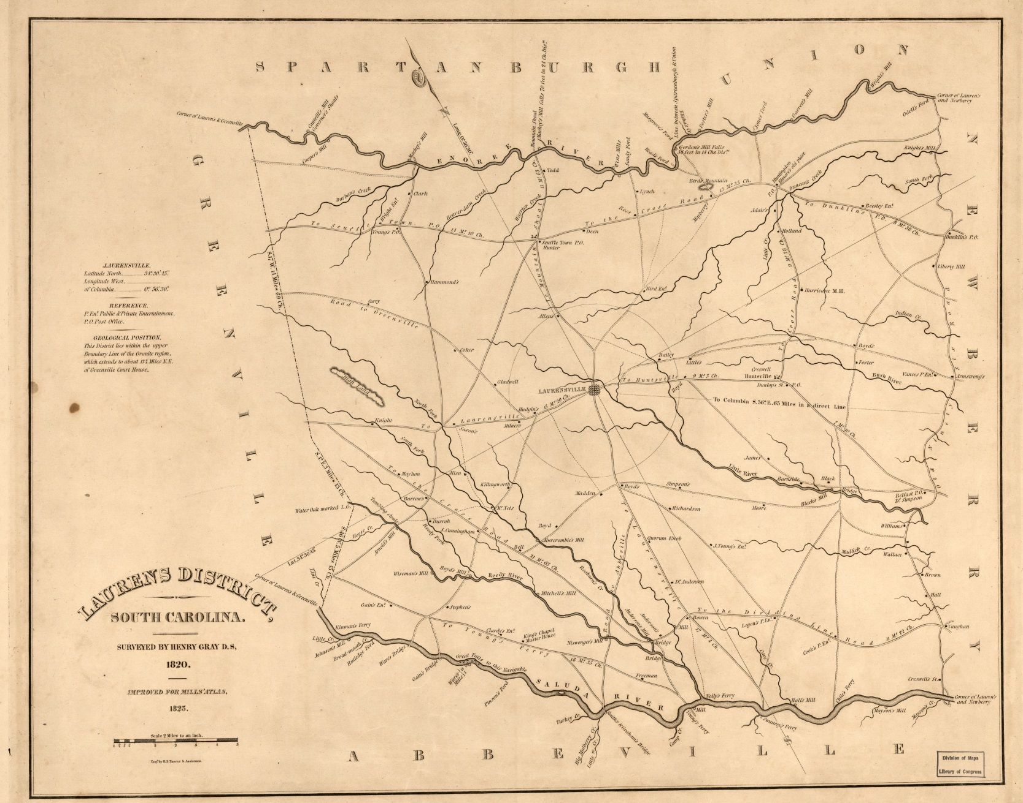
Greenville-Laurens County Line

Slide 56
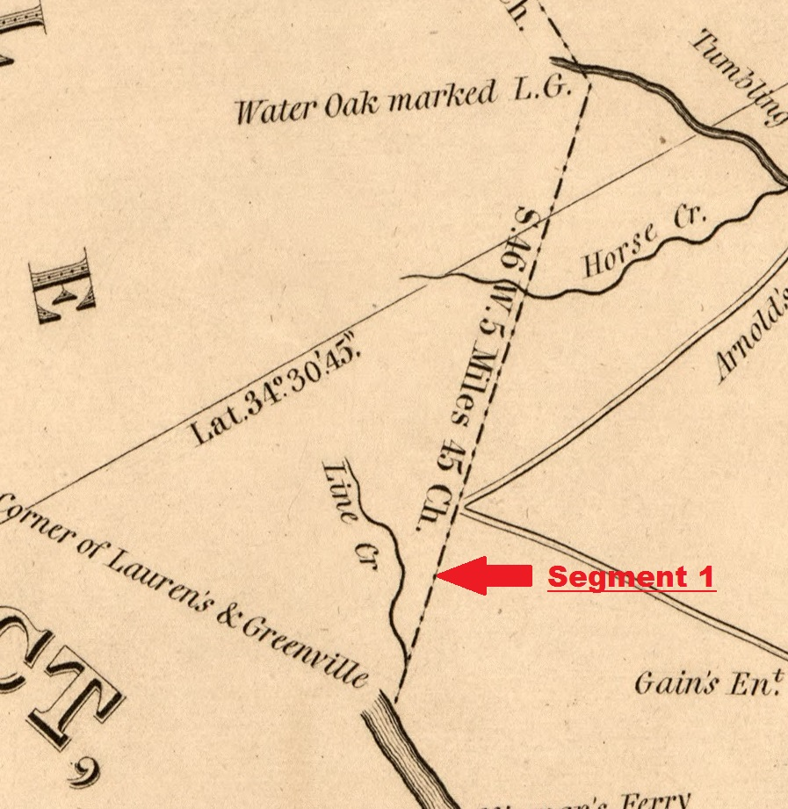
Greenville-Laurens County Line

Slide 57
Greenville-Laurens County Line
This line was surveyed again in 1906 for a proposed Fairview County, apparently to determine the area to be contributed to Fairview by Greenville and Laurens counties
The line on this map has a bearing of N 51-45 E and distance of 5 miles and 49.50 chains and ends as a corner in the Reedy River

Slide 58
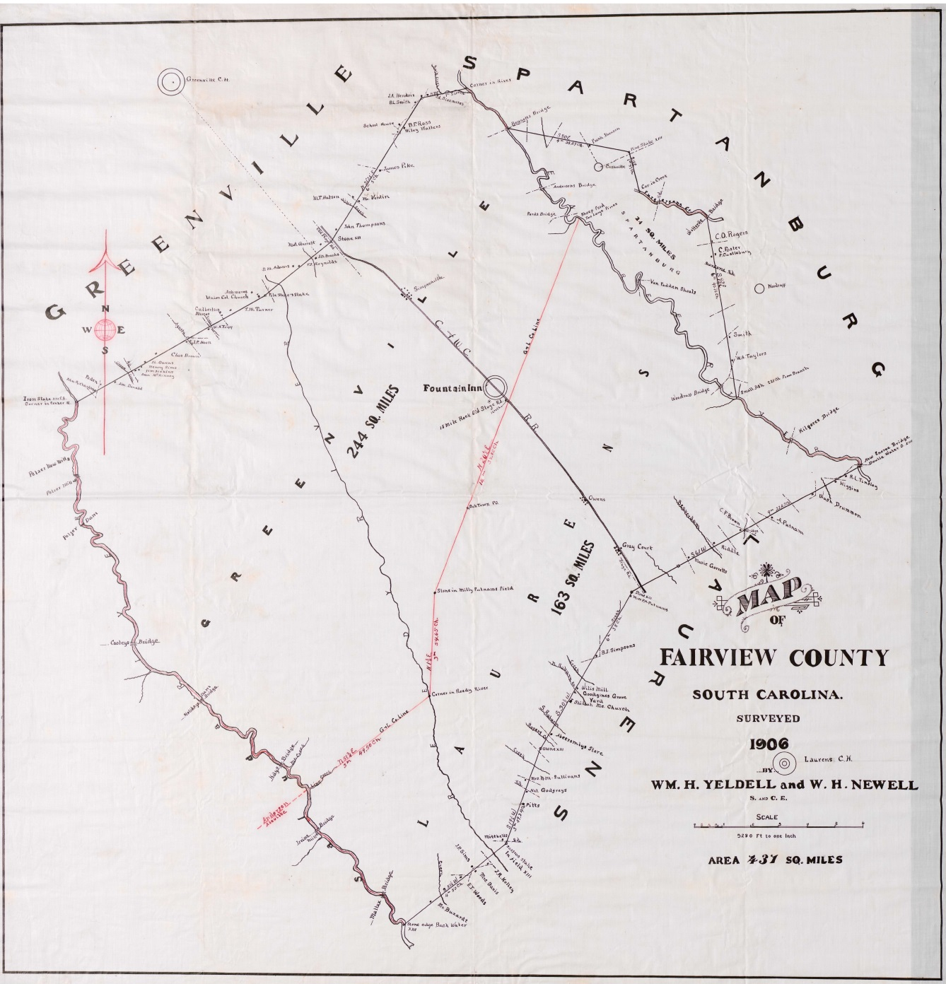
Greenville-Laurens County Line

Slide 59
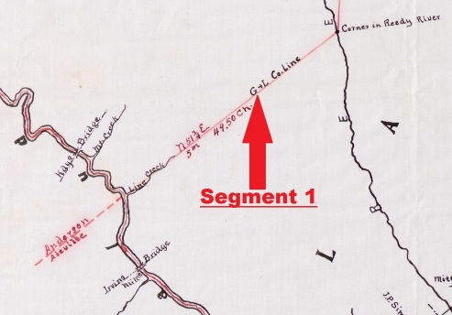
Greenville-Laurens County Line

Slide 60
Greenville-Laurens County Line
The northeast termination of the Cherokee Boundary line (and county boundary) in our retracement was determined by intersecting the 1766 Cherokee Boundary (determined as described above) with the 1767 Cherokee Boundary (determined as to be described in detail below)
This intersection was 14’ northeast of the top of bank on the northeast side of the Reedy River

Slide 61
Greenville-Laurens County Line
In 1766 and 1820 the corner tree was on the southwest bank of the Reedy River
In 1906 the corner was in the Reedy River
The intersection determined for that corner in 2016 is on northeast bank of the Reedy River
It appears the Reedy River has been moving slowly but steadily to the southwest over the last 250 years

Slide 62
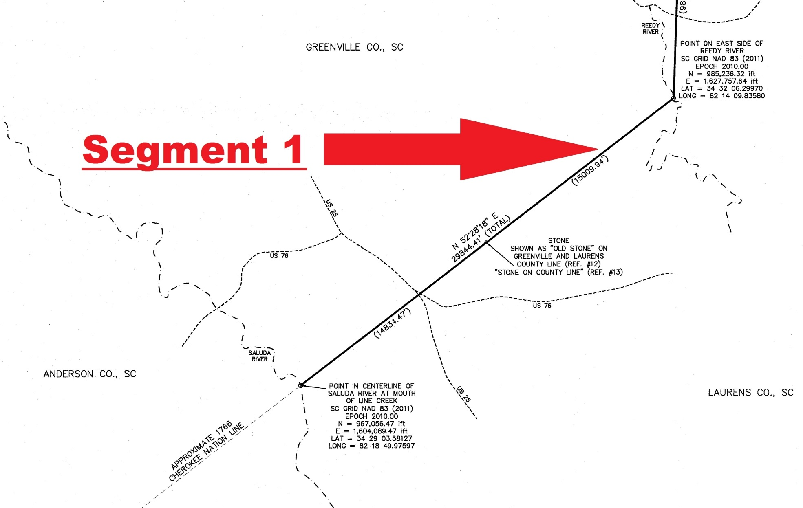
Greenville-Laurens County Line

Slide 63
Greenville-Laurens County Line
The bearing CESI determined for Segment 1 is N 52-28-18 E, which compares well with the original bearing of N 50 E, the 1906 bearing of N 51-45 E, and allowing for magnetic variation of the time of the 1820 survey with the bearing on that survey of N 46 E

Slide 64
Greenville-Laurens County Line
The distance CESI determined from the center of the Saluda River to the intersection at the corner is a grid distance of 29,844.41’
This compares well with the 1906 distance of 29,667.00’ (5 miles 49.50 chains) differing by less than 0.6%
And the 1906 survey was only 297’ longer than the 1820/1825 survey, so it compares well with that survey, too

Slide 65
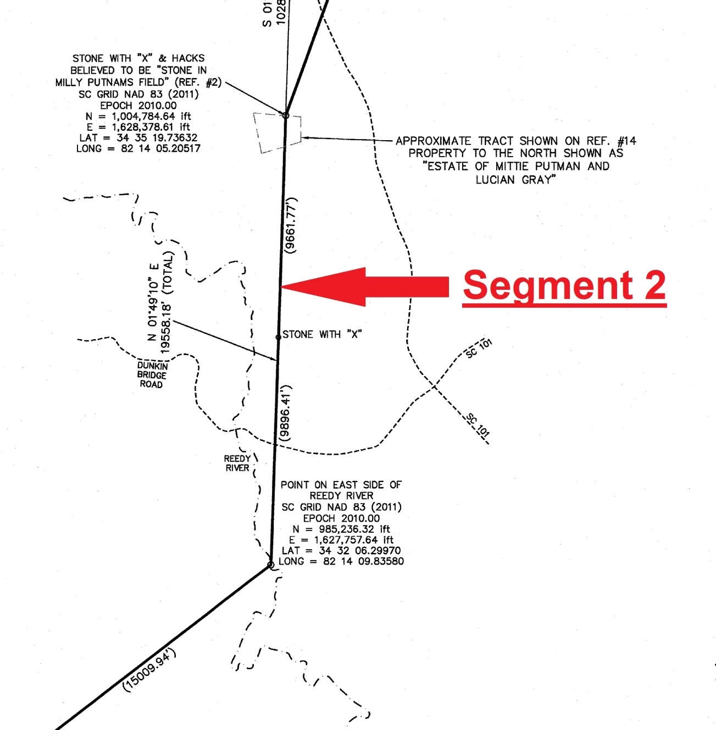
Greenville-Laurens County Line

Slide 66
Greenville-Laurens County Line
Research along and just north of Segment 2 found two grants that could be placed approximately on the ground by a combination of geographical features and/or grant line artifacts in the current GIS parcel data
John Anderson 1784 Grant
Joseph Kellet 1785 Grant

Slide 67
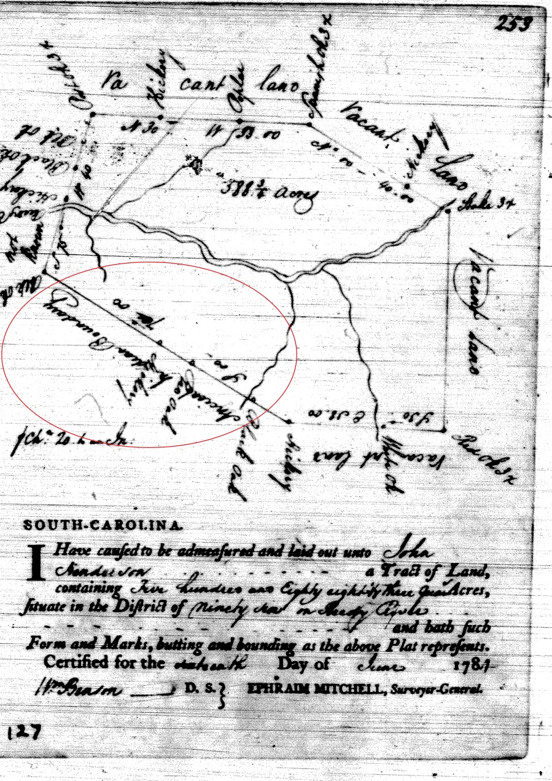
Greenville-Laurens County Line

Slide 68
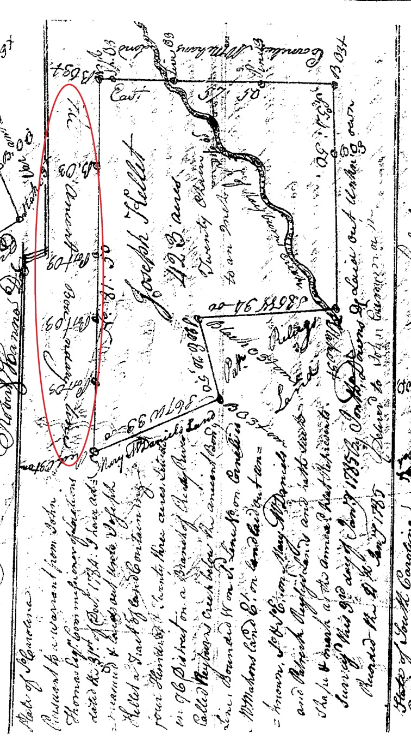
Greenville-Laurens County Line

Slide 69
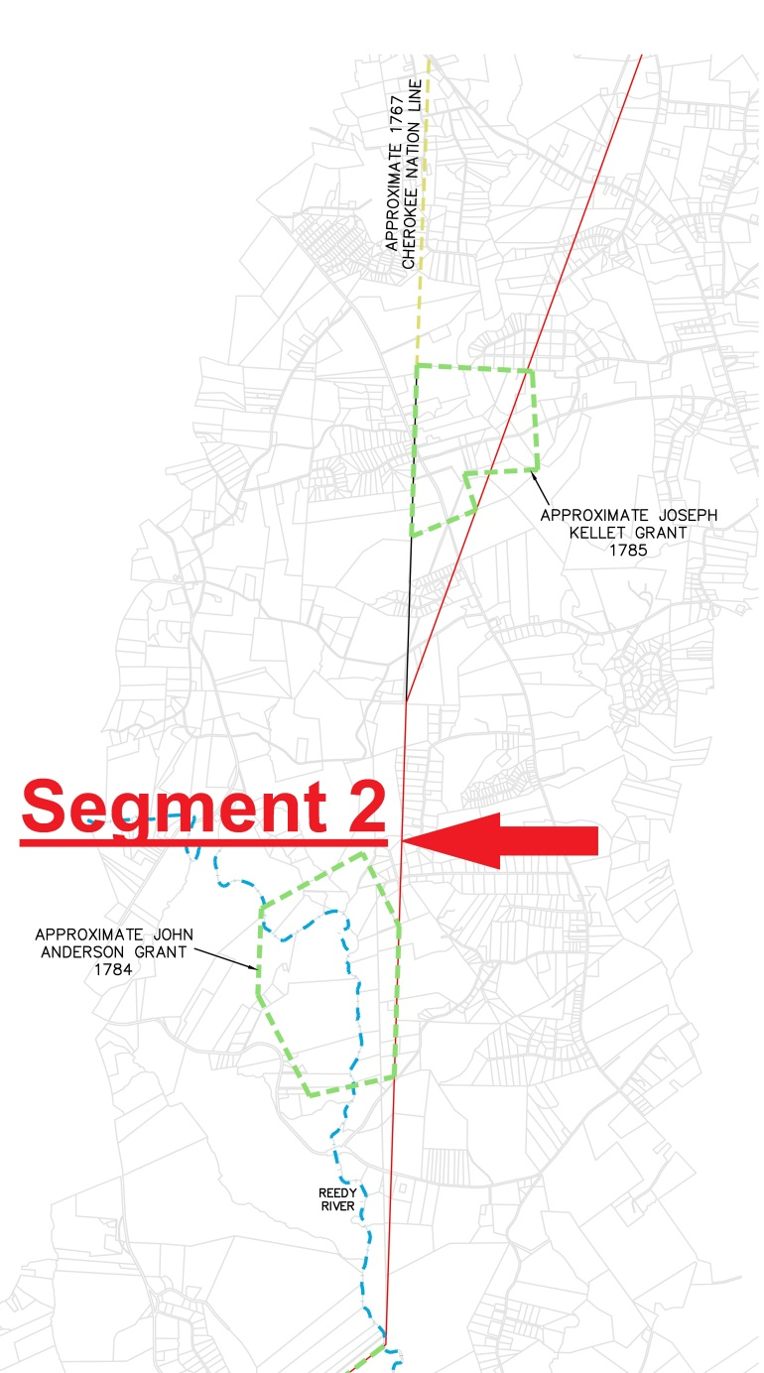
Greenville-Laurens County Line

Slide 70
Greenville-Laurens County Line
While the Anderson Grant can be approximately sited because of the depiction of the Reedy River on the Grant Map, the Cherokee Boundary line has been lost due to tracts combining in order to be under one ownership between the river and the road
Added to that, the GIS “county line” creates confusion by looking like a property line in the parcel data, but it is in fact not a property line

Slide 71
Greenville-Laurens County Line
The Kellet Grant, however, could be approximately located because of “Rayburn Creek” (currently Rabon Creek) and also because some of the grant lines are still visible in the GIS parcel data.
This allowed CESI to identify perpetuated grant corners, that are still current property corners, and to send survey crews to locate them and obtain coordinates
And, in this location the line was well away from the GIS “county line,” simplifying things

Slide 72
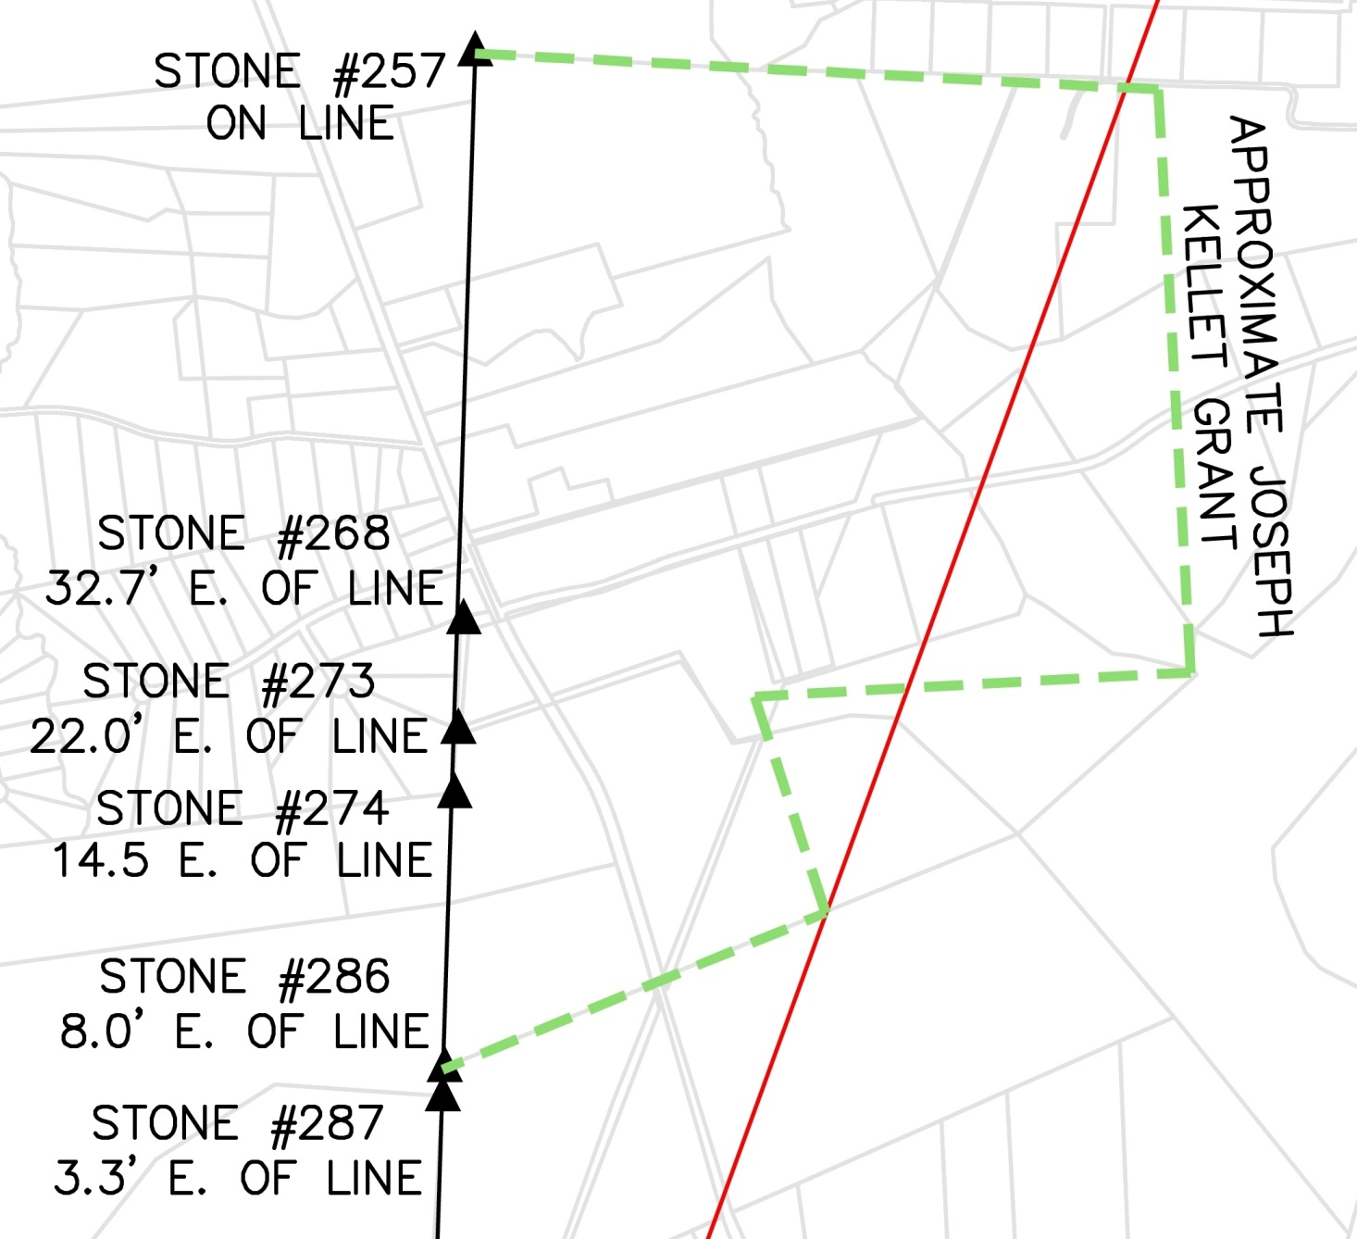
Greenville-Laurens County Line

Slide 73
Greenville-Laurens County Line
The 1906 survey proved to be an extremely accurate survey, and doing a best fit of the entire survey between the mouth of Line Creek and the Enoree River provided some trial points to look for
Even with just this rough positioning the portion of the 1906 survey representing Segment 2 fell very close to the line indicated by the Kellet Grant

Slide 74
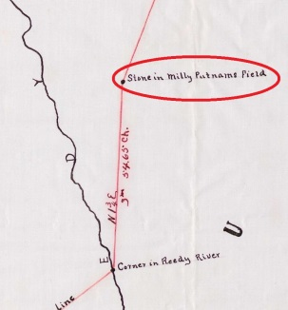
Greenville-Laurens County Line
At the northern end of Segment 2 the 1906 survey called for a specific monument, “Stone in Milly Putnams Field”

Slide 75
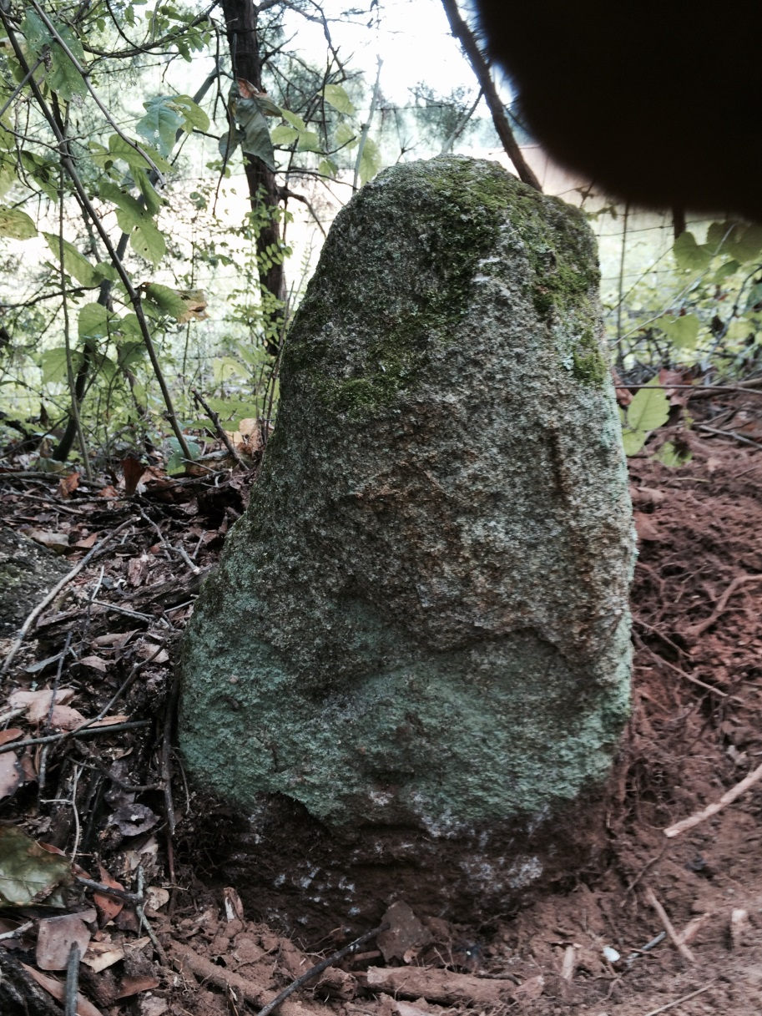
Greenville-Laurens County Line
A trial look at rough coordinates generated by the distances on the 1906 survey turned up, within a hundred feet, a planted stone with a clearly marked “X” and what look like three hacks

Slide 76
Greenville-Laurens County Line
Additional research never found a deed listing Milly Putnam as a property owner
But, a plat from Greenville County Registry, Plat Book R Page 57B, shows an adjoiner as “Estate of Mittie Putman”
This plat is dated 7 February 1913, just 7 years after the 1906 survey
The property covered by the plat is still clearly visible as Laurens Parcel 032-00-00-002, Greenville Parcel 0565010101600, and others

Slide 77
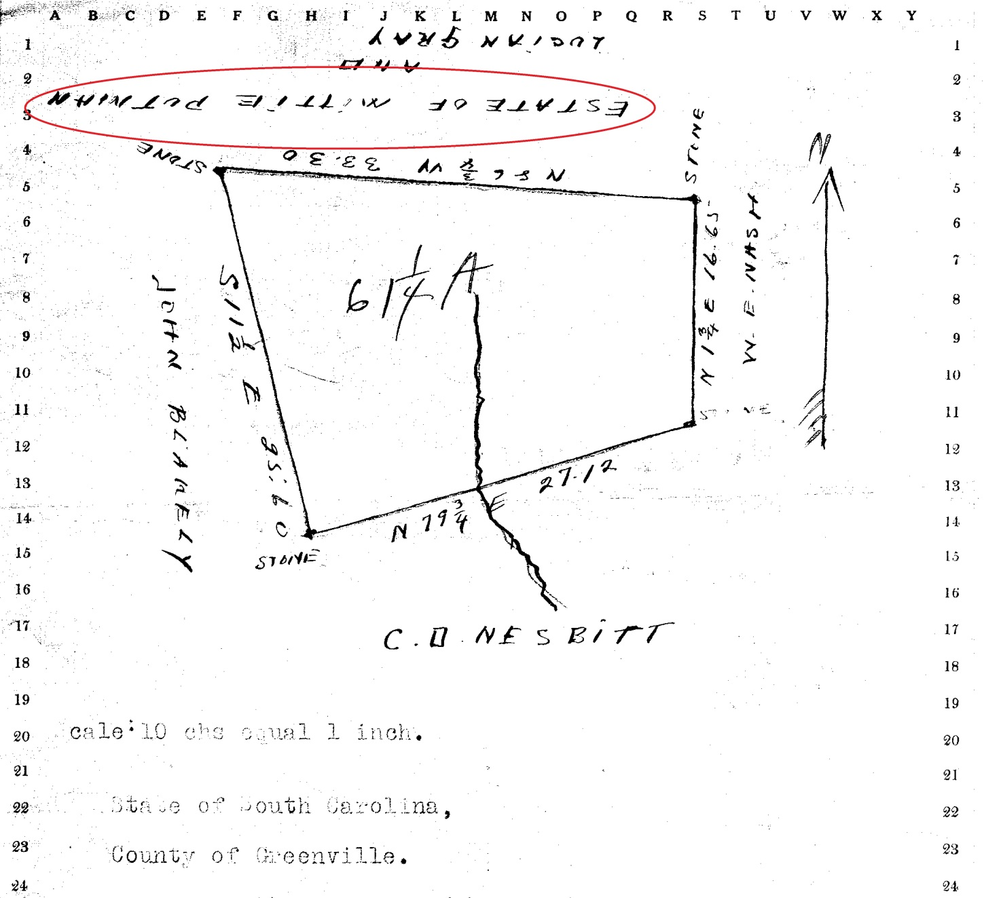
Greenville-Laurens County Line

Slide 78
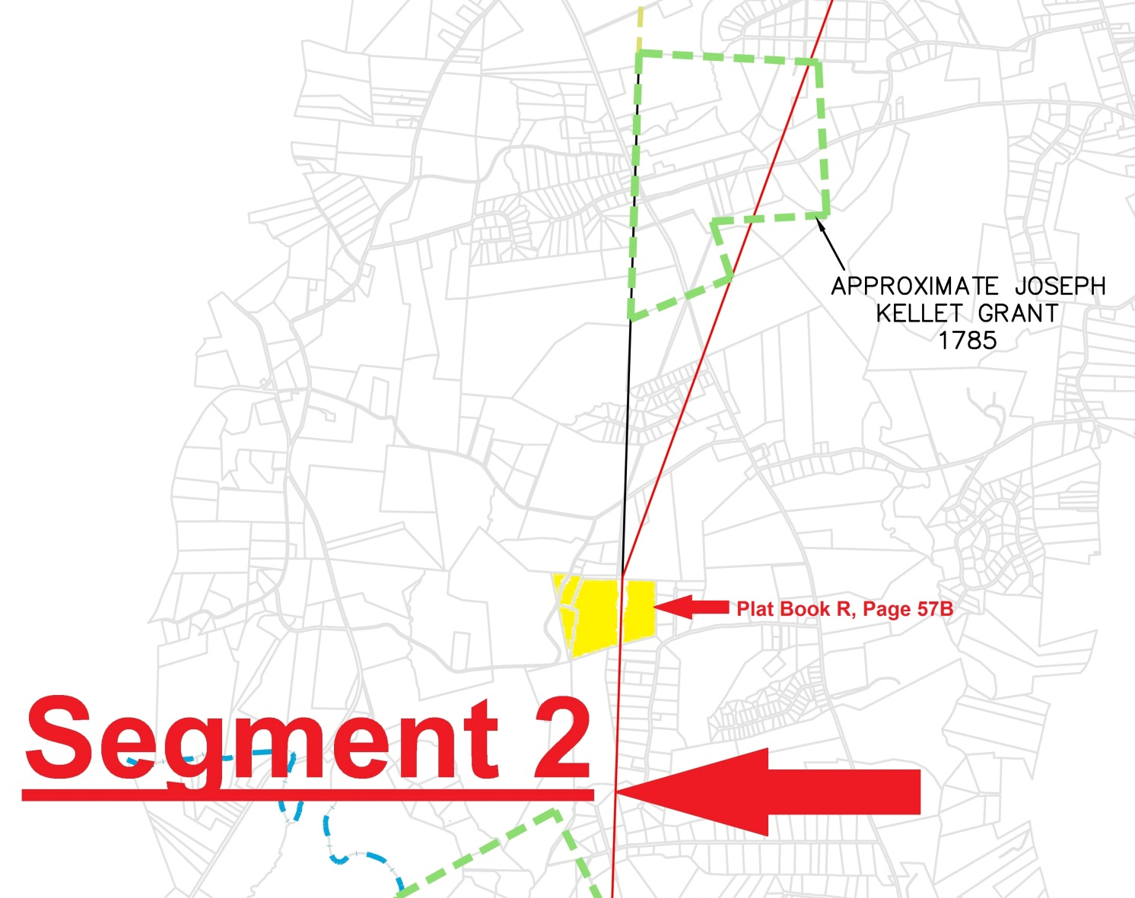
Greenville-Laurens County Line

Slide 79
Greenville-Laurens County Line
It’s hard not to conclude that “Milly Putnam” and “Mittie Putman” are the same person, and that the stone with the “X” is in the northern line of Plat Book R, Page 57B, and that it’s the “Stone in Milly Putnams Field” referred to by the 1906 survey
But is it in the 1767 Cherokee Boundary?

Slide 80
Greenville-Laurens County Line
Comparing the “Stone in Milly Putnams Field,” which we located and designated Stone #348, with the stones located along the Kellet grant showed a general agreement
However, it appeared that the southern stones on the Kellet Grant were set during later divisions that didn’t accurately locate the Cherokee Boundary line

Slide 81
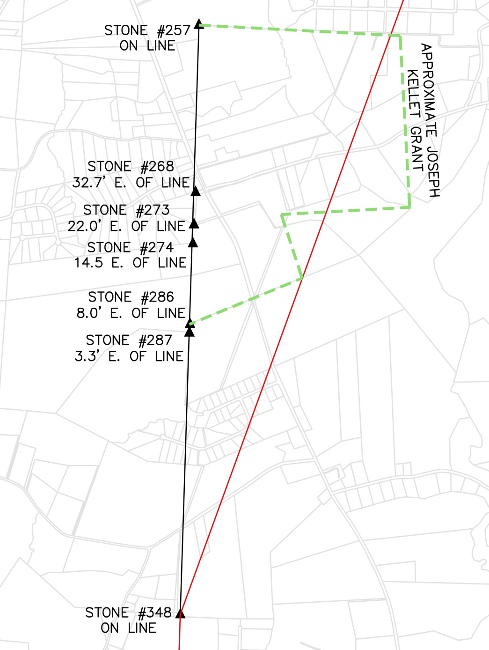
Greenville-Laurens County Line

Slide 82
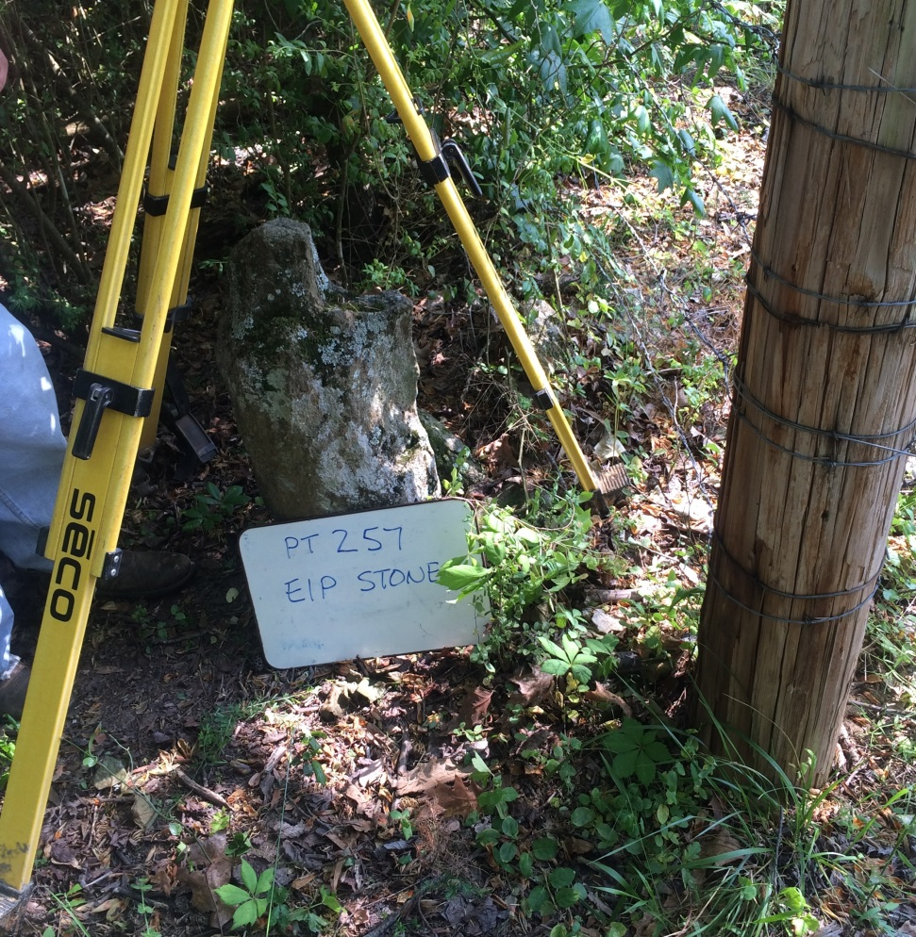
Greenville-Laurens County Line
Feeling most confident about the northwest Kellet grant corner, Stone #257, and Stone #348, we extended that line south to see if we matched any GIS or possession lines

Slide 83
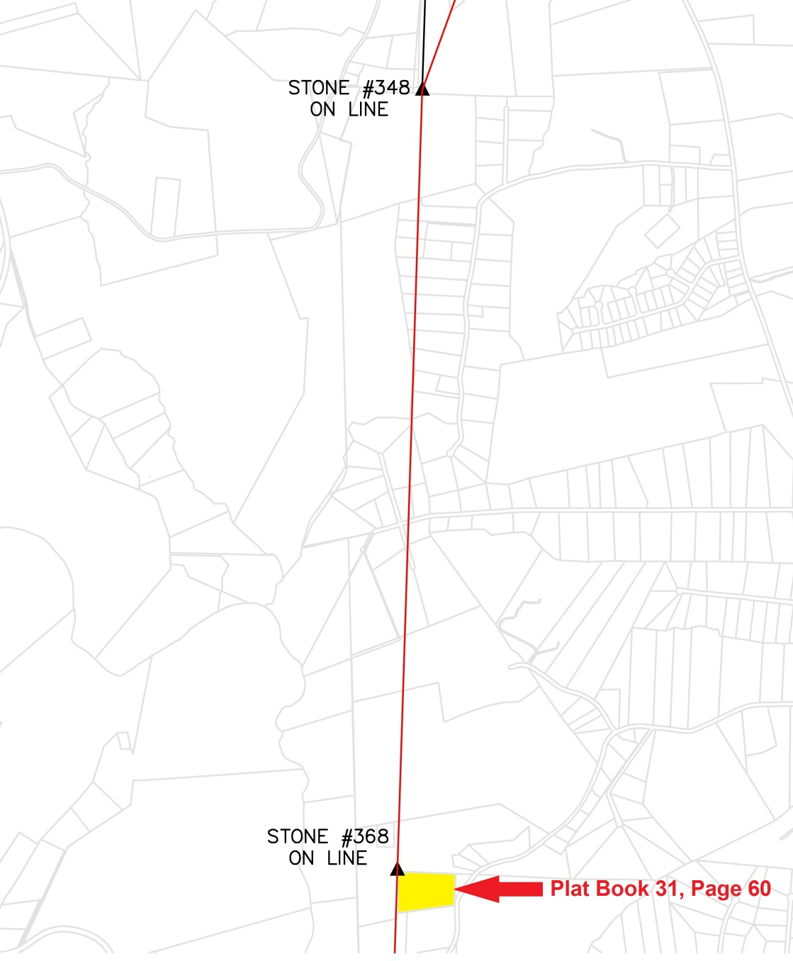
Greenville-Laurens County Line

Slide 84
Greenville-Laurens County Line
That extension coincided almost exactly with the western boundary of Laurens GIS Parcel 034-00-00-013
Laurens Plat Book 31 Page 60 indicated that the northwest corner of this parcel was a stone
CESI staff went into the field and located this stone, which we designate Stone #368

Slide 85
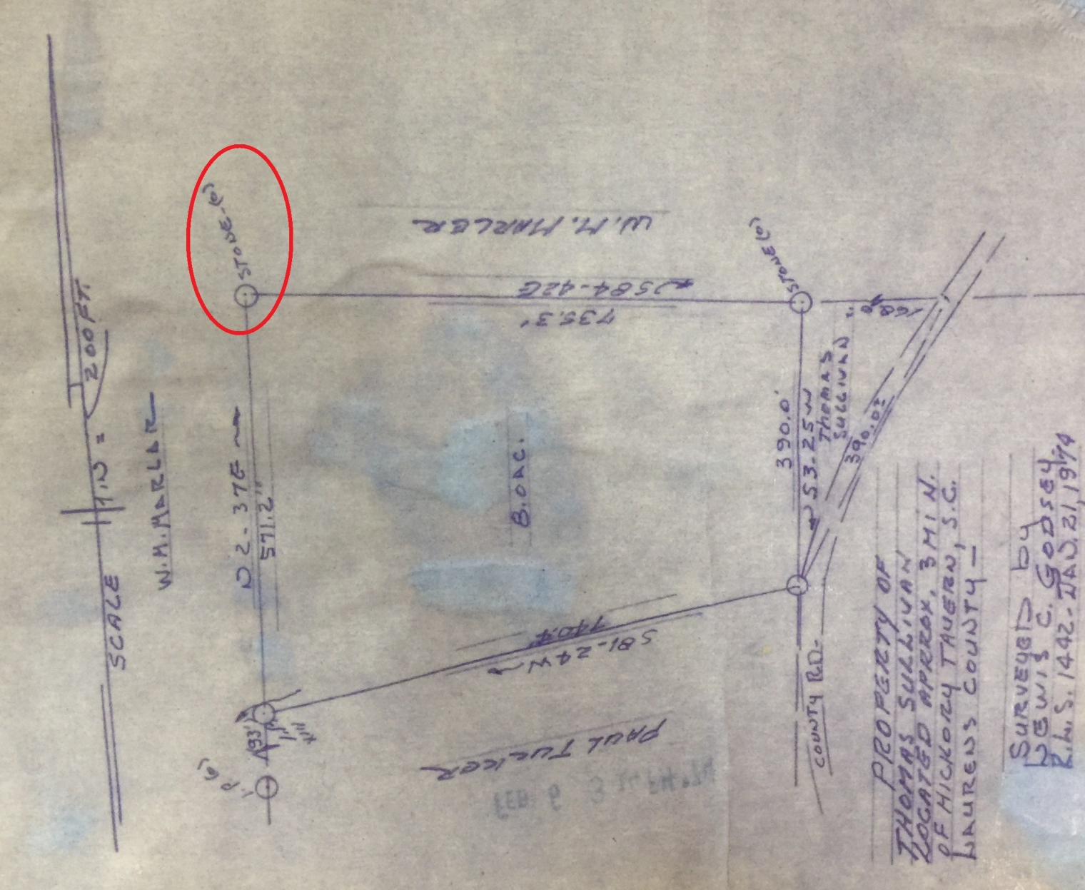
Greenville-Laurens County Line

Slide 86
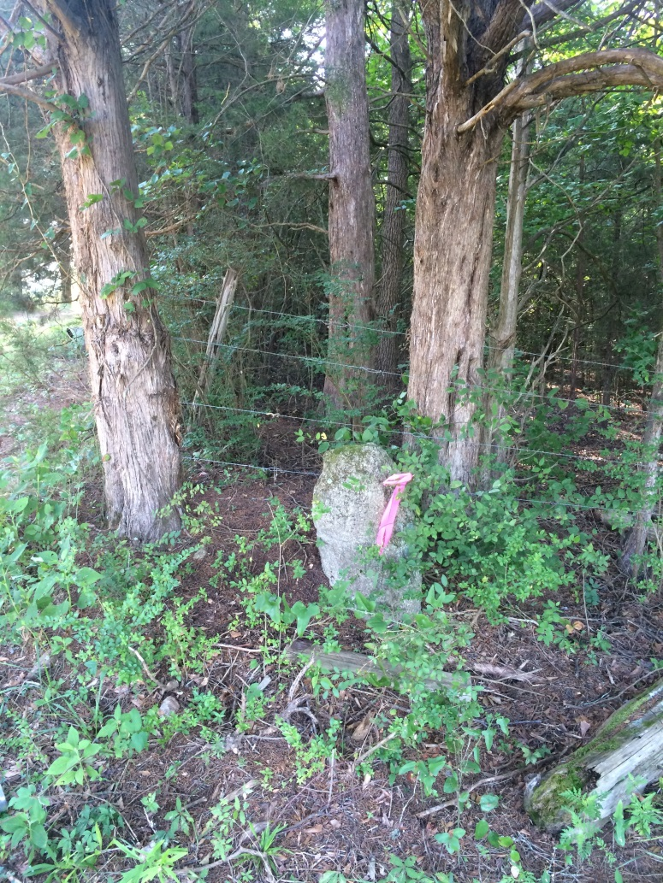
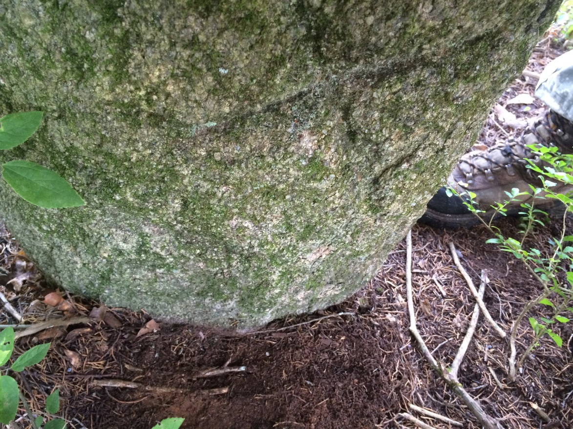
Greenville-Laurens County Line

Slide 87
Greenville-Laurens County Line
It, too, had an “X” scribed on it – and looked surprisingly like Stone #348, the “Stone in Milly Putnams Field”
These two stones may have been set at the same time, possibly as part of a large grant for which the record is undiscovered
Most compelling of all, Stone #257 (Kellet), Stone #348 (Milly Putnam), and Stone #368, all lie on exactly the same line!!

Slide 88
Greenville-Laurens County Line
CESI concluded that this line best represents the Cherokee Boundary of 1767
This line was extended and intersected with the Cherokee Boundary of 1766 (determined as described above)
This intersection point represents the “Wahoo” or “Waughoe” that marked the termination of the 1766 survey and the beginning of the 1767 survey

Slide 89
Greenville-Laurens County Line
As noted above, this intersection is on the northeast bank of the river, consistent with the river’s slow migration to the southwest
Additionally, Stone #368 is just 660’ shy of two miles north of the intersection point, two miles lies just beyond the top of a hill, which is shown on Laurens County Plat Book A659, Page 6

Slide 90
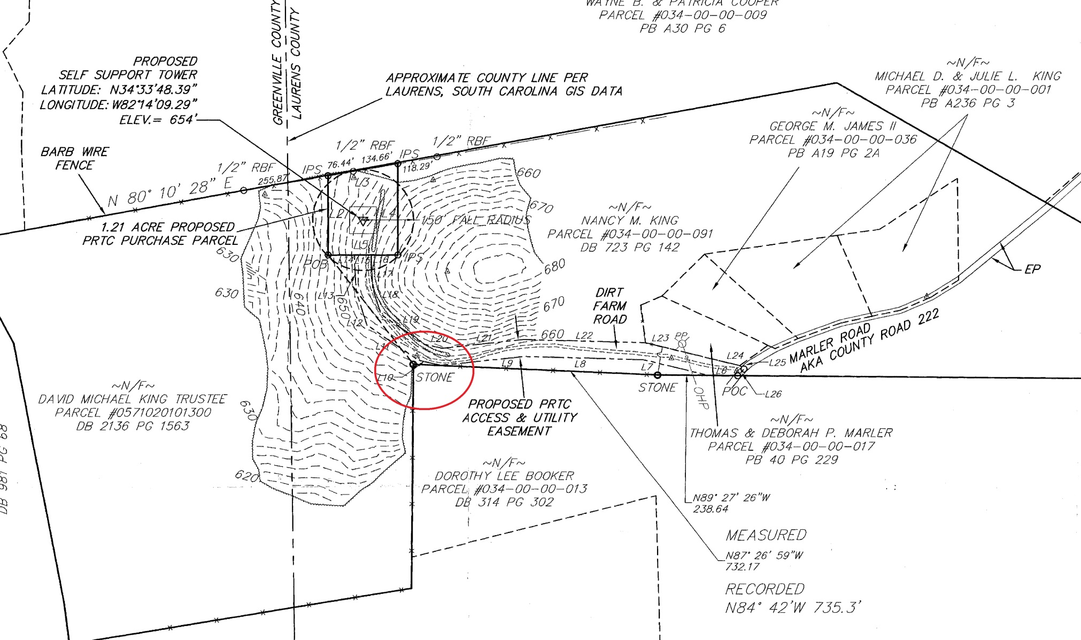
Greenville-Laurens County Line

Slide 91
Greenville-Laurens County Line
Gov. Tryon’s camp would most likely have been on a hill top to take advantage of level ground at the summit and breezes afforded by the elevation
We know from the record that his camp was two miles from the “Waughoe” and the line ran through it
Based on that we believe this is the site of his camp and have taken to calling Stone #368 the “Campground Stone”

Slide 92
Greenville-Laurens County Line
The grid bearing and grid distance from the intersection at Reedy River to Stone #348 is N 1-49-10 E and 19,558.18’
This compares well with the original bearing in 1767 of Due North
It also compares very favorably with the 1906 bearing of N 1-45 E
The 1906 distance of 19,446.90’ (3 miles 54.65 chains) differs by less than 0.6%

Slide 93
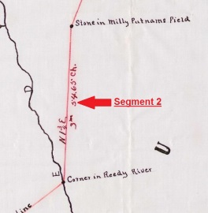
Greenville-Laurens County Line

Slide 94
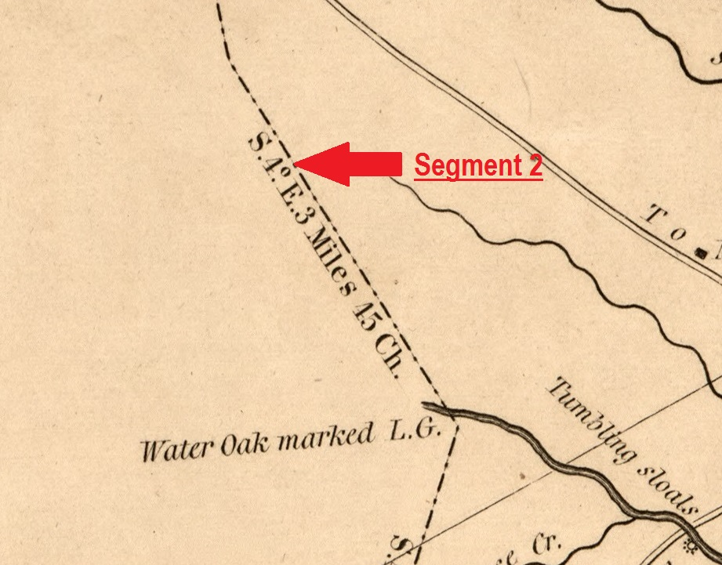
Greenville-Laurens County Line
It also compares reasonably well with the 1820/1825 distance of 18,810’
And the bearing of N 4 W compares well, once magnetic variation is considered

Slide 95
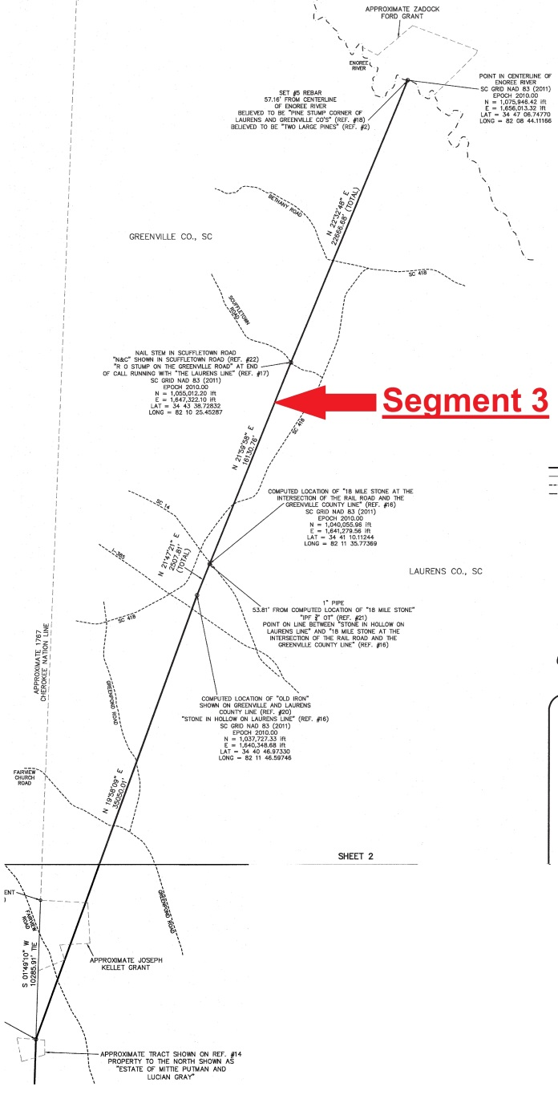
Greenville-Laurens County Line

Slide 96
Greenville-Laurens County Line
Act #1560 of 1792 created a new county line running “from ford on Enoree River, opposite Zadock’s Ford, in a direct course to the widow Killit’s on Raburn’s creek”
It is possible that the “widow Killit’s” could have been the wife of Joseph Kellet, since his 1784 grant is just inside the area annexed to Greenville County, and it is reasonable to assume her property was mentioned because she wanted to be included in the annexation

Slide 97
Greenville-Laurens County Line
Zadock’s Ford appears to have been an 18th century typo, or a later transcription error
Zadock Ford had property on the Enoree River in Spartanburg County
It may be that the description was supposed to read – ford on the Enoree River opposite Zadock Ford’s….

Slide 98
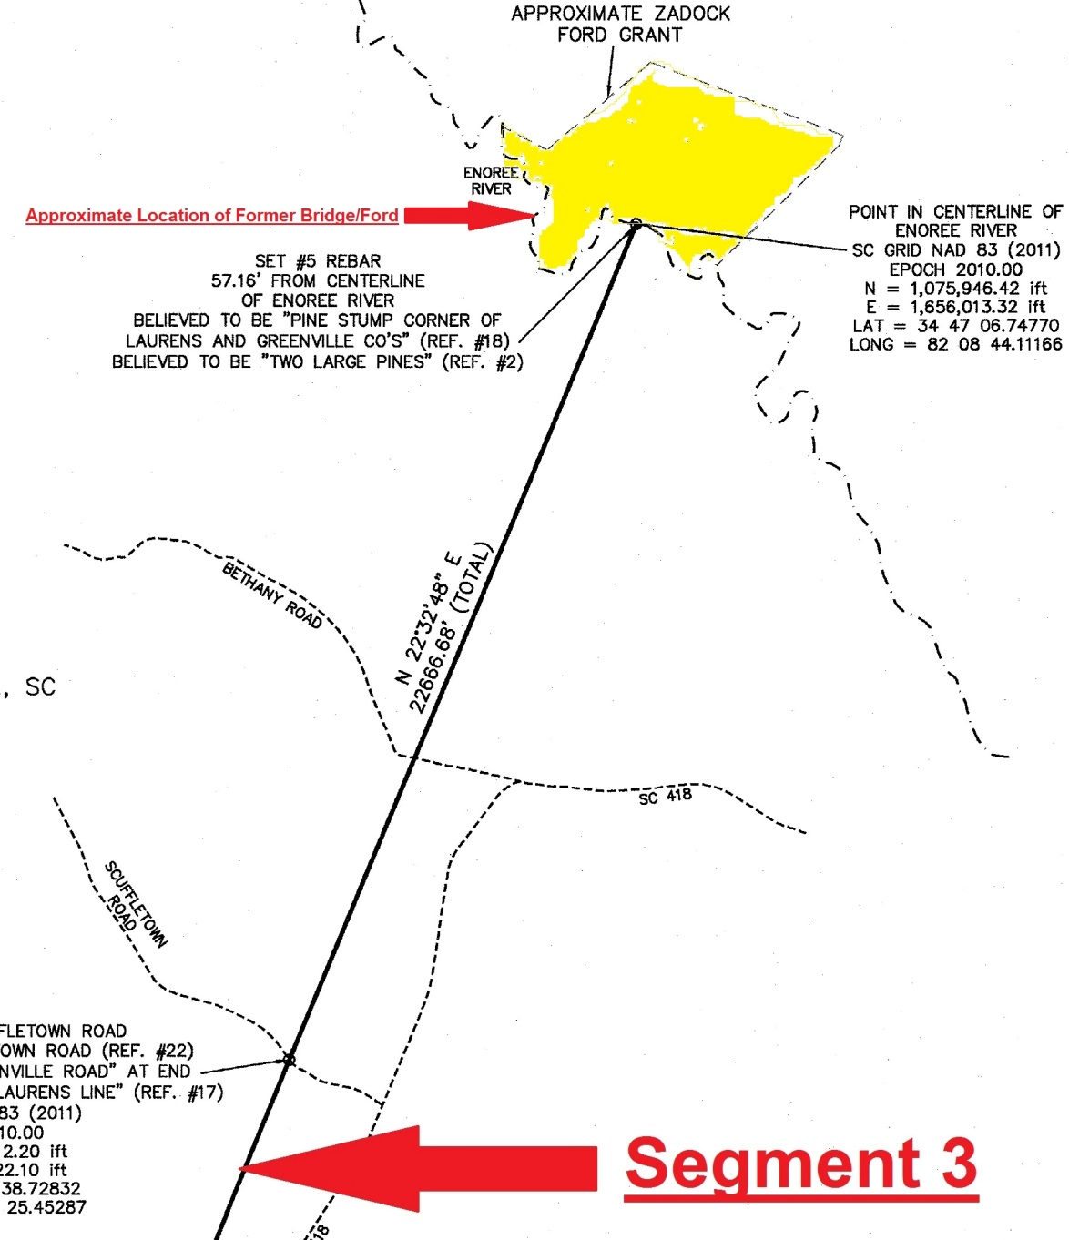
Greenville-Laurens County Line

Slide 99
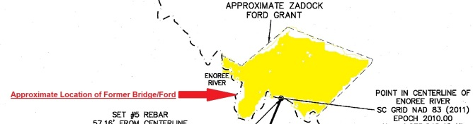
Greenville-Laurens County Line
Adding to the confusion is that there was a road (Ford Road) that crossed the Enoree just upstream, as indicated above, and that there was once a ford and later a bridge located here (Ford Road Bridge)

Slide 100
Greenville-Laurens County Line
The earliest survey we have is the 1820/1825 survey
This survey was run less than 30 years after Act #1560 was adopted, well within living memory
This survey and the 1906 survey both clearly indicate a stretch of river that is downstream of the Ford Road ford location

Slide 101
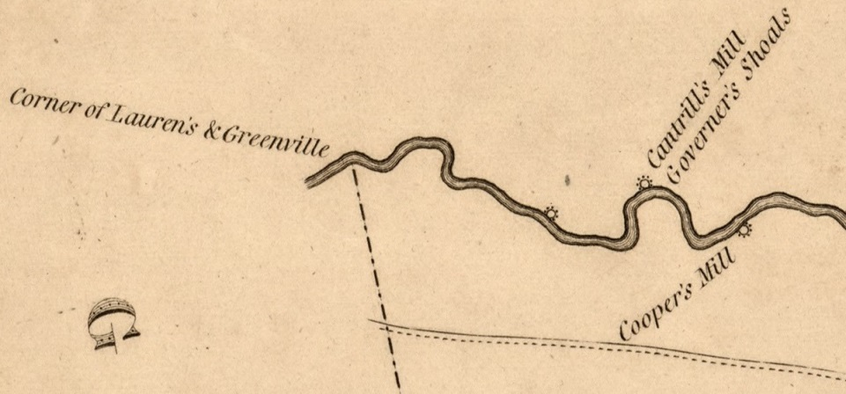
Greenville-Laurens County Line

Slide 102
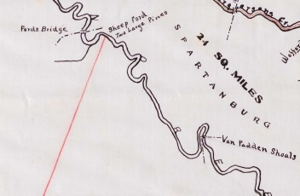
Greenville-Laurens County Line

Slide 103
Greenville-Laurens County Line
Other than providing a bearing and distance and graphic evidence that the county line intersects the Enoree downstream of the Ford Road ford, and the big U-shaped bend in the river it sits on, the 1820/1825 map is silent on a specific location of the county line
In contrast, the 1906 map notes the line terminates at a “Sheep Ford” and “Two Large Pines”

Slide 104
Greenville-Laurens County Line

Slide 105
Greenville-Laurens County Line
Prior research by South Carolina Geodetic Survey recovered Greenville County Plat Book S, Page 25
This plat shows a “Pine Stump” on the south bank of the Enoree River and describes it as “Corner of Laurens and Greenville Co’s”
This plat dates from 1947, only 41 years after the 1906 survey described the corner as “Two Large Pines”

Slide 106

Greenville-Laurens County Line

Slide 107

Greenville-Laurens County Line

Slide 108
Greenville-Laurens County Line
Sid Miller and Alan-Jon Zupan with South Carolina Geodetic Survey visited this site on 21 April 1999 and talked with Mr. W. J. (Olin) Riddle, the surveyor who had surveyed and drawn the 1947 plat
Mr. Riddle described it as the biggest pine stump he had ever seen, about 4’ in diameter, and right on the river

Slide 109

Greenville-Laurens County Line
Mr. Miller and Mr. Zupan found the remnants of the stump, photographed it, and obtained GPS coordinates of the location

Slide 110

Greenville-Laurens County Line
In 2015, CESI used those coordinates to reestablish the location and, the pine stump having long since rotted away, set a #5 rebar (Set Iron #252) to mark the spot

Slide 111
Greenville-Laurens County Line
CESI then extended a line from Stone #348 (Stone in Milly Putnams Field) through Set Iron #252 and created a point at the intersection of that line with the center of the Enoree River
The resulting line had a grid bearing of N 21-13-23 E and a grid distance of 76,339.21’
This compares well with the 1906 survey bearing of N 20-30 E and ground distance of 76,454.40’ (14 miles 38.40 chains), a difference of right at 0.15%

Slide 112
Greenville-Laurens County Line
Taking magnetic variation into account it also compares reasonably well with the 1820/1825 survey bearing of N 17 E and distance of 78,474’ (14 miles 69 chains)
At this point we were confident that we had the same endpoints and had established the line as surveyed in 1906, and probably the same as 1820/1825, but we wanted any additional information we could develop to support that conclusion

Slide 113

Greenville-Laurens County Line
The 1820/1825 map is silent on specific monuments at the endpoints, or along the length of the county boundary line
All it provides is a bearing and distance

Slide 114

Greenville-Laurens County Line
By contrast, the 1906 map, in addition to providing specific monuments at both ends, provides two specific mid-point landmarks
The line crosses the Babtown PO, and passes 12.70 chains from the “18 mile Rock on Old Stage Rd.”

Slide 115


Greenville-Laurens County Line

Slide 116
Greenville-Laurens County Line
CESI contacted the Fountain Inn Museum and met with Mr. Jack Marler seeking information on both these landmarks
Mr. Marler was unable to provide any information about the “18 Mile Rock”
However, he was able to direct us to the specific property and general location of the Babtown Post Office

Slide 117
Greenville-Laurens County Line
CESI visited the site of Babtown Post Office, which correlated well with the location as scaled from the 1906 survey
However, the Post Office building no longer stands and there was nothing specific remaining from that structure that could be located and used to vet the alignment we had developed
So we sought other sources of information for the location of the “18 Mile Rock”

Slide 118
Greenville-Laurens County Line
In 1906 the “18 Mile Rock” was beside the C.&W.C. railroad track
The current operator of that line is the Carolina Piedmont Railroad
CESI contacted the offices of CPR and asked if any railroad valmaps showed the “18 Mile Rock” and gave a mile number to it that would allow us to determine where it stood
It did not show up on any CPR valmaps

Slide 119
Greenville-Laurens County Line
Finally, in desperation, we started going through back deeds in the general area we calculated from our reconstruction of the 1906 survey for the “18 Mile Rock”
Our reasoning was that if it was significant enough to show up on a survey of the county boundary, perhaps it was significant enough that deeds adjacent to it mentioned it, perhaps even gave a tie to it

Slide 120
Greenville-Laurens County Line
We found what we were looking for (a little to our surprise)!
Searching back deeds for Greenville Parcel 0351000100900 we found Deed Book RR, Page 760 with the words, “Beginning at the 18 Mile Stone…”
This description is one of a series for lots created by a 23 January 1886 survey by Jas. K Dickson

Slide 121

Greenville-Laurens County Line
The darker lines are the lots from the 1886 Dickson survey
The yellow is Greenville Parcel 0351000100900
We tied to existing property corners that related back to the 1886 Dickson survey
Based on those we calculated point #1502, the location of the 18 Mile Stone

Slide 122
Greenville-Laurens County Line
In 1906 the distance from the county boundary, along the railroad track, to the “18 Mile Rock” was 838.20’ (12.70 chains)
We obtained a grid distance from our reestablished 1906 line to our calculated 18 Mile Stone of 853.02’ or 12.92 chains

Slide 123
Greenville-Laurens County Line
CONFIRMATION OF OUR LOCATION!!!!
There was only one problem….

Slide 124
Greenville-Laurens County Line
As stated above, Deed Book RR, Page 760 read, “Beginning at 18 Mile Stone…”
But it continued on to read, “…at the intersection of the Rail Road and the Greenville County line…”
At the time of the 1886 survey Dickson understood the county line to run across the 18 mile stone, not almost 13 chains farther down the railroad!

Slide 125
Greenville-Laurens County Line
Now it began to look as if the 1906 tie to the “18 Mile Rock” was not an arbitrary tie to a locally recognized monument
But instead an attempt to prove to the citizens of Fountain Inn that a straight line between the two endpoints of the county line did not go over the 18 Mile Stone
If that was the case then in 1906 they got the math all correct, and the location all wrong

Slide 126
Greenville-Laurens County Line
The 1906 survey is a VERY accurate survey that holds up well, even now, more than 100 years later, when we can use satellites to measure distances of 20 miles within millimeters
But accurately connecting two endpoints and establishing a perfectly straight line between them does not necessarily mean that the county boundary follows that straight line

Slide 127
Greenville-Laurens County Line
The county boundary exists wherever the first surveyor to run it placed it – however imperfectly that may work with the description created from that survey
The bearings and distances from a survey are only pointing to the location of the line
If there is other, more specific, evidence of where the line is located, it must be honored

Slide 128
Greenville-Laurens County Line
Could there be other evidence that supported the county boundary to be in a location different than indicated by the 1906 survey?
We began to look for any additional evidence that we could discover by extending the line described as the “Greenville County line” in the deeds from the 1886 Dickson survey northeast and southwest from our calculated point for the 18 Mile Stone

Slide 129
Greenville-Laurens County Line
Because the GIS “county line” runs close to this extended line, creating the illusion of property lines where often there are none, we looked primarily for possession lines that were parallel and close to our extended line
About 3 miles to northeast there was a possession line running from Durbin Creek to Scuffletown Road (S-23-571) that was close to and parallel with our extension

Slide 130
Greenville-Laurens County Line
Investigating back deeds for Greenville Parcel 0556010100200 we recovered Deed Book KK Page 121 that describes the eastern line of the parcel from Durbin’s Creek to what was then called “the Greenville Road” as “the Laurens line”
The date on this deed is 28 December 1860, approximately halfway in time between the 1820 survey and the 1906 survey

Slide 131
Greenville-Laurens County Line
Currently that point on “the Laurens line” in “the Greenville Road” is the northeast corner of Greenville Parcel 0556010100101 and is shown on Plat Book 20R, Page 76
CESI located the northeast corner of this property, a nail stem
It is designated Point #1023

Slide 132

Greenville-Laurens County Line

Slide 133

Greenville-Laurens County Line

Slide 134
Greenville-Laurens County Line
Extending this line to the northeast found no more possession lines to investigate
The extended line hit the Enoree River within a few hundred feet of Set Iron #252, the location of the old pine stump
CESI believes that these two deeds are two of a very few, possibly the only two, that were created after the running of the original 1792 line, or possibly, the 1820 retracement, and which used that line as a property line

Slide 135
Greenville-Laurens County Line
Laurens County had existed since 1785, and prior to its creation the colony, and then the state, had been issuing grants in this area
Unlike the Cherokee Boundary, which was a hard border that had to be adhered to (at least for a while) and thus shows up in subsequent plats and deeds, initially there was no border along Segment 3

Slide 136
Greenville-Laurens County Line
By the time of Act #1560 in 1792 the land the new county boundary would run over would have been largely granted out
CESI searched in the Department of History and Archives for any grants after 1792 in this area to see if any showed the new county boundary and found none
The only opportunity for a deed to preserve this line would be if someone wished to divide property along it

Slide 137
Greenville-Laurens County Line
As the line was apparently not monumented that could only happen soon after the line was surveyed and residents still knew where it was
Since Fountain Inn was a stage stop, and then a town along the railroad, it was most likely one of the few places along the county boundary that had properties being divided and subdivided in the early 19th century

Slide 138
Greenville-Laurens County Line
It appears that the 1906 survey was a very well done transit and tape survey, and was not subject to variations in magnetic declination that might affect a compass at various points along the length of the line
By contrast, any survey that may have been done in 1792, and the survey that was done in 1820 for the 1820/1825 map, were compass surveys subject to variations in magnetic north

Slide 139
Greenville-Laurens County Line
Based on the existence of the Cherokee boundaries, and the similarities in distance between the 1820/1825 survey and 1906 survey along those lines, CESI is satisfied that the “Stone in Milly Putnams Field,” Stone #348 is the correct southern terminus for Segment 3

Slide 140
Greenville-Laurens County Line
Based on the similarities in the appearance of how the river is drawn at the point that the county boundary intersects it on both the 1820/1825 map and the 1906 map, the fact that the extended line from the properties described as being on the county line points to this general location, and the fact that the statute describes a ford, the 1906 map describes a sheep ford, and the topography make an animal ford feasible, CESI is satisfied Set Iron #252 (the pine stump) represents the correct location for the northern terminus of Segment 3

Slide 141
Greenville-Laurens County Line
CESI concludes that on the original compass survey of the line about 1792, or during the compass survey retracement of it in 1820, magnetic variation pulled the line to the west in the Fountain Inn area and the mid-19th century deeds we have recovered are evidence of that happenstance

Slide 142
Greenville-Laurens County Line
CESI therefore concludes that the proper alignment for Segment 3 is: Beginning at Stone #348 the “Stone in Milly Putnams Field;” then runs in a straight course to Calculated Point #1500, the southern end of Lot 19 from Dickson's survey; runs in a straight course to #1502, the 18 Mile Stone; runs in a straight course to Nail Stem #1023; and then runs in a straight course over Set Iron #252, the pine stump, to the center of the Enoree River

Slide 143

Greenville-Laurens County Line

Slide 144


Greenville-Laurens County Line

Slide 145

Greenville-Laurens County Line
Monument 1 is on the Greenville-Laurens county line and is 194.02’ from the point in the center of the Saluda River where those counties meet Abbeville and Anderson counties

Slide 146


Greenville-Laurens County Line

Slide 147

Greenville-Laurens County Line
Monument 1A is on the county line and is 117.20’ from Monument 1 and 311.22’ from the center of the Saluda River

Slide 148


Greenville-Laurens County Line

Slide 149


Greenville-Laurens County Line

Slide 150

Greenville-Laurens County Line
The County Corner fell off the bank in the North edge of the Reedy River
Monument 3 is on the county line and on the bank on the South side of the Reedy River
Monument 3 is 118.93’ from the actual County Corner

Slide 151

Greenville-Laurens County Line

Slide 152


Greenville-Laurens County Line

Slide 153


Greenville-Laurens County Line

Slide 154


Greenville-Laurens County Line

Slide 155


Greenville-Laurens County Line

Slide 156


Greenville-Laurens County Line

Slide 157



Greenville-Laurens County Line

Slide 158



Greenville-Laurens County Line

Slide 159



Greenville-Laurens County Line

Slide 160



Greenville-Laurens County Line

Slide 161

Greenville-Laurens County Line
Monument 10 is on the south bank of the Enoree River and is 57.16’ from the centerline of the river
The Enoree centerline is the line between Greenville and Laurens counties and Spartanburg County

Slide 162


Greenville-Laurens County Line

Slide 163

Greenville-Laurens County Line

