Slide 1
SC Fiscal Update
Presented to
The Joint Meeting of the South Carolina
Council of Technical College Presidents
State Board for Technical and Comprehensive Education
Association of Technical College Commissioners
September 22, 2026
South Carolina Revenue and Fiscal Affairs Office
Rembert C. Dennis Building, 1000 Assembly Street, Suite 400, Columbia, SC 29201
(803) 734-3793 | WWW.RFA.SC.GOV

Slide 2
South Carolina Personal Income - Historical Growth
SC personal income growth accelerated during the pandemic, establishing a higher base before returning to more normal growth expectations

Slide 3
Personal Income Growth by County
SC total personal income grew 84.1% over 10 years, but growth varied widely among counties; only 10 counties grew faster than the state average

Slide 4
Population Change 2025 – SC is 5th Largest
From 2024 to 2025, SC’s population increased by 79,958, or 1.46%, the highest rate of growth in the US

Slide 5
Components of SC Population Change
Migration is driving population growth as deaths have started to exceed births

Slide 6
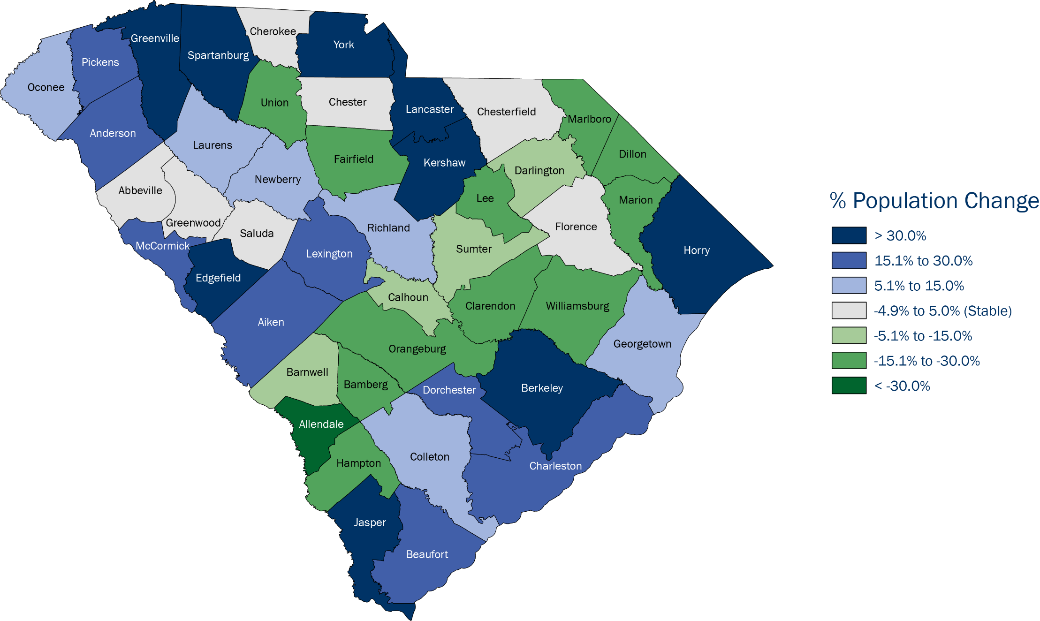
Projected Total Population Change by SC County, 2020 - 2040
Significant differences in population growth by county are expected, resulting in different fiscal conditions; 22 counties are expected to increase notably, while 16 are expected to decline
Data Sources: US Census Bureau Population Estimates Program, Vintage 2025 Postcensal Estimates, December 2025

Slide 7
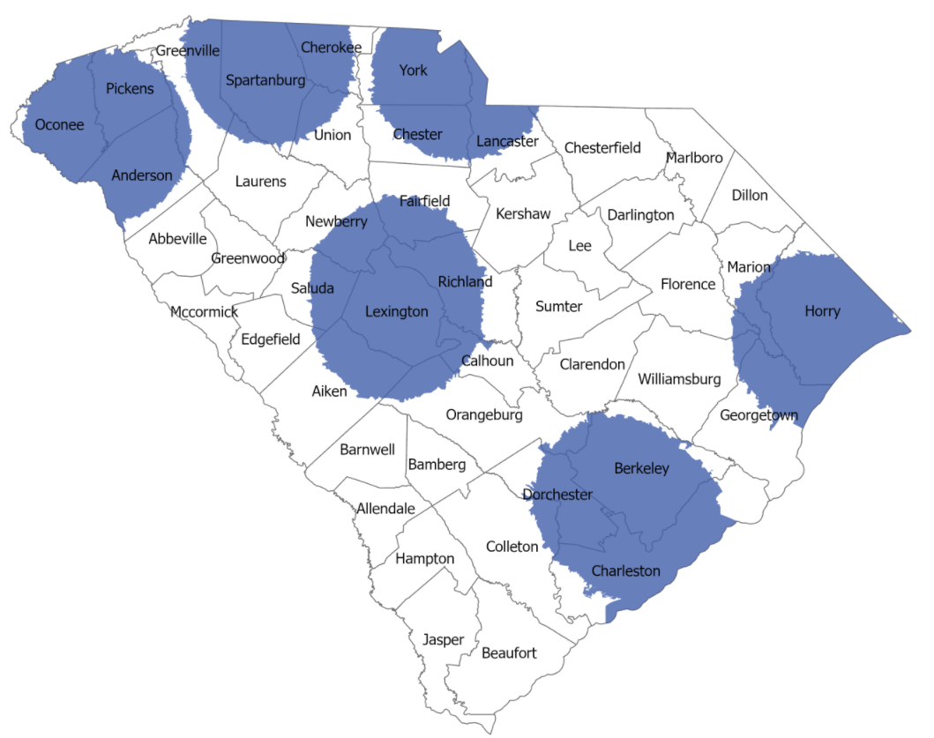
Six Most Populated Areas with a 25-Mile Radius
These six circles represent about 37% of the state’s area (11,884 sq miles) and about 67% of the total SC population
Areas with highest population density in a 25-mile radius
Data Source: US Census Bureau, 2020 Census

Slide 8
SC Population by Age Group
By 2030, there are projected to be more people over 64 than under 18; the percentage of people of workforce age is projected to decrease (relatively fewer workers to support a larger population)

Slide 9
General Fund Revenue – Long-term Growth
Prior to the pandemic, annual revenues tracked closely to long-run trends

Slide 10
General Fund Revenue – Long-term Growth
In response to the stimulus funding during the pandemic, revenues grew significantly, well above long-term trends
SC Income Tax Cuts

Slide 11
General Fund Revenue – Long-term Growth
Post pandemic, revenues have settled at a higher level, and growth rates are steadier
SC Income Tax Cuts

Slide 12
FY 2026-27 Estimated General Fund Revenue and Budget Growth
Economic changes from the pandemic and federal stimulus payments resulted in dramatic revenue growth in FY 21 and FY 22, which has taken longer to incorporate into the budget and tax cuts

Slide 13
General Fund Revenue Growth
Revenue growth since the pandemic era spike has returned to more normal levels due to tax cuts, but this measure is often overlooked as the budget includes appropriations of prior year surpluses

Slide 14
Individual Income Tax Rate Cuts Since 2022
The income tax cuts since tax year 2022 will lower income taxes by an estimated $1.35 billion in FY 2026-27

Slide 15
Recurring Appropriation Increases - FY 2022-23 to FY 2025-26
Over 65% of recurring General Fund and EIA appropriations in the last four fiscal years were in these eight areas

Slide 16
Additional Information and Resources
SC Population Data and Projections
  https://rfa.sc.gov/programs/census-state-liaison-and-data-center/population-estimates

Slide 17
Questions?
Thank you!
For more information, please visit our website: www.rfa.sc.gov
To be added to the BEA distribution list email: emily.prosser@rfa.sc.gov

