Slide 1
South Carolina Geographic Information Council
2026 Q1 Meeting
March 4, 2026

Slide 2
Adoption of Meeting Minutes

Slide 3
Agenda
Local Liaison Introduction
Aerial Imagery Update
Statewide Initiatives Update
GIC Budget Update
GIC Working Groups
US Census Bureau Updates
Additional Updates
DNR Presentation
GIC Member Discussions

Slide 4
Local Liaison Introduction
Per the GIC MOA, membership of the council allows for a local government representative:
  D. GIS Coordination Organizational Structure
    The SCGIC will be composed of agency directors, or their designated representative, from each member agency plus a representative from a recognized local government organization as recommended by the South Carolina Association of Counties (SCAC) and approved by the SCGIC as defined within the by-laws. The local government representative will provide an important liaison for the non-state government GIS constituency and will not be expected to contribute to the financial support of the Council but would participate as a voting member on all Council activities as defined within the by-laws.
    SCGIC MOA, Page 3 Section D

Slide 5

GIC Local Liaison: Welcome Justin Schools!
Justin joined Horry County’s IT/GIS Department in 2005 and moved into IT project management in 2008, becoming the County’s Enterprise Project Manager in 2015. He later served as GIS Manager and, in 2019, became Assistant CIO while continuing to oversee all IT projects. In 2024, he was named Chief Information Officer, leading technology and innovation countywide.

Slide 6
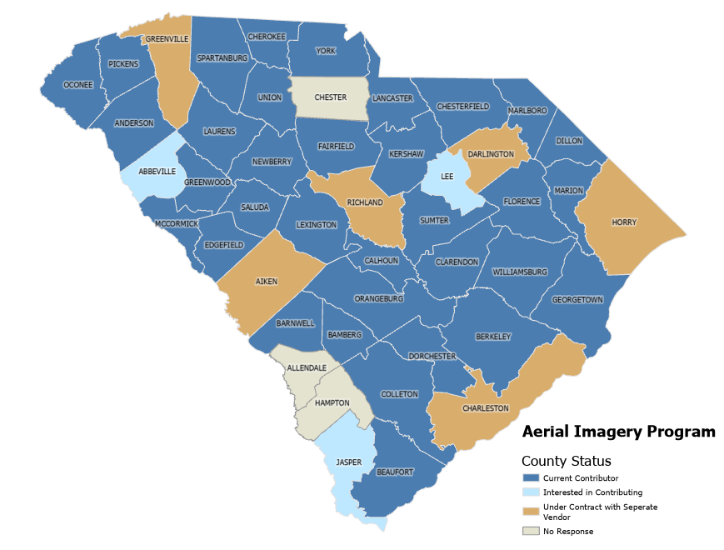
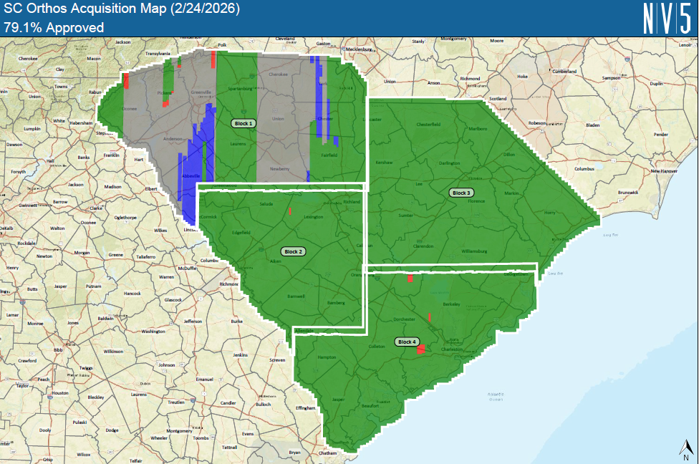

Aerial Imagery 2026 Update
Aerial Imagery Working Group
  14 volunteers from 6 agencies
  Adam will send an email to start communication
QAQC should begin ~April
County Participation:
  -34 of 46 counties contributed as of June 2025
  -Individual contributions based on geographic and economic adjustments; average of $5,000 per county annually

Slide 7
Statewide Initiatives Update
RFA Infrastructure complete
  Open data services are published
    County boundary, official statewide municipal boundary, ZIP codes, all political districts, geodetic monuments
  Secure data services almost complete (Premium Data Store)
    Parcels, centerlines, address points
    GIC member needs to have a public AGOL profile to access secure group in AGOL
      Email with instructions on how to access secure data
Open data discussions have begun with local governments
SC Open Data HUB architecture and design in progress

Slide 8

SCGIC Open Data Group
Group will feed SC Open Data HUB
Open Data group shared to everyone in AGOL
  Tags: scgic, sc open data, open data, gic
GIC member agencies will share open content with group
  Tags & Categories will be dictated by Data Work Group
  AGOL member profile must be public to be added to the group
    Survey with instructions will be sent to set gather user account information

Slide 9

GIC Budget Update
GIC funds purchased ESRI Premium Data Store for AGOL
  $31,000 annual subscription
  Up to 6TB of storage without credit cost
  Increased processing speed for end users
  Hosted features stored in Premium Data Store include:
    Parcels
    Address points
    Centerlines
    GIC member data if needed

Slide 10
GIC Working Groups
Recommend establishing three working groups to develop recommendations for the GIC and the State GIS Coordinator
  Advisory
  Data
  Technical
Each working group would consist of 4 to 5 key members
  Limit member participation to one working group
Groups to meet monthly or as needed
  Each working group to present at quarterly GIC Meetings
GIS Coordinator to designate each working group’s Chair and reserve final approval of working group recommendations

Slide 11
GIC Working Groups
Advisory Committee
  Strategic Plan and Annual Initiatives
  Communications
  Job Retention & Recruitment
  Procurement/Contracting
    Aerial Imagery
Data Committee
  Disaster Response
    GIS Augmentee List
  State & Federal Data List
  Local Data List
  NOAA Digital Coast
Technical Committee
  SC HUB Best Practices
  Data Standards
  Hardware/Software
  ADA Compliance
  AI Integration
  Dept of Admin Regs

Slide 12
GIC Working Group
A survey will be sent to gather volunteers for the initial working groups
We’re starting small to establish a foundation, then expanding into additional working groups.
First Meeting:
March 25 or April 1st?

Slide 13
Additional Updates
The Department of Administration is requesting approval for the creation of a Statewide Data Office with a Chief Data Information Officer and staff
  Mission is to account for and ensure appropriate use of state government data, not to assume hosting responsibilities for the data
Department of Administration’s AI Officer, CIO, and Governance Manager will meet with GIC to discuss AI Center of Excellence
  Provide feedback to our agencies on use of AI within GIS software
  Do we want to set up a meeting on behalf of the GIC?

Slide 14
Additional Updates
State GIS Coordinator presented the following at the SC Association of Counties Legislative Action Day in February:
  Open Data proposal
  SC GIS HUB
  Aerial Imagery updates and participation

Slide 15
SCDNR Presentation
Jim Davis
  Geospatial Program Manager, SC Dept of Natural Resources
  davisjh@dnr.sc.gov

Slide 16

















GIC Member Discussions
Currently 16 organizations Non-governmental agencies included $20,000 annual membership dues

Slide 17
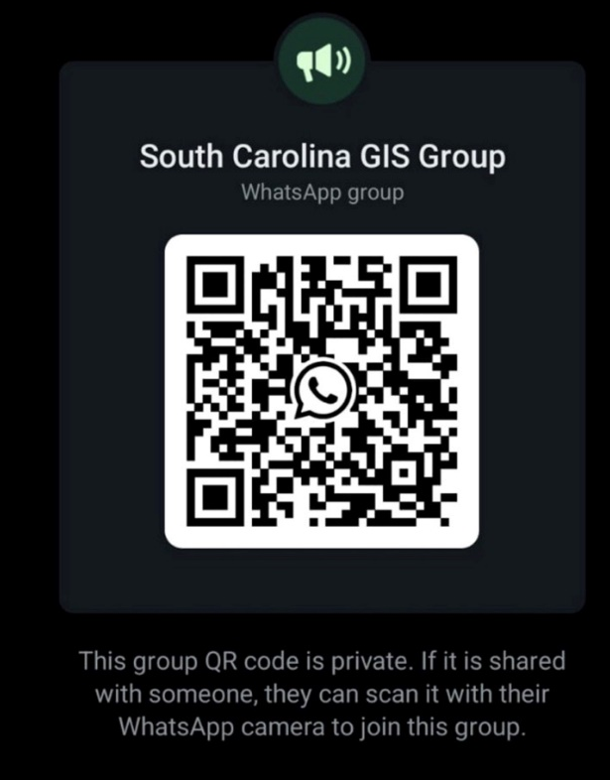
Next GIC meeting: June 3, 2026
SCARC’s Spring Symposium @ Ndoki Lodge at Riverbanks Zoo
  Thursday, April 23, 2026 from 9:00am to 4:00pm
Join SC GIS WhatsApp Group
  Thank you to Andrew White for administering this!

Slide 18
Thank You
Christy Jacobs
Christine.jacobs@rfa.sc.gov
803-734-3291

